Slide 1
A scalable preference elicitation algorithm using group generalized binary search
Max Yi Ren
Clayton Scott
Panos Papalambros
August 6, 2013, IDETC Portland
University of Michigan

Slide 2
Overview
In online shopping, one may encounter overwhelming alternatives to choose from.
Recommender systems have been developed to enhance online shopping experience, by recognizing similarities among users and products in real time.
Motivation of this paper: Develop a query algorithm that helps users to find their most preferred product in least effort, based on comparisons of products and product features.

Slide 3
Problem statement
Objective: An efficient query algorithm to find the most preferred product of the user.
A product set: contains a finite number of products, represented by a known set of features.
A query is a pairwise comparison question to the user, e.g., “Do you prefer design A or design B?” The response to a query is binary: A or B.

Slide 4
Problem statement
An interaction consists of a sequence of queries. It terminates when Probability(some product is the most preferred | all queries and responses) = 1.
Key assumptions: The user has consistent preference throughout the interaction; Responses have no error; Product features are known and a linear utility model can be applied to user preference
What is the best way to query so that an interaction has the least expected number of queries?

Slide 5
Demonstration of the problem
Feature 2
Product A
B
Feature 1
D
C
Which two products will you query next if the user prefers A over B?
(Assuming the preference follows a linear utility function)

Slide 6
Demonstration of the problem
A
B
D
C
When the user prefers A over B and C, we can conclude that A>D

Slide 7
Object identification (20 questions)
20 questions (20Q) is a game between two people: Player A has a person in mind. Player B asks yes/no questions, e.g., “Is the person a female?” Player B wins if he gets the correct person within 20 questions.
Query strategy of 20Q: Generalized binary search (GBS)
Main idea of GBS: Query the most uncertain feature, i.e., pick feature I such that Probability(Has feature i? | all responses to previous queries) close to 0.5
 | Feature 1 | Feature 2 | Feature 3
Person A | Yes | No | No
Person B | Yes | Yes | No
Person C | No | Yes | Yes
Person D | No | No | No

Slide 8
Group identification
Group identification problem: From “20 questions”, what should be the query strategy if player B wins by knowing which group the person belongs to?
The expected number of queries needed to identify a group has an analytical form and can be treated as a function of query strategy, i.e., a tree structure that tells which query to make under what previous responses. For details, please see the paper and references **.
 |  | Feature 1 | Feature 2 | Feature 3
Group 1 | Person A | Yes | No | No
 | Person B | Yes | Yes | No
Group 2 | Person C | No | Yes | Yes
 | Person D | No | No | No

Slide 9
Group generalized binary search
More queries / Less entropy
The expected number of queries for group identification is an analytical function of:
the query strategy, i.e., a tree structure that tells which query to make under what previous responses (variables)
the prior distribution of the groups (parameters)
1
Query 2
3
No
2
Leaf node = Group label
Query 1
3
Yes
2
Query 2’
1
Path length = query size

Slide 10
Group generalized binary search
Main idea of GGBS: Query the feature that (1) is the most uncertain and (2) the response to which will not separate objects from the same group.
This query strategy requires calculation of Probability(Group i is the correct group | all responses from previous queries)
 |  | Feature 1 | Feature 2 | Feature 3
Group 1 | Figure A | Yes | No | No
 | Figure B | Yes | Yes | No
Group 2 | Figure C | No | Yes | Yes
 | Figure D | No | No | No

Slide 11
Our problem is identical to group identification
 |  | A>B | A>C | B>C
Product A is the best | A>B>C | Yes | Yes | Yes
 | A>C>B | Yes | Yes | No
Product B is the best | B>A>C | No | Yes | Yes
 | B>C>A | No | No | No
… | … | … | … | …
The key step in the solution is the calculation of Probability(Product i is the most preferred | all responses from previous queries)

Slide 12
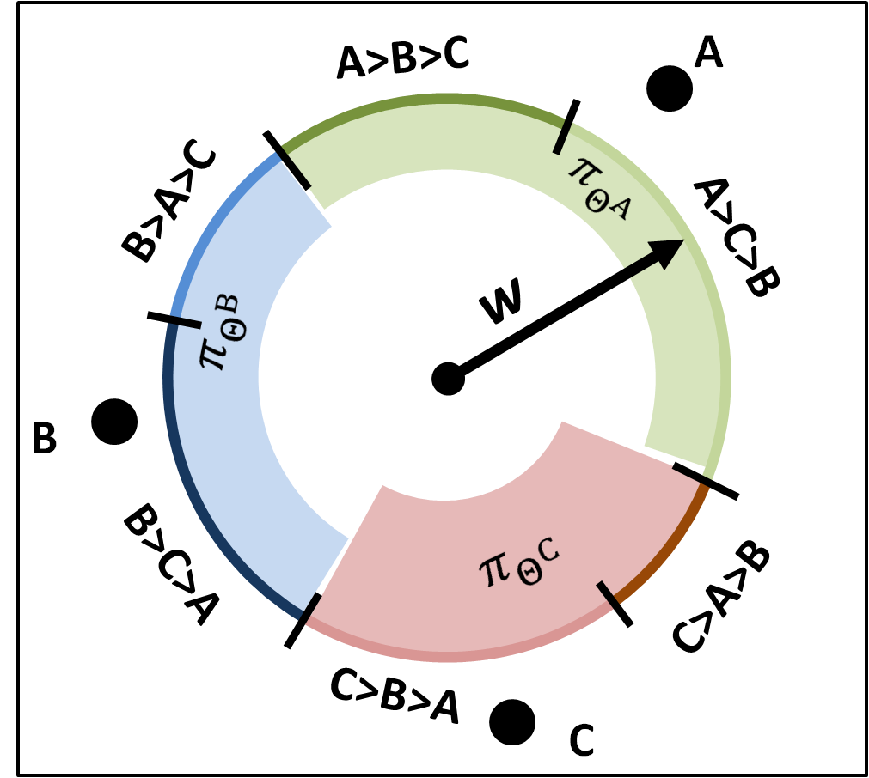
Implementation difficulty
Calculating Pr (Product i is the most preferred | all responses from previous queries) is time consuming.

Slide 13
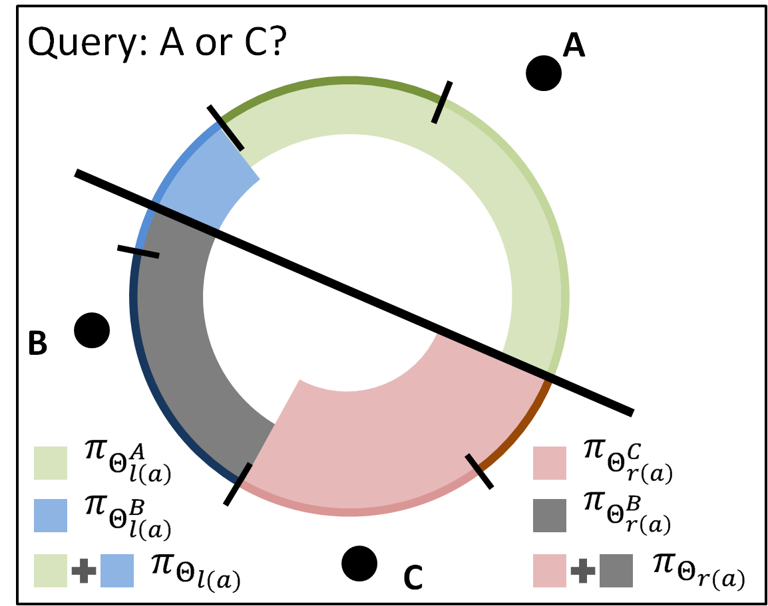
Implementation difficulty
The conditional probability requires calculation of arc lengths, or surface areas of a hypersphere in general.
At each iteration, the surface area calculation routine will be called (#product*#candidate query) times

Slide 14
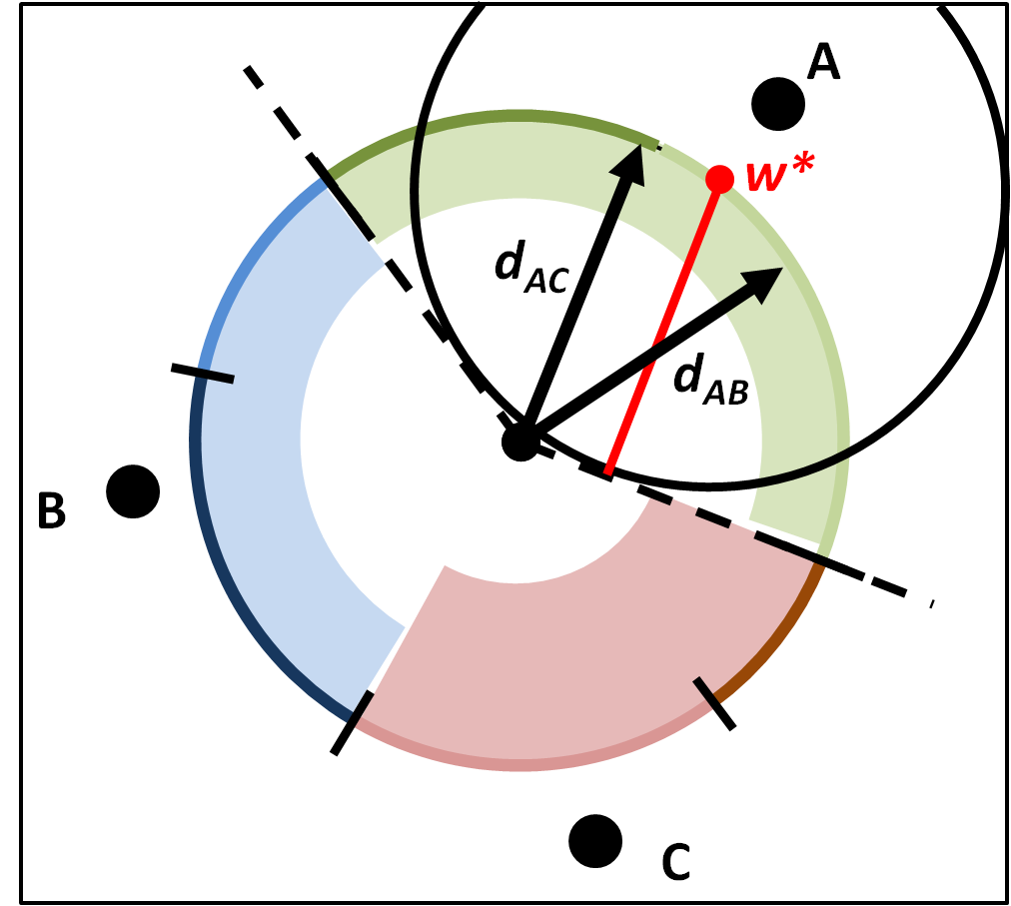
A fast approximation
Approximating the probability of product A being the most preferred:
Fit a circle such that its center lies on the green arc and it tangents with one of the boundaries
Calculate the radius of the circle R
The approximation is then R^{(d-1)}

Slide 15
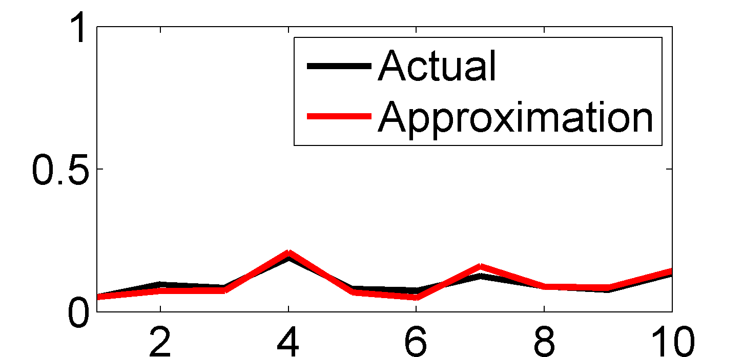
A fast approximation
Finding such a circle involves a convex optimization problem identical to a hard-margin SVM, thus liblinear can be used to achieve O(current query size) complexity.
Accuracy of the approximation in R⁵
Conditional probability
Product index

Slide 16
Simulation study
Algorithm implementation: appGGBS
Find the four products with highest conditional probability to be the most preferred (6 candidate queries)
Pick a pair from the four designs using GGBS
After getting user response, update the partworth vector and conditional probabilities
Terminate when one product has probability 1 to be the most preferred

Slide 17
Simulation study
Algorithm to compare with: EGO
The first query contains the two products with highest prior probabilities to be the most preferred
After getting user response, update the partworth vector and conditional probabilities
Each following query contains (i) the previously preferred product and (ii) the product with highest predicted utility that hasn’t been queried yet
Terminate when one product has probability 1 to be the most preferred

Slide 18
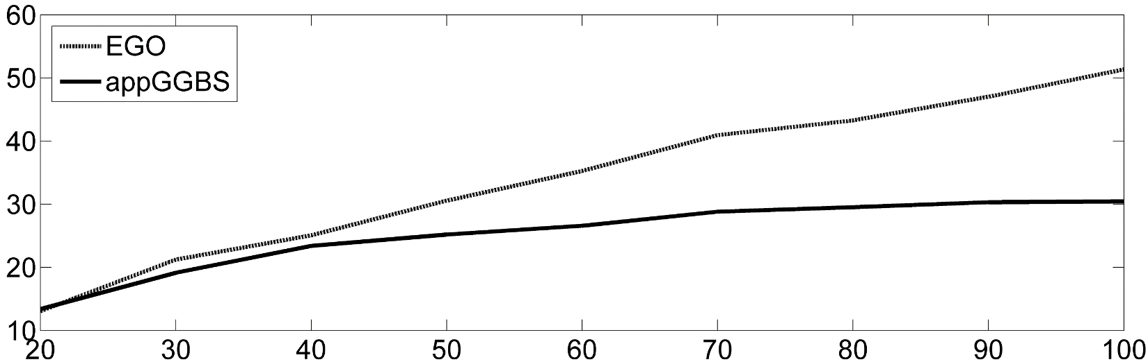
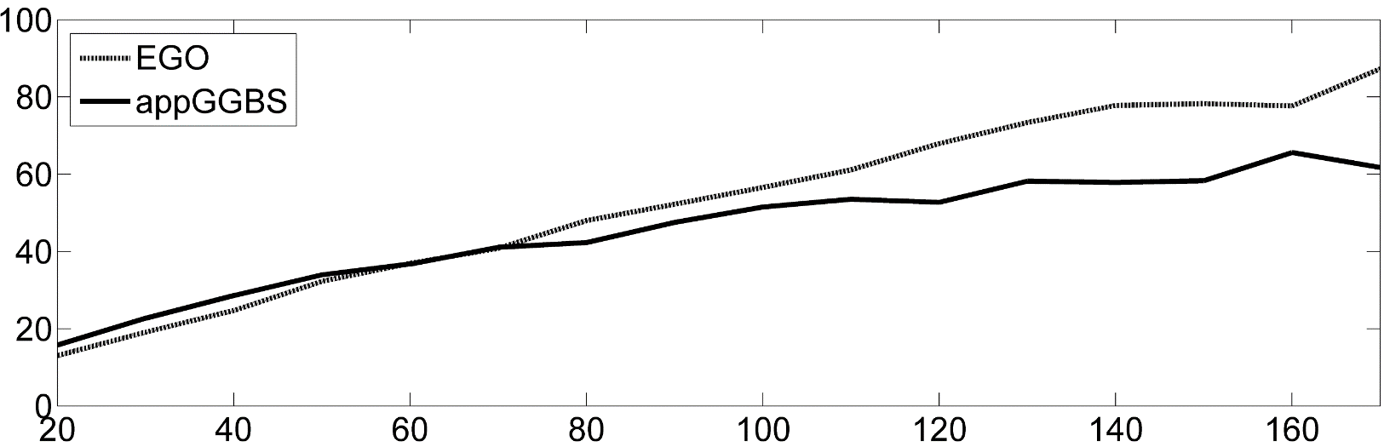
Simulation results
100 random runs for each data point
Conclusions
appGGBS has overall better performance. Its superiority increases with #product and decreases with #feature
EGO can outperform appGGBS under high #feature and low #product
10 product features
Average number of queries
15 product features
Number of products

Slide 19
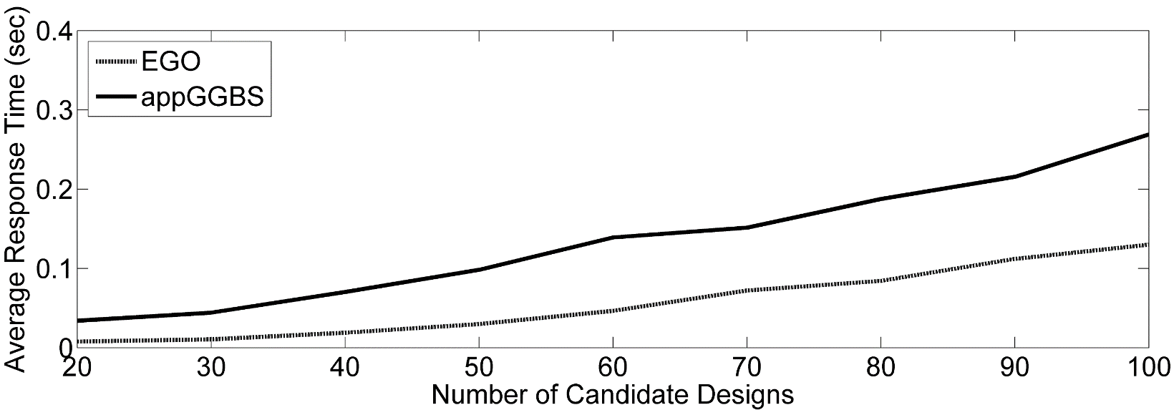
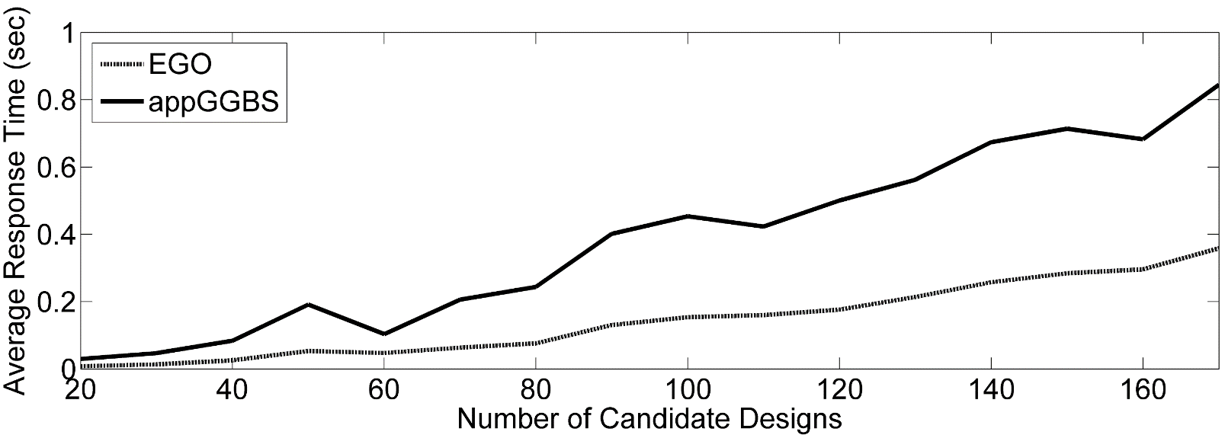
Simulation results
10 product features
Computational cost
Response time is practical
An application has been launched at: ***
Average response time (sec)
15 product features
Number of products

Slide 20
User test
A set of laptops with:
Screen size: 11 or 13 inches
Storage: 64, 128 or 256 Gb
CPU: Average or fast
Keyboard: With or without
Battery life: Half-day or full-day
Price: based on other features and market prices
Test procedure:
The user is shown the entire product set and asked to choose the most preferred one. The user can use filters and sorting tools.
The user then goes through two interactive sessions using appGGBS and EGO.

Slide 21
User test results
All user choices from the entire product list are consistent with the outcome from the interactive sessions
appGGBS outperforms EGO on average
User ID | appGGBS | EGO
1 | 6 | 10
2 | 6 | 10
3 | 10 | 9
4 | 7 | 13
5 | 6 | 6
6 | 9 | 14
7 | 9 | 13
8 | 6 | 6
9 | 6 | 7
10 | 7 | 9
11 | 6 | 10
Average | 7.1 | 9.7
Note: For the linear utility model to work, the features need to be hand tuned to ensure that appGGBS (EGO) will not mistakenly eliminate the correct product based on user responses

Slide 22
Conclusions
An active query (and learning) mechanism can enhance online shopping experience when a large amount of products are available
A query algorithm is proposed with strong theoretical support and practical computational cost
The algorithm is shown to be superior than a previously proposed heuristic algorithm in both simulations and a user test

Slide 23
Future works
An existing GGBS algorithm that handles responses with error will be incorporated to make the algorithm more robust
Multiple choice instead of pairwise comparison shall be used as queries.
A collaborative filter can be incorporated with the GGBS algorithm to provide better estimation of conditional probabilities *

Slide 24
Acknowledgement

