Slide 1
Design Preference Elicitation Using Efficient Global Optimization
Yi Ren
Panos Y. Papalambros
University of Michigan
ASME International Design Engineering Technical Conference 2011
Washington D.C.
August 2011

Slide 2
Outline
Motivation:
Eliciting individual preferences effectively
Problem Formulation:
“Black box” optimization with binary outputs
Approach:
Support vector machine + efficient global optimization
Demonstration:
Web application with 3D vehicle shape design

Slide 3
Design preference elicitation
Common Approaches:
1. Create a model to capture and predict people’s preferences.
Models are based on aggregation of data from many subjects, e.g., conjoint analysis.
2. Find the most preferred design for an individual subject.
Identify desirable designs through direct interaction with subject, e.g., interactive GA.

Slide 4
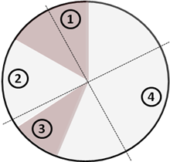
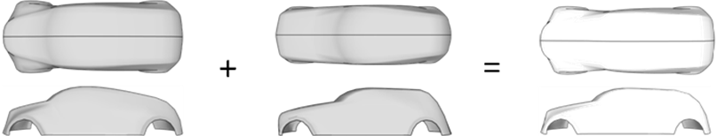
Interactive genetic algorithm (IGA)
IGA follows traditional GA to search for an optimal design. The difference from GA is that in IGA the fitness function is evaluated by the subject*.
Fitness evaluation
/Parent selection
Crossover
/Mutation
*Takagi, H. et al., Interactive evolutionary computation: Fusion of the capabilities of EC optimization and human evaluation, Proceedings of the IEEE, Volume 89, 1275--1296, 2001.
*Ren, Y., Papalambros, P.Y., Design preference elicitation: Exploration and learning, International conference on engineering design, 2011.

Slide 5
IGA
Drawbacks
Has poor convergence in high dimensions.
Places heavy burden on subject to rate or rank all individual designs, and slows down convergence*.
Search mechanisms (crossover and mutation) may not work efficiently due to use of randomness and need for parameter tuning.
*Takagi, H. et al., Interactive evolutionary computation: Fusion of the capabilities of EC optimization and human evaluation, Proceedings of the IEEE, Volume 89, 1275--1296, 2001.

Slide 6
Design preference elicitation
Without fitness
Help the subject to understand his/her preference at that time, and create and deliver that preference.
Start (random guess)
Choice
Now on the right track
No, not so good
This is what I want!
This is better
Not really the right direction
User-centric, no model, no inferences from other subjects’ input.

Slide 7
Proposed approach
Problem: For a given design space D and assuming a unknown preference function f exists, find the optimal solution(s) of f.
Assumptions: (1) Subjects possess deterministic preference functions; (2) Subjects always behave consistently with their preferences, e.g., they make no mistakes during interactions.
Interaction: (1) Ask for binary feedback; (2) Require very small number of iterations to converge.
Notes:
We go back to our topic. Let me emphasize the assumptions we made.

Slide 8
Elements of proposed algorithm
Efficient global optimization* (i)
Objective value
Objective value
Design space
Design space
Build a metamodel based on the initial sample set.
Calculate uncertainty of prediction. Points away from existing samples have higher uncertainty.

Slide 9
Elements of proposed algorithm
Efficient global optimization (ii)
Objective value
Objective value
Design space
Design space
Optimize a merit function that combines prediction and uncertainty.
Update metamodel based on new sample.
Balance exploitation and exploration!

Slide 10
Elements of proposed algorithm
Interpret binary feedbacks
EGO finds a new design based on a real-valued metamodel.
Support Vector Machine (SVM) is used to create the metamodel using binary data.
Preferred design
Not-preferred design
+1
-1

Slide 11
Algorithmic procedure
Present a set of n designs to the subject.

Slide 12
Algorithmic procedure
Present a set of n designs to the subject.
From the binary subject feedback, construct a decision function using SVM. Let the number of preferred designs be a.

Slide 13
Algorithmic procedure
Present a set of n designs to the subject.
From the binary subject feedback, construct a decision function using SVM. Let the number of preferred designs be a.
Find a set of n-a designs that have high predicted decision function values and are away from current samples, i.e., optimize the merit function using GA.

Slide 14
Algorithmic procedure
Present a set of n designs to the subject.
From the binary subject feedback, construct a decision function using SVM. Let the number of preferred designs be a.
Find a set of n-a designs that have high predicted decision function values and are away from current samples, i.e., optimize the merit function using GA.
Present to the subject the new set and the previously “preferred” designs.

Slide 15
Simulated interaction results
We compared the proposed algorithm with a previous SVM Search algorithm* that sampled new points randomly within the positive region of a classifier based on accumulated knowledge. Results show the proposed algorithm outperformed SVM Search especially when the dimensionality of the problem is high.
Both methods outperform GA*.
*Ren, Y., Papalambros, P.Y., Design Preference Elicitation, Derivative Free Optimization and Support Vector Machine Search, In Proceedings of the ASME IDETC 2010.

Slide 16
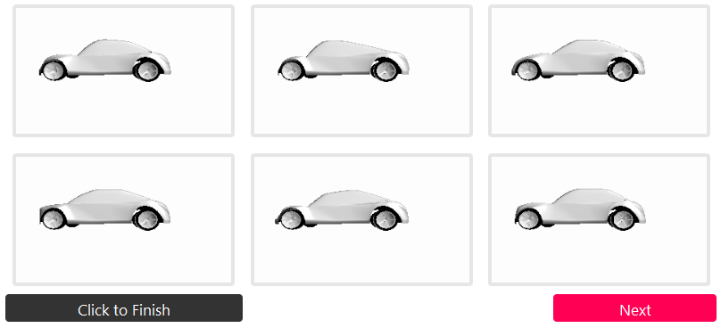
Demonstration
A web application for vehicle exterior shape design w/ 20 dimensions
Yirenumich.appspot.com
WebGL for online 3D modeling
Google datastore for data storage

Slide 17
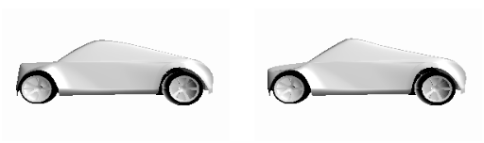
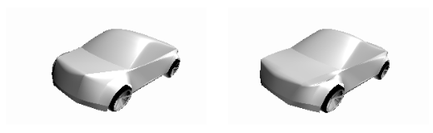
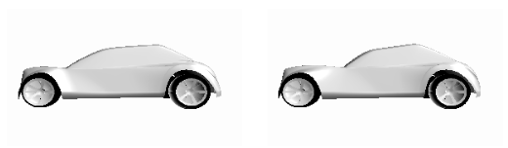
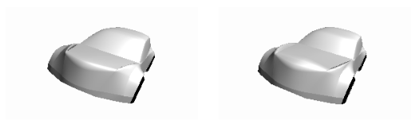
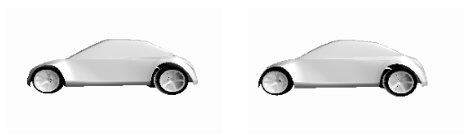
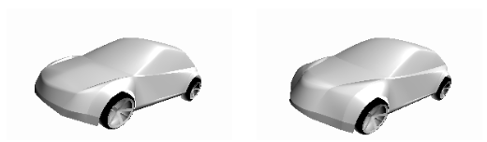

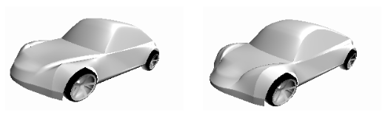
Convergence test
Pilot test results at yirenumich.appspot.com/log.html
Most of the tests last less than 20 iterations.
Side view
Perspective view
User
Result
Target
Result
Target
1
2
3
4

Slide 18
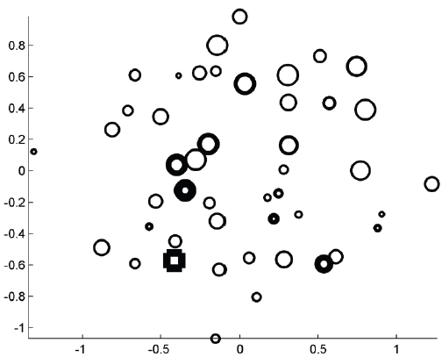
Convergence test
Does the search algorithm work?
Inner radius:
when the sample showed up
Outer radius:
when the sample was dropped
Square: the target
Euclidean space (projected to 2D)

Slide 19
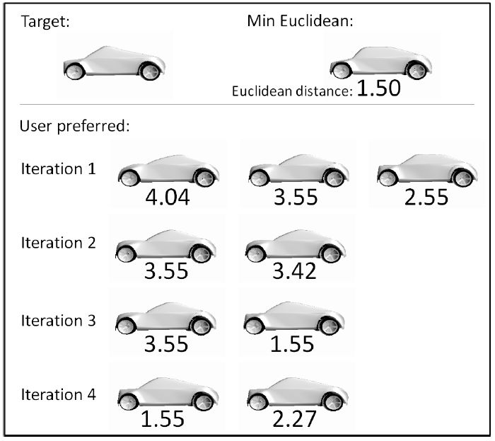
Convergence test
Do people use Euclidean distances in the design space?

Slide 20
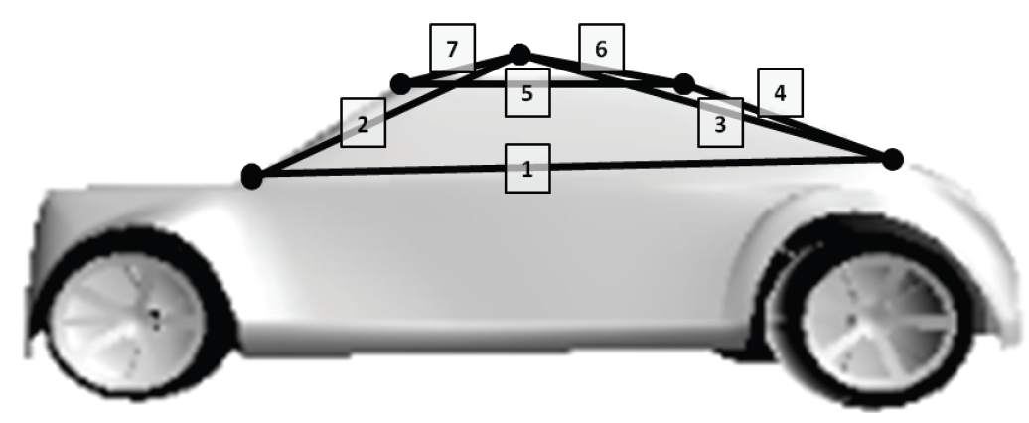
Convergence test
Construct a feature space
Use the distances between control points as features

Slide 21
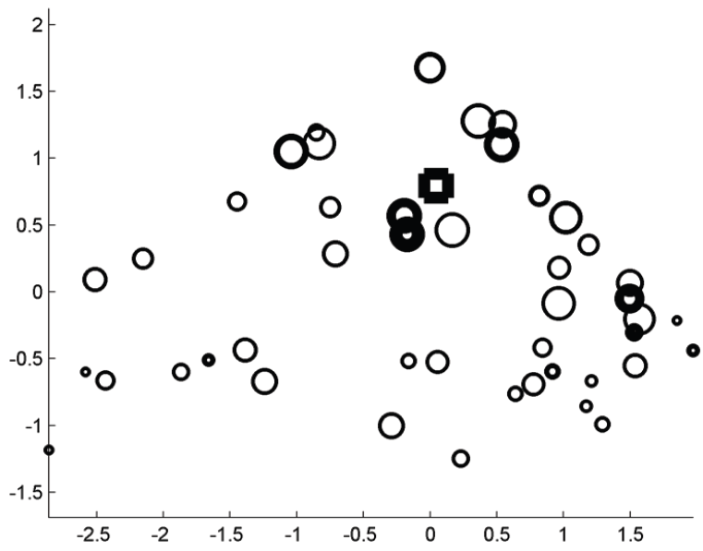
Convergence test
Does the search algorithm work?
Inner radius:
when the sample showed up
Outer radius:
when the sample was dropped
Square: the target
Feature space (projected to 2D)

Slide 22
Future Work
Incorporate viewing angle data in the interactions:
Rotational matrices that determine viewing angles may provide insight on features important to the subject.
Better interpretation of binary feedback:
A more accurate decision function may be created using the comparison tree rather than the binary labels on the queried samples.

Slide 23
Thank you

Slide 24
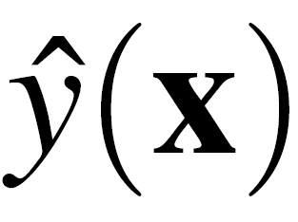
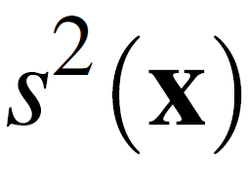
Elements of proposed algorithm
Efficient global optimization* (i)
Objective value
Objective value
Design space
Design space
: Prediction/
Model for exploitation
: Uncertainty in prediction/
Model for exploration

Slide 25
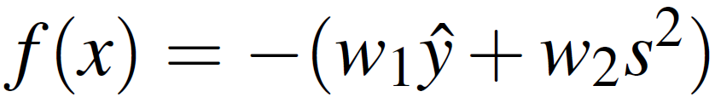
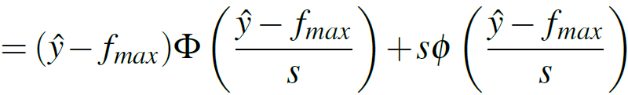

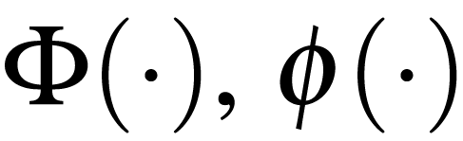
Merit functions
used in proposed algorithm
Balancing exploitation and exploration
Weighted sum (no physical meaning, but works):
Expected improvement:
: best functional value so far,
: CDF and PDF of standard normal distribution.

Slide 26
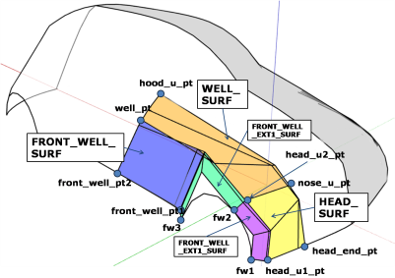
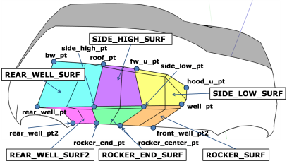
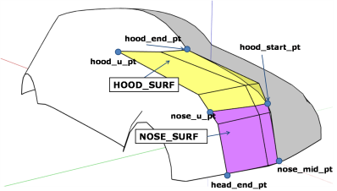
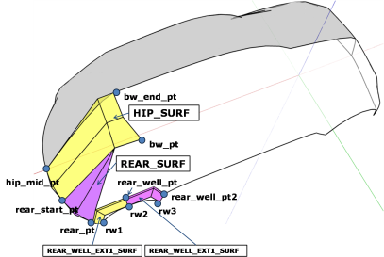
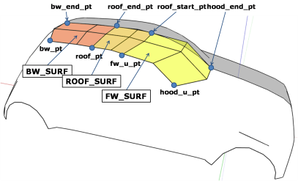
Modeler

Slide 27
Implementation environment
Allow open access interactions, i.e., web based
Accumulated user data: But which ones are real?

Slide 28
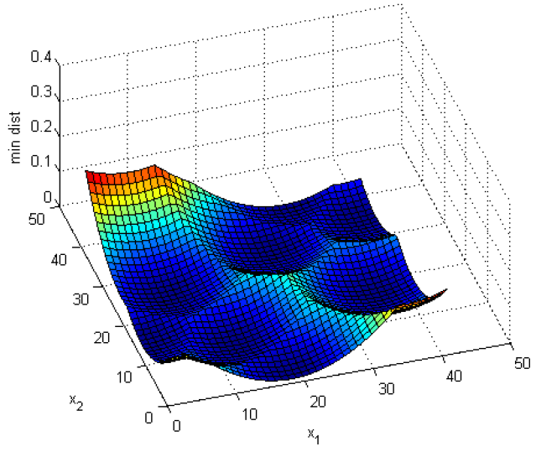
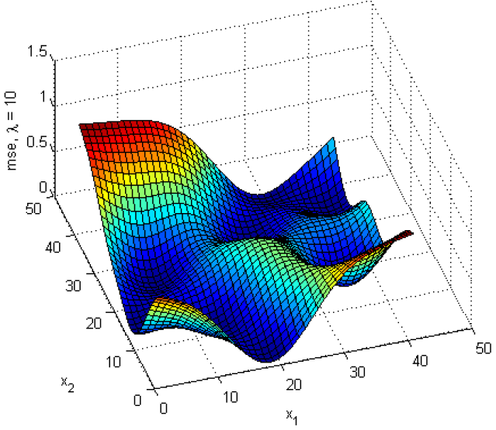
Uncertainty of the prediction
Its relationship with minimum distance
The minimum distance from x to all sampled points:
The uncertainty in :

Slide 29
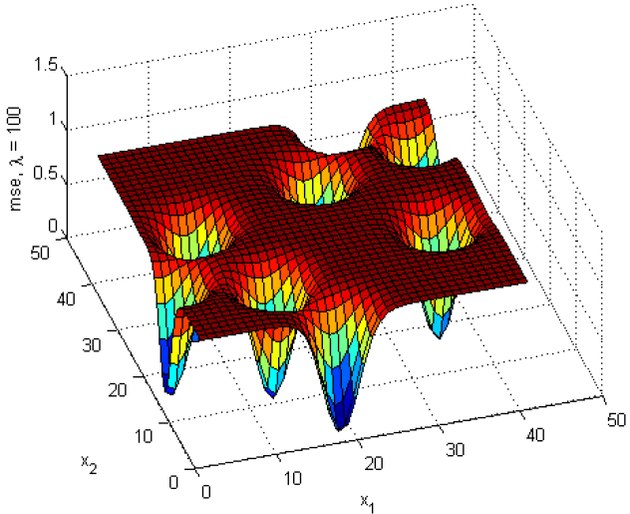
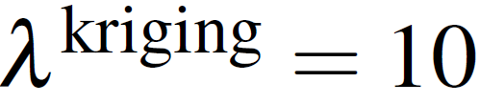

Uncertainty of the prediction
Spread of the Gaussian basis
The uncertainty in :

Slide 30
Future Work (iii)
Tuning in the expected improvement function:
Merit function with
s²_{scaled} = 10 s²
Merit function with
s²_{scaled} = s²

Slide 31
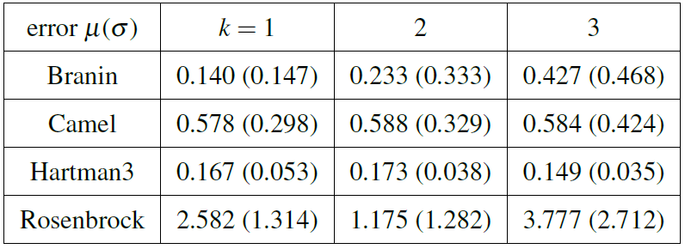
Parameter Tuning
Simulated interaction results
For weighted sum merit, different schemes of w are tested where t is the total number of iterations:

Slide 32
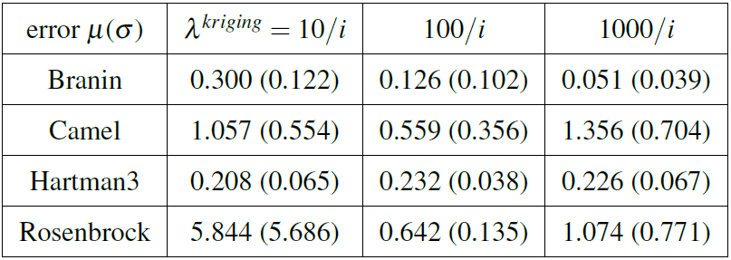
Parameter Tuning
Simulated interaction results
For expected improvement, different model spreads are tested:

Slide 33
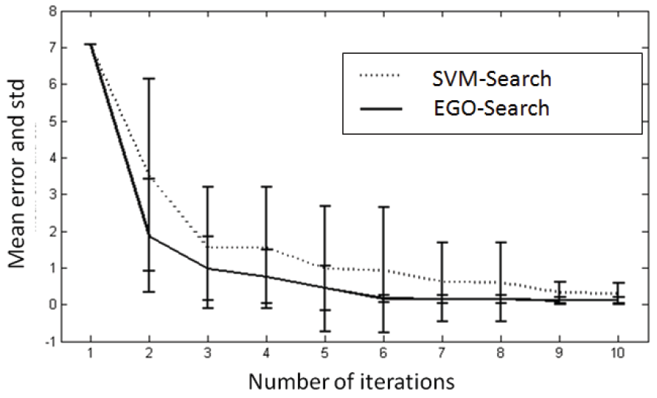
Simulated interaction results (i)
Function: | 2D Branin
#Sample: | 8
#Iteration: | 10
#Test: | 10

Slide 34
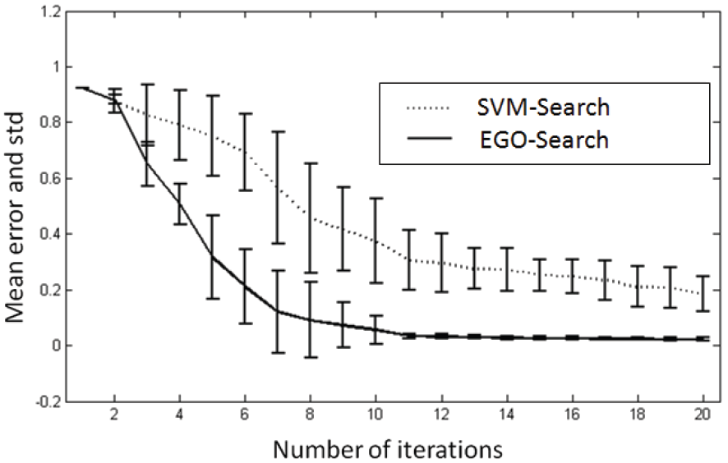
Simulated interaction results (ii)
Function: | 10D Gaussian
#Sample: | 8
#Iteration: | 20
#Test: | 10

Slide 35
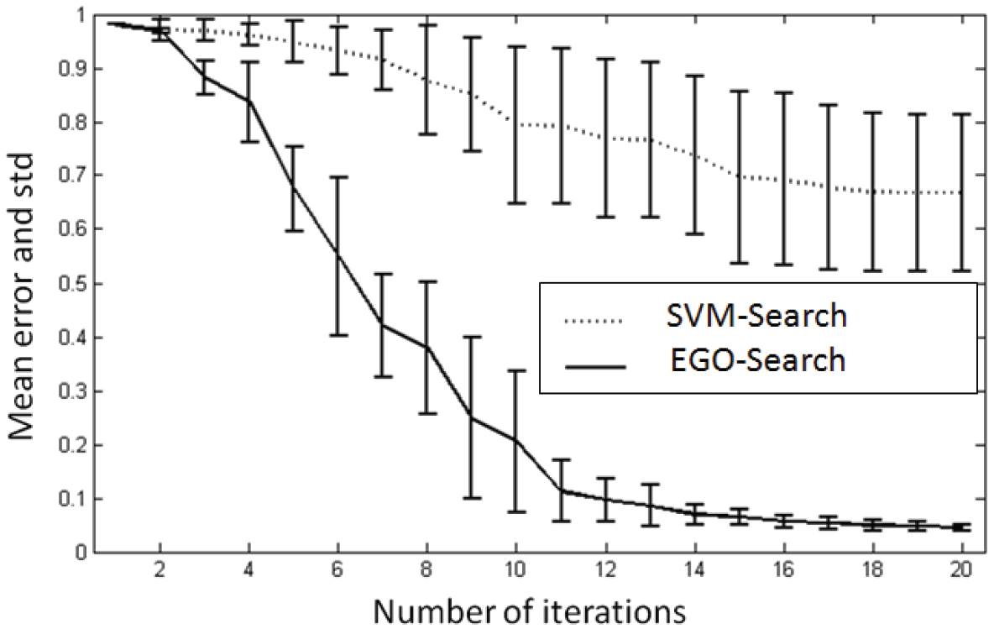
Simulated interaction results (iii)
Function: | 15D Gaussian
#Sample: | 8
#Iteration: | 20
#Test: | 10

