Slide 1
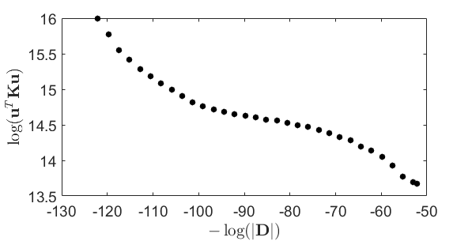
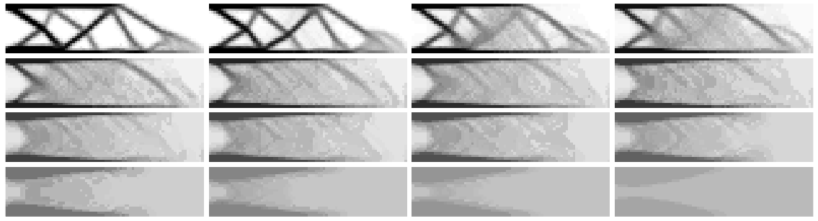
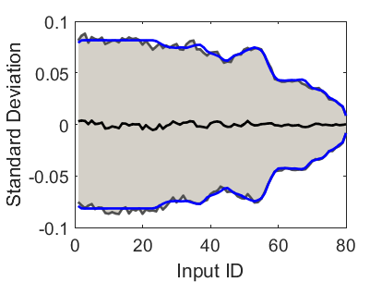
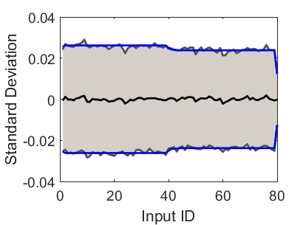
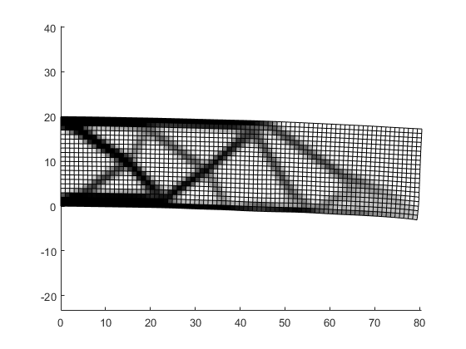
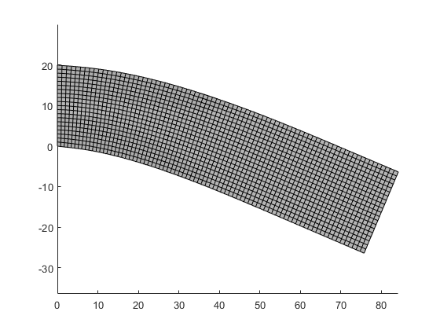
(a)
(b)
1
16
16
1
(c)
(d)
1
Exp.
Theoretical
16
1
16
Input #1
Input #80

Slide 2
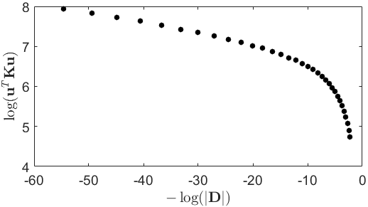
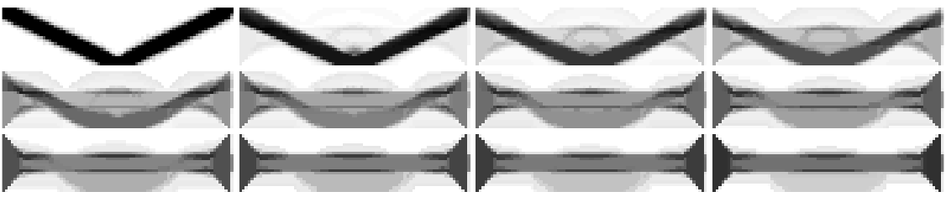
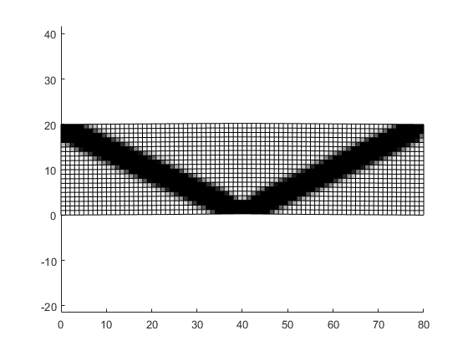
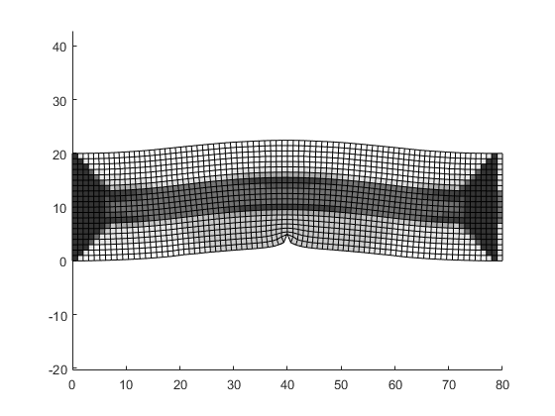
(a)
(b)
1
12
12
1
(c)
(d)
1
Exp.
Theoretical
12
1
12
12
Theoretical: 0.0135, 0.0135
Exp: 0.0140, 0.0137
Force dist. for compliance calculation
Input for this simulation

Slide 3
Compliance
Variance of input estimation error

Slide 4
n_{x} = 4
n_{y} = 3

