Slide 1
20 min
total
30
rounds
10 sec
wait

Slide 2
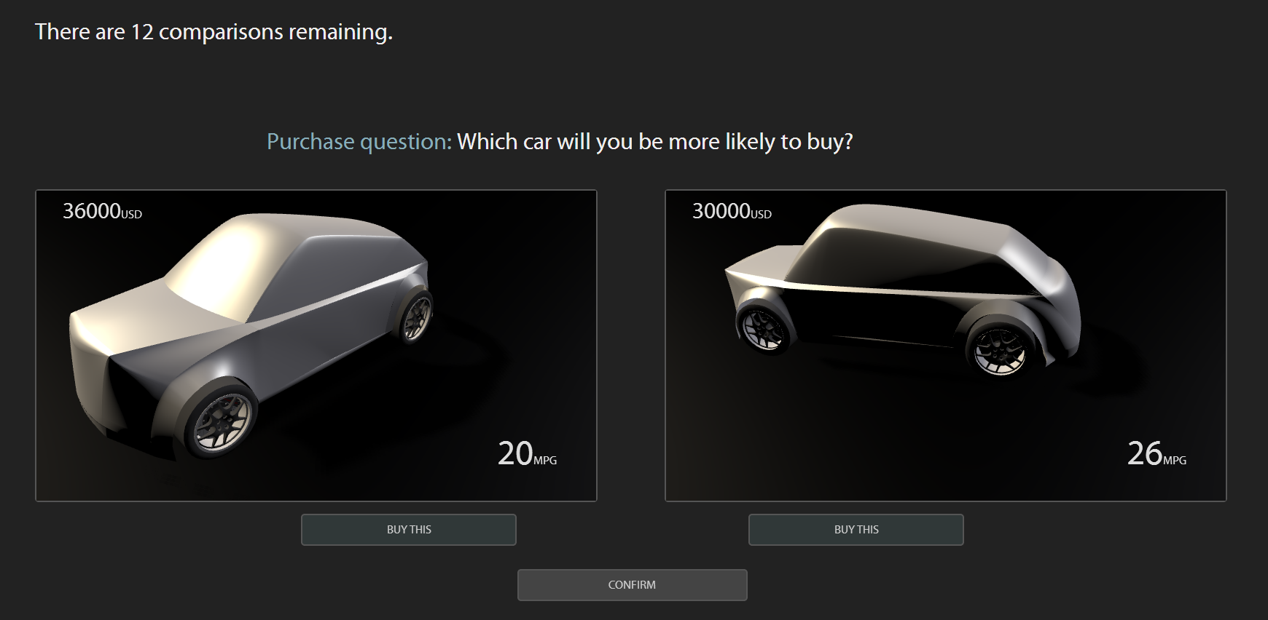
① Check the question type
Drag mouse to rotate
② Make a choice
③ Confirm

