Slide 1
SQL • PYTHON • POWER BI
Customer Purchase Behavior Analysis
An end-to-end analytics project: cleaning and engineering data in Python, modeling customer behavior in SQL Server, and visualizing insights in Power BI.
Antara Basak

Slide 2
Project Overview
Objective
Analyze retail customer transactions end-to-end — from raw data to a decision-ready dashboard — to uncover what drives revenue, who the loyal customers are, and where discounting and subscriptions move the needle.
Dataset
~3,900 customer transaction records covering demographics, product category, purchase amount, discounts, subscription status, and review ratings.
SQL
SQL Server
Aggregations, CTEs, and window functions to answer business questions
PY
Python (Pandas)
Cleaning, feature engineering, and automated load to the database
BI
Power BI
Interactive dashboard surfacing KPIs and segment-level trends
2

Slide 3
Methodology: How the Pieces Connect
1
2
3
4
Raw CSV Data
→
Python
→
SQL Server
→
Power BI
Customer shopping
behavior export
Clean, engineer
features, validate
Load via SQLAlchemy,
query for insight
Interactive dashboard
for stakeholders
Each stage feeds the next: pandas ships clean, feature-rich data into SQL Server; SQL turns that data into business answers; Power BI puts those answers in front of decision-makers.
3

Slide 4
Python: Data Cleaning & Feature Engineering
Cleaning
Filled missing review ratings with the category median, not a global average — keeps outlier categories honest
Renamed columns to snake_case for clean SQL compatibility
Dropped 'promo_code_used' after confirming it duplicated 'discount_applied' — avoids redundant columns downstream
# Impute missing ratings by category median
df['Review Rating'] = df.groupby('Category')
['Review Rating'].transform(
lambda x: x.fillna(x.median()))
# Standardize column names
df.columns = df.columns.str.lower()
.str.replace(' ', '_')
Feature Engineering
qcut() splits customers into four equal-sized age quartiles — fair comparison groups instead of arbitrary bins
Mapped text purchase frequencies ("Weekly", "Fortnightly"...) to day counts, enabling numeric cadence analysis
# Age segments for behavioral analysis
labels = ['Young Adults','Adult',
'Middle-aged','Senior']
df['age_group'] = pd.qcut(df['age'],
q=4, labels=labels)
# Purchase cadence -> comparable day counts
freq_map = {'Weekly': 7, 'Monthly': 30, ...}
4

Slide 5
Python: Automated Load into SQL Server
Connect & load with SQLAlchemy
Why this matters
from sqlalchemy import create_engine
import urllib
params = urllib.parse.quote_plus(
"DRIVER={ODBC Driver 17 for SQL Server};"
f"SERVER={server};DATABASE={database};"
"Trusted_Connection=yes;"
)
engine = create_engine(
f"mssql+pyodbc:///?odbc_connect={params}")
# Push the cleaned DataFrame to a live table
df.to_sql(name="customer", con=engine,
if_exists="replace", index=False)
One pipeline, no manual re-entry: cleaned data lands directly in SQL Server as a live table
Windows-authenticated connection — no hardcoded credentials
'replace' mode keeps the table in sync every time the source data refreshes
Creates a single source of truth that both SQL analysts and the Power BI dashboard query
5

Slide 6
SQL: Revenue & Customer Segmentation
Revenue by subscription status
Segment customers by loyalty
SELECT subscription_status,
COUNT(customer_id) AS total_customers,
ROUND(AVG(purchase_amount),2) AS avg_spend,
ROUND(SUM(purchase_amount),2) AS total_revenue
FROM dbo.customer
GROUP BY subscription_status
ORDER BY total_revenue DESC;
WITH customer_type AS (
SELECT customer_id, previous_purchases,
CASE
WHEN previous_purchases = 1 THEN 'New'
WHEN previous_purchases BETWEEN 2 AND 10
THEN 'Returning'
ELSE 'Loyal'
END AS customer_segment
FROM dbo.customer)
SELECT customer_segment, COUNT(*) AS customers
FROM customer_type
GROUP BY customer_segment;
Compares customer count, average spend, and total revenue side by side — shows whether subscribers are worth more per head, not just in aggregate.
A CTE with a CASE expression buckets every customer into New / Returning / Loyal — the foundation for lifecycle-based targeting.
6

Slide 7
SQL: Product & Purchasing Behavior
Top 3 products per category
Repeat buyers' subscription rate
WITH item_counts AS (
SELECT category, item_purchased,
COUNT(customer_id) AS total_orders,
ROW_NUMBER() OVER (
PARTITION BY category
ORDER BY COUNT(customer_id) DESC
) AS item_rank
FROM dbo.customer
GROUP BY category, item_purchased)
SELECT item_rank, category, item_purchased,
total_orders
FROM item_counts WHERE item_rank <= 3;
SELECT subscription_status,
COUNT(customer_id) AS repeat_buyers
FROM dbo.customer
WHERE previous_purchases > 5
GROUP BY subscription_status;
Filters to loyal, repeat shoppers first, then checks how many convert to paid subscriptions — a direct read on upsell potential.
Highest-discount products
SELECT TOP 5 item_purchased,
ROUND(100.0*SUM(CASE WHEN discount_applied
='Yes' THEN 1 ELSE 0 END)/COUNT(*),2) AS pct
FROM dbo.customer
GROUP BY item_purchased ORDER BY pct DESC;
ROW_NUMBER() ranks products within each category, so results stay a clean top-3-per-group instead of one global top list.
7

Slide 8
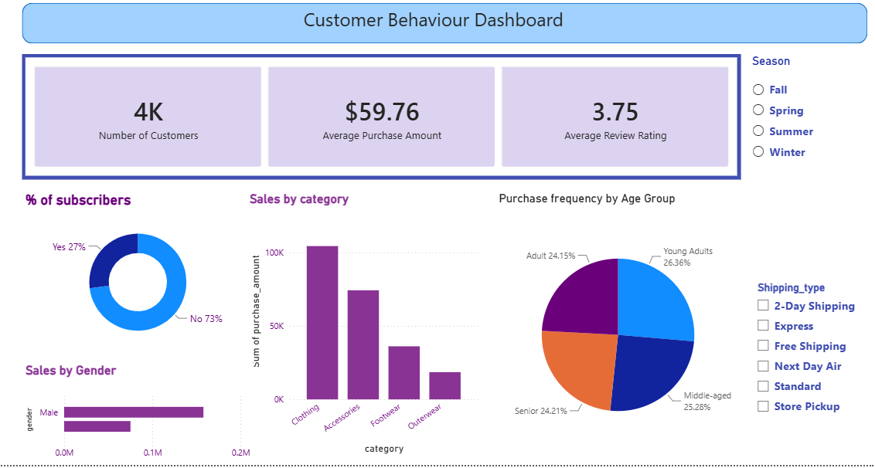
Power BI: The Customer Behavior Dashboard
4K
Customers
$59.76
Avg. purchase
3.75
Avg. review rating
27%
Sliceable by season and shipping type, so any KPI or chart above can be filtered live for deeper cuts.
Subscribers
8

Slide 9
Key Insights
Clothing leads every category
1
Clothing sales are more than double the next category, making it the clear focus for inventory and promotions.
Subscription is underpenetrated
2
Only 27% of customers subscribe — the SQL query on repeat buyers points to this as a targeted upsell opportunity.
Age isn't a differentiator
3
Purchase frequency splits almost evenly across the four age groups (24–26% each) — marketing shouldn't over-index on age segments.
Discount-driven demand is real
4
A meaningful share of high-spend customers are discount users, per the SQL query on above-average spenders using discounts.
9

Slide 10
Skills Demonstrated
SQL
Python
Power BI
• CTEs & subqueries
• Window functions (ROW_NUMBER)
• Aggregation & grouping
• Conditional logic (CASE)
• Pandas data cleaning
• Feature engineering
• Missing-value handling
• SQLAlchemy DB integration
• Interactive dashboards
• KPI cards & slicers
• Categorical & segment charts
• Stakeholder-ready visuals
Thank you
10

