Slide 1
Smart Timetable Generator & Workload Manager
Presented by:
Antara Pal
Sayar Sekhar Ghosh
An Excel-Based Academic Scheduling & Faculty Workload Management System
9 sheets | 100+ records | Macros | Pivot tables | Dashboard | Data Cleaning

Slide 2
Project Summary
9-Sheet Workbook Text: Index, Data Cleaning, Raw Data (x2), Clean Data (x2), Pivots (x2), Dashboard
Data Cleaning Text: Missing value imputation + duplicate removal in both datasets
Smart Formulas Text: Smart formulas like nested if, countblank have been used.
Data Validation Text: Data validation on Departments, Sections have been done.
Conditional Formatting Text: Color-coded workload status, conflicts, labs & duplicates
Macro Buttons Text: One-click automation for sort, filter, navigate & export
Pivot Tables & Charts Text: Interactive analysis with slicers for Department, Semester, Status
Dashboard Text: Live KPIs & charts summarizing the entire timetable system

Slide 3
Index Sheet – Navigation with Hyperlinks
Purpose & Features
Acts as the home page of the workbook.
Contains clickable hyperlinks to all 8 other sheets.
Each link uses Excel's Insert > Hyperlink > Place in This Document feature.
Allows one-click navigation — no scrolling through tabs.
Numbers 1–7 label each sheet link clearly.
Improves usability for complex multi-sheet workbooks.
1. Raw Timetable Schedule
2.Raw Faculty Workload
3. Clean Timetable Schedule
4. Clean Faculty Workload
5. Timetable Pivot Table
6. Faculty Pivot Table
7. Dashboard
8. Data Cleaning

Slide 4
Raw Timetable Schedule-Source Data
Slot ID | Day | Time Slot | Department | Subject | Faculty ID | Sem | Section | Duration | Is Lab | Conflict
TS0001 | Tuesday | 11:00-12:00 | ECE | Algorithms | FAC1048 | 1 | A | 1 | No | -
TS0002 | Friday | 11:00-12:00 | CE | Dist. Systems | FAC1042 | 4 | D | 2 | Yes | -
TS0014 | Wednesday | 8:00-9:00 | (Blank) | Embedded Systems | FAC1036 | 1 | A | 2 | Yes | -
TS0030 | (Blank) | 8:00-9:00 | IT | CAD/CAM | FAC1013 | 5 | A | 2 | Yes | -
TS0009 | Saturday | 2:00-3:00 | ECE | Cloud Computing | FAC1005 | 8 | C | 2 | Yes | DUP
Data Quality Issues Found in Raw Sheet:
Missing Department values in rows TS0014, TS0021, TS0055 → filled with 'Unknown' in Clean sheet
Missing Day values in rows TS0030, TS0040, TS0065 → filled with 'Unknown' after cleaning
Duplicate Slot IDs detected: TS0009, TS0016, TS0046, TS0061, TS0064, TS0084 → removed in Clean sheet

Slide 5
Raw faculty workload-Source data
16 columns in faculty workload sheet, having:
Faculty ID | Faculty Name
Department | Designation
Experience (yrs) | Subjects Assigned
Theory Hours/Week | Lab Hours/Week
Total Contact Hours | Max Allowed Hours
Workload Status | Extra Duties
Overload Flag | Semester
Academic Year | Remarks
100
Total Faculty
9
Departments
20
Max Hours/Wk
3
Missing Dept records
~14
Overloaded Faculty

Slide 6
Data Cleaning – Raw -> Clean Transformation
1. Fill Missing Values | 2. Remove Duplicates | 3. Standardize & Validate
Blank Department → "Unknown" | Duplicate Slot IDs identified in raw sheet | Data Validation: dropdown lists for Day, Dept, Section
Blank Day → "Unknown" | TS0009, TS0016, TS0046, TS0061, TS0064, TS0084 | Time slots locked to predefined values
Blank Workload Status → computed from hours | Removed using Excel's Data → Remove Duplicates | Is Lab column: only Yes/No allowed
Blank Overload Flag → derived via IF formula | Kept first occurrence; deleted subsequent copies | Conflict Flag auto-flagged via COUNTIFS
Formula: =IF(A2="","Unknown",A2) | Clean sheet has unique Slot IDs only | Consistent formatting across all rows

Slide 7
Excel Formulas – VLOOKUP, IF, COUNTIF & more
VLOOKUP:
VLOOKUP(G2, Faculty_Workload!A:B, 2, FALSE)
Syntax: VLOOKUP(lookup_value, table_array, col_index, [exact_match])
Fetches Faculty Name from Faculty_Workload sheet using Faculty ID — links timetable to faculty data without manual copy-paste.
COUNTIFS:
=COUNTIFS(G:G, G2, B:B, B2, C:C, C2)
Syntax: COUNTIFS(range1, criteria1, range2, criteria2, ...)
Detects scheduling conflicts — counts how many slots share the same Faculty, Day, and Time. If >1, it's a conflict.
IF+Nested:
=IF(I2>J2, "Overloaded", IF(I2=J2, "At Limit", "Normal"))
Syntax: IF(condition, value_if_true, value_if_false)
Classifies Workload Status based on Total Contact Hours vs Max Allowed Hours — automates the status column.
Fill Missing:
=IF(D2="", "Unknown", D2)
Syntax: IF(cell="", default_value, cell)
Fills blank Department cells with 'Unknown' in the clean sheet, ensuring no empty cells break pivot tables or formulas

Slide 8
Data validation and conditional formatting
Data Vaidation
Dropdown — Section: List: A, B, C, D
Dropdown — Is Lab: List: Yes, No
Numeric — Duration (hrs): Whole Number between 1 and 4
Numeric — Semester: Whole Number between 1 and 8
Conditional Formatting
Conflict Flag = Yes — Red row highlight on scheduling conflicts
Overloaded Faculty — Red highlight when Total Hours > Max Allowed
Normal Workload — Nothing when Total Hours = Max Allowed
Underloaded Faculty — Amber highlight when Total Hours < Max Allowed

Slide 9
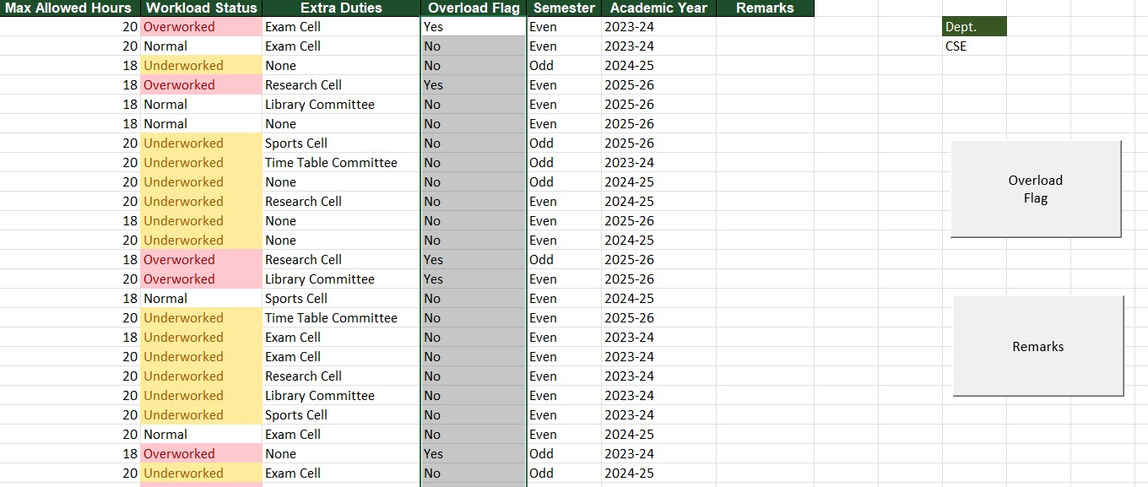
Macros and automation buttons
Macros are recorded VBA (Visual Basic for Applications) scripts embedded in Excel.
They automate repetitive tasks with a single button click.
Stored in .xlsm (macro-enabled) format.
Can sort, filter, clear, format, or navigate sheets automatically.
Buttons are inserted via Developer tab → Insert → Form Control → Button, then assigned a macro.
Each button in this workbook triggers a specific VBA Sub procedure.

Slide 10
Pivot tables: Timetable and Faculty analysis
Timetable Pivot Table
ROWS — Department, Day
COLUMNS — Is Lab
VALUES — Count of Slot IDs
FILTERS — Semester, Section
Key Insights:
Shows how many slots each dept has per day
Separates theory vs lab sessions
Identifies busiest days for each department
Filter by semester to see specific workload
Faculty Pivot Table
ROWS — Department, Designation
COLUMNS — Workload Status
VALUES — Average Total Contact Hours
FILTERS — Semester, Academic Year
Key Insights:
Compares avg workload across departments
Breaks down by designation (Prof, Lecturer, etc.)
Identifies overloaded departments at a glance
Academic Year filter for trend comparison

Slide 11
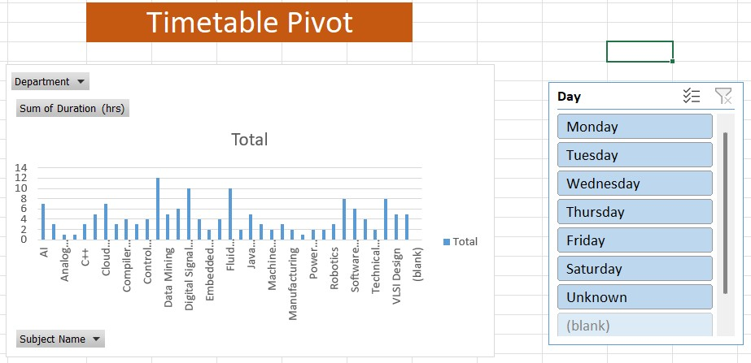
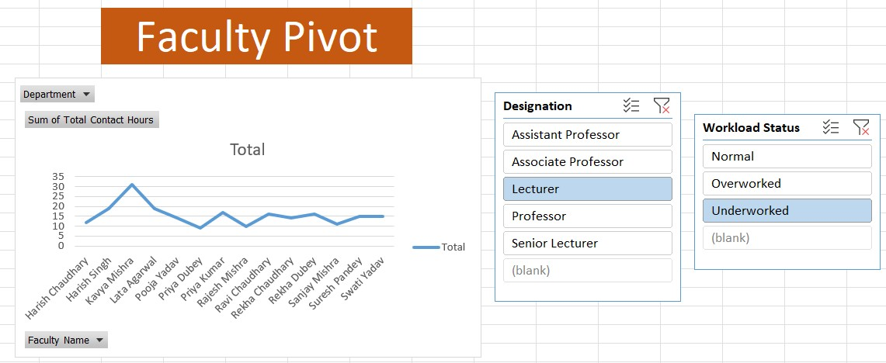
Pivot tables, charts & slicers
Timetable Pivot:
Pivot table & chart consists of no. of cumulative hrs a subject gets, filtered by Department.
Slicer slices pivot data according to Weekdays.
Faculty Pivot:
Pivot table and chart consists of cumulative contact hrs of a faculty, filtered by Department.
Slicer slices the pivot data according to faculty designation & workload

Slide 12
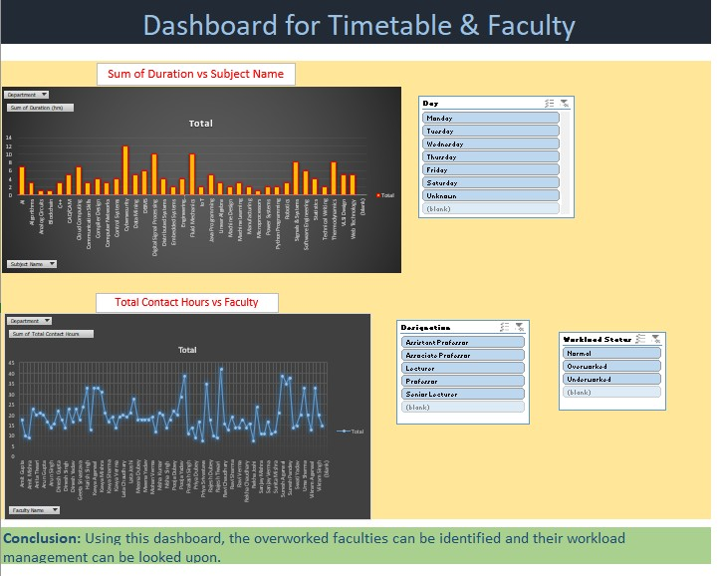
Dashboard- unified & visual summary
Dashboard pulls live data from pivot tables — all charts & KPIs update automatically when source data changes.

