Slide 1

Quickshop Antara Ganesh Kolar Shriya Rodi Hariram Natarajan

Slide 2

Overview
Customer can:
Search for a product by name or by category.
Search for Sellers.
Add or remove an item from the cart.
View cart.
Make payment.
Place an order.
View placed orders
Seller can:
Add or remove products from the store.
Seller can view placed orders
Admin can:
Create user accounts.
Remove user accounts.
View orders placed by customers

Slide 3




Technologies Used
MYSQL Database
Java Swing GUI
Eclipse(Java IDE)
JDBC
Eclipse Window Builder

Slide 4
Demo Video

Slide 5
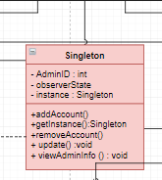
Design Patterns – Singleton

Slide 6
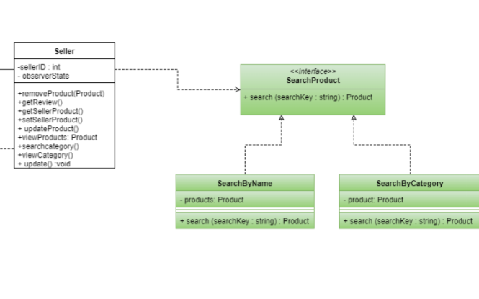
Design Patterns - Strategy

Slide 7
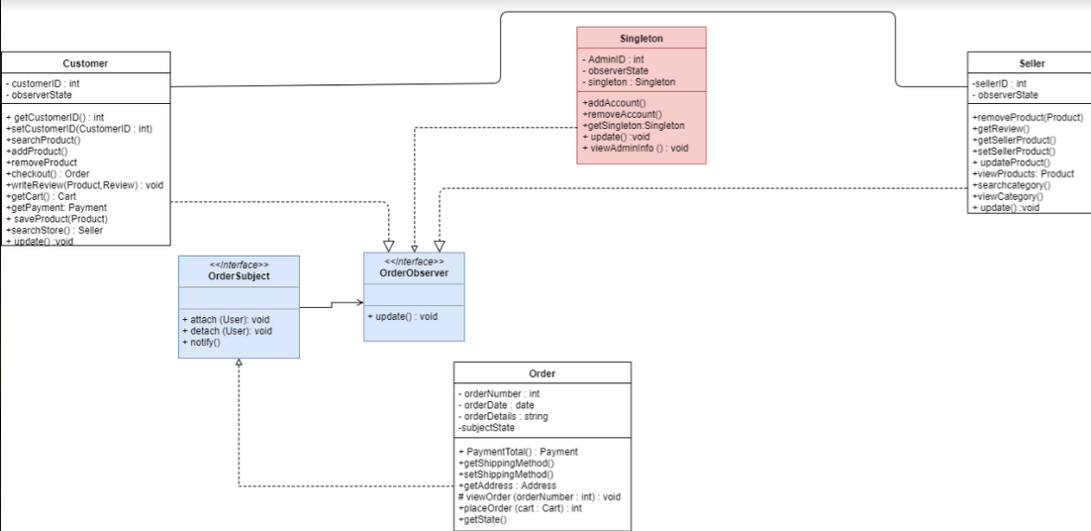
Design Patterns - Observer

Slide 8
Improvements and learnings
Factory Design Pattern
Reduced Coupling
Open Closed Principle

Slide 9


