Slide 1
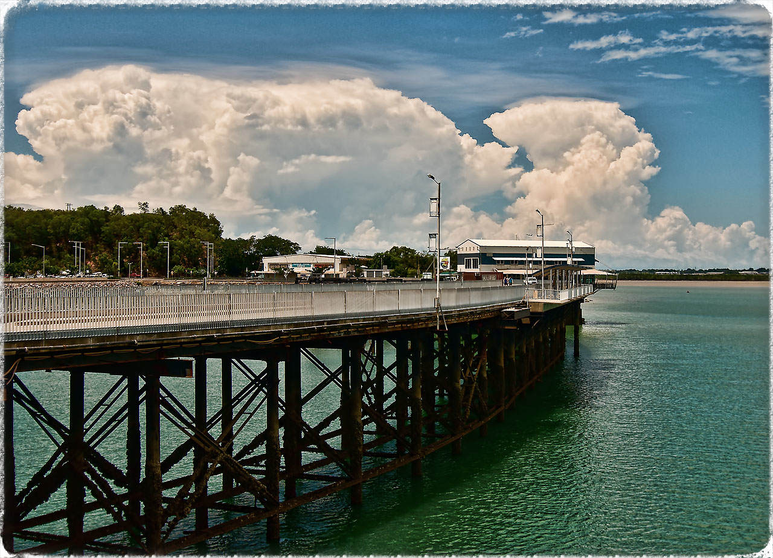
EXTREME EVENTS OF TROPICAL ISLAND THUNDERSTORMS
DOES A RESOLUTION INCREASE IMPROVE THEIR REPRESENTATION?
Follow this link to get to presentation
Martin
Bergeman Uni Melbourne

