Slide 1

Team “Deep Ruby”
The SoftUni Mafia Website
https://github.com/antataiv/Deep-Ruby

Slide 2
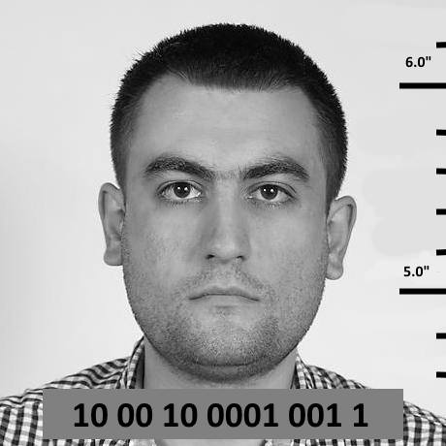
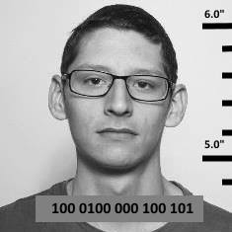
The Team
Anton Velikov
Main developer and story-teller
Dimitar Mazulov
The picture master

Slide 3
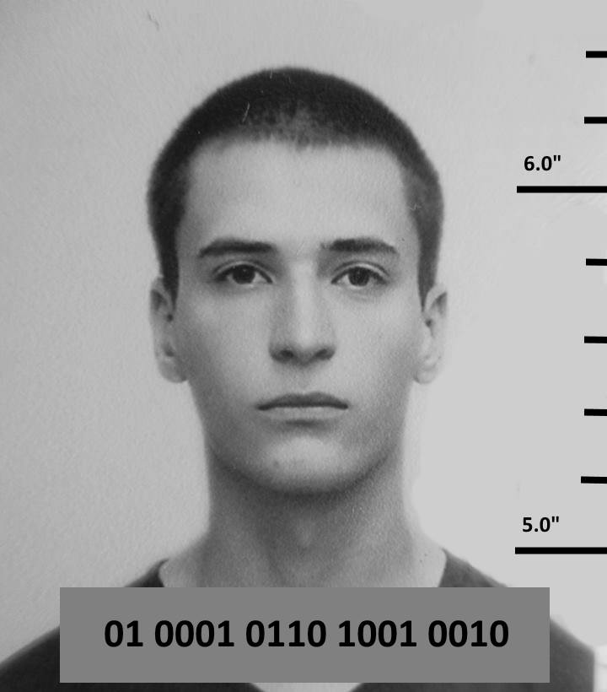
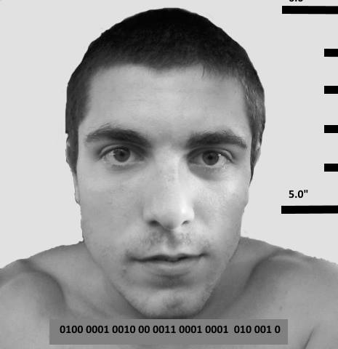
The Team
Ilia Velkov
The main story-teller
Velislav Nikolov
Developer and story-teller

Slide 4

The website http://soft-uni-mafia.cloudvps.bg/

