Slide 1
TEAM "LINNAEUS"
ПРЕДСТАВЯТ...

Slide 2
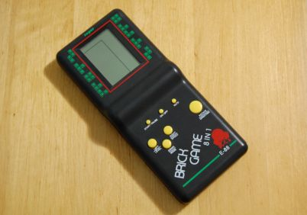
TETRIS GAME

Slide 3
Contributors:
Joana Marinova
(joanmar)
Ivan Kitukov
(fargo)
Todor Velchev
(Tushe2000)
Anton Velikov
(antata_iv)

Slide 4
Team’s contributions to the project:
Check out the contributions of each team member at this link ☺ :
GitHub:
https://github.com/antataiv/TEAM-LINNAEUS
Trello:
https://trello.com/b/Ju362CP3/team-linnaeus

