Slide 1
Playing the Odds
A Machine Learning Game for the NBA
Anthony Chan
2017-05-31

Slide 2
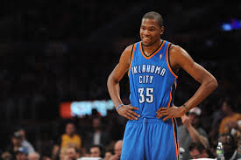
Project Scope
Using Machine Learning techniques to predict whether a particular team will win
against a particular opponent
On what day
By how much
Who do I bet on?
Is this method sustainable?

Slide 3


Intended Audience
Datasets
Everyday basketballs fan
Casual or die hards
Sports Gamblers
NBA or Team executives
Stat nerds
Sports Reporters/bloggers
Conspiracy Theorists
Vegas Insider
Basketball Reference

Slide 4
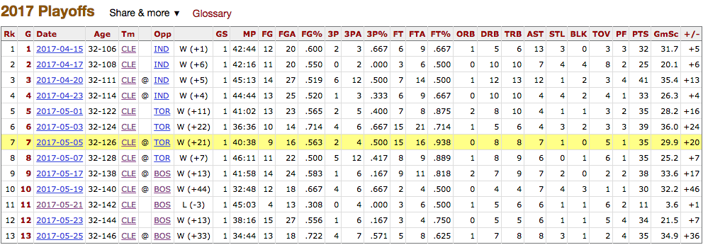

Slide 5

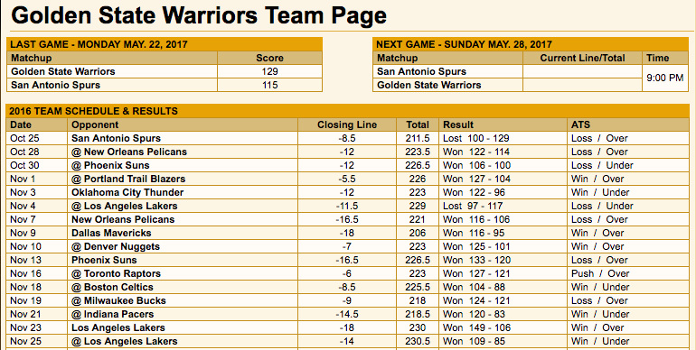

Slide 6
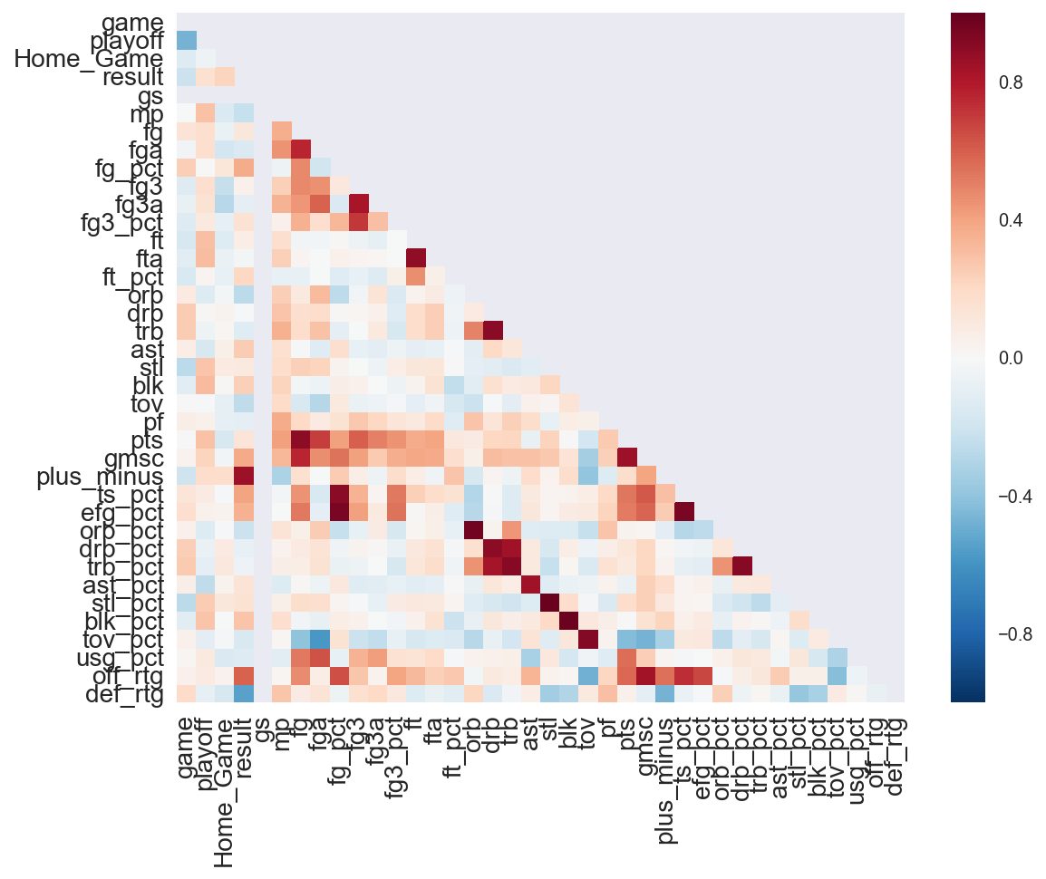
Key Metrics - Points
Minutes played (mp)
Field goals (fg)
Field goals attempted (fga)
Field goals % (fg_pct)
3-pt field goals (fg3)
3-pt field goals attempted (fg3a)
3-pt FG % (fg3_pct)
Free throws (ft)
Free throws attempts (fta)
Free throws % (ft_pct)
True shooting % (ts_pct)
Effective FG % (efg_pct)
Usage % (usg_pct)
Offensive Rating (off_rtg)

Slide 7
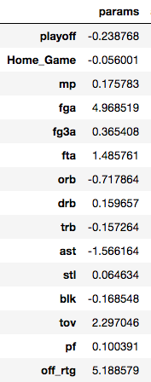
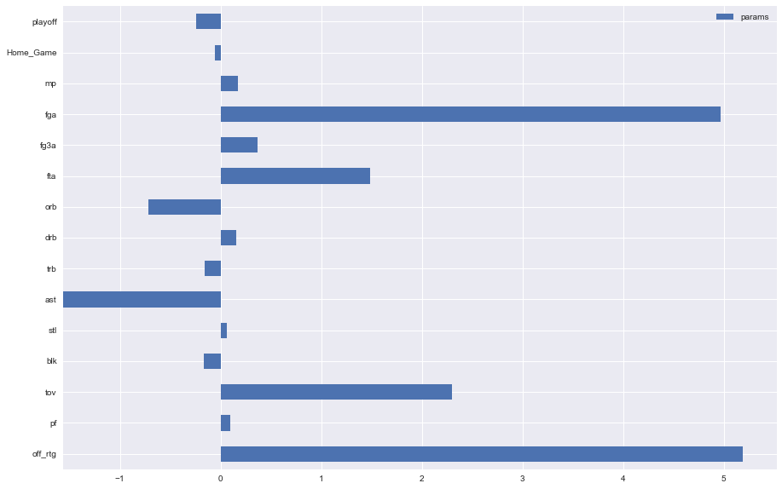
EDA - Feature Importance

Slide 8

What do you know about basketball?
48 Minutes per game
Each player used as a weighted average
5 Players from each team on the floor at a time
5 * 48 minutes = 240 minutes per game
13 Total Active players per team per game
Each game has a winner and loser (no ties)
Needed for spread

Slide 9
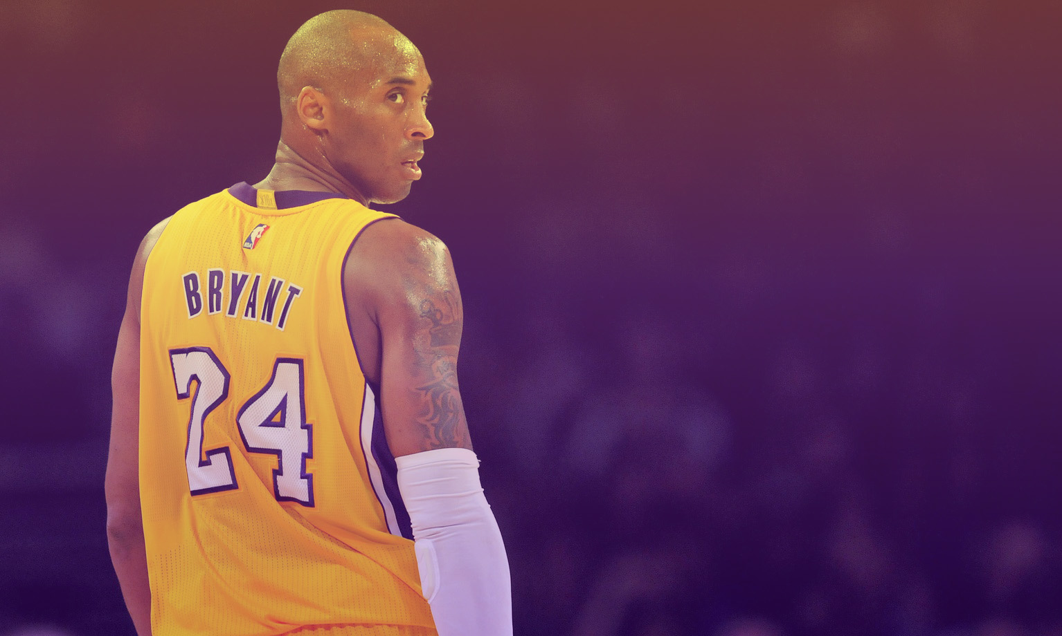
What do you know
about Vegas?
Betting options:
Which team wins
Which team wins by how much
Combined Score (over-under)

Slide 10






Why the House always wins
Cleveland | Boston | Description
 |  | Pay $600 to win $100
 |  | Pay $100 to win $450
 |  | Cleveland favored by 10.5 points
 |  | Boston underdog by 10.5 points
 |  | Combined final score is over 217
 |  | Combined final score is under 217
-110: Pay $110 to win $100 (House collects 10%)
Notes:
Need better indication on what line goes to what stat, mention that you are going after the spread

Slide 11

Moving Line
“Contrary to what most people believe, the spread is not established according to what the bookmakers feel will happen in the game. It is established to get equal action on both sides of a certain game. If heavy action comes in on one side, the spread is adjusted to try and attack action on the other side.” ~ www.docsports.com

Slide 12
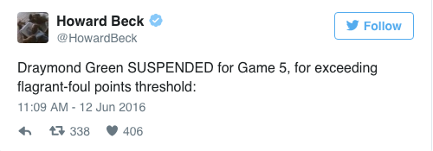
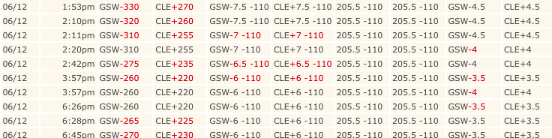
Closing the line at the Beginning of Game

Slide 13
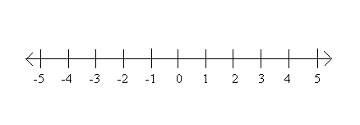
Explaining the Spread - Favored Team
Game Result; Team A
Vegas Line; Team A
Vegas Line; Team B
Game Result; Team B
Favored Team
Underdog Team

Slide 14
Explaining the Spread - Underdog Team
Vegas Line; Team A
Game Result; Team A
Game Result; Team B
Vegas Line; Team B
Favored Team
Underdog Team

Slide 15
Assumptions and Input Variables
Assumptions
Calculate for spread only
Line is not moving
No future information given besides opponent
Input Variables
Player
Opponent
Last X Games Average
Playoff Game
Home Game
Game Started
Player Year
Before Date

Slide 16
Data Pipeline
Player Prediction
Weighted Aggregate Score
Vegas Predicted
Score/Spread
Final Score
Database
Player A1
Team A
Player A2
Predicted Score A
Vegas
Score A
Final
Score A
Player A3
Player A4
Final
Spread
Predicted Spread
Vegas Spread
Player B1
Team B
Player B2
Predicted Score B
Vegas
Score B
Final
Score B
Player B3
Player B4
Legend:
Data
Comparison
Result

Slide 17
Is your Bet Good or Bad?
Predicted
Spread
Did team Win by more than Vegas Spread
Is Predicted Spread Better
Bet on Team
Successful bet!
Bet against Team
Unsuccessful Bet
Vegas
Spread

Slide 18
Model Prediction Progression
Initial Analysis:
Logistic Regression to classify winner and loser
87% Accuracy Score
Secondary Analysis
Linear Regression (Ridge)
93% R-Square Score
Random Forest Regression
76% R-Square Score

Slide 19
Results
A win is defined by if the predicted bet matches the outcome of the game.
Baseline | Random Forest | Linear Regression (Ridge)
50% | 51.2% | 52.5%

Slide 20
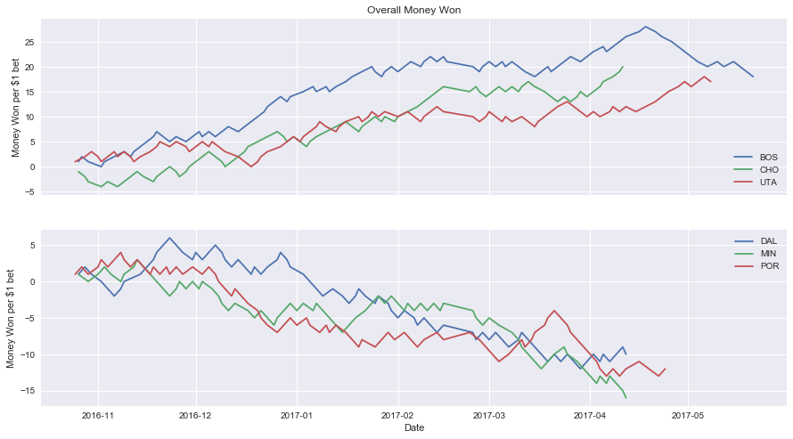

Slide 21
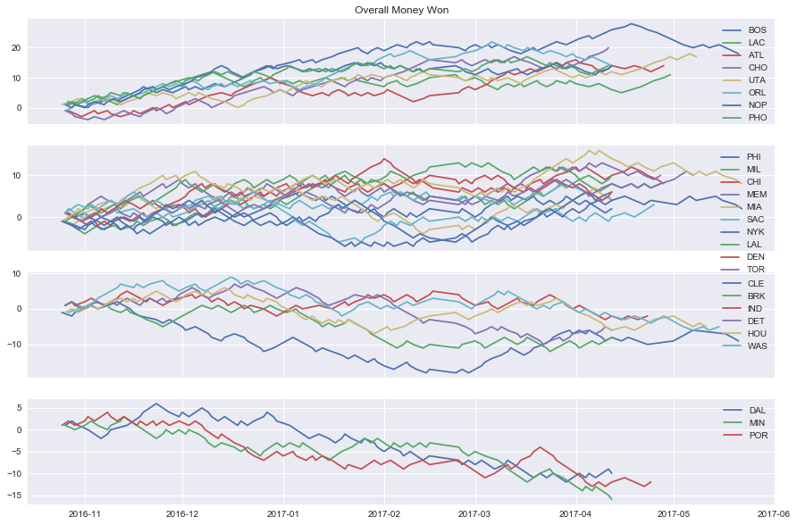

Slide 22
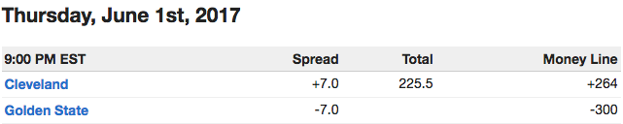
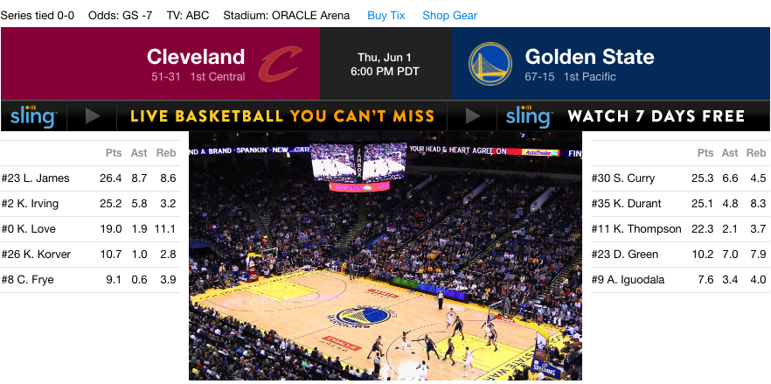
Demo

Slide 23

Improvements
Current Work
Metric adjustments
Train Test Split
Different Models
Alternative ways of setting up prediction matrix
Future Work
Moving line
Prop bets
Opponents Defense
Days since last played

Slide 24
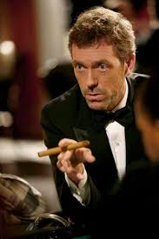
The House Always Wins
YOU LOSE!
Based on a money line of -110, you must win 52.38% of the time to win break even

Slide 25
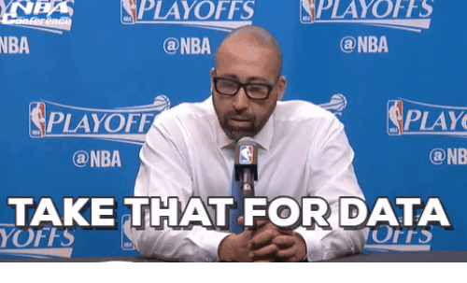

Slide 26
Thank You!
email: antawnchan@gmail.com

