Slide 1
Background Subtraction
using 3D CNN and ConvLSTM
Anthony Alessandro Benavides Arce
anthony.benavides@ucsp.edu.pe
Undergraduate Program in Computer Science
UCSP - San Pablo Catholic University
July of 2020

Slide 2
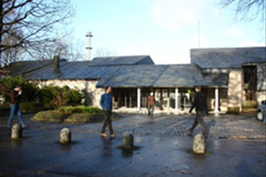
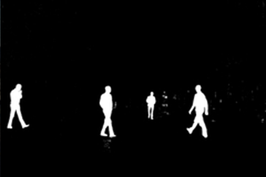
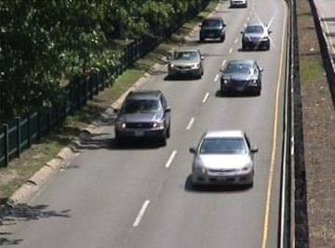
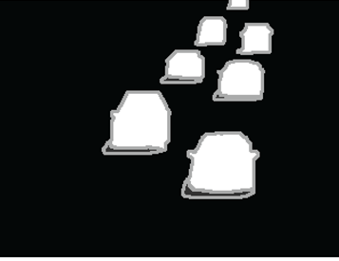
Background Subtraction
Notes:
Background Subtraction (BS) is a widely used approach for detecting moving objects or movement of the foreground.
BS can be treated as a binary classication task which assigns each pixel in video sequences with labels belonging to either the Foreground (FG)
(moving objects) or the background (static scenario).

Slide 3
Proposed model

Slide 4
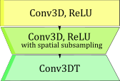
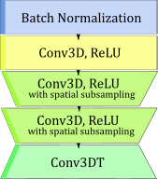
Proposed model

Slide 5
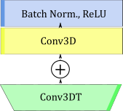
Proposed model

Slide 6
Results

Slide 7
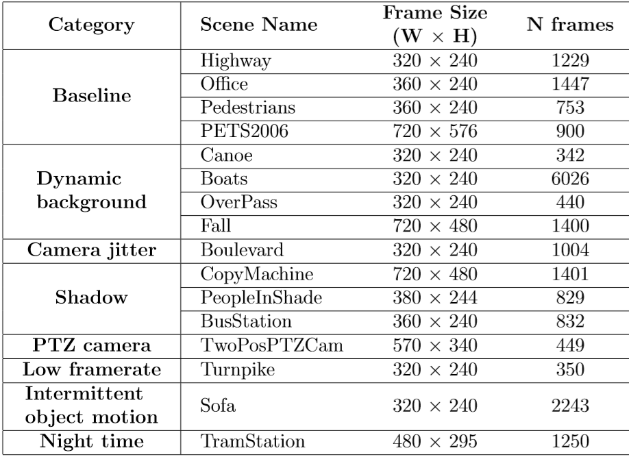
Data-set
CDnet2014 dataset was used to the experiments, because it contains a variety of environments.

Slide 8
Metrics

Slide 9
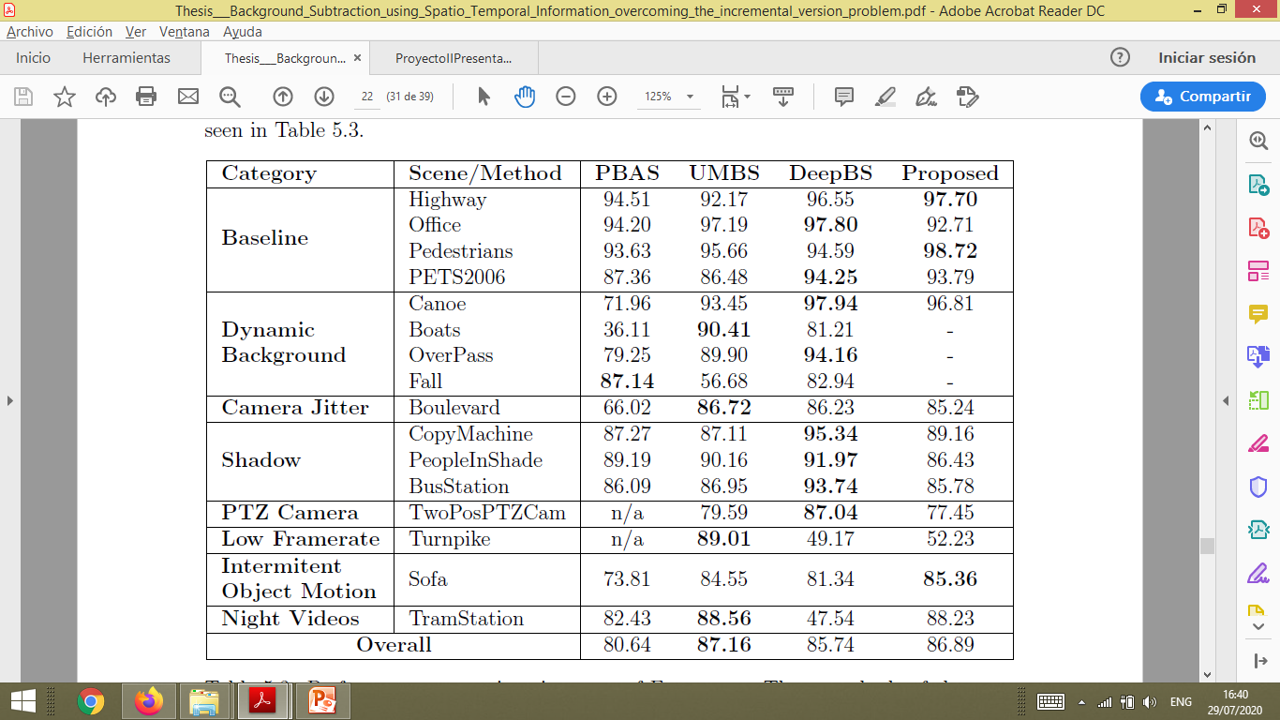
Performance comparison in terms of F-measure
Three methods of the state of the art (PBAS, UMBS, DeepBS) and the proposed method were tested in sixteen scenes of CDnet2014 dataset.

Slide 10
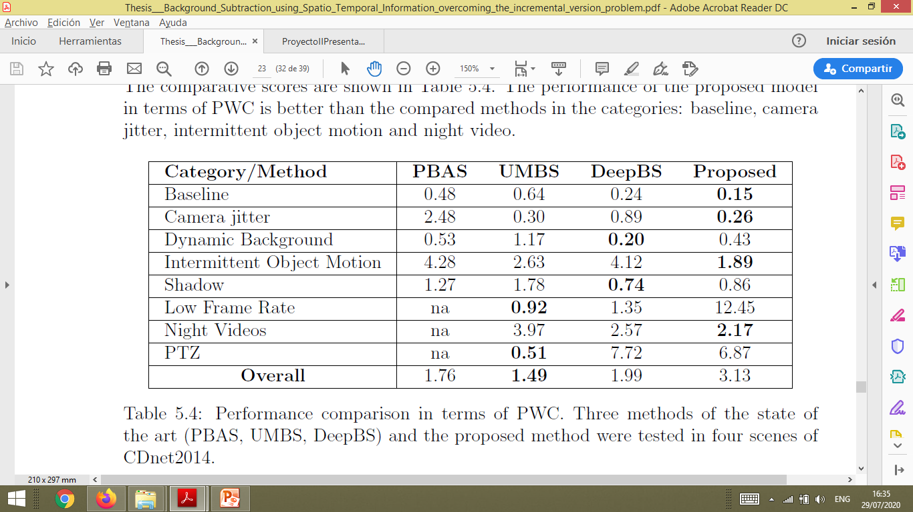
Performance comparison in terms of PWC
Three methods of the state of the art (PBAS, UMBS, DeepBS) and the proposed method were tested in eight categories of CDnet2014 dataset.

Slide 11
Qualitative results

Slide 12
Background Subtraction
using 3D CNN and ConvLSTM
Anthony Alessandro Benavides Arce
anthony.benavides@ucsp.edu.pe
Undergraduate Program in Computer Science
UCSP - San Pablo Catholic University
July of 2020

