Slide 1

Distributed Adaptive Systems (DAS) Unit
Epidemics
Antonio Bucchiarone
Fondazione Bruno Kessler, Trento – Italy
bucchiarone@fbk.eu
4 October 2018

Slide 2
Gossip in Distributed Systems
It is the diffusion of information to a collection of nodes.
Messages could be broadcast to all nodes.
Updates should be applied to all the copies of a replicated database.
Chunks of a live streaming video must be delivered to all connected clients.
Some nodes are aware of a piece of information and some other not.
The nodes that have it should cooperate in order to diffuse these pieces to those that do not.

Slide 3
Problem Definition - I
We consider a system composed by a fixed collection P of nodes, which is known to all nodes (strong assumption).
Nodes may communicate with each other by exchanging messages.
Nodes may fail and messages can be lost.
Each node maintain a single variable value whose content is replicated among all nodes.
Nodes receive updates to this variable:
Either by exchaning messages between each other, or
By means of an external mechanism like a primitive invocation or a client request.
Updates completely overwrite the content of the variable.
Value.time returns the timestamp of the latest update known to the node, taken from a totally ordered set of timestamps T.

Slide 4
Problem Definition - II
The Goal is to spread the updates to all the nodes:
If no new updates are injected after some time t, eventually all correct nodes will have the same copy of the variable.
A node can be in one of three states:
Susceptible (S): the node does not know about the update;
Infected (I): the node knows the update and is actively spreading it;
Removed (R): the node knows the update, but it does not participate in the spreading any more.
A susceptible patient has not contracted the virus (yet).
An infected one is carrying the virus and can infect other patients.
A patient is removed when is not contagious any more.
==> The goal is to obtain a pandemic.

Slide 5
SI Model: Anti-entropy
Three styles of anti-entropy protocols have been proposed:
Push style
Nodes periodically send (push) the current content of variable value to a node selected randomly from P.
Pull style
Nodes periodically ask (pull) new updates of the replicated variable from other, randomly selected nodes.
Push-Pull style
Push and pull are combined together.

Slide 6
PUSH Style
The content of the variable is sent to a randomly selected node through a PUSH message.
Irrespective of whether this node has already received the update or not.
When the update is received, its timestamp is compared with the local one; if the update is newer, it is copied in value.

Slide 7
PULL Style
The latest timestamp known to p is sent to a randomly selected peer through a PULL message.
When a PULL message is received, the node compares it with the local timestamp.
If the local timestamp is newer, a REPLY messages is sent with the content of the value.
When a REPLY message is received, the timestamp of the received value is compared with the local once again, because other updates may be received in the period between the PULL and the REPLY.

Slide 8
PUSH-PULL Style
The content of the value is sent by p to a randomly selected peer q through a PUSHPULL message.
When such message is received, the timestamps are compared:
If the received timestamp is newer, the update is copied on the local variable.
If the received timestamp is older, a REPLY message is sent to the sender of PUSHPULL.
If they are equal, the content is ignored.

Slide 9
Execution Rounds
The execution is divided in a set of consecutive rounds of length 𝝙 times units.
It is represented by the on timeout code blocks at the beginning of each version, ended by a set timeout operation at the end.

Slide 10
Implementation Assumptions
The nodes do not fail.
Communication is reliable.
Consecutive rounds are synchronized: they start at the same time on all nodes.
All the messages sent during the execution of a round (PUSH, PULL, PUSHPULL and their potential REPLY) arrive before the next rounds starts – Round are not intermixed.

Slide 11
ApplicationMain
The ApplicationMain, as usual is a place where we can put experiment configurations, which, in this case is only a parameter epiType:
private static enum EpiType {PUSH, PULL, PUSHPULL};
private static EpiType epiType = EpiType.PUSH;

Slide 12
Epidemic Actor
The EpidemicActor is a base class to hide all complicated stuffs.
3 other classes that extend this base class: EpidemicPushActor, EpidemicPullActor, and EpidemicPushPullActor.
In these classes, you need to provide implementation of the 2 following methods for each type of Anti-Entropy version):
upon timeout and
upon receive

Slide 13
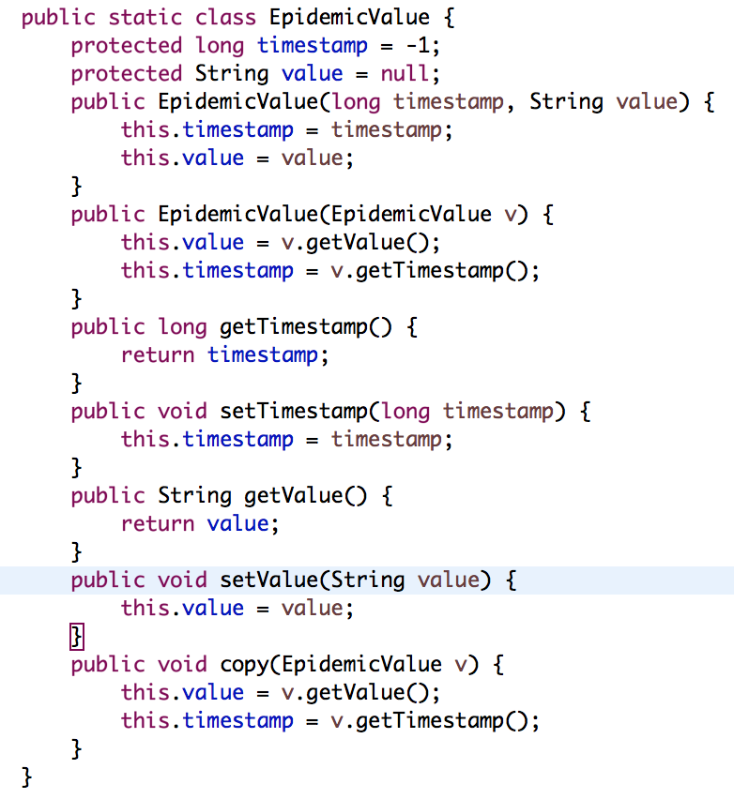
Epidemic Value

Slide 14
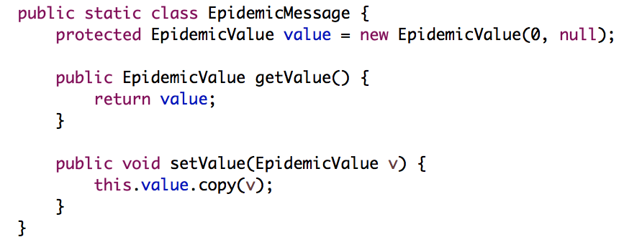
Epidemic Message

Slide 15
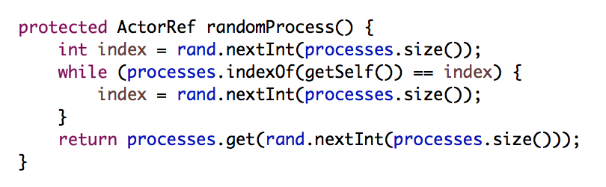
Random Process

Slide 16
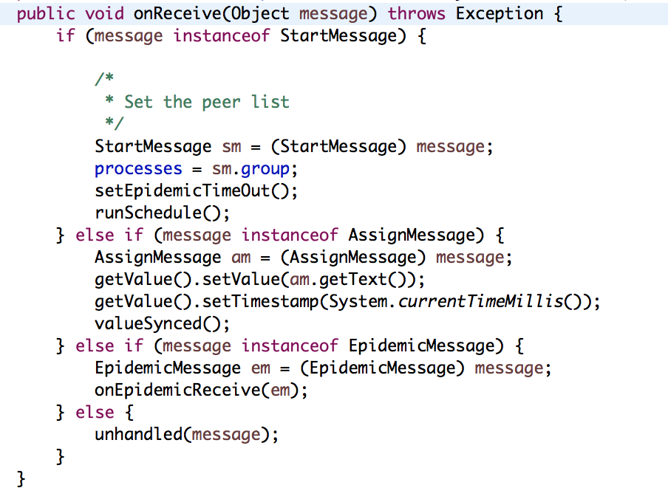
OnReceive

