Slide 1
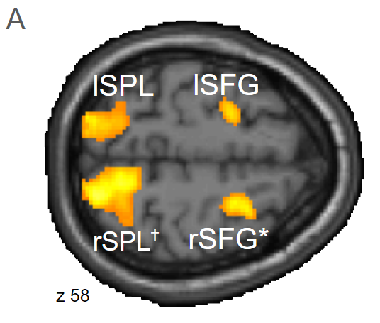
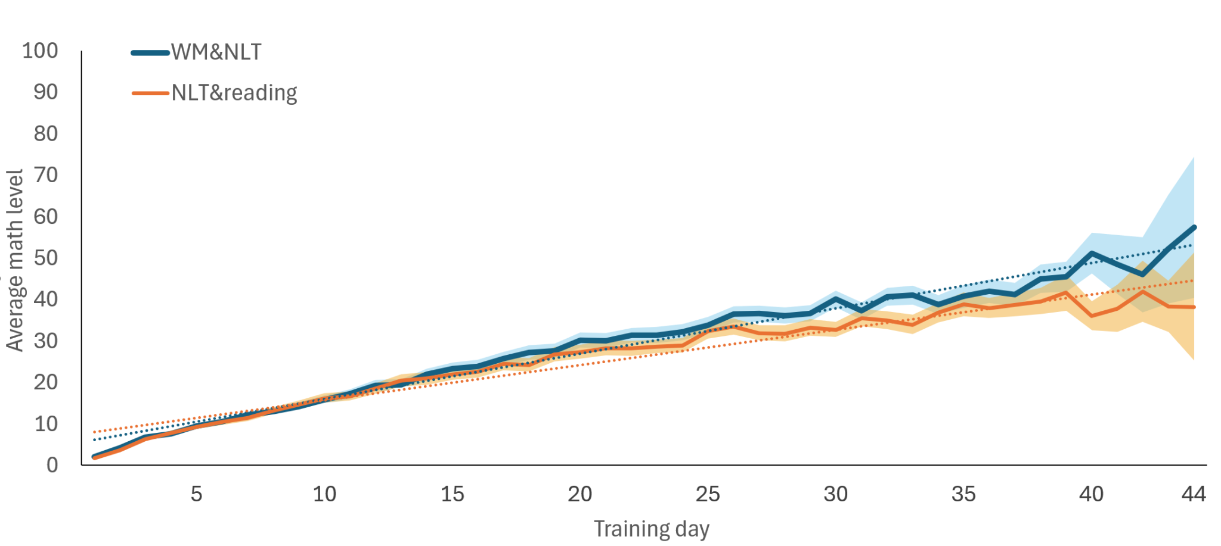
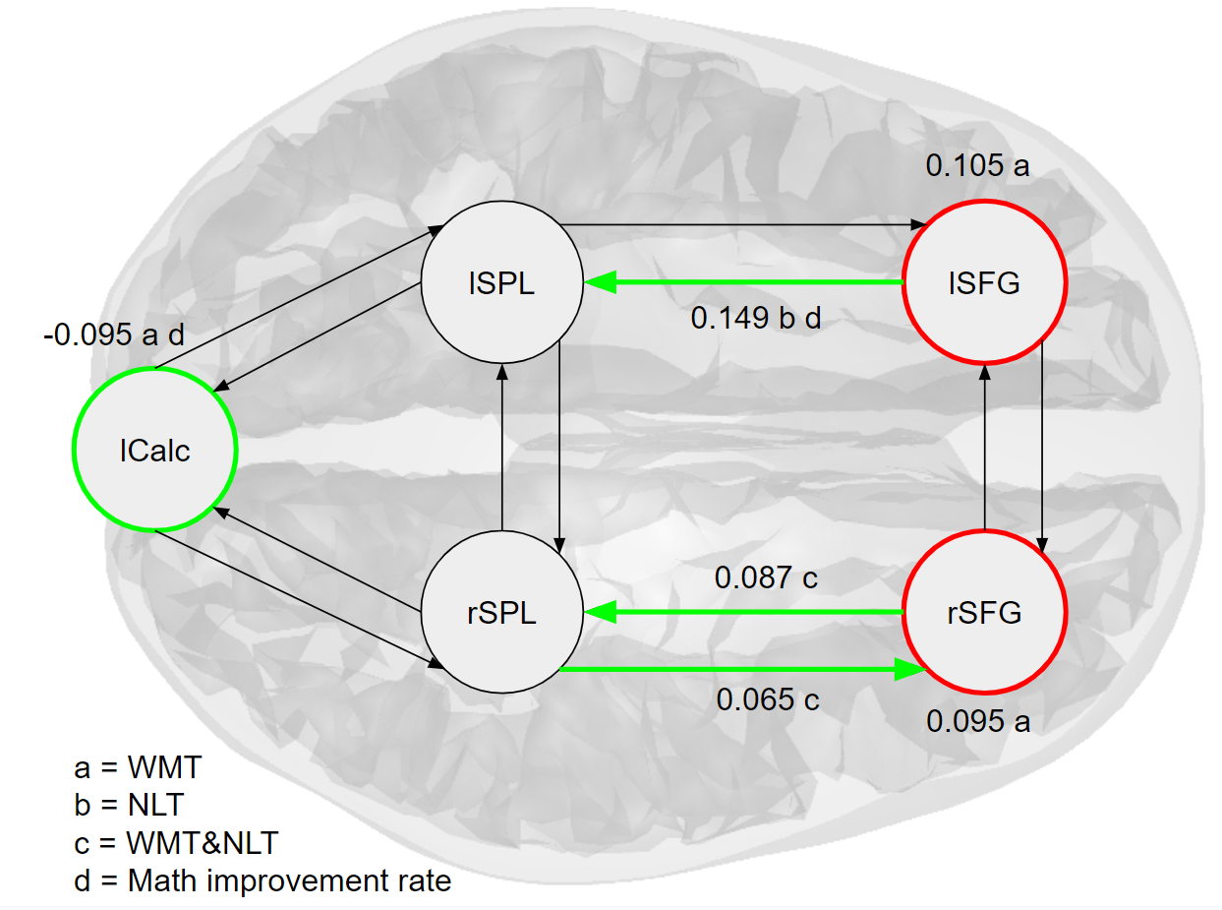


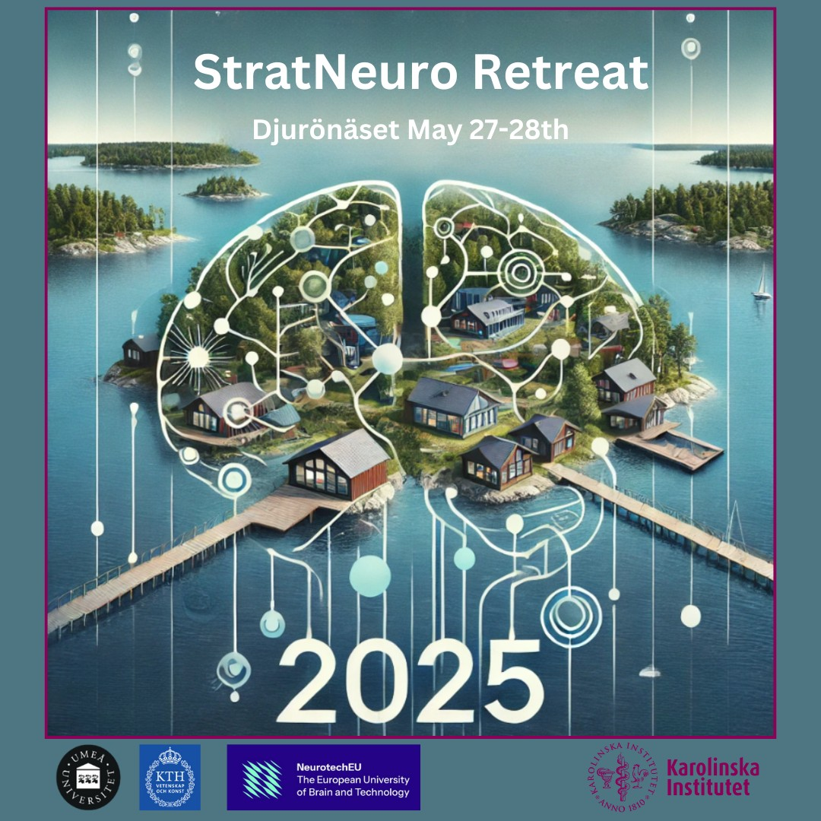
Neuroscience in Education:
Dynamic Causal Modeling Predicts Learning
Aims and hypothesis:
What is the better biomarker for learning-related change; effective connectivity or peak task activity?
Is there utility in using cognitive neuroscience for evaluating educational interventions?
To answer this, we analysed 54 6-year-olds with longitudinal fMRI, before and after cognitive training.
Training mix affects
Math trajectory
WM-task BOLD activity
Results:
Significant difference in math outcome between children with both math and WM training and those with math and reading.
rSFG is active during a WM task, but shows no significant changes in task activity after training.
DCM shows that connectivity changes after training and can predict both training conditions and math improvement rate.
NLT=Number-Line Training.
WM=Working Memory.
Shaded Areas=SEM.
p<0.001 uncorrected, *=p<0.05(FWE)
Dynamic Causal Model of longitudinal connectivity-changes
Conclusions:
DCM reveals training-specific changes.
DCM predicts math improvement rate.
Connectivity can be more sensitive than peak task BOLD levels.
Training-specific biomarkers are potentially useful in curriculum- or intervention-evaluation.
Changes after training.
Values=parameter strengths(Hertz). Letters=covariates predicted by LOO analysis.
Green=Excitatory. Red=Inhibitory
84 x 119 cm
Methods: n=54, 6 year olds, with longitudinal fMRI (pre- and post-training) from Nemmi et al., (2016). Analysed using SPM 12. 8 Weeks cognitive training using ‘Vektor’ App by Torkel Klingberg.
Key references:
Nemmi, F., Helander, E., Helenius, O., Almeida, R., Hassler, M., Räsänen, P., & Klingberg, T. (2016). Behavior and neuroimaging at baseline predict individual response to combined mathematical and working memory training in children. Developmental Cognitive Neuroscience, 20, 43-51.
Gabrieli, J. D., Ghosh, S. S., & Whitfield-Gabrieli, S. (2015). Prediction as a humanitarian and pragmatic contribution from human cognitive neuroscience. Neuron, 85(1), 11-26.
Berger, E. M., Fehr, E., Hermes, H., Schunk, D., & Winkel, K. (2025). The Impact of Working-Memory Training on Children’s Cognitive and Noncognitive Skills. Journal of Political Economy, 133(2), 492-521.
Friston KJ, Harrison L, Penny W. Dynamic causal modelling. Neuroimage. 2003 Aug;19(4):1273-302. doi: 10.1016/s1053-8119(03)00202-7. PMID: 12948688.
Andreas Lidström, Torkel Klingberg
andreas.lidstrom.2@ki.se
Karolinska Institute, Department of Neuroscience, C4 Neurovetenskap, C4 Forskning Klingberg, 171 77 Stockholm, Sweden

