Slide 1
Effect of ambient air quality factors on bluebird nesting in Montgomery County, MD
Ziying Sherwin
National Library of Medicine

Slide 2
Background
Current air quality monitoring efforts by U.S. EPA e.g., via the national AirNow sensors and others focus on ozone and PM2.5 (small-size or “fine” particulate matter)
Birds could serve as sentinel species for air quality

Slide 3
The Efficient Lung Structure in Birds:
unidirectional airflow
push gas directly to their bones
Illustrated by Eleanor Lutz

Slide 4
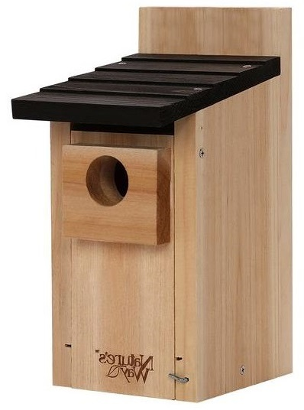
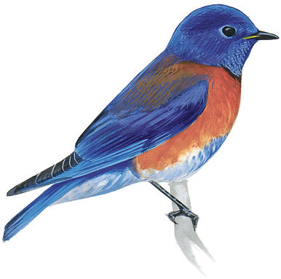
Why Bluebird?
Rely on specially designed nest boxes
Do not migrate, so they are exposed to the air quality in one area all year round.
Been closely monitored since mid-70s
The nesting data have been collected since 1992 in Montgomery County, MD.

Slide 5
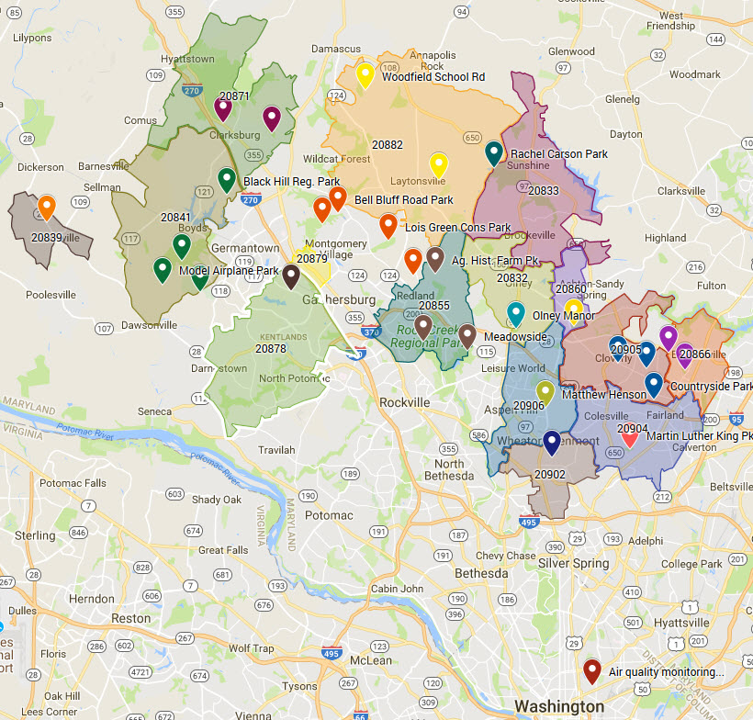
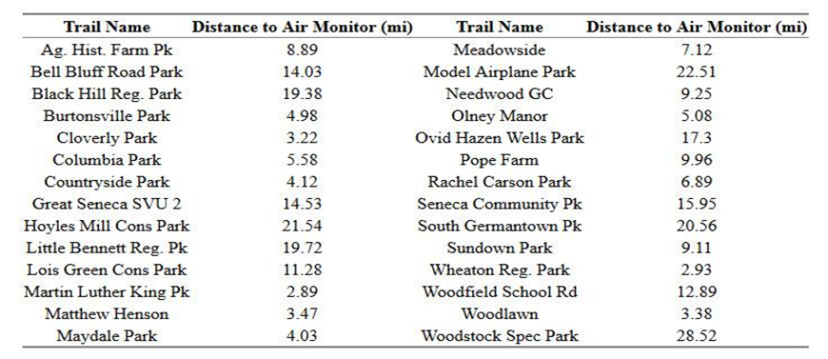

Bluebird Trails Included in Study

Slide 6



Data Retrieval and Preparation
CSV file
Annual Excel Summary
CSV file
R studio
Python
CSV file
Python/
Shell Scripting

Slide 7
Frequentist Approaches for Correlation Test
Pearson
Kendall
Spearman

Slide 8
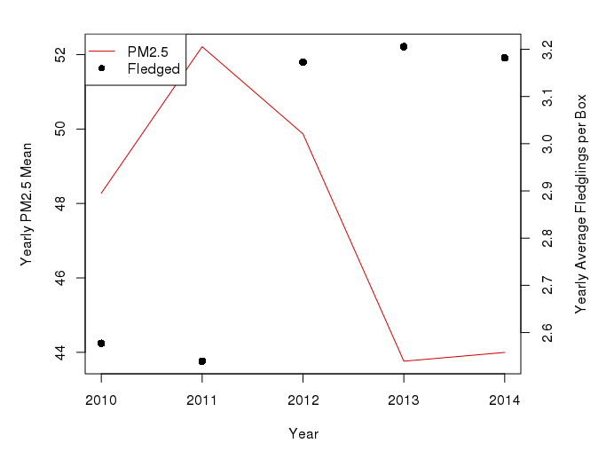
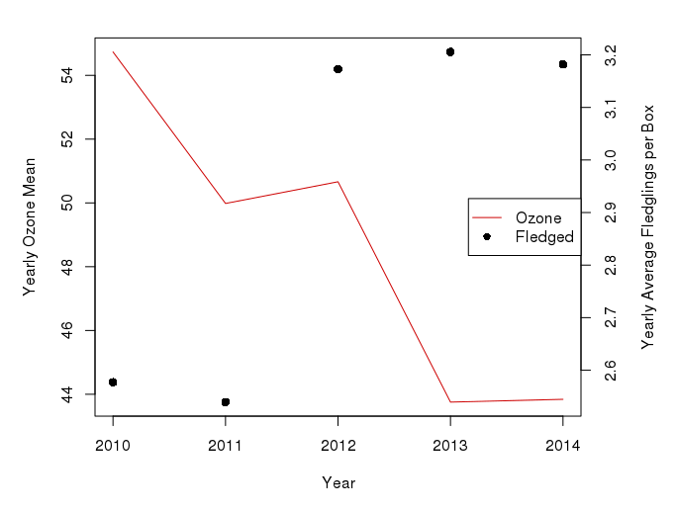
PM2.5 and Ozone on average number of fledglings per year, visually shows a correlation between the variables.

Slide 9
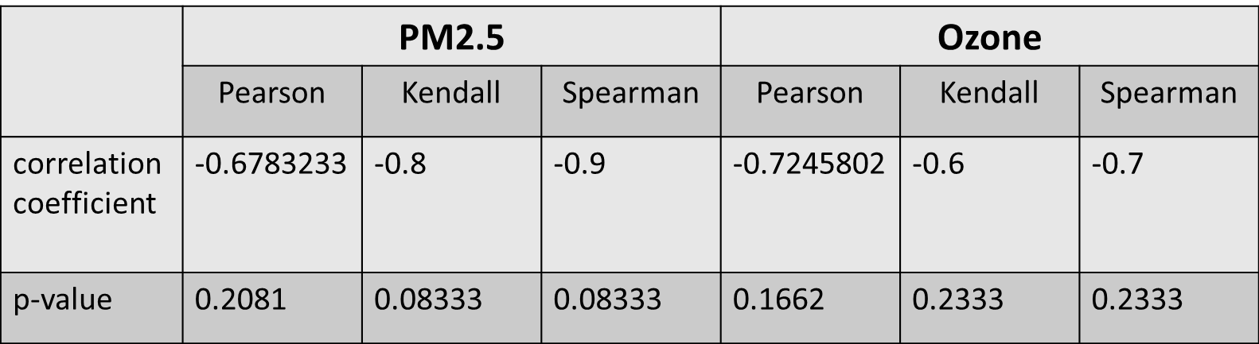
Correlation coefficient and p-value for PM2.5/ Ozone using each test

Slide 10
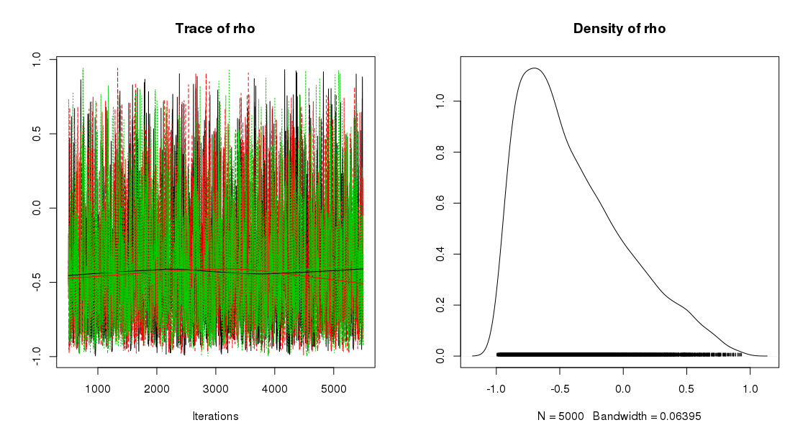
Bayesian alternative to the correlation test

Slide 11
summary(mcmc_samples)
Iterations = 501:5500
Thinning interval = 1
Number of chains = 3
Sample size per chain = 5000
1. Empirical mean and standard deviation for each variable, plus standard error of the mean:
Mean SD Naive SE Time-series SE
-0.389386 0.412811 0.003371 0.007580
2. Quantiles for each variable:
2.5% 25% 50% 75% 97.5%
-0.9317 -0.7164 -0.4864 -0.1336 0.5761

Slide 12
Sample Code
data_list = list(x = bf2[, c("avg", "PM")], n = nrow(bf2))
inits_list = list(mu = c(mean(bf2$avg), mean(bf2$PM)), rho = cor(bf2$avg, bf2$PM), sigma = c(sd(bf2$avg), sd(bf2$PM)))
jags_model <- jags.model(textConnection(model_string), data = data_list, inits = inits_list, n.adapt = 500, n.chains = 3, quiet = T)
update(jags_model, 500)
mcmc_samples <- coda.samples(jags_model, c("rho"), n.iter = 5000)
plot(mcmc_samples)
Source: http://www.sumsar.net/blog/2013/08/bayesian-estimation-of-correlation/

Slide 13
Random Forest – Sample Code
set.seed(18)
sample.ind <- sample(2, nrow(trailmaster_1y), replace=T, prob = c(0.6,0.4))
bb.dev <- trailmaster_1y[sample.ind==1,]
bb.val <- trailmaster_1y[sample.ind==2,]
bb_forest = randomForest(Fledged ~ Boxes+PM+distance+PRCP, data=bb.dev, mtry=4, importance = TRUE, ntrees=500)
importance(bb_forest, type=1)
varImpPlot(bb_forest, type = 1)
bb_forest_tst_pred = predict(bb_forest, newdata = bb.val)
plot(bb_forest_tst_pred, bb.val$Fledged, xlab = "Predicted", ylab = "Actual", main = "Predicted vs Actual: Random Forest, Test Data", col = "dodgerblue", pch = 20)
grid()
abline(0, 1, col = "darkorange", lwd = 2)
https://daviddalpiaz.github.io/r4sl/ensemble-methods.html

Slide 14
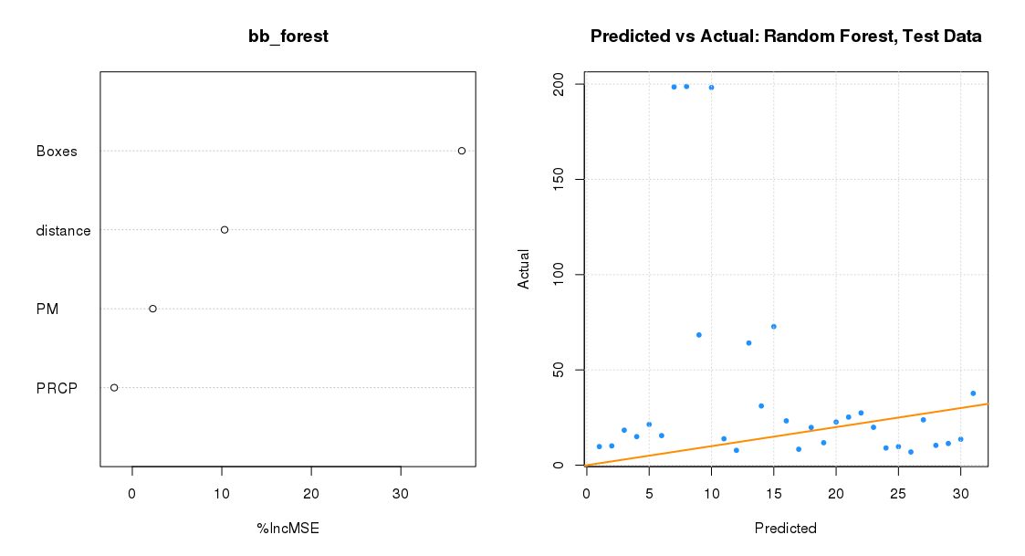
Random Forest

Slide 15
Challenges

