Slide 1
Characterization of Oncogenes in Pretreatment and Post-treatment Sequence Data
Samuel Chatmon
National Cancer Institute

Slide 2
Background
Obtained Two SRA fastq files from the SRA database.
Files were labeled as WES Nextgen Sequence data which were obtained from a melanoma patient before and after treatement
Wanted to examine the sequences for the variant levels in Ocogenes

Slide 3
Project Overview
Fastq files were obtained from NCBI’s SRA database and transfer using the Fastq-dump tool
The complete hg38 human genomic sequence was downloaded from the UCSC Genomic Browser Site
The top twenty genes that contains somatic mutations for melanoma was obtained from the Cosmic Cancer Browser site and their chromosome number and position was obtained from the UCSC site
Both sets of fastq sequences were aligned against the human genome with the BWA aligner

Slide 4
Project Overview (continued)
Samtools and BCFtools were employed to create VCF files that the contained base substitutions, deletions and insertions in the data.
Python programming and bash scripting were utilized to score the number of times variants were found in the genes

Slide 5
First Issue: Forgot about HIPAA Compliance
Fortunately, A Few Files were downloadable

Slide 6
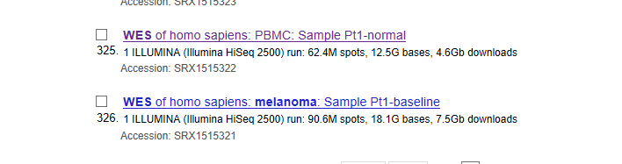
Fortunately, a Few Files were downloadable.
Study: WES of patient derived pre-treatment metastatic melanoma on anti-PD-1 antibody treatment. We will call treatment srr8 and pre-treatment srr7 for short.

Slide 7
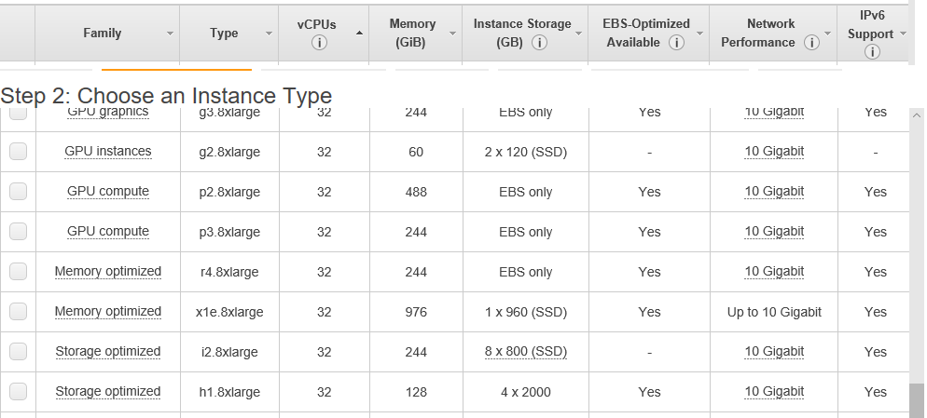
Second Issue Issue: Did not consider memory or CPU requirements
Bowtie Alignment ~12 hours in Oracles VirtualMachine ~12gb memory and 2 cpu’s
BWI Alignment ~3 hours in Amazon AWS. But Alas, ,most data on machine. Decided to continue virtual machine and use BWA instead.

Slide 8
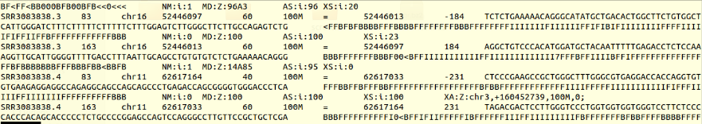
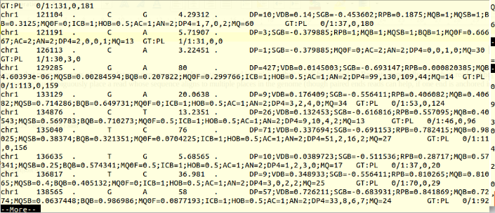
Finally can use Samtools to create bam file of alignments.
and BCFtools to create vcf file which contains all variants.

Slide 9
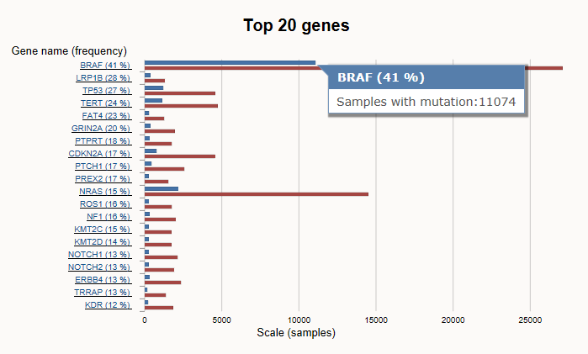
Obtained 20 more frequent Mutated Genes from Cosmic Site

Slide 10
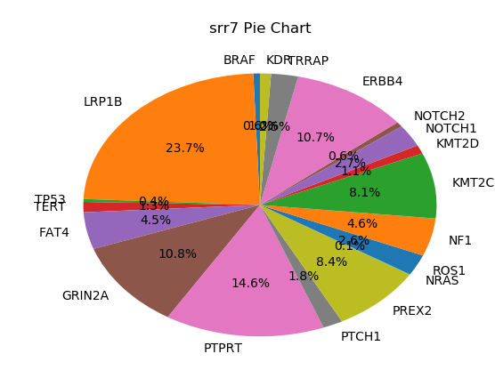
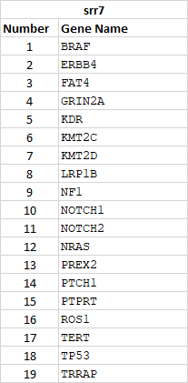
Utilized Python and BASH scripting to score variants in each data set : List of Genes and Pie Chart for srr7
Total number of variants = 1985

Slide 11
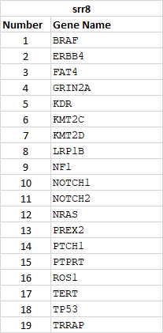
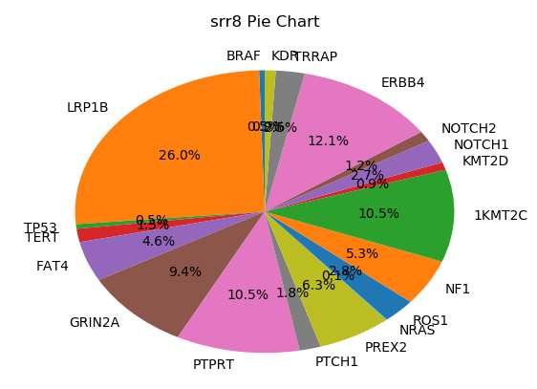
Utilized Python and BASH scripting to score variants in each data set : List of Genes and Pie Chart for srr8
Total number of variants = 1707

Slide 12
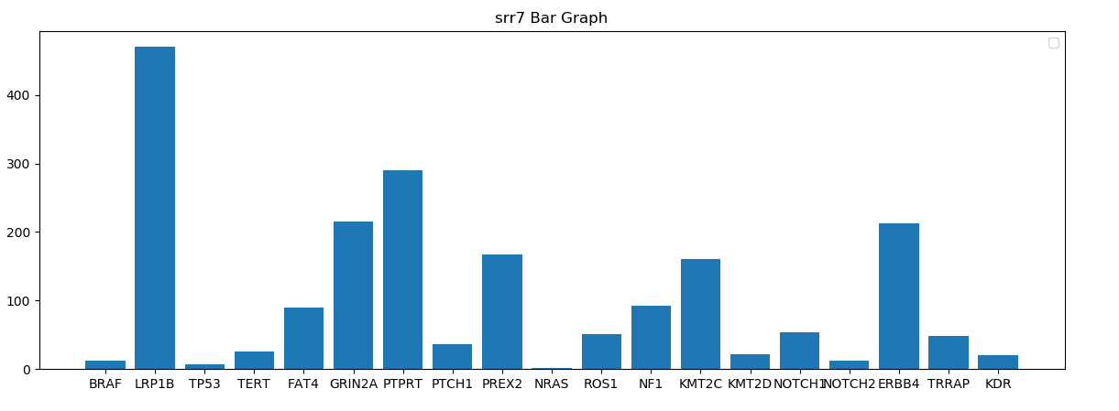
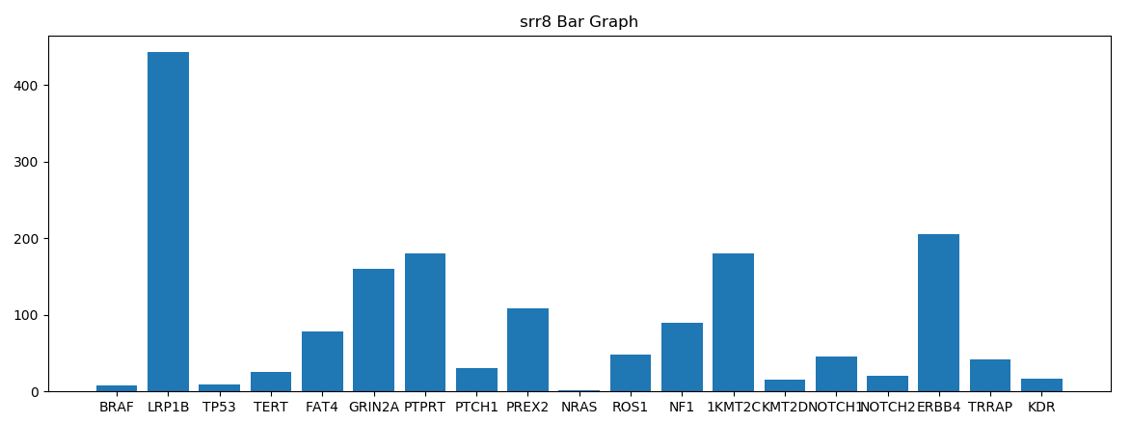
Utilized Python and BASH scripting to score variants in each data set : Bar Graphs for srr7 and srr8

Slide 13
Conclusion
Can’t really hypothesize anything by just using simple visualization tools.
Most likely would need to look at much more data and using Transcriptomics tools and star alignment tool

