Slide 1
Actionable correlations
Text Mining
of
Safety Data Narratives
to find
William A. Studniarz
Project Manager
Project Enhancement Corporation – Contractor to: Office of the Environmental Safety and Health
U. S. Department of Energy
Washington, D. C.
Class Project Results BIOF475 Spring 2018
May 2, 2018

Slide 2


Objectives
Share results of the class project public data set and code
Provide background on what the project working code will do to solve real world Agency problems

Slide 3
Outline
Background on the Department of Energy
Structural Rigidity
Project Overview
April 26th, 2018
Packages and code used
Output of the code
Challenges
Takeaways
The path forward

Slide 4
Department of Energy
Mission
The mission of the Energy Department is to ensure America’s security and prosperity by addressing its energy, environmental and nuclear challenges through transformative science and technology solutions.

Slide 5
Department of Energy
Important Characteristics
DOE is a self-regulated agency for nuclear safety.
DOE is also the owner of the nuclear facilities and materials.
DOE nuclear facilities and operations pose fundamentally different risk profiles and issues than those of different Agencies and commercial work:
Offsite Doses
Public Health/Consequences
Worker Safety and Health
Criticality

Slide 6
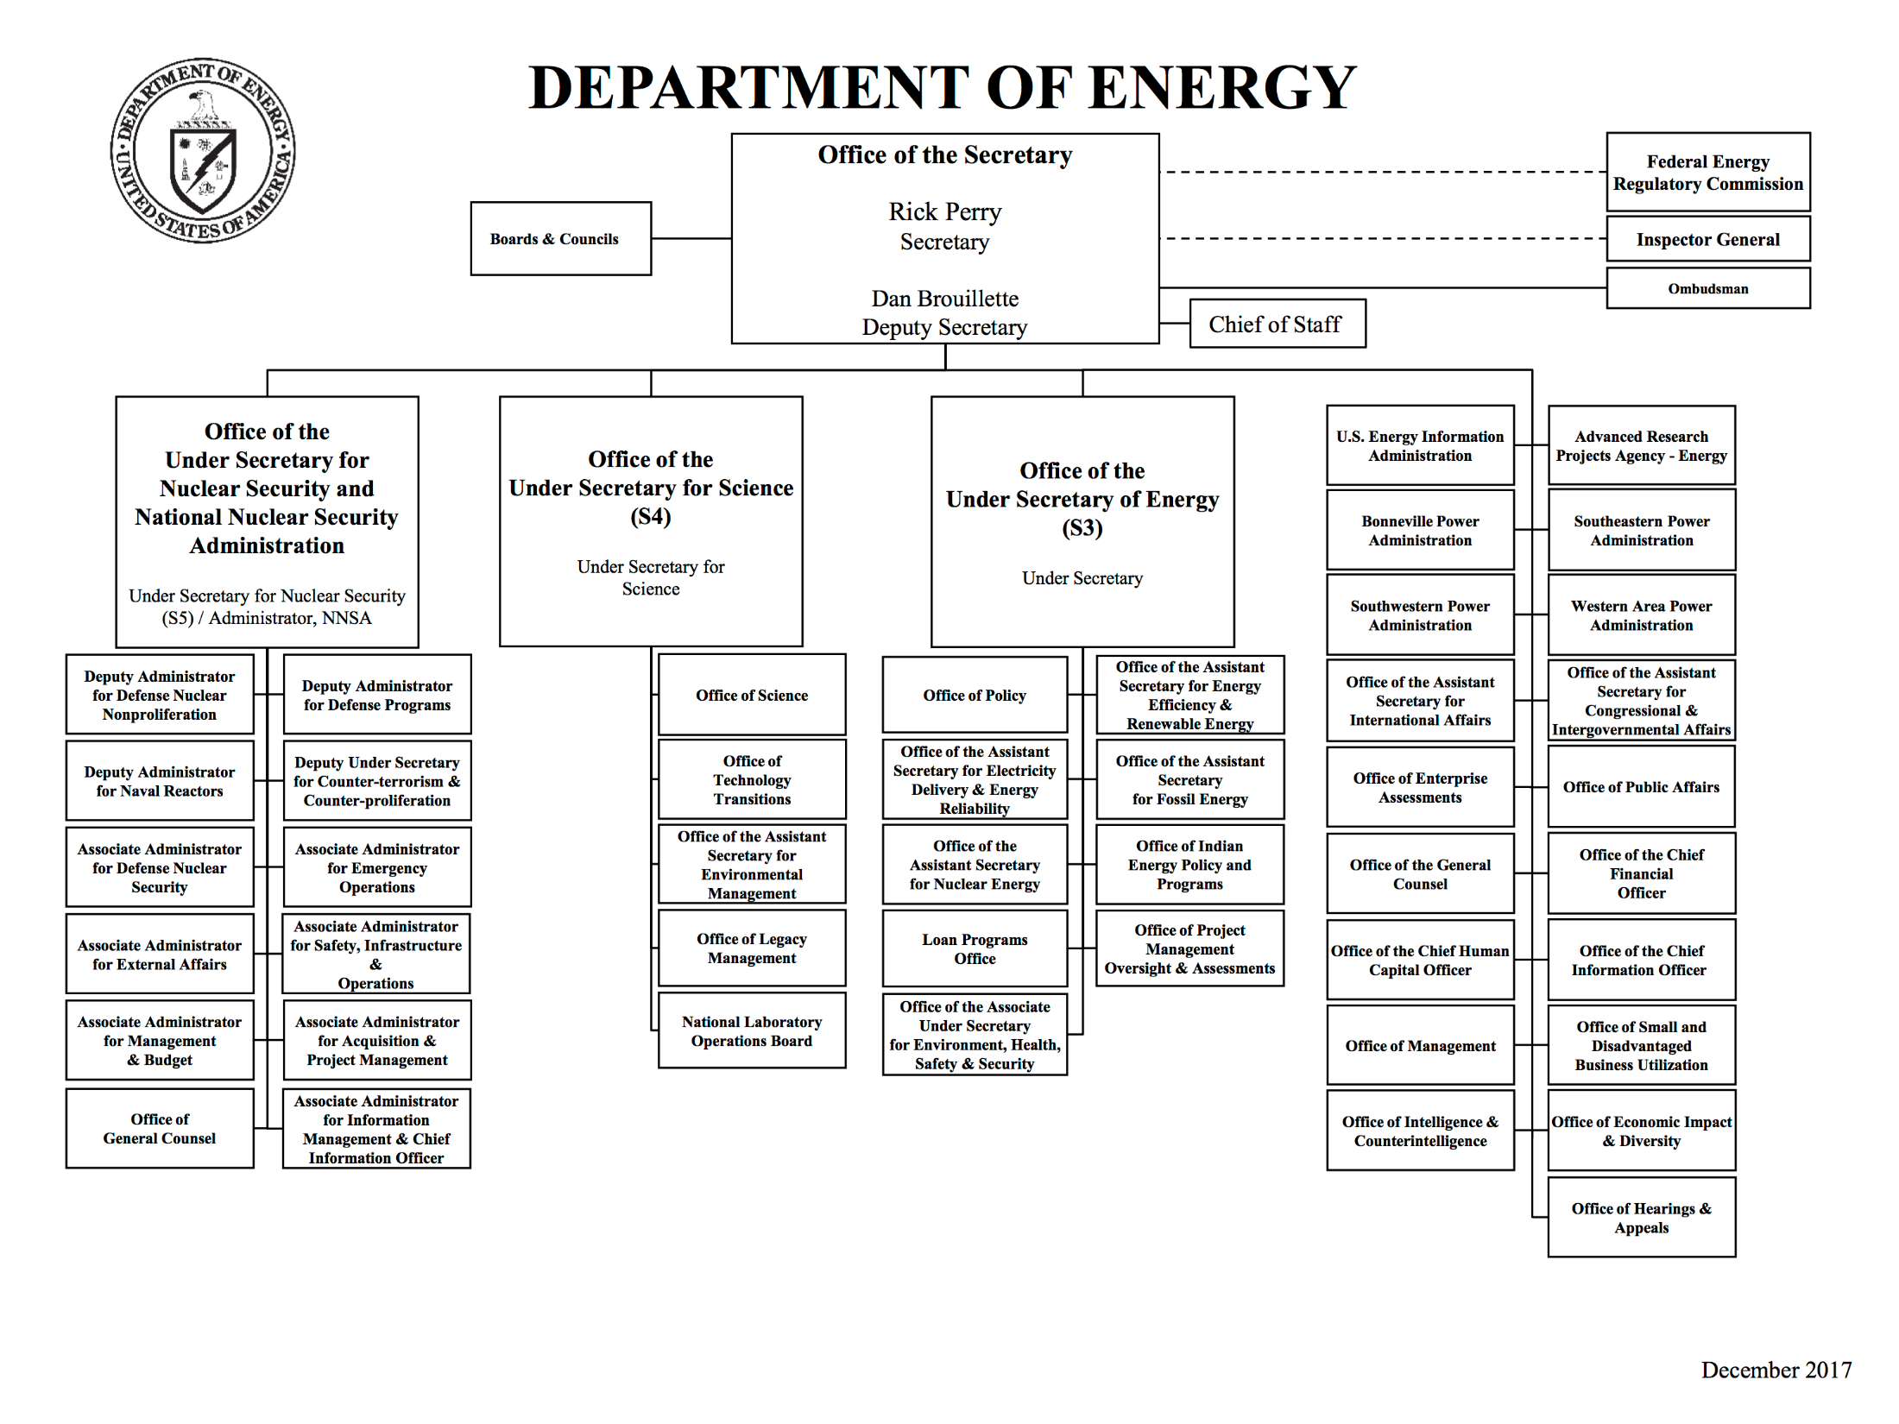

Slide 7
Department of Energy It’s all the data we have problem
Breaking Structural Rigidity Realizing that there was declining regulatory safety reporting within our division many were concerned with the idea of running out of data. “It’s all we have to work with.” This then led to the need to find more data but highly relevant data. But how?

Slide 9
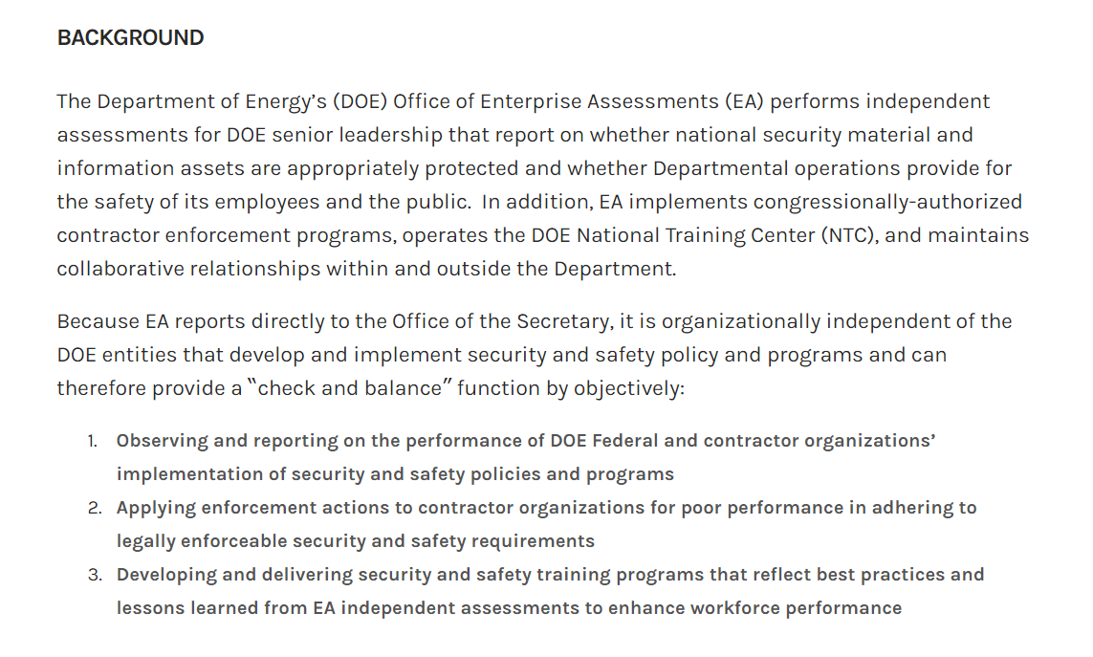

Slide 10
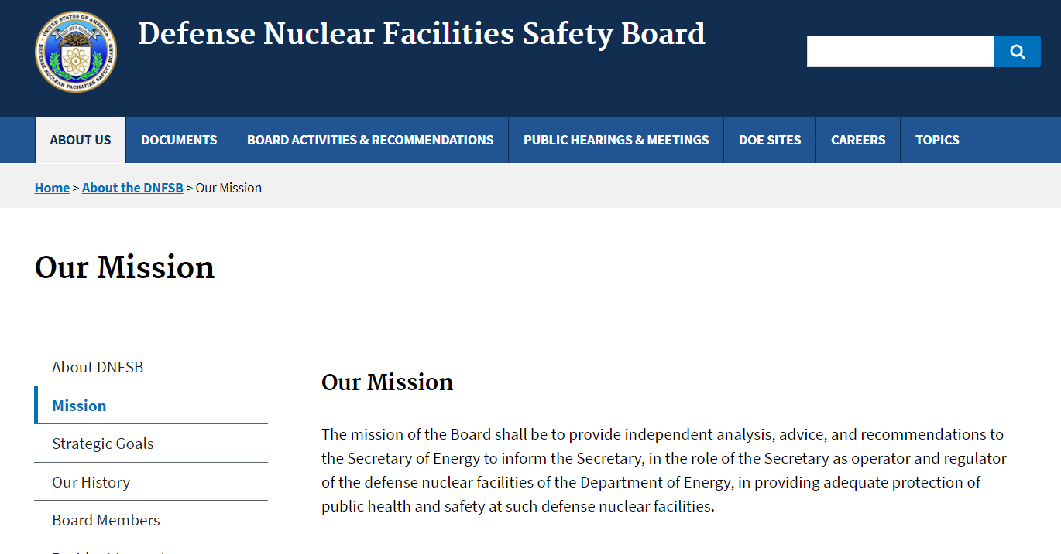

Slide 11


Slide 12
Much More Data!
EHSS Data
DNFSB
EA
NRC

Slide 13
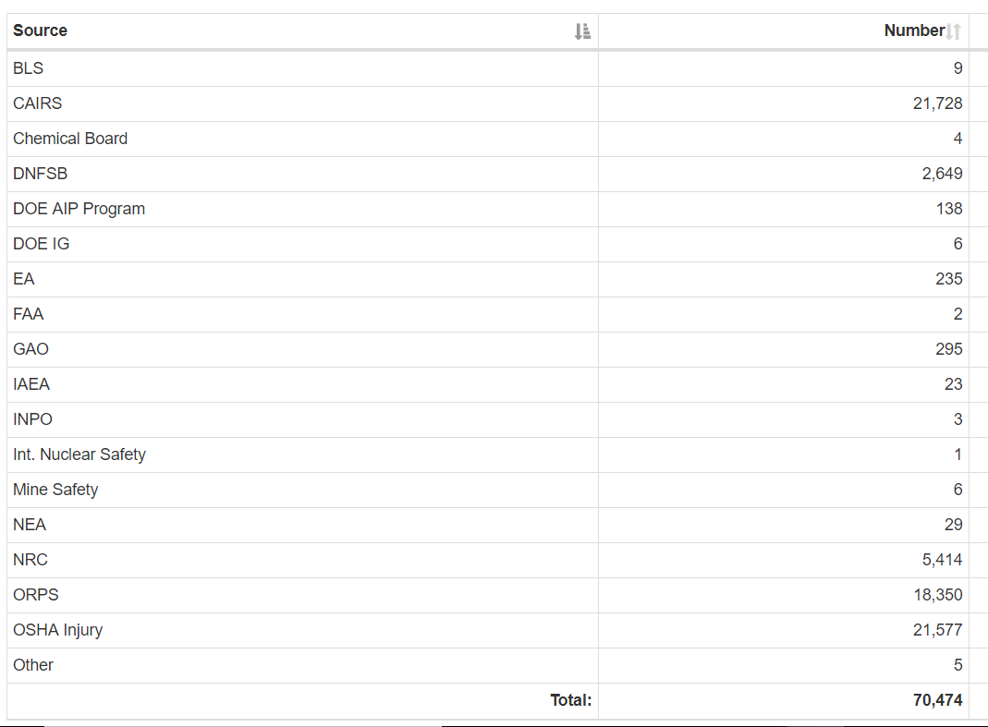

Slide 14
Project Overview
Work Goal/ Project Goal: To use AI packages to parse unstructured text related to undesirable safety outcomes to find precursor information that may be general enough to be actionable for intervention

Slide 15
Project Overview (cont.)
Work Goal/ Project Goal: To achieve the project goal, a publicly available dataset was obtained. OSHA severe injury database reporting. Similar enough to relevant work that the code would be portable. https://www.osha.gov/severeinjury/index.html

Slide 16
Project Overview (cont)
49 Juypter notebooks (measured attempts estimate)
20 newsgroups example
Word2Vec
K-means
NLTK POS Tagger
NLTK Tree
NLTK Frequency Distribution
NLTK Nearest Neighbor
TSNE

Slide 17
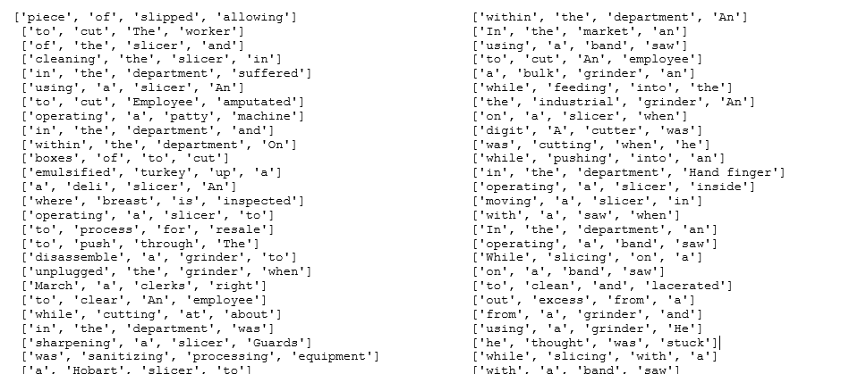
Early Results – nearest neighbor

Slide 18
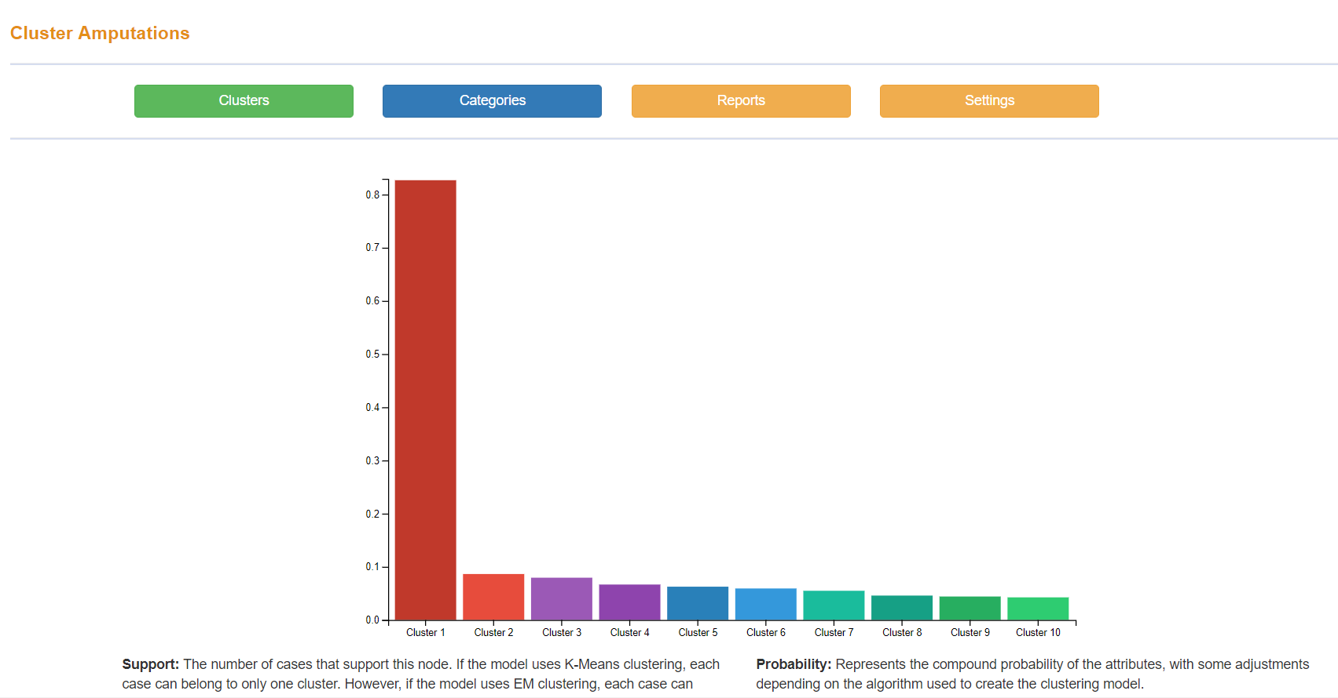
Early Results – K-means with BOW in SQL

Slide 19
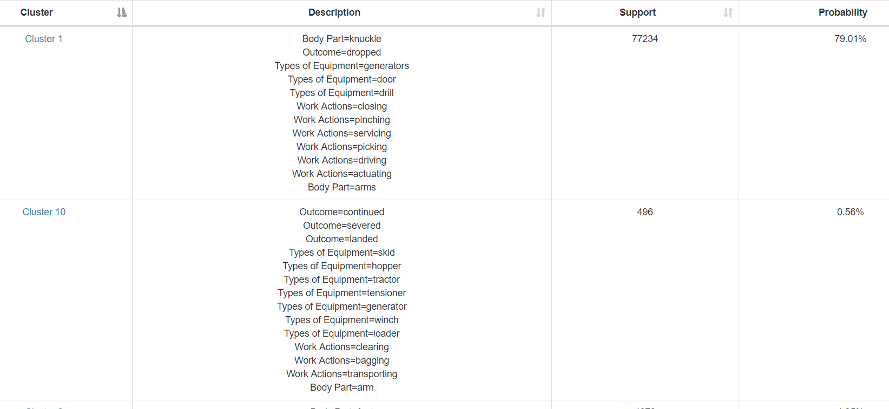
Early Results – K-means with BOW in SQL

Slide 20
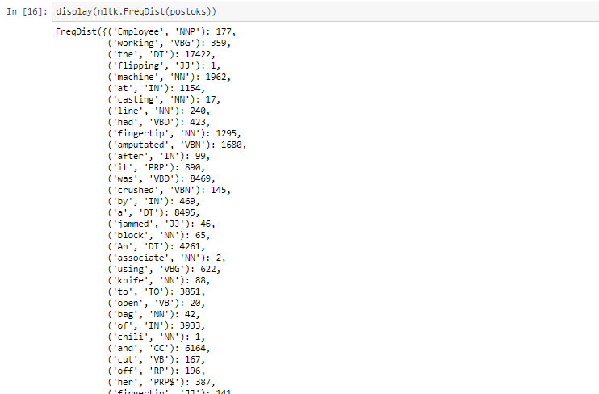
Early Results – NLTK Frequency Distribution

Slide 21
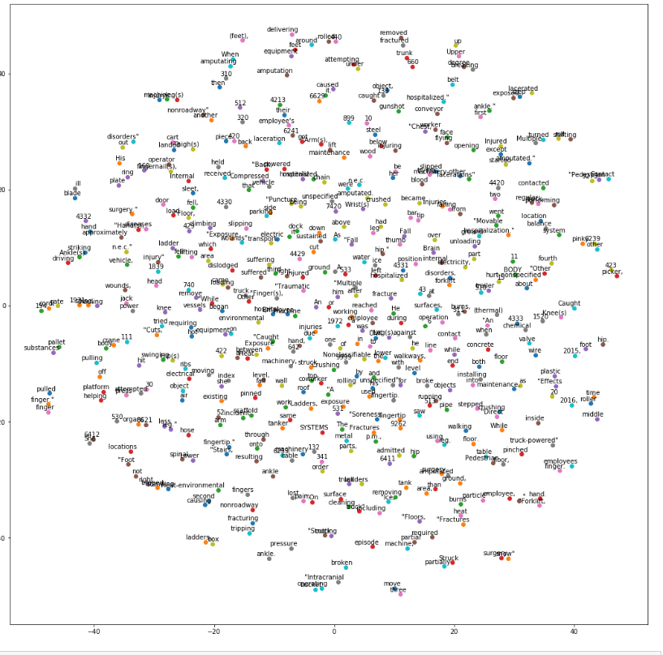
Early Results – Word2Vec with Tensorflow
TSNE perplexity=31
%matplotlib inline
def plot_with_labels(low_dim_embs, labels):
assert low_dim_embs.shape[0] >= len(labels), 'More labels than embeddings'
plt.figure(figsize=(18, 18)) # in inches
for i, label in enumerate(labels):
x, y = low_dim_embs[i, :]
plt.scatter(x, y)
plt.annotate(label,
xy=(x, y),
xytext=(10, 2),
textcoords='offset points',
ha='right',
va='bottom')
try:
# pylint: disable=g-import-not-at-top
from sklearn.manifold import TSNE
import matplotlib.pyplot as plt
tsne = TSNE(perplexity=31, n_components=2, init='pca', n_iter=5000, method='exact')
plot_only = 500
low_dim_embs = tsne.fit_transform(final_embeddings[:plot_only, :])
labels = [reverse_dictionary[i] for i in xrange(plot_only)]
plot_with_labels(low_dim_embs, labels,)

Slide 22
Janaury 26th – April 25th, 2018
Me “This is a unique problem, most of the packages are geared to sales” “We are not trying to predict customer behavior for products”
All Advisors (Antej, Ben Busby, Lena Pons, etc.)
“You need to have categories to your data”
“There are existing packages that should work if your data is defined correctly.”

Slide 23
April 26th, 2018
I was wrong

Slide 24
April 26th (Cont.)
Sales packages and consumer modeling are perfect to find precursor information
Yes, we aren’t “selling” a product. In this case the product is undesirable. But the ability to correlate an activity to a product category is exactly what was needed.

Slide 25
Multi-Class Test Classification with Scikit-Learn
“There are lots of applications of text classification in the commercial world. For example, news stories are typically organized by topics; content or products are often tagged by categories; users can be classified into cohorts based on how they talk about a product or brand online …
However, the vast majority of text classification articles and tutorials on the internet are binary text classification such as email spam filtering (spam vs. ham), sentiment analysis (positive vs. negative). In most cases, our real world problem are much more complicated than that. Therefore, this is what we are going to do today: Classifying Consumer Finance Complaints into 12 pre-defined classes. The data can be downloaded from data.gov.”
https://towardsdatascience.com/multi-class-text-classification-with-scikit-learn-12f1e60e0a9f

Slide 26
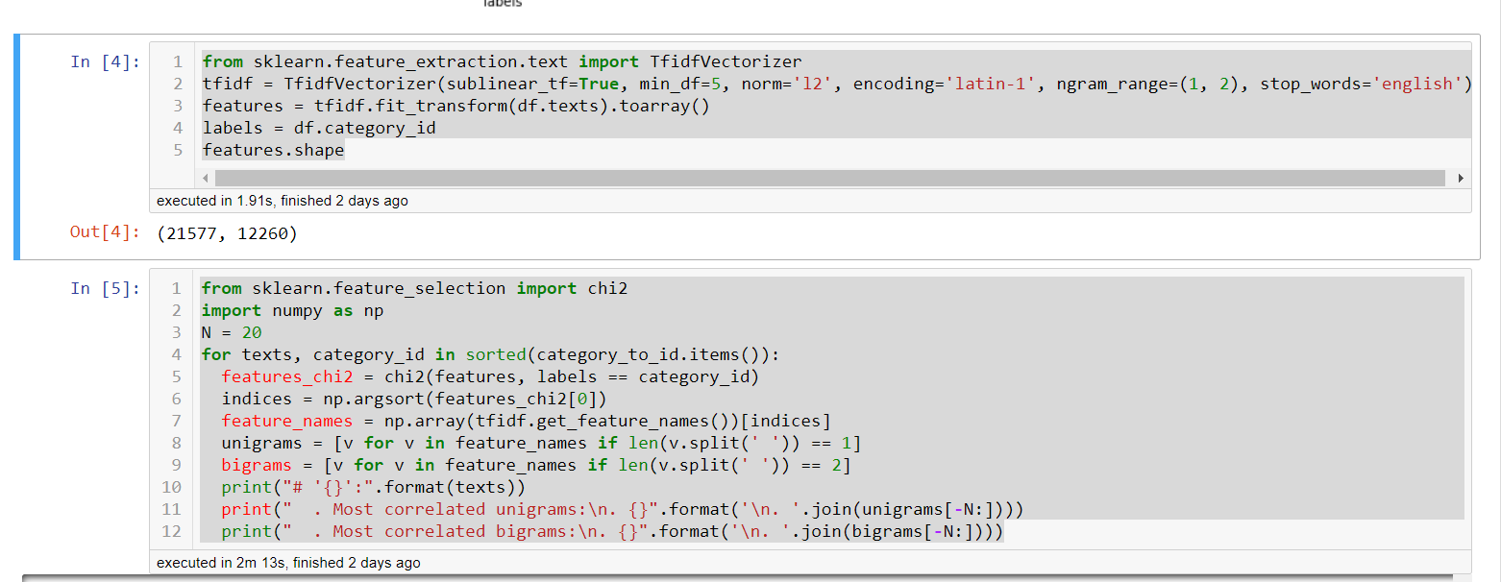
Sample Code Used

Slide 27
Output – (Body systems)
Most correlated unigrams:
. attack
. symptoms
. feeling
. exposure
. respiratory
. monoxide
. feel
. allergic
. reaction
. cramps
. shock
. cramping
. experienced
. ill
. related
. illness
. stress
. exhaustion
. dehydration
. heat
. Most correlated bigrams:
. felt ill
. heat illness
. received electrical
. employee experienced
. possible heat
. severe dehydration
. dehydration heat
. heat stroke
. experienced heat
. began feel
. carbon monoxide
. allergic reaction
. electrical shock
. related illness
. suffered heat
. hospitalized dehydration
. heat related
. heat stress
. heat exhaustion
. hospitalized heat

Slide 28
What’s it mean?
Exploring the distribution of states that reported and total counts

Slide 29
What’s it mean?
While Texas did report the most heat related injuries, the distribution was across all States. Normalizing would be interesting to see percentage of heat related to total state reports.
More interesting: Were most of the heat related injuries in July/August? No, it appears June. With some occurring in August etc.
Assuming it truly is June, June is the start of most labor project work. If I was an OSHA domain expert, I would examine the data and perhaps write an alert or intervention strategy that would remind certain occupational areas that fall into these injuries to review with workers the procedures to prevent heat exhaustion etc.

Slide 30
Takeaways
Listen to others ideas even if you think they don’t understand your problem
All the code has been written
If 10-12 packages aren’t doing the trick it might not be the math, it might be the data.
One can correlate text to undesirable outcomes to find precursors or actionable data for domain experts depending on data quality

Slide 31
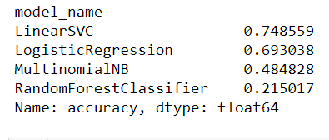
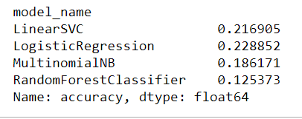
Path Forward
Take the code and run it on DOE data (done)
The text with known categories works well, however the training algorithms for DOE data don’t reach above 23%. (Barry has a job to do.)
Work on predictive models based on precursors and structured data. Perhaps ensemble methods.
OSHA Data Training
DOE Data Training

