Slide 1
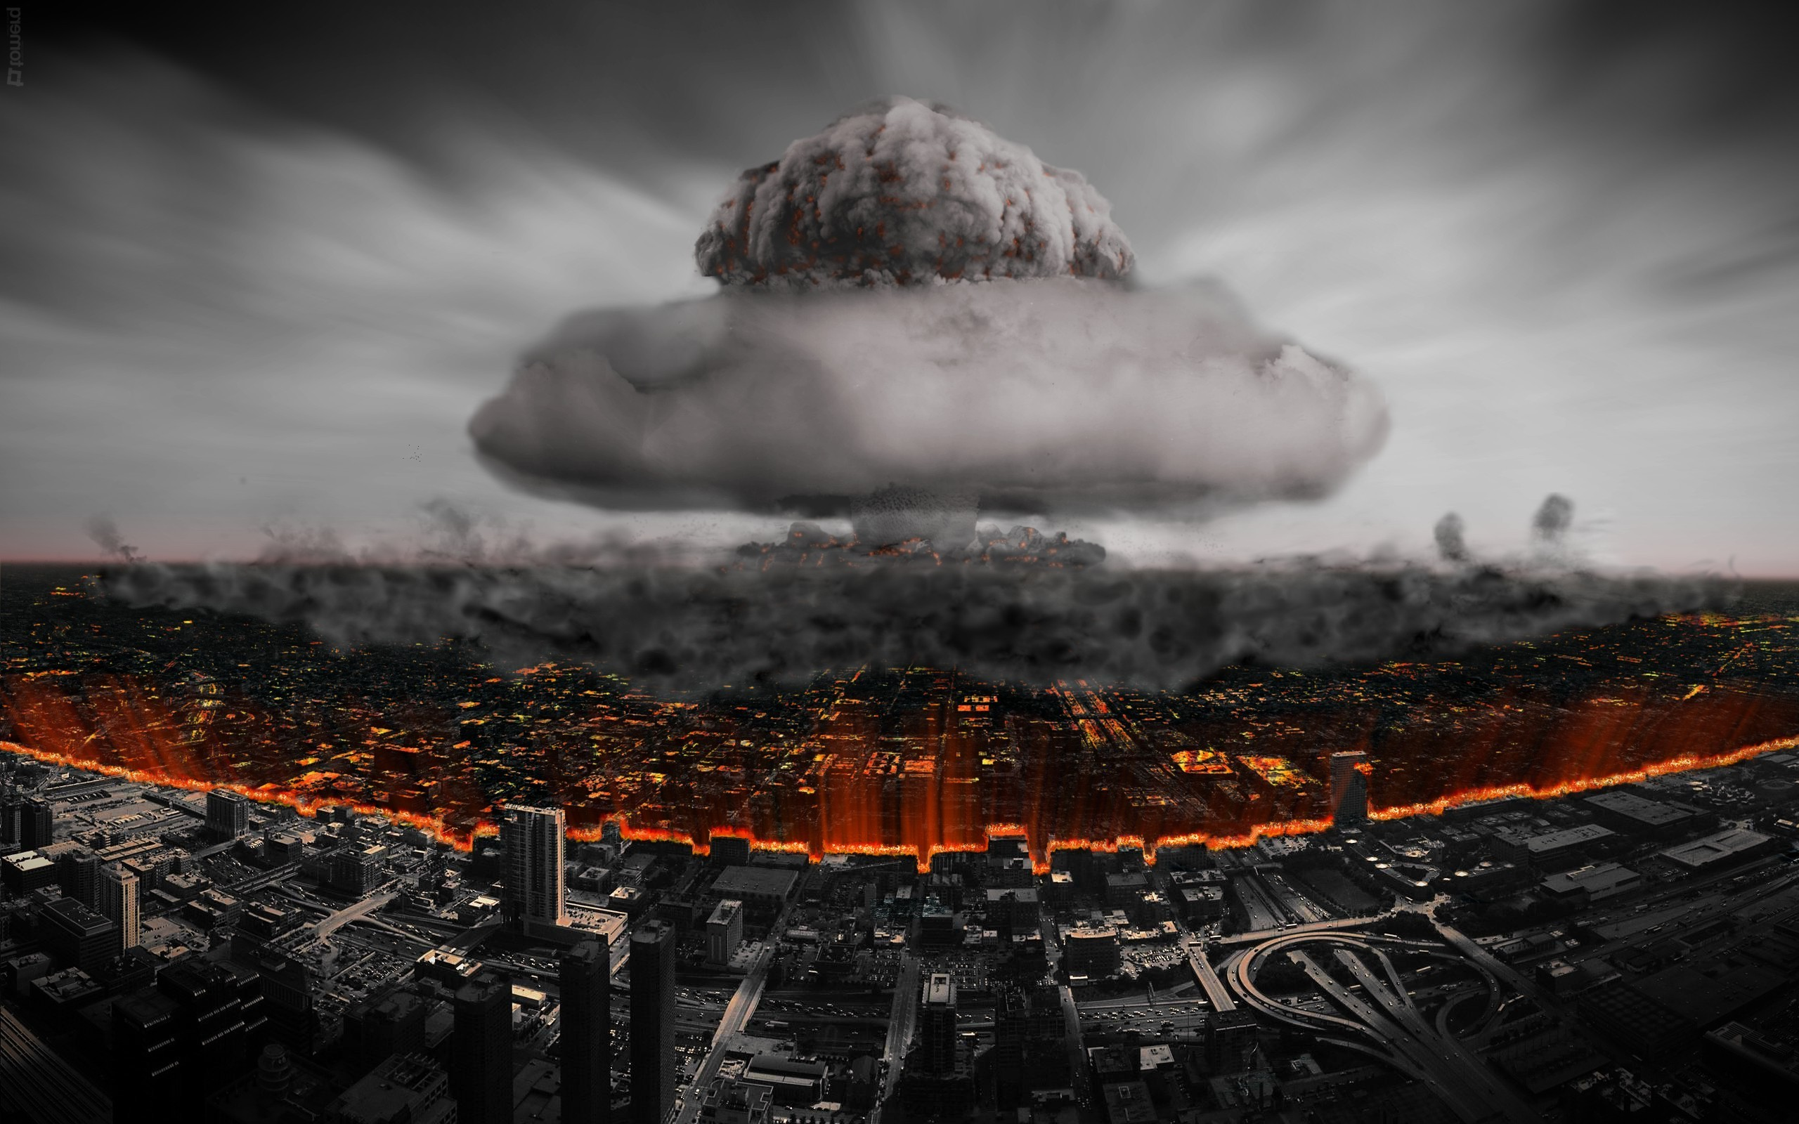
AI, Desktop CUDA & sKYNET

Slide 2
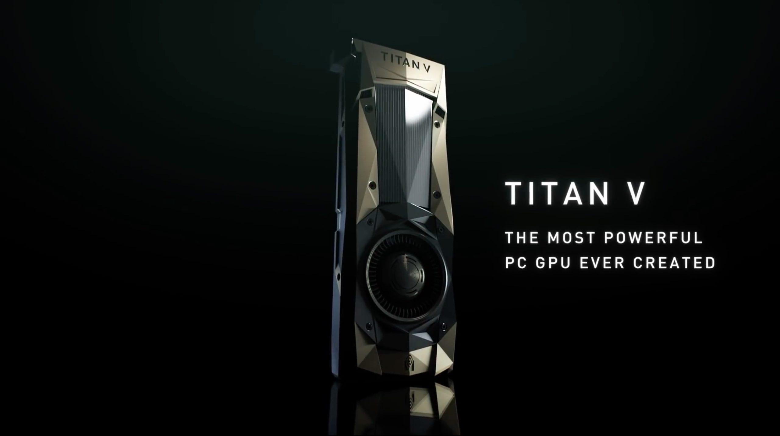
The question at hand
How to conduct desktop AI in an efficient and effective manner for documents
The hardware minimums
Must have an NVIDIA CUDA (Compute Unified Device Architecture) compatible video card
Expensive! $$$$ NVIDIA models GTX1070, GTX1080 or better for $500 to $1000
Titan V is the latest and greatest from NVIDIA: $3000
At least 32 Gb of ram at 2700hz or better
M.2 compatible motherboard with at least a 256 Gb solid state M.2 drive installed (OS)
The software suggestions (That work so far) for building a viable predictive model
Windows 10 PRO with Tensorflow 1.5 or later for easy setup of parallel processing on GPU
Tensoflow 1.6 just came out a few days ago, and I will be taking a look at it for ease of use
Many, many steps to load the CUDA drivers and the cuDNN library for GPU parallel processing
Linux UBUNTU 16.04 LTR with CUDA 375.32 using Tensor flow 1.4
Same as above! (many, many steps to get NVIDIA to play nice!), (Stable, but CUDA’s non-functional)

Slide 3
Progress of mission
The “Dark Side” machine is built (Windows) and running with CUDAs
Desktop Machine with extremely easy access to interior components
Has a NVIDIA GTX1080 GPU
Has 32 Gb of Ram at 2400Hz (slows it down a little with the lower frequency)
Uses a 256 Gb Samsung Pro M.2 Solid State Hard Drive
Tested and works with samples from NVIDIA (Wave interaction and N-Body models)
The “Resistance Machine” is built and is ready for CUDAs
OS is Linux Ubuntu 16.04 LTR (The “Force” is with this one!)
17” laptop
Has an NVIDIA GTX1070 GPU
Has 32 Gb of ram at 3000Hz (Super fast!)
Uses a 512 Gb M.2 Samsung Pro Solid State Hard Drive

Slide 4
Next Steps
Finish software install of “Resistance” laptop for CUDAs and cuDNN
Experiment with the NVIDIA drivers and Libraries to find optimal versions that work together well with Ubuntu (since all are open source)
Create a corpus from documents using Python 3.6, Anaconda and Jupyter notebook
Build models using tensor generated from outer vector products of word vector tokens adjusting the step size between iterations toward a “best” fit model to find the optimal set of theta’s for a training model against a training set of documents previously classified
Run the model against a test set of documents also previously classified, and iterate the process to make a working model to develop a predictive tool for safety
End of Semester, but then….
Build the “Conan-the-Barbarian” computer with a NVIDIA Titan V and begin shredding documents this summer….

