Slide 1
Pairing Phenology Data with Invasive Species Data
Deena Bleich
BIOF475 Spring 2018

Slide 2
What is Phenology?
Phenology is the study of cyclic and seasonal natural events in the life of plants and animals.
Sources of Phenology data:
Citizen science
Government and non-profit organizations
Historic data – old diaries, field notes

Slide 3
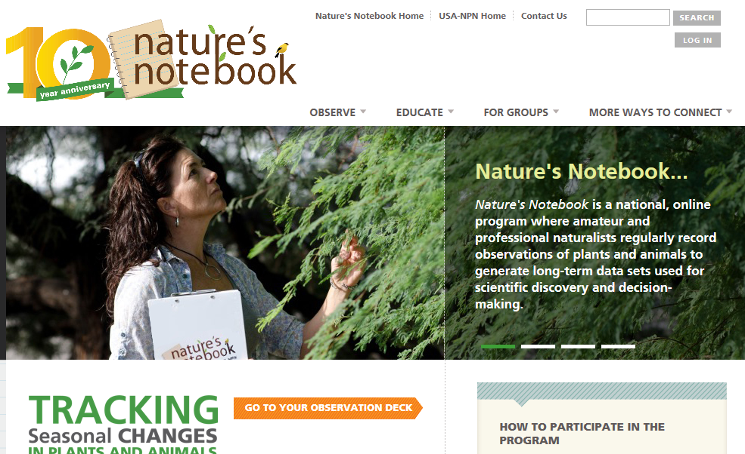
Source of Phenology data for this project: USA National Phenology Network (NPN) Nature’s Notebook – Citizen Science

Slide 4
Project Data Source
https://www.usanpn.org/data/observational
“You are invited to use the Phenology Observation Portal to download customized datasets of observational data from the National Phenology Database, which includes phenology data collected via the Nature's Notebook phenology program (2009-present for the United States), and additional integrated datasets, such as historical lilac and honeysuckle data (1955-present). Filters are available to specify dates, regions, species and phenophases of interest.”

Slide 5
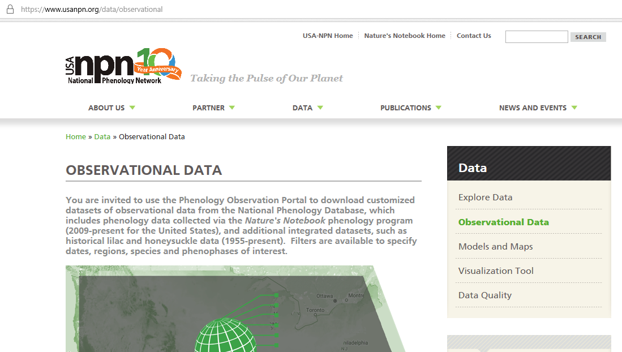

Slide 6
Produces lots of data observations! Types of observation data:
Location data – ex. latitude/longitude; state
Data and Time
Person making the observation
Plant or animal species
Phenophase – “An observable stage or phase in the annual life cycle of a plant or animal that can be defined by a start and end point. Phenophases generally have a duration of a few days or weeks. Examples include the period over which newly emerging leaves are visible, or the period over which open flowers are present on a plant.” – USA National Phenology Network

Slide 7
Uses of Phenology
Climate science – changes of important plant of animal annual events. Ex. First blooming of a plant.
Information regarding seasonal activities – when to plant, when to spray for pests

Slide 8
Project Question
Can we use the phenology data collected to answer a different question – that is, break out of functional rigidity?
Can we see the relationship between host species and their destructive invasive species using this data?

Slide 9
Ash Trees and the Emerald Ash Borer
“Emerald ash borer (EAB), Agrilus planipennis Fairmaire, is an exotic beetle that was discovered in southeastern Michigan near Detroit in the summer of 2002. The adult beetles nibble on ash foliage but cause little damage. The larvae (the immature stage) feed on the inner bark of ash trees, disrupting the tree's ability to transport water and nutrients. Emerald ash borer probably arrived in the United States on solid wood packing material carried in cargo ships or airplanes originating in its native Asia. As of February 2018, it is now found in 32 states, and the Canadian provinces of Ontario, Quebec, and Manitoba.”
Source: http://emeraldashborer.info/

Slide 10
Retrieving the Data
Use the Observational portal download tool to select data.
Data is in a csv file.
Ingest it into python, using pandas.
# create a DataFrame from the ash .csv
df_tree = pd.read_csv('C:/Users/Deena/Documents/BIOF475/ProjectData/ash_data.csv')
df_tree = df_tree[df_tree.State != '-9999'] #Remove records with unknown states

Slide 11
Draw a simple Scatter Diagram
#Very simple Scatter Diagram
plt.figure(figsize=(12,8))
plt.scatter(df_tree.State, df_tree.Common_Name)
plt.title('States where Ash Trees were observed')
plt.xlabel('States')
plt.ylabel('Species')
plt.show()

Slide 12
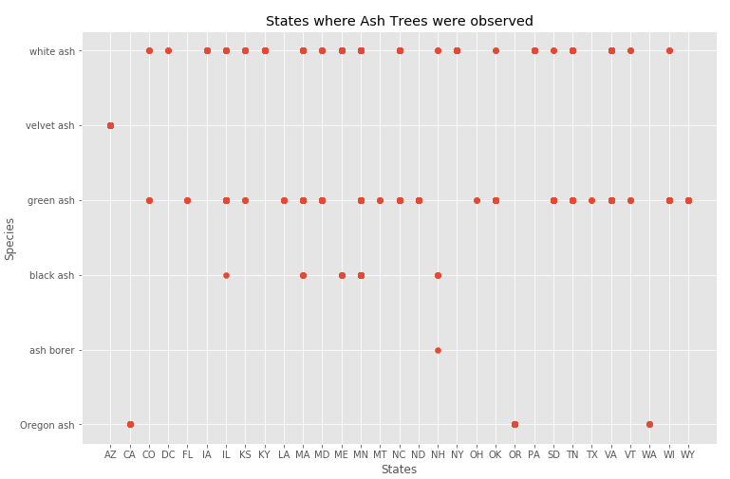
States where Ash Trees were observed (Phenology data)
There is not enough invasive species data.

Slide 13
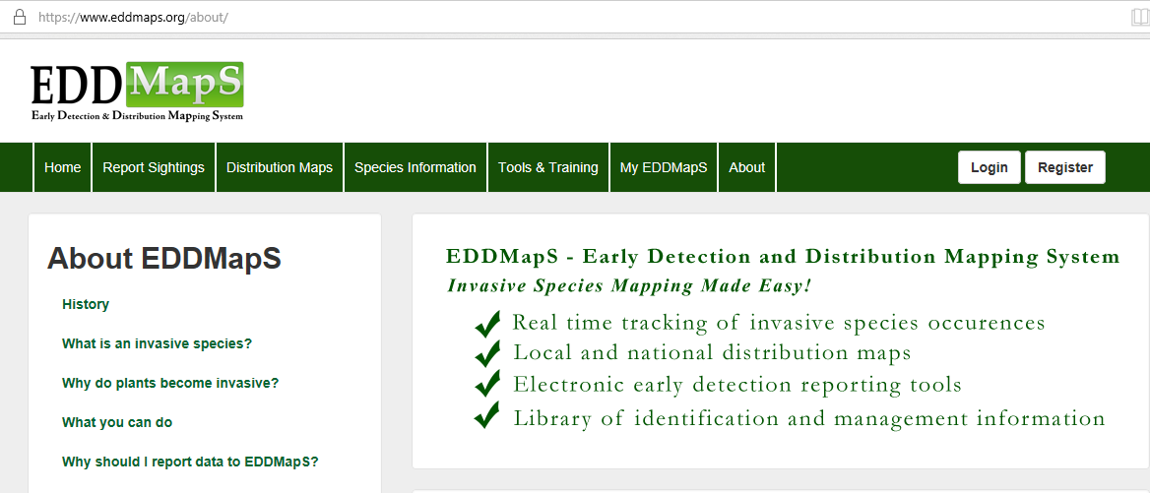
The relationship cannot be observed solely from the phenology data
It is easier to observe phases of trees than of bugs.
However, using other datasets, we can see the relationship! Invasive species data

Slide 14
Formatting/Analyzing the invasive species data
Retrieved from EDDMapS. 2018. Early Detection & Distribution Mapping System. The University of Georgia - Center for Invasive Species and Ecosystem Health. Available online at http://www.eddmaps.org/
Needed to be matched with Lat/Long by county - https://www.gaslampmedia.com/download-zip-code-latitude-longitude-city-state-county-csv/
And with State abbreviations - https://scottontechnology.com/list-of-50-us-states-in-excel/

Slide 15
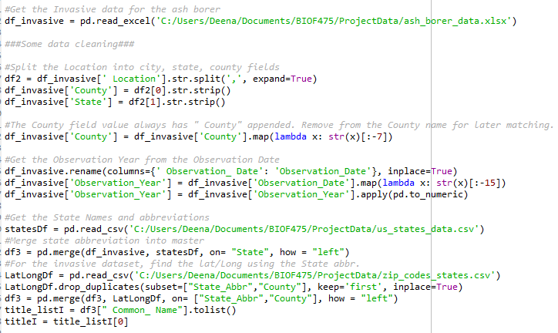
Finding and cleaning data was a challenge

Slide 16
Visualizing the data
Used Basemap
Reference: http://geodesygina.com/matplotlib.html
Installing basemap was a challenge –
Found help on Stack Overflow website
Use Anaconda Prompt
conda install -c conda-forge basemap-data-hires=1.0.8.dev0

Slide 17
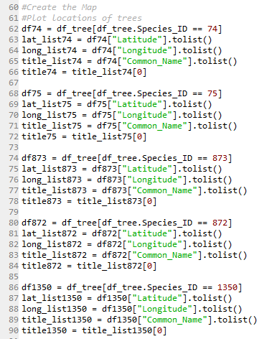
Get the plot points for each Ash tree species (from phenology database)
These points will be on each map.

Slide 18
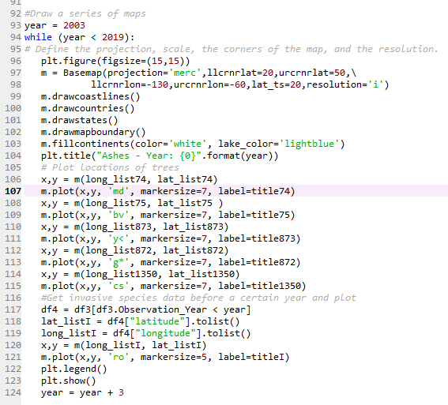
Draw the map at three year intervals
Loop begin
Plot the trees
Plot the emerald ash borers
Loop end

Slide 19
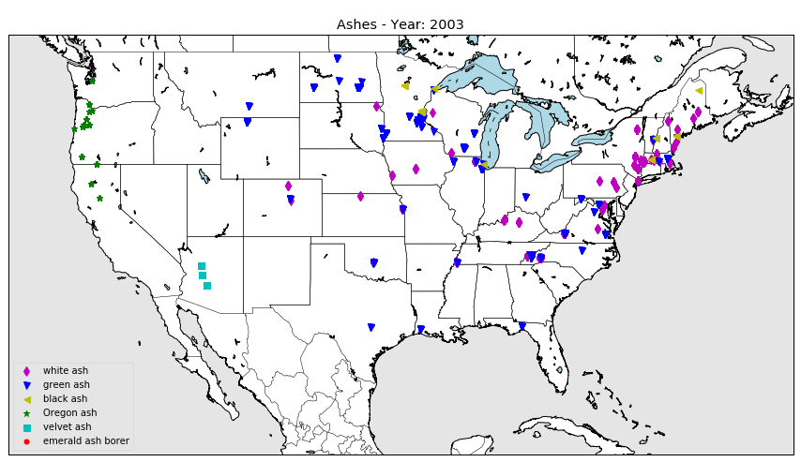
Ashes (Phenology data) distribution

Slide 20
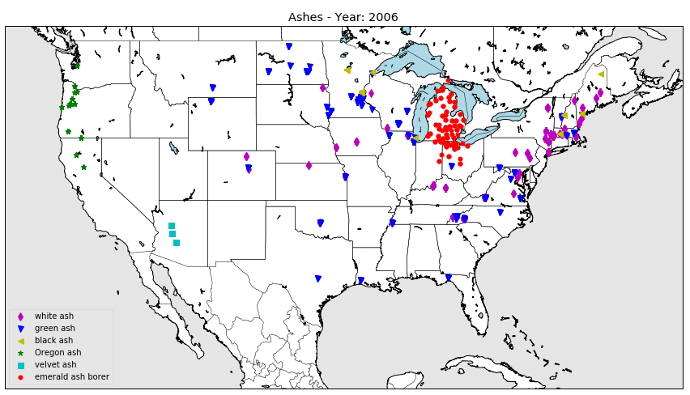
Ashes and Emerald Ash Borer -2006

Slide 21
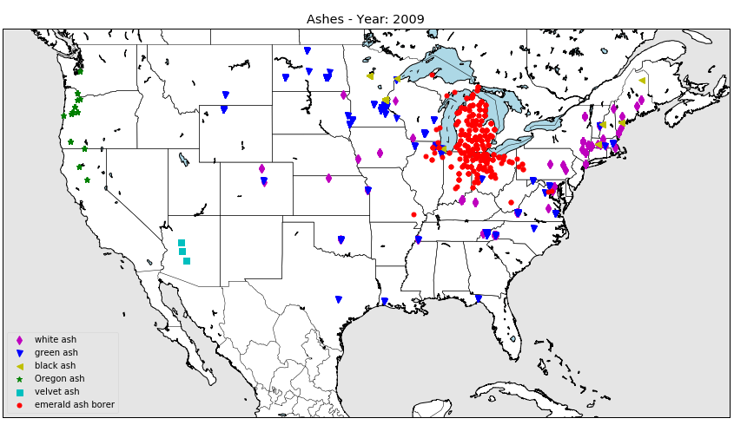
Ashes and Emerald Ash Borer -2009

Slide 22
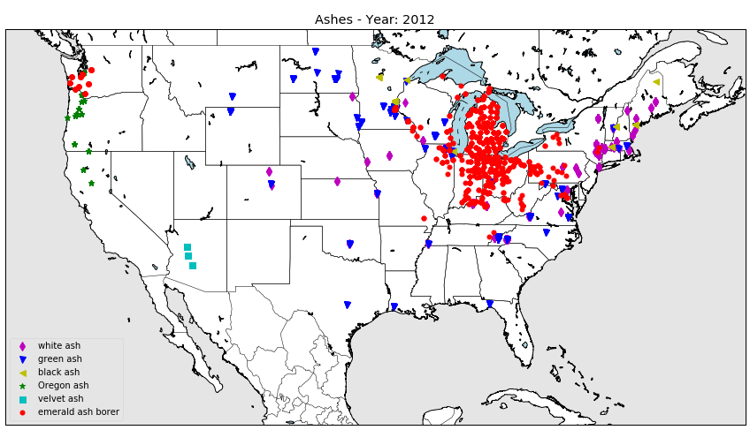
Ashes and Emerald Ash Borer -2012

Slide 23
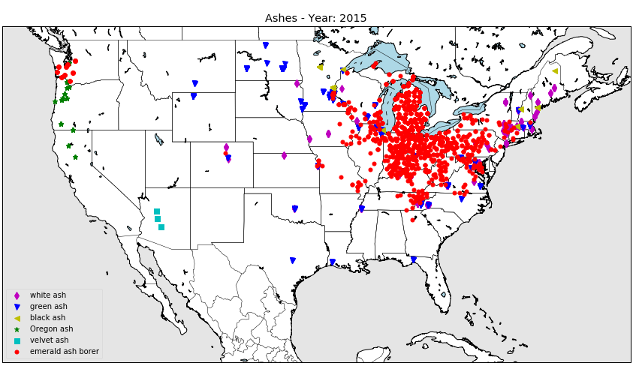
Ashes and Emerald Ash Borer -2015

Slide 24
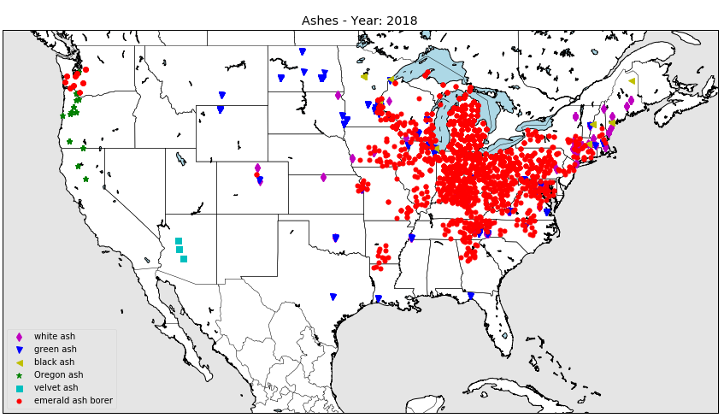
Ashes and Emerald Ash Borer -2018

Slide 25
Repeated the process with Hemlocks
Hemlock woolly adelgid was inadvertently introduced to North America from Japan. It was first noticed in the eastern United States near Richmond, Virginia, in 1951. (https://en.wikipedia.org/wiki/Hemlock_woolly_adelgid)
However, the invasive species data that I have retrieved from the EDD site starts in 2004.

Slide 26
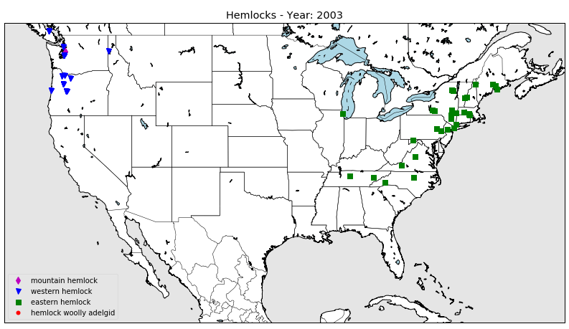
Hemlocks (Phenology data) distribution

Slide 27
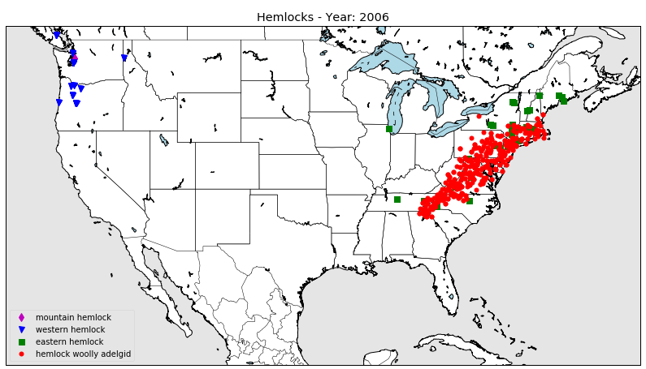
Hemlock and Hemlock Woolly Adelgid -2006

Slide 28
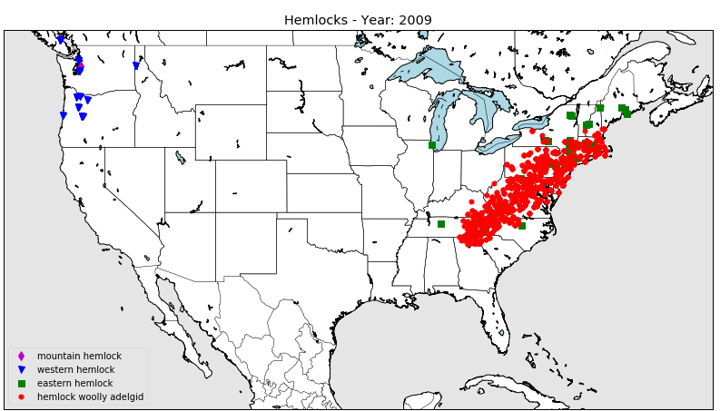
Hemlock and Hemlock Woolly Adelgid -2009

Slide 29
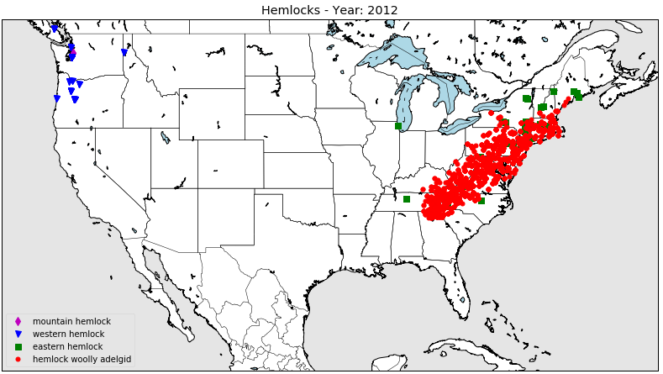
Hemlock and Hemlock Woolly Adelgid -2012

Slide 30
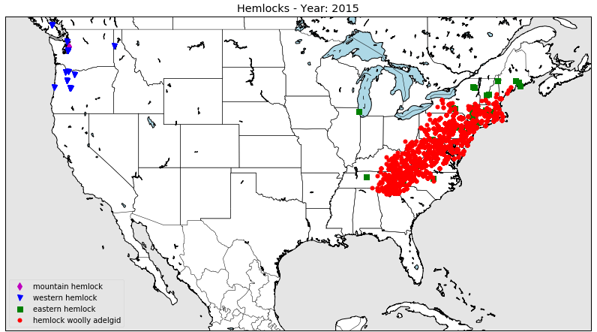
Hemlock and Hemlock Woolly Adelgid -2015

Slide 31
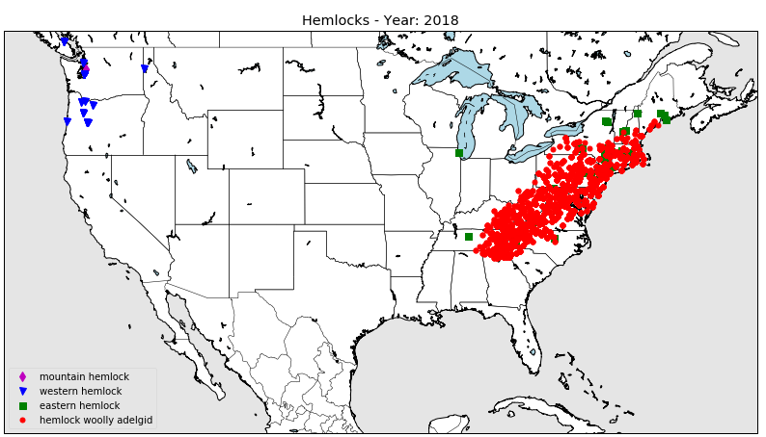
Hemlock and Hemlock Woolly Adelgid -2018

