Slide 1
Predicting IMDB Star Ratings
Michael Green

Slide 2
Topics
Description of the Problem
Data Source
Features In Data Source Used In Model
Synthesized Features
Top 5 Positive and Negative Correlation Features
Linear Equation with Coefficients
Final Test Score
Residual Plot, Distribution of Error, QQ Plot
Future Work
Appendix

Slide 3
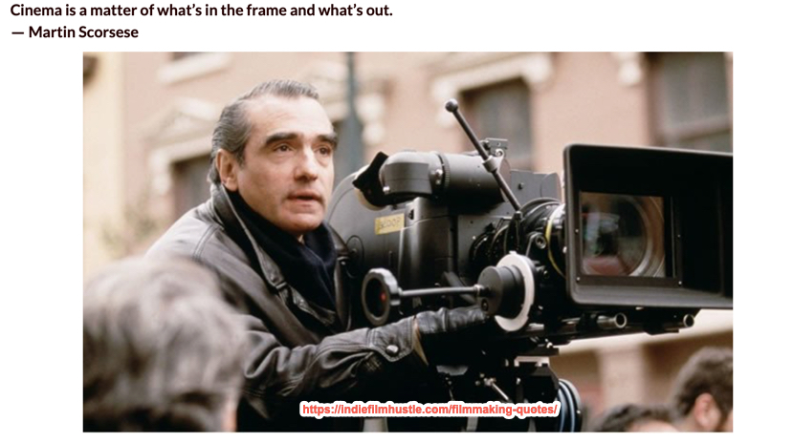
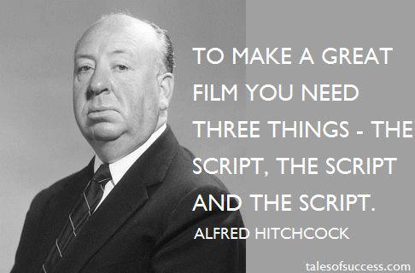
Description of the Problem
There are many ideas of how to make a good movie:

Slide 4
Description of the Problem
The problem is that these are not easily quantifiable.
Many content creation companies (like Netflix) want be able to make movie making/buy decisions faster and with greater efficacy and over a larger volume of movie proposals.
This project develops a model that uses as inputs features of movies that can be well known on or before its release date to predict if the movie will be well liked by viewers.

Slide 5
Description of the Problem
This model could then assist executives by doing a quick first pass scoring of large volumes of movie proposals.
This would enable movie executives to then focus valuable deep analysis time on already quantitatively promising movies.

Slide 6
Data Source
The starting data set are 4000 movies released in the US with an MPAA rating between January 1, 2010 and December 31, 2019.
This original data set was then cleaned to 2127 movies that had all required data fields defined.
The data was scraped from imdb.com using Python requests and BeautifulSoup.

Slide 7
Features In Data Source Used In Model
The following features were used in the model:
Runtime: length of the movie in minutes
Budget: Amount of money it took to make the movie (in US $)
Release month of the movie: One-hot encoded (12 categories)
Genre of the movie: One-hot encoded (17 categories)
MPAA Rating of the Movie: (4 categories)
One-hot encoded value of the month the movie was released (12 categories encoded
One-hot encoded value of the genre of the movie (17 categories encoded)
Director Star Power: 1 point for each Best Director Award for earned or nominated by the director of said movie
Cast 1 Star Power: 1 point for each Best Actor or Best Actress Award earned or nominated by the 1st cast member listed for the movie
Cast 2 Star Power: 1 point for each Best Actor or Best Actress Award earned or nominated by the 2nd cast member listed for the movie
Cast 3 Star Power: 1 point for each Best Actor or Best Actress Award earned or nominated by the 3rd cast member listed for the movie
Log(Budget): Logarithm of the Budget

Slide 8
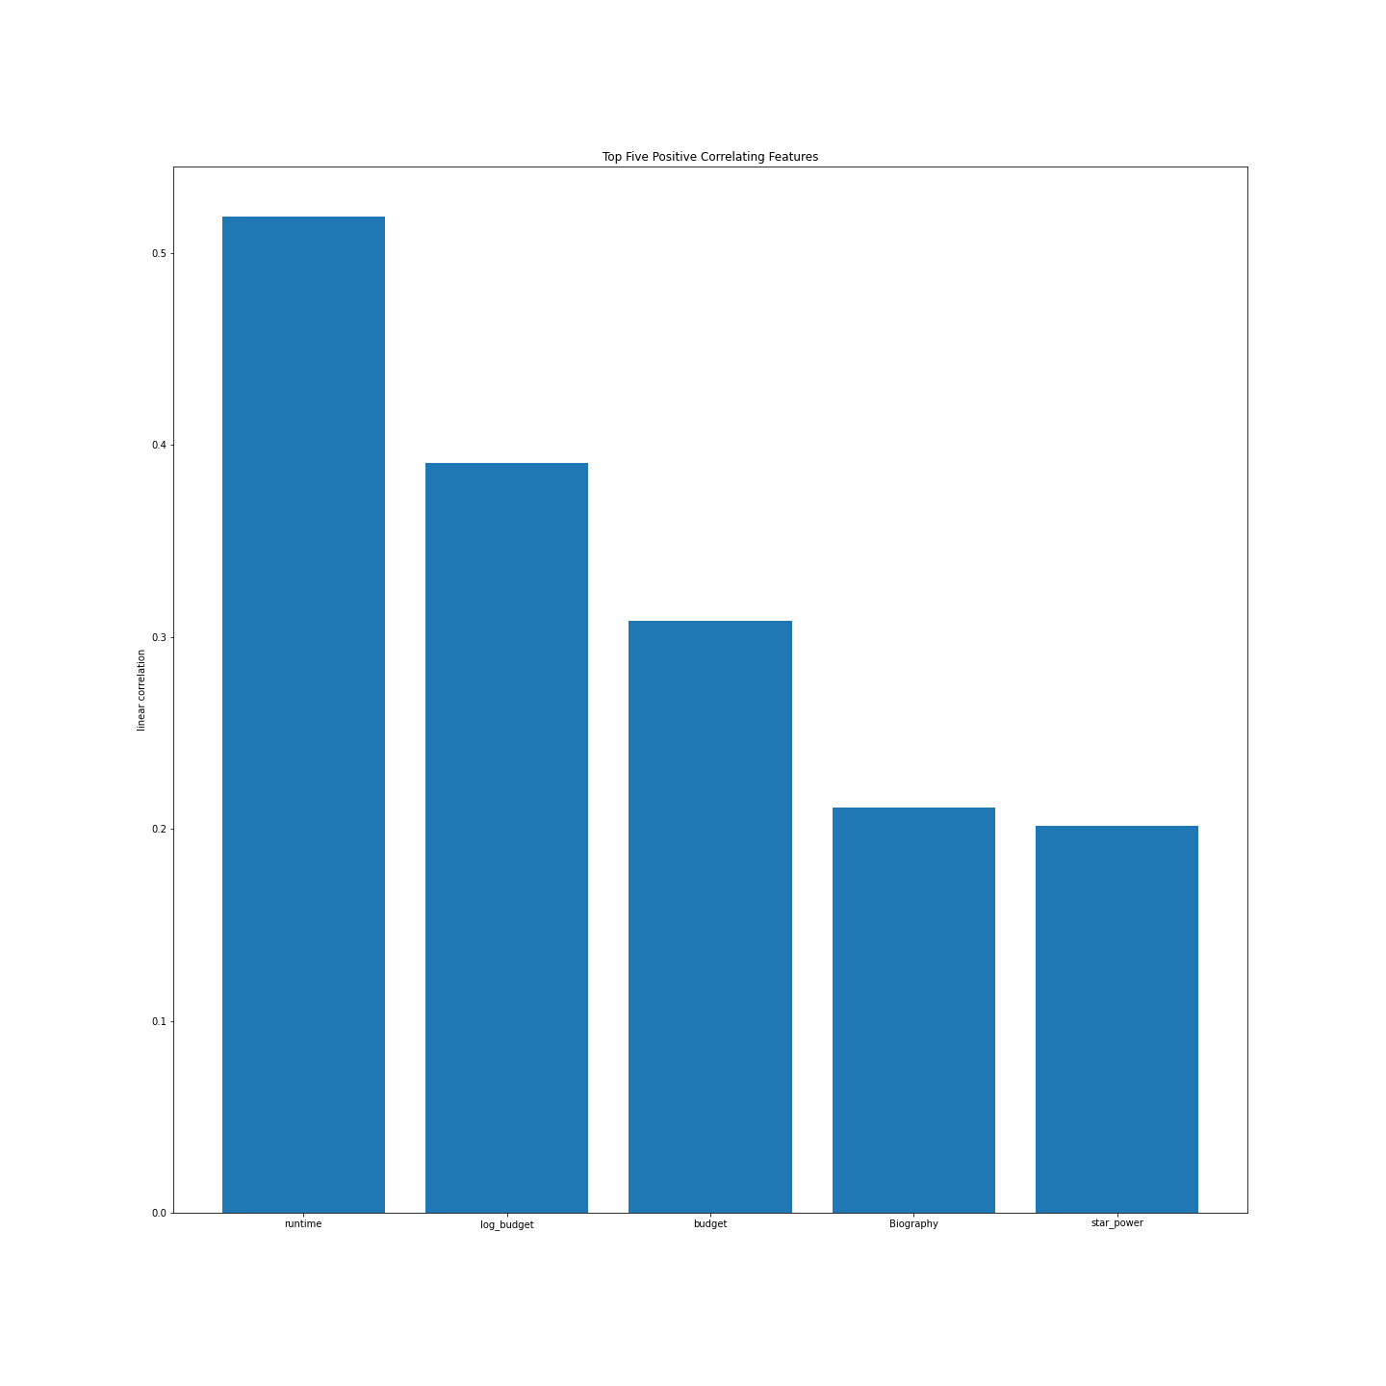
Top 5 Positive and Negative Correlation Features

Slide 9
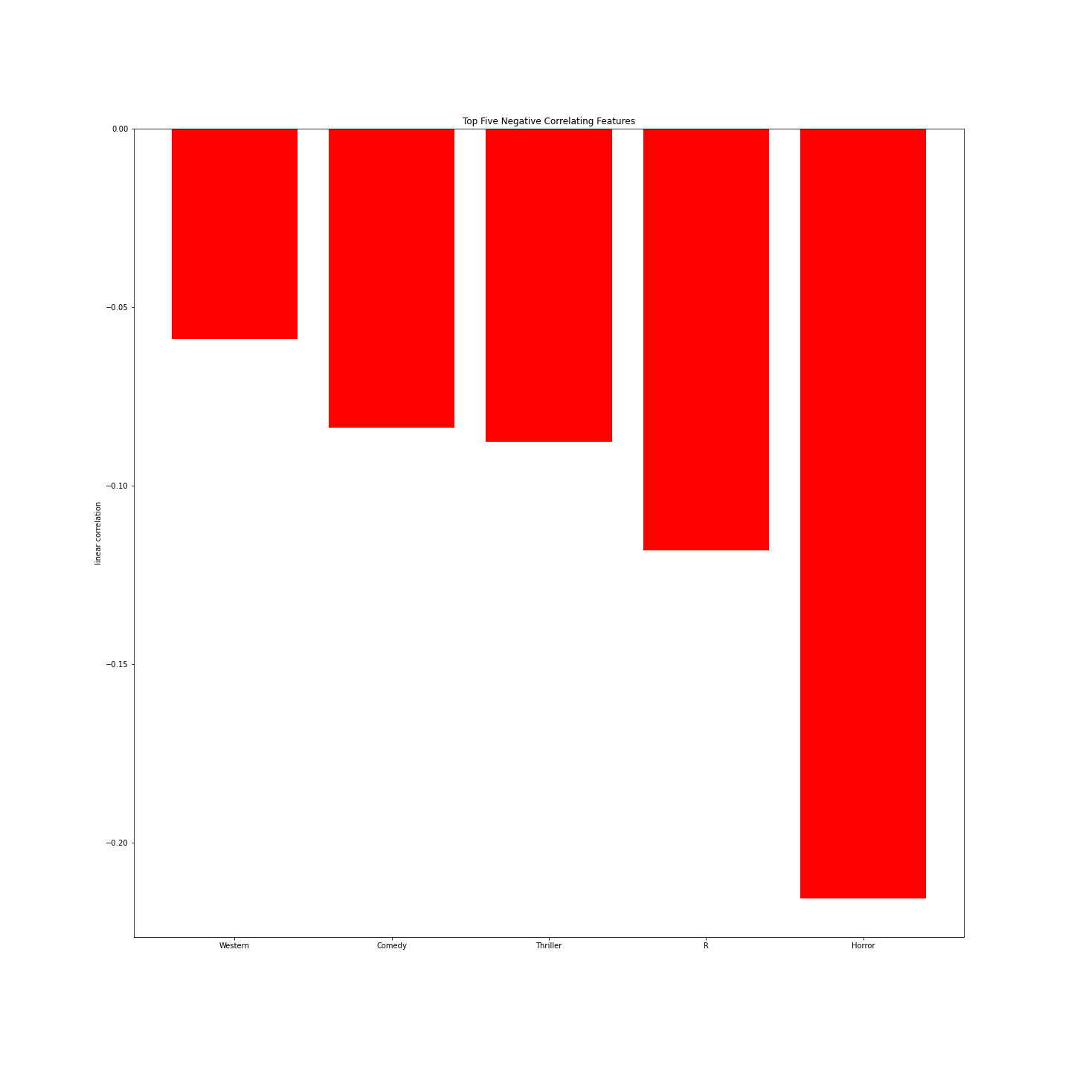
Top 5 Positive and Negative Correlation Features

Slide 10
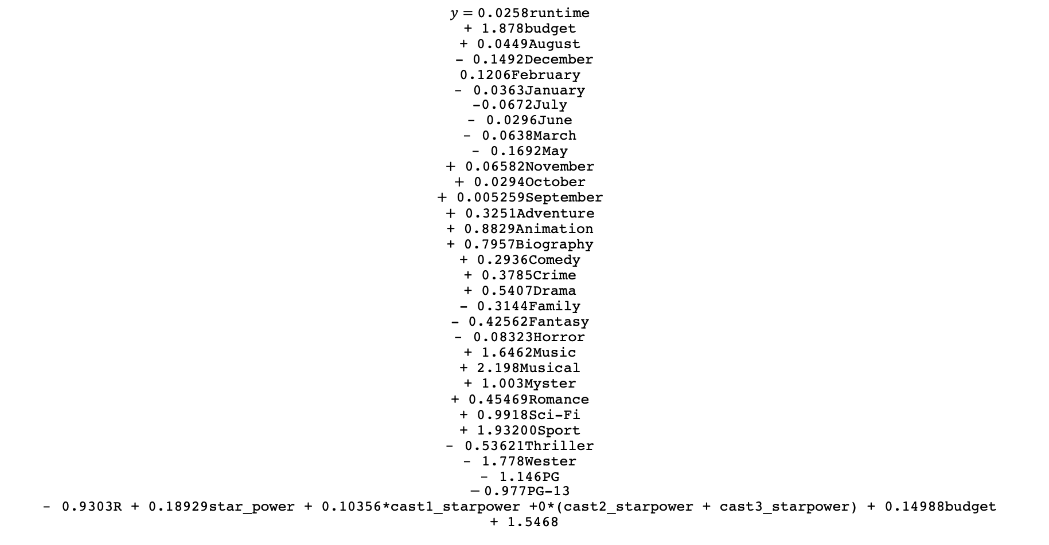
Linear Equation with Coefficients
$$y=\text{0.0258}\text{runtime}$$
$$\text{+ 1.878}\text{budget}$$
$$\text{+ 0.0449}\text{August}$$
$$\text{ - 0.1492}\text{December}$$
$$\text{0.1206}\text{February}$$
$$–\text{ 0.0363}\text{January}$$
$$\text{-0.0672}\text{July}$$
$$–\text{ 0.0296}\text{June}$$
$$–\text{ 0.0638}\text{March}$$
$$–\text{ 0.1692}\text{May}$$
$$+\text{ 0.06582}\text{November}$$
$$+\text{ 0.0294}\text{October}$$
$$+\text{ 0.005259}\text{September}$$
$$+\text{ 0.3251}\text{Adventure}$$
$$\text{+ 0.8829}\text{Animation}$$
$$\text{+ 0.7957}\text{Biography}$$
$$\text{+ 0.2936}\text{Comedy}$$
$$\text{+ 0.3785}\text{Crime}$$
$$\text{+ 0.5407}\text{Drama}$$
$$\text{- 0.3144}\text{Family}$$
$$\text{- 0.42562}\text{Fantasy}$$
$$–\text{ 0.08323}\text{Horror}$$
$$\text{+ 1.6462}\text{Music}$$
$$\text{+ 2.198}\text{Musical}$$
$$\text{+ 1.003}\text{Myster}$$
$$\text{+ 0.45469}\text{Romance}$$
$$\text{+ 0.9918}\text{Sci}\text{-}\text{Fi}$$
$$\text{+ 1.93200}\text{Sport}$$
$$–\text{ 0.53621}\text{Thriller}$$
$$–\text{ 1.778}\text{Wester}$$
$$–\text{ 1.146}\text{PG}$$
$$− \text{0.977}\text{PG}\text{-13 }$$
$$–\text{ 0.9303}\text{R}\text{ + 0.18929}\text{star}\text{_}\text{power}\text{ + 0.10356*}\text{cast}\text{1_}\text{starpower}\text{ +0*(}\text{cast}\text{2_}\text{starpower}\text{ + }\text{cast}\text{3_}\text{starpower}\text{) + 0.14988}\text{budget}$$
$$\text{+ 1.5468}$$

Slide 11
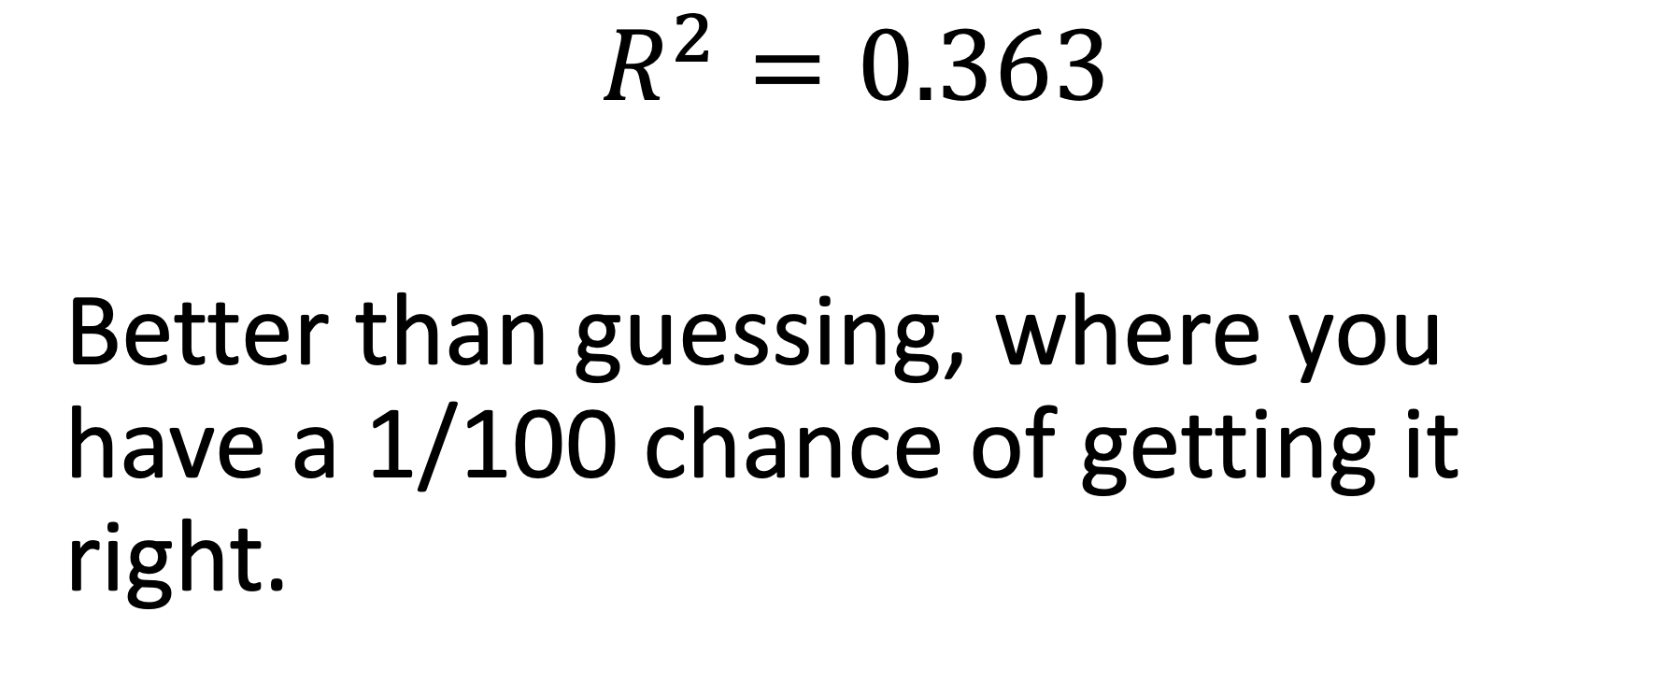
Final Test Score
$$R^{2}=0.363$$
Better than guessing, where you have a 1/100 chance of getting it right.

Slide 12
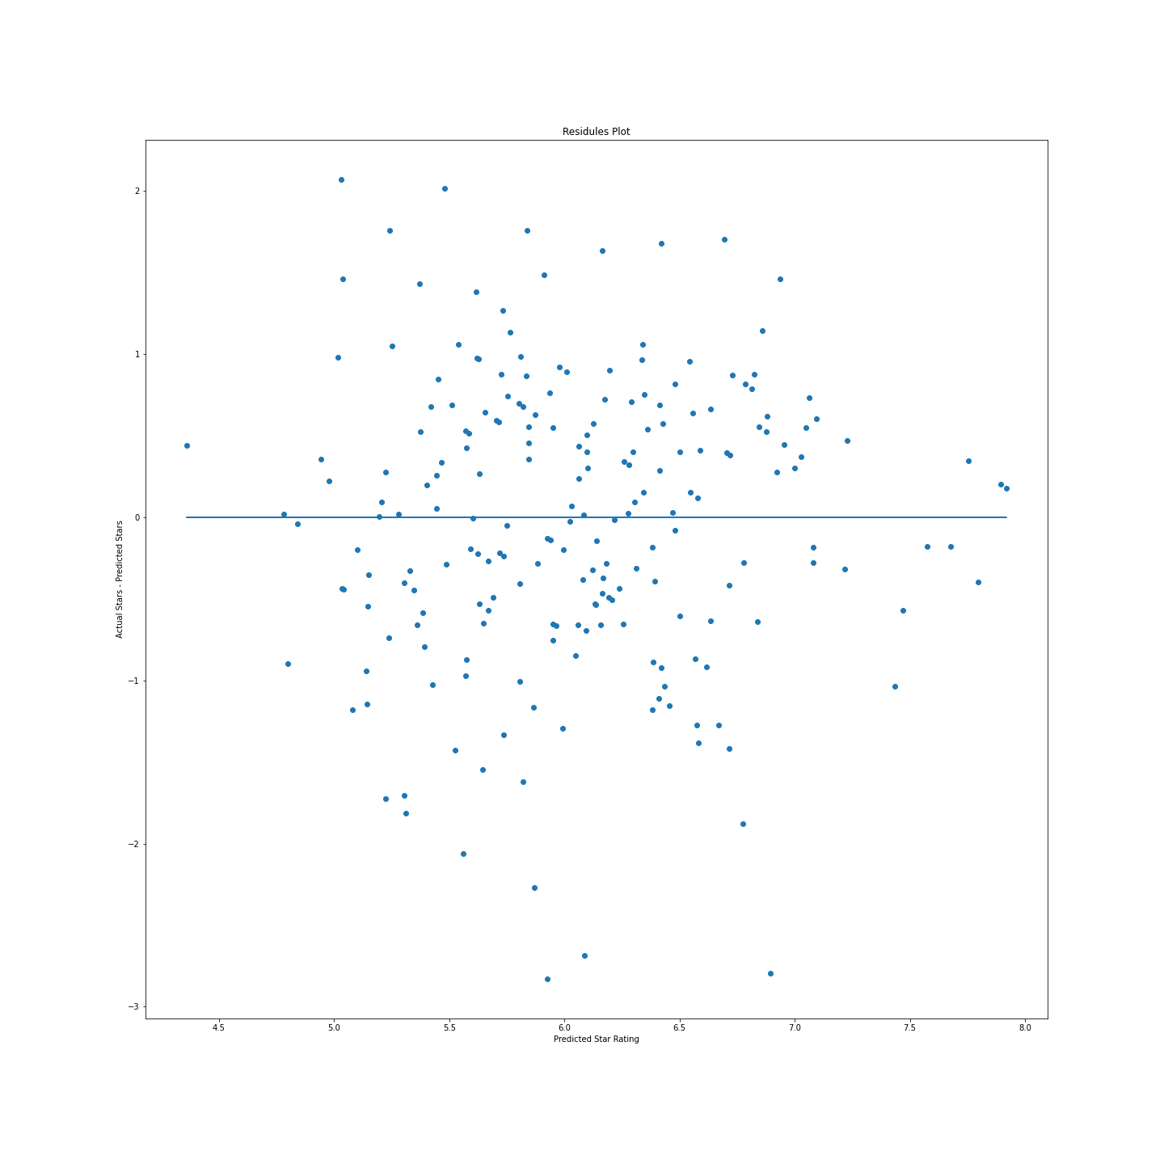
Residual Plot
Mean of the Error = -0.02

Slide 13
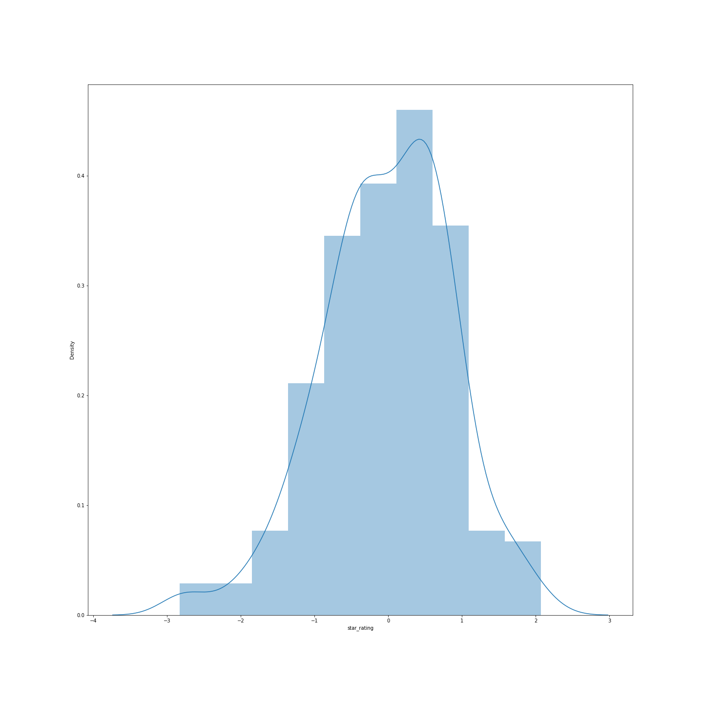
Distribution of Error

Slide 14
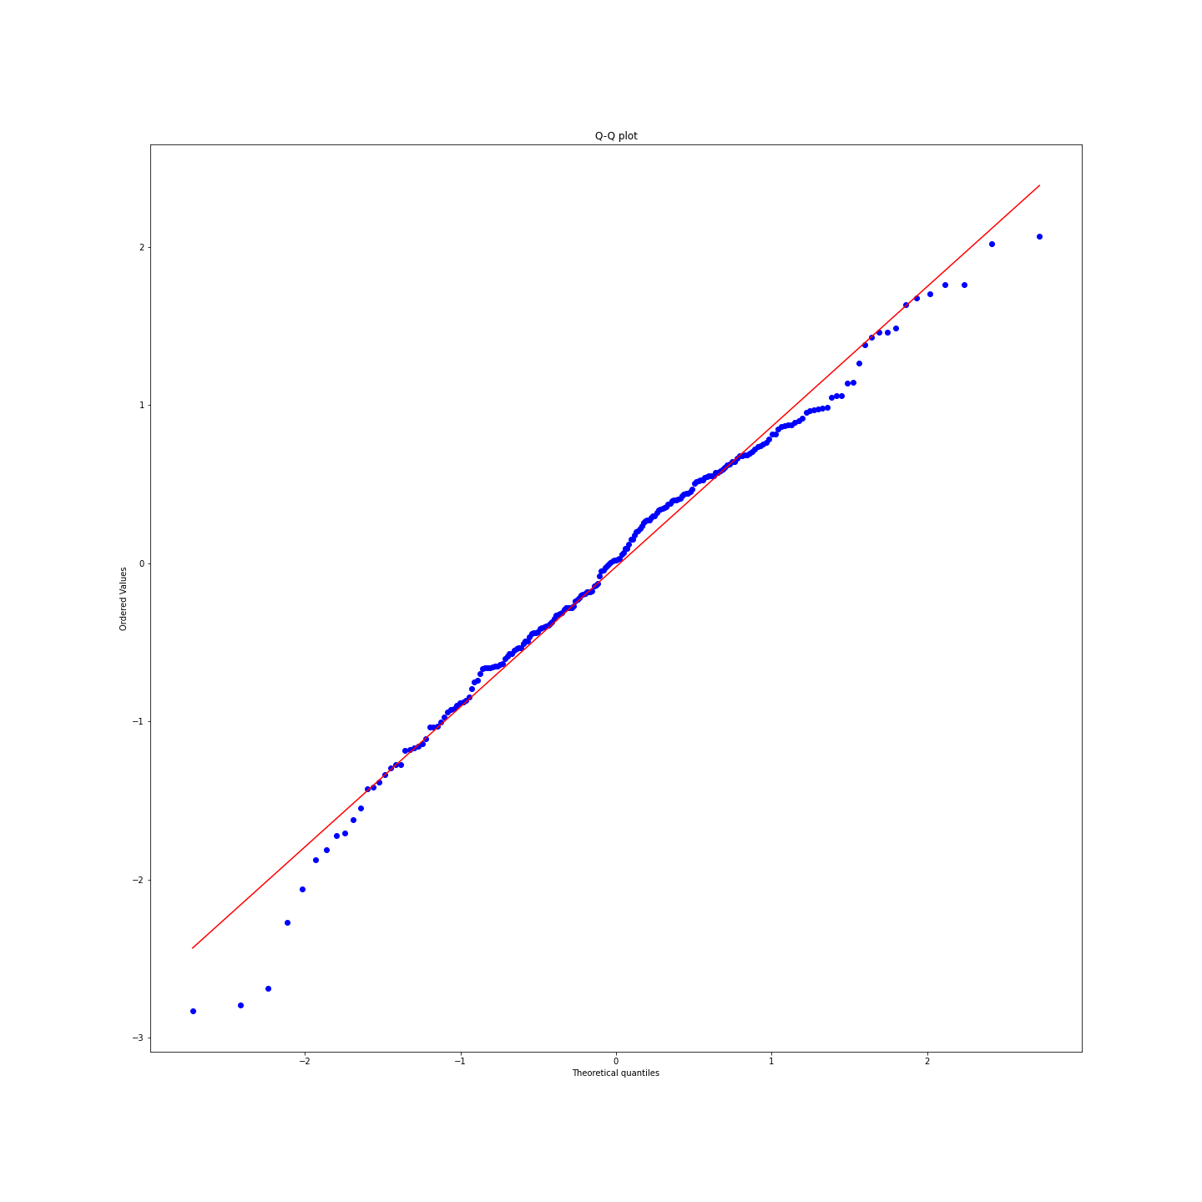
QQ Plot

Slide 15
Future Work
Scrape more data. There are over 50,000 movies that have been released over the last 10 years.
Collect more data on the cast and crew: How many producers on the movie have been awarded Best Picture, how many writers have been awarded for Best Adapted Screen Play.
Dynamic Duos, Trios, Quartets, Etc.: Anecdotally there are a lot of movies where you see the same (director, cast) combinations. Quantify the level of influence the existence of these tuples have on the star rating of the movie.

Slide 16
Appendix

