Slide 1









DEPARTMENT OF COMPUTER SCIENCE AND ENGINEERING & III CELL
Problem Statement ID –SKB-P4
Problem Statement Title –Stochastic Multi Modal Fusion for "Cloud Proof" dMRV and Methane Aware Carbon Governance
Theme -Climate Tech & Sustainable Environment (AI, Remote Sensing, IoT, Data Science)
PS Category – PS-4
Team ID – SKB-28
Team Name = Team Idea factory

Slide 2

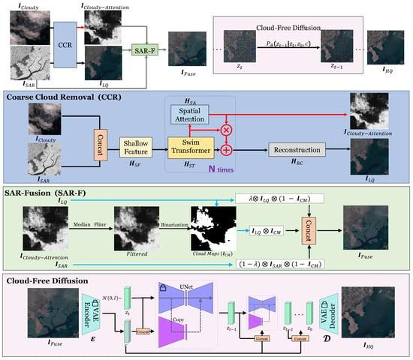
TEAM
IDEA FACTORY
solution to the problem statement
Solution to the Problem Statement
Combine satellite, sensor, and weather data
Use multi-modal data fusion for better accuracy
Apply stochastic modeling to handle missing data (clouds)
Enable cloud-proof monitoring using radar (SAR)
Detect methane emissions in real-time
Provide prediction and alerts for quick action

Slide 3
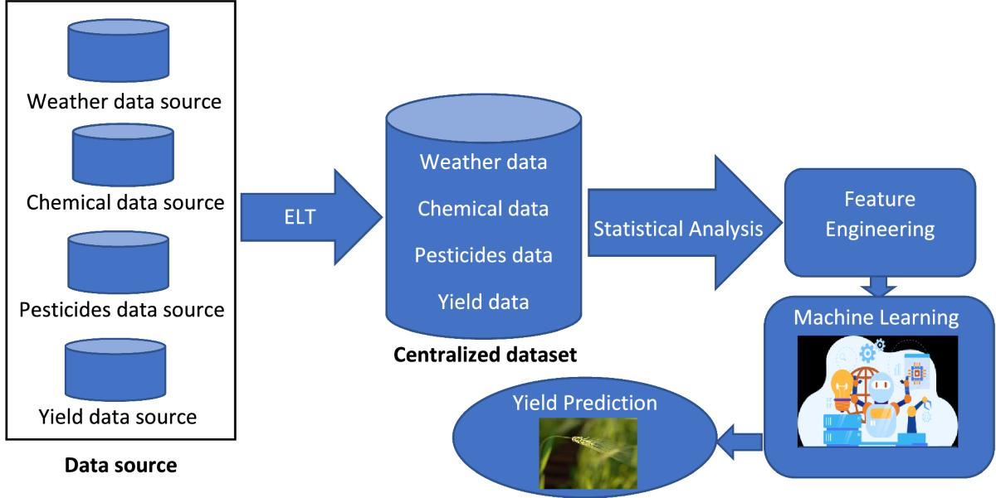
TEAM
IDEA FACTORY
architechture / workflow
Solution Architecture & Logical Flow Data Collection: Satellite (Optical + SAR), IoT Sensors, Weather Data
Data Processing: Cleaning and normalization of data
Multi-Modal Fusion: Combine all data into a single system
Stochastic Modeling: Handle missing data (cloud interference)
Detection & Prediction: Identify methane emissions and forecast trends
Output: Dashboards, alerts, and decision support

Slide 4
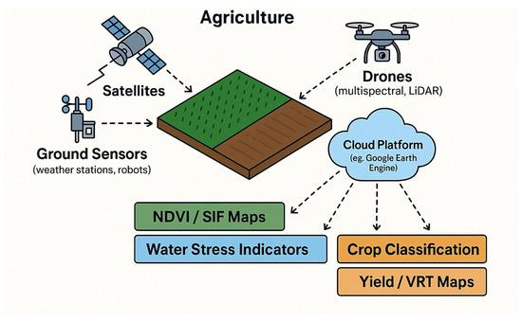
TEAM
IDEA FACTORY
Feasibility & Scalability
Feasibility
Built using existing technologies (AI, IoT, satellite data)
Easy to develop as a working prototype
Uses available datasets and low-cost sensors
Can run on basic systems or cloud platforms
Scalability
Can expand from small model → city → national level
Supports large-scale, real-time monitoring
Can integrate more sensors and data sources
Applicable to agriculture, industries, and smart cities

Slide 5
TEAM
IDEA FACTORY
tech stack
Tech Stack
Data Sources: Satellite (Optical + SAR), Weather Data
Software: Python, OpenCV, Pandas, Scikit-learn
Hardware: Arduino/ESP32, MQ-4 Gas Sensor, DHT11
Platform: Streamlit Dashboard / Cloud
Core Tech: Multi-Modal Fusion, Stochastic Modeling, AI/ML

Slide 6
Thank You

