Slide 1

LESSON 6: Cloud Deployment

Slide 2
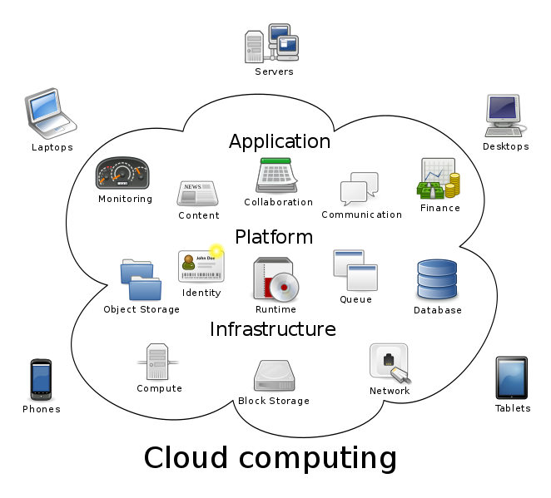
Cloud computing relies on sharing of resources to achieve coherence and economies of scale, similar to a public utility
Ubiquitous access to shared pools of configurable system resources and higher-level services.
Three standard models are Infrastructure as a Service (IaaS), Platform as a Service (PaaS), and Software as a Service (SaaS)

Slide 3

AWS
In 2003, the AWS concept was publicly reformulated when Chris Pinkham and Benjamin Black presented a paper describing a vision for Amazon's retail computing infrastructure.
In 2004, AWS launched is first service

Slide 4
Compute: allowing you to develop, deploy, run, and scale your applications and workloads
EC2 | Virtual machine on the Cloud where is possible to install and run applications
EC2 Container Service | Cluster Docker container running on EC2
Elastic Beanstalk | GUI to provision all the resources needed from your application
Lambda | Serverless function that allow to execute code without taking care of the HW

Slide 5
Storage: holding the information used both by application both by archival
S3 | Object storage
Glacier | Decouple an abstraction from its implementation allowing the two to vary independently.
EFS | Network file system (NFSv4.1)
Storage Gateway | Gateway to connect company data center to AWS cloud

Slide 6
Databases: broad range of fully managed services purpose-built for your specific application use cases
RDS | Relational database (OLTP, online transaction processing)
DynamoDb | No-SQL database
Redshift | Data warehouse (OLAP, online analytic processing)
Elasticache | Cache query results

Slide 7
Messaging: implement event sourcing to create scalable, distributed systems
SNS | Push notification message
SES | Send and receive e-mail
SQS | Queue system to decoupling application

Slide 8
Artificial Intelligence: solving cognitive problems commonly associated with human intelligence, such as learning, problem solving, and pattern recognition
Lex | Understand statements
Polly | Turn text to voice
Machine Learning | Dataset and outcome and AWS provide forecasts
Rekognition | Understand what is in a picture (e.g face recognition)

Slide 9
Let’s Start to Play
Store notes in AWS

Slide 10
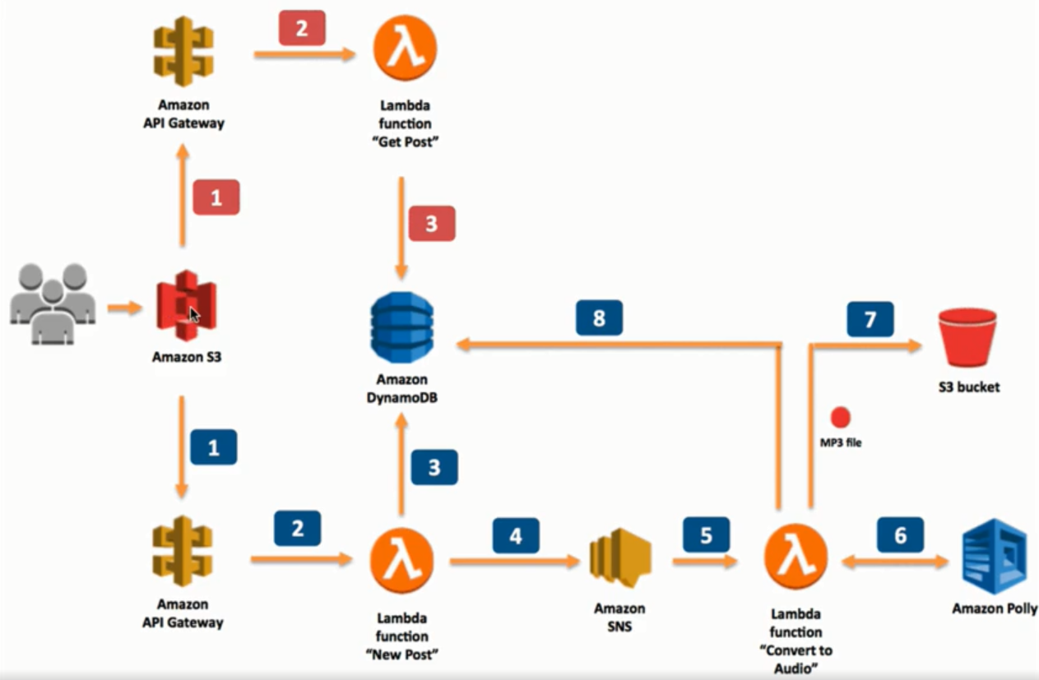
Exercise from aCloudGuru “Using Polly to help you pass the exam”

Slide 11

Thank you very much for your time
If you have any questions about this document please don’t hesitate to contact me at:
fin.antonio@gmail.com

