Slide 1

Exercise 5: Kanban Web App

Slide 2
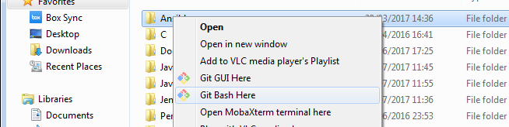
Precondition
Download GIT
e.g https://git-scm.com/downloads
Create a folder where to install the course exercise
e.g. C:\Users\afin\code\
Open a shell where it’s possible to run GIT command and move to the created folder
e.g. In Window, using Git Bash in the created folder
Donwload the exercise code cloning the git repository
git clone https://github.com/antfin/ComputerProgrammingBasic.git
Download NodeJS
e.g. https://nodejs.org/it/download/
Steps needed to run the exercise

Slide 3
App.js
App.js
Configure the logger
Configure the HTTP REST request body parser
Configure the Viewer to render HTML page
Configure All the HTML pages (Widgets)
Configure the routing of static resources (images, javascript library...)
Configure Error Handling
Entry point and configuration of the Web App

Slide 4
Home Widget
home/
interface.js: configure the routing of the HTML page
view.hbs: template of the HTML page
Home HTML page

Slide 5
Setting Widget
settings/
interface.js: configure the routing of the HTML page, of the REST APIs and of the client side script
view.hbs: template of the HTML page
controller.js: server side functions
model.json, task.json, color.json, group.json: data
settings/client/settings.js: client side javascript
Settings HTML page

Slide 6
Kanban Widget
kanban/
interface.js: configure the routing of the HTML page, of the REST APIs and of the client side script
view.hbs: template of the HTML page
controller.js: server side functions
model.json, task.json, color.json, group.json: data
kanban/client/kanban.js: client side javascript
Kanban HTML page

