Slide 1

LESSON 5: Client/Server Model REST Architecture

Slide 2

How programs cooperate in an Web application?
Distributed application structure partitions tasks between servers and clients: the providers of a resource or service and service requesters

Slide 3

Roy Fielding
Born 1965, he is an American computer scientist, one of the principal authors of the HTTP specification and the originator of the Representational State Transfer (REST), a key architectural principle of the World Wide Web

Slide 4
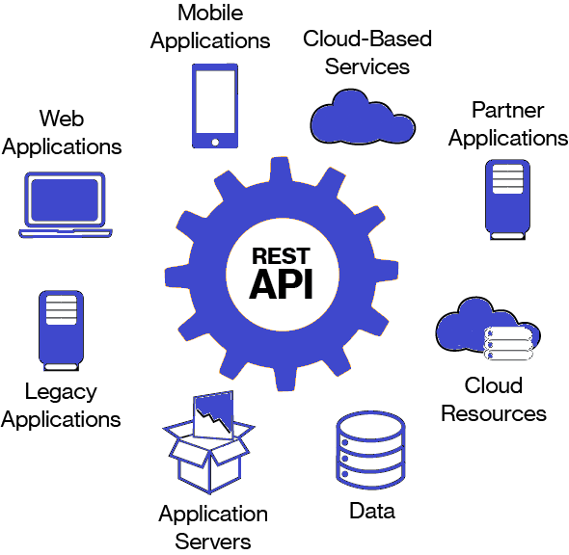
REST provides interoperability between computer systems on the Internet
REST-compliant Web services allow requesting systems to access and manipulate Web resources using a uniform and predefined set of stateless operations (e.g. CRUD HTTP methods GET, POST, PUT, DELETE..)

Slide 5
Client-server architecture: separating the user interface concerns from the data storage concerns improves the portability of the user interface across multiple platforms
Clients and servers exchange messages in a request–response messaging pattern:
the client sends a request, and the
server returns a response
This exchange of messages is an example of inter-process communication.
The client only has to understand the response based on the well-known application protocol. The application layer protocol defines the basic patterns of the dialogue. To formalize the data exchange even further, the server may implement an application programming interface (API)

Slide 6
Statelessness: client requests contain all the necessary information
No client context being stored on the server between requests and session state is held in the client.
Server design is simple because there is no need to deal with conversations in progress: if a client session dies in mid-transaction, no part of the system needs to be responsible for cleaning up the present state of the server.
A disadvantage of statelessness is that it may be necessary to include additional information in every request, and this extra information will need to be interpreted by the server.

Slide 7
Cacheability: clients and intermediaries can cache responses
A web cache is an information technology for the temporary storage of web resources to reduce server lag.
Well-managed caching partially or completely eliminates some client–server interactions, further improving scalability and performance.
Responses must define themselves as cacheable or not to prevent clients from reusing stale or inappropriate data in response to further requests.

Slide 8
Layered system: components are grouped in a hierarchical arrangement
Lower layers provide functions and services that support the functions and services of higher layers
A client doesn’t know if it is connected directly to the end server or to an intermediary along the way.
Intermediary servers may improve system scalability by enabling load balancing and by providing shared caches. They may also enforce security policies.

Slide 9
Code on demand: servers can temporarily customize the functionality of a client by transferring executable code
The client-side content is generated on the user's local computer. The dynamic behavior occurs within the presentation.
Client-side scripting is used to:
changing interface behaviors within a specific web page in response to mouse or keyboard actions, or at specified timing events.
requesting additional information from a server, using a hidden frame, XMLHttpRequests (AJAX), or a Web service.

Slide 10
Uniform interface: simplifies and decouples the architecture, to enable each part to evolve independently
The 4 constrains are:
Resource identification in requests (e.g. URIs): the resources themselves are conceptually separate from the representations that are returned to the client
Resource manipulation through representations: metadata representing a resource are enough to modify or delete the resource
Self-descriptive messages: each message includes enough information to describe how to process the message
Hypermedia as the engine of application state (HATEOAS): there is no need for the client to be hard-coded with information regarding the structure or dynamics of the REST service, because the server responds with text that includes hyperlinks to other actions that are currently available and the REST client should then be able to use server-provided links dynamically to discover all the available actions and resources it needs

Slide 11
Let’s Start to Play
Programming Kanban Web App

Slide 12
Exercise 5 part 1
Read the Exercise documentation
./ComputerProgrammingBasic/exercise5/Exercise_5.pptx
Read App documentation
Read Home documentation
Read Settings documentation
Read Kanban documentation
Run the Web App
Change the settings group.json and color.json
Run the Kanban Web App documentation

Slide 13
Exercise 5 part 2
Review the ValidateTask() function
./ComputerProgrammingBasic/exercise5/kanban/client/knaban.js
Add AJAX post resquest to save data on the server
e.g.
...
console.log(tasks);
$.post(
"../api/kanban?task=set",
{"tasks": JSON.stringify(tasks)},
function(result, status) {
console.log(result);
}).error(function() {
alert("Unable to save task file");
});
}
Complete the Save action adding the REST POST to sand the tasks to the Server

Slide 14

Thank you very much for your time
If you have any questions about this document please don’t hesitate to contact me at:
fin.antonio@gmail.com

