Slide 1

Exercise 1: OpCode Debugger

Slide 2
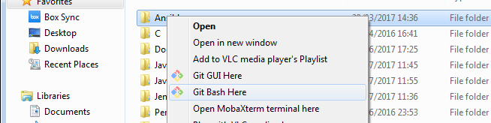
Precondition
Download GIT
e.g https://git-scm.com/downloads
Create a folder where to install the course exercise
e.g. C:\Users\afin\code\
Open a shell where it’s possible to run GIT command and move to the created folder
e.g. In Window, using Git Bash in the created folder
Donwload the exercise code cloning the git repository
git clone https://github.com/antfin/ComputerProgrammingBasic.git
Download Python
e.g. https://www.python.org/downloads/
Donwload one code editor like Eclipse or PyCharm
e.g https://www.jetbrains.com/pycharm/download
https://www.eclipse.org/downloads/eclipse-packages/
Steps needed to run the exercise

Slide 3
Virtual Microcontroller OpCodes
LD
LD_A
LD_N
ADD
DIV
ST
6 OpCodes are implemented into the microcontroller.py file

Slide 4
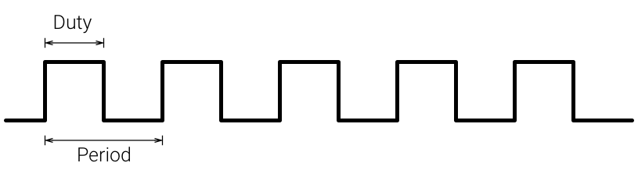
LD(source_register, destination_register): Load the value of the source register into the destination register
EXAMPLE:
LD(2,0) → Load the value of Register 2 into Register 0
CPU
Program Counter
Registers
00000000
11000100
R0
Clock
00000000
R1
11000100
R2
00000000
R3

Slide 5
LD_A(source_address, destination_register): Load the value of the source address into the destination register
EXAMPLE:
LD_A(12,0) → Load the value of Memory Address 12 into Register 0
CPU
Program Counter
Registers
00000000
00100111
R0
Clock
00000000
R1
11000100
R2
00000000
R3
Memory
...
...
Address 11
01010110
Address 12
00100111
Address 13
00000010
...
...

Slide 6
LD_N(number, destination_register): Load the number value into the destination register
EXAMPLE:
LD_N(4,0) → Load the value 4 into Register 0
CPU
Program Counter
Registers
00000000
00000100
R0
Clock
00000000
R1
11000100
R2
00000000
R3

Slide 7
ADD(first_register, second_register, destination_register): Add the value of the first and second registers and save the result into the destination register
EXAMPLE:
ADD(1,2,0) → Add the value of Register 1 and Register 2 and save the result into Register 0
CPU
Program Counter
Registers
00000000
11010101
R0
Clock
+
00010001
R1
11000100
R2
00000000
R3

Slide 8
DIV(first_register, second_register, destination_register): Div the value of the first by the value of the second registers and save the result into the destination register
EXAMPLE:
DIV(1,2,0) → Div the value of Register 1 by Register 2 and save the result into Register 0
CPU
Program Counter
Registers
00000000
00010110
R0
Clock
/
00101100
R1
00000010
R2
00000000
R3

Slide 9
ST(source_register, destination_address): Load the value of the source register into the destination memory address
EXAMPLE:
ST(0,13) → Load the value of Register 0 into Memory Address 12
CPU
Program Counter
Registers
00000000
00000010
R0
Clock
00000000
R1
11000100
R2
00000000
R3
Memory
...
...
Address 11
01010110
Address 12
00100111
Address 13
00000010
...
...

Slide 10
Virtual Microcontroller Debugger
print_registers
print_data
print_overflow_flag
3 functions are use to debug what it’s happening inside the cpu

