Slide 1

Exercise 4: Pomodoro App

Slide 2
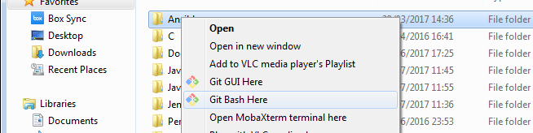
Precondition
Download GIT
e.g https://git-scm.com/downloads
Create a folder where to install the course exercise
e.g. C:\Users\afin\code\
Open a shell where it’s possible to run GIT command and move to the created folder
e.g. In Window, using Git Bash in the created folder
Donwload the exercise code cloning the git repository
git clone https://github.com/antfin/ComputerProgrammingBasic.git
Download Python
e.g. https://www.python.org/downloads/
Donwload one code editor like Eclipse or PyCharm
e.g https://www.jetbrains.com/pycharm/download
https://www.eclipse.org/downloads/eclipse-packages/
Steps needed to run the exercise

Slide 3

Pomodoro Timer
__init__(.):
initMenuBar(): initialize the App Menu Bar
initTaskName(): initialize the label and the task name input form
initTimer(): initialize the timer
initButtons(): initialize the action buttons
initShortcut(): link CTRL+L to the log menu
Create the TK UI for the Pomodoro Timer Apps

Slide 4
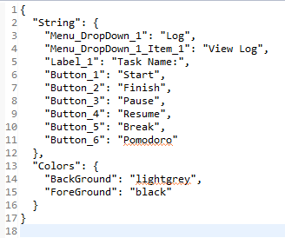
Config
config.json file
Parse the JSON file and store it on internal dictionary

Slide 5
Log Window
__init__(.):
initNotebook(): initialize the log window as a notebook
addTab(): add a tab into the notebook for each date
queryDates(): query all the dates into the dB
queryTasks(): query all the task into the dB
Create the Log Window

Slide 6
Counting Thread
run(.) start the count down
Thread that perform the timer count down and update the Pomodore App window

