Slide 1

Exercise 2: OS

Slide 2
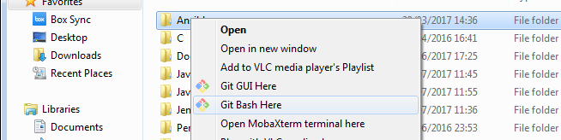
Precondition
Download GIT
e.g https://git-scm.com/downloads
Create a folder where to install the course exercise
e.g. C:\Users\afin\code\
Open a shell where it’s possible to run GIT command and move to the created folder
e.g. In Window, using Git Bash in the created folder
Donwload the exercise code cloning the git repository
git clone https://github.com/antfin/ComputerProgrammingBasic.git
Download Python
e.g. https://www.python.org/downloads/
Donwload one code editor like Eclipse or PyCharm
e.g https://www.jetbrains.com/pycharm/download
https://www.eclipse.org/downloads/eclipse-packages/
Steps needed to run the exercise

Slide 3
File System APIs
list_files(.):
Input: directory path where to list
Output: list of all files and directories
read_file(.):
Input: file name
Output: file data or None if the read fails
write_file(.):
Input: file name
Output: operation result (i.e. True or False)
create_directory(.):
Input: directory name
Output: operation result (i.e. True or False)
4 APIs are implemented into the filesystem.py file

Slide 4
Scheduler APIs
start_thread(.):
Input: thread function name and arguments
1 API is implemented into the scheduler.py file

Slide 5
Driver APIs
read_input(.):
Output: data read
write_output(.):
Input: text to write
log_error(.):
Input: error text to log
wait_time(.):
Input: seconds to wait
clear_screen(.):
shutdown(.):
6 APIs are implemented into the driver.py file

