Slide 1

LESSON 1: Computer Assembler

Slide 2
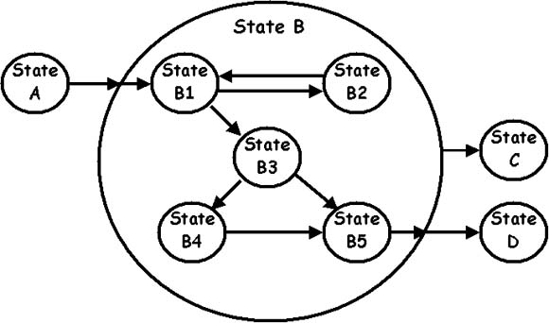
What do we mean for programming?
Programming is the process to implement various sets of instructions to complete a certain task
Considering state machines, a program specifies how to move from a state to another

Slide 3
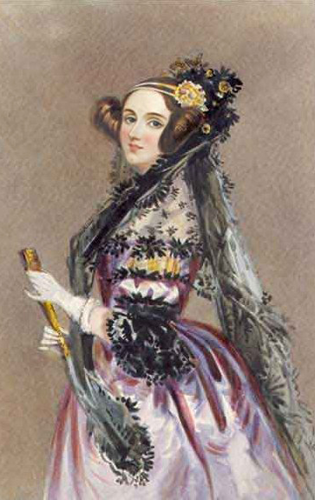
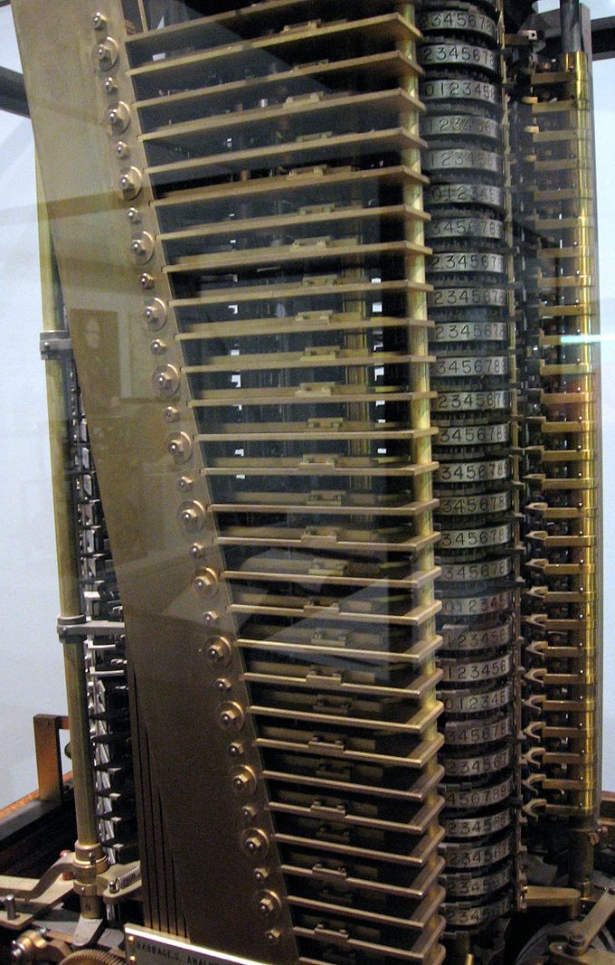
First Computer Program
Dated to 1843
Mathematician Ada Lovelace published an algorithm to calculate a sequence of Bernoulli numbers, intended to be carried out by Charles Babbage's Analytical Engine

Slide 4



Transistor and Integrated Circuit boosted Computer Technology
0101110...
Binary Information
Basic information is stored as binary bit (e.g. Elettric Circuit Open/Close, ON/OFF, 0/1, true/false…)
Code
Sequence of bits are associated to Numbers, Strings and Commands
Storage
Memories and Magnetic devices store the binary information temporarly (e.g. RAM…) or persistently (e.g. EEPROM, FLASH, HDD..)
Transport
Protocols are used to transmit the data inside the embedded devices (e.g. I2C, SCSI…) and among different devices (e.g. TCP/IP, FTP, HTML…)
Computing
Digital circuits perform logic operation based on inputs.
The output can depend of the sequence of past inputs (i.e. used to construct a finite state machine)
IO Devices
Input devces provide data and control signals (e.g. keyboard, mouse…)
Output devices converts infortmation into human readable form (e.g. printer, monitor…)

Slide 5
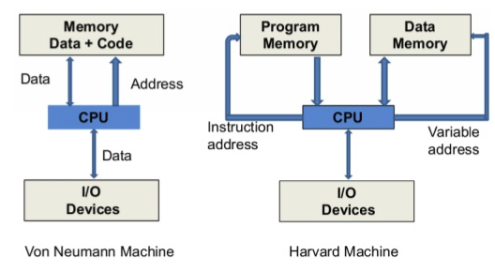
What are the fundamental capabilities and limitations of computers?
General Pourpose Computer can automatically carry out arbitrary sequences of arithmetic or logical operations
In 1936, Alan Turing proposed a machine capable of computing anything that is computable by executing instructions (program) stored on tape, allowing the machine to be programmable

Slide 6
Assembler language maps OpCode (Machine Instructions) to a Mnemonic Human Readable instruction
Memory
Address 0
10001010
PSEUDOCODE:
Load from Address 10 into Register 0
Load from Address 11 into Register 1
Add Register 0 and Register 1 into Register 3
Store from Register 3 into Address 12
BINARY/ASSEMBLER:
Address 1
10011011
Code
Address 2
11110001
Address 3
01101100
...
...
10 00 1010 → LD #10 R0
10 01 1011 → LD #11 R1
11 11 0001 → ADD R0 R1 R3
01 11 1100 → ST R3 #12
Address 10
11000100
Address 11
01010110
Data
Address 12
00100111
Address 13
00000010
...
...

Slide 7
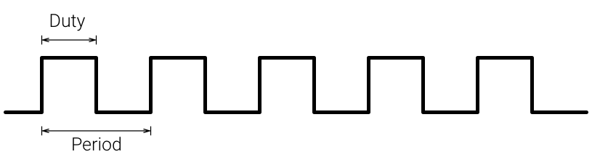
CPU Program Counter Register points to the next OpCode to execute, every Clock Tic the OpCode is executed and the Program Counter incremented
Memory
CPU
Address 0
10001010
Program Counter
Registers
Address 1
10011011
00000000
00000000
R0
Clock
00000000
R1
Address 2
11110001
Address 3
01101100
00000000
R2
...
00000000
R3
...
Address 10
11000100
Notes
JUMP/GO-TO OpCode change the value of the Program Counter Register
Address 11
01010110
Address 12
00100111
Address 13
00000010
...
...

Slide 8
CPU Pipeline specifies the sequential steps to execute the OpCode,
This technique is used for implementing instruction-level parallelism within a single processor
Memory
CPU
Address 0
10001010
Program Counter
Registers
Address 1
10011011
00000000
11000100
R0
Clock
00000000
R1
Address 2
11110001
Address 3
01101100
00000000
R2
...
00000000
R3
...
Address 10
11000100
Fetch
2. Decode
3. Execute
4. WriteBack
Address 11
01010110
10001010
10 → LD
00 → R0
1010 → #10
11000100
11000100
Address 12
00100111
Address 13
00000010
...
...

Slide 9
Let’s Start to Play
Programming a virtual Microcontroller in Assembler

Slide 10
Exercise 1 part 1
Read the Exercise documentation
./ComputerProgrammingBasic/exercise1/Exercise_1.pptx
Complete all the Precondition steps
Read OpCode documentation
Read debugger documentation
Review the main code
./ComputerProgrammingBasic/exercise1/main.py
Update the main code to calculate the mean of 10 value
Using the virtual 10 Hz 8 bits Microcontroller with 4 registers, calculate the mean of the first 10 values of the Data Memory and
store the results in the 11th Data Memory position

Slide 11
Exercise 1 part 2
Try to change the CPU frequency
Try to add more CPU registers and to modify the code to use all of them
Try to create new OpCodes in the microcontroller to speed up Mean calcultation
Speed Up the Microcontroller of the Exercise 1 changing its architecture and/or adding new OpCode

Slide 12

Thank you very much for your time
If you have any questions about this document please don’t hesitate to contact me at:
fin.antonio@gmail.com

