Slide 1

LESSON 2: Structured Language Operative System

Slide 2
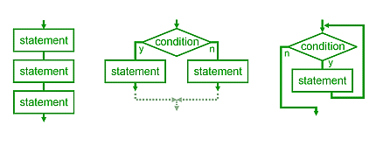
Starting improving the clarity, quality and development time using Structured Programming
Bohn-Jacopini theorem (1966) demonstrates that the three ways of combining programs (i.e. sequencing, selection, and iteration) are sufficient to express any computable function

Slide 3
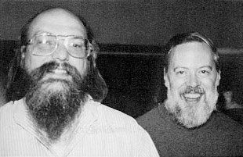
C Language and Unix
Throughout the 1970s
Dennis Ritchie creates the C Program Language
Ken Thompson and Dennis Ritchie collaborated on the Unix operating system at the Bell Labs

Slide 4
Variables, Pointers and Structures are used to simplify the memory handling, hiding the physical addresses of the data
Memory
POINTERS:
It’s still possible to work with address using the pointer operator of reference «*» and dereference «&»
C LANGUAGE:
...
...
byte a
Address 100
10001010
byte a
struct b = {
byte c;
int d;
byte e[4]
}
Address 101
10011011
byte b.c
Address 102
11110001
&a → Address 100
*(103) → Data in Address 103
01101100
int b.d
Address 103
Address 104
11000100
byte b.e[0]
Address 105
01010110
byte b.e[1]
Address 106
00100111
byte b.e[2]
Address 107
00000010
byte b.e[3]
...
...

Slide 5
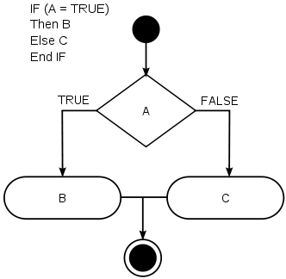
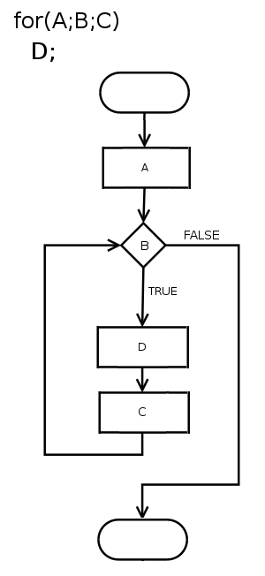
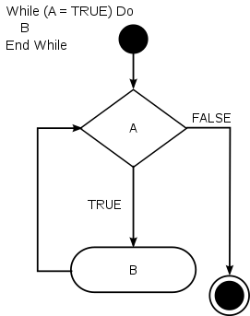
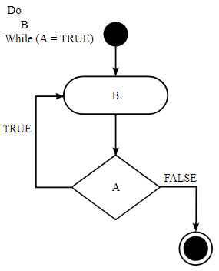
The order in which the statements are executed can be manipulated by Flow of Control Primitives
If/Else
Switch
For
Similar to if/else but multibranch
switch (A) {
case 1:
case 2:
case 3:
…
}
For (A;B;C)
D
For
While
Do While

Slide 6
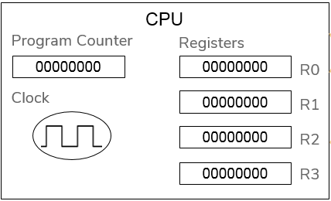
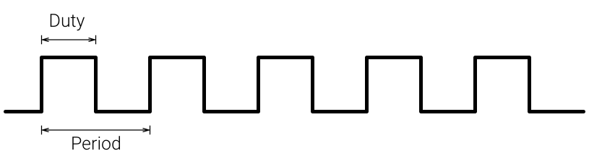
Blocks (i.e. {…}) treats groups of statements like a single statement
Functions (i.e. f(.) {…}) allows to reuse the same Blocks using a call command
int main(void)
{
char name1[] = «John»;
char name2[] = «Anna»;
hello(name1);
hello(name2);
return 0;
}
STACK:
When a function calls another one, its informations (i.e. CPU registers, Program Counter...) are pushed into a memory area called Stack
When a function returns, the informations of its caller function are restored into the CPU by a pop from the Stack
CPU
Stack
PUSH
call
Program Counter
Registers
00000000
00000000
R0
void hello(char *pname)
{
print(«Hello »);
print(pname);
return;
}
Clock
00000000
R1
POP
return
00000000
R2
00000000
R3

Slide 7
How are Structured Program Languages executed by the Computer?
Compilers translate these structured language in CPU OpCodes trying to maximize the speed performance and to minimize the memory space used
Normally Compilers create one object file for each source code file and they use only relative addresses for the instructions
Linkers combine all the object files and they create and executable binary, they also arrange the binary in an address space
For

Slide 8
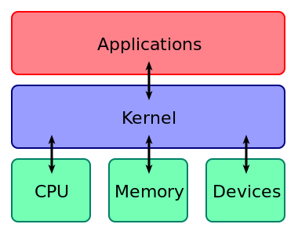
OS manages HW and SW and it provides common services for application programs
An operating system (OS) is system software that manages all the computer resources (i.e. CPU, Memory and Devices) the OS acts as an intermediary between programs and the computer hardware

Slide 9
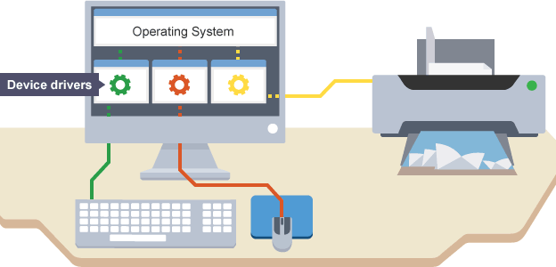
Device Drivers abstract the hardware enabling OS to access hardware functions without needing to know precise details of the hardware implementation

Slide 10

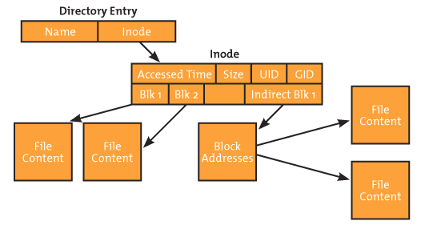
File System is a SW that manages the information storage handling all the metadata required to read, to write and to browse the files using their hierarchic structure
Block file systems divide the storage devices into block of data and normally a file is contained into several blocks
The starting point is the Root directory
A directory is a file that contains a table with all the other files inside itself, this table links the file names to file metadata (e.g inode)
A file metadata specifies the file information like the access rights and the phisycal location of the file data

Slide 11
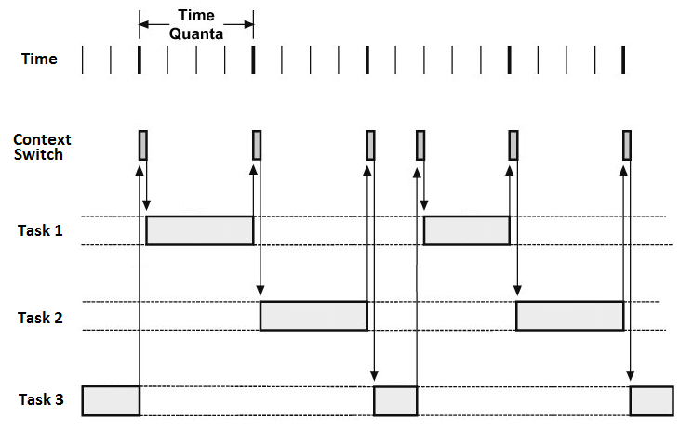
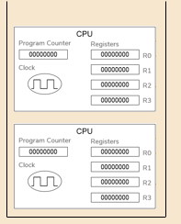
Process Scheduler is a SW that decides which process to run using time sharing and allowing in this way multitasking
CONTEXT SWITCH:
The Context Switch allows to stop and restore different tasks storing their states (for instance storing the Stacks of all the tasks)
Task 1
Stack
Task 2
Stack
Task 3
Stack

Slide 12
Let’s Start to Play
Programming a virtual OS in a Structured Language

Slide 13
Exercise 2 part 1
Read the Exercise documentation
./ComputerProgrammingBasic/exercise2/Exercise_2.pptx
Read FileSystem documentation
Read Driver documentation
Read Scheduler documentation
Run the Shell and try all the commands (start with help)
Run the shell of the virtual OS and try to execute all the commands (use "help" to list all the available commands)

Slide 14
Exercise 2 part 2
Review the File System commands code
./ComputerProgrammingBasic/exercise2/filesystem.py
Review the OS commands code
./ComputerProgrammingBasic/exercise2/operativesystem.py
Update _create_directory(.) adding the right File System API
./ComputerProgrammingBasic/exercise2/operativesystem.py
Add a mkdir command that create new folder
Implement mkdir using filesystem API

Slide 15

Thank you very much for your time
If you have any questions about this document please don’t hesitate to contact me at:
fin.antonio@gmail.com

