Slide 1

Exercise 4: Task List Web App

Slide 2
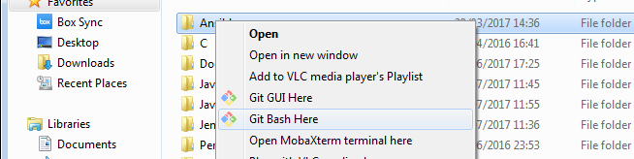
Precondition
Download GIT
e.g https://git-scm.com/downloads
Create a folder where to install the course exercise
e.g. C:\Users\afin\code\
Open a shell where it’s possible to run GIT command and move to the created folder
e.g. In Window, using Git Bash in the created folder
Donwload the exercise code cloning the git repository
git clone https://github.com/antfin/ComputerProgrammingBasic.git
Download Chrome
e.g. https://www.google.ca/intl/en/chrome/browser/desktop/index.html
Steps needed to run the exercise

Slide 3

Model-Viewer-Controller separated the user command handling from the data storage and from the data visualization

Slide 4
Event Dispatcher
Event(.):
attach(): link a listener function to the event. The function will be called to handle the new event notification
notify(): notify all the listener that a new event has happend
Events are used to send information between SW components

Slide 5
Task Model
TaskModel(.):
addTask(): add a new Task
getTask(): return the Task data
setSelectedTask(): set a Task as selected
unselectedTask(): set a Task as unselected
setTasksAsCompleted(): set all selected Tasks as completed
deleteTasks(): delete all selected Tasks
validateTask(): validate and decore a Task based on its name
Store and handle all the information of the Task List

Slide 6
Task Viewer
TaskView(.):
init(): initialize the Viewer parts
addTaskButton(): notify the Add Button press Event
completeTaskButton(): notify the Complete Button press Event
deleteTaskButton(): notify the Delete Button press Event
selectOrUnselectTask(): notify the Select or Unselct Event
buildList(): create and show the Task List
Show the Task List on the Web Page

Slide 7
Task Controller
TaskController(.):
init(): initialize the Controller parts
addTask(): handle Add Event updating the Model
selectTask(): handle Add Event updating the Model
unselectTask(): handle Add Event updating the Model
completeTask(): handle Complete Event updating the Model
deleteTask(): handle Delete Event updating the Model
Handle the User interaction on the Web Page

