Slide 1

LESSON 3: Object Oriented Programming MultiLayer Architecture

Slide 2
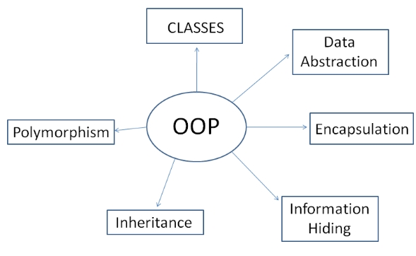
Object-oriented is a programming paradigm based on the concept of "objects" which may contain data attributes and code methods.
The notion of an object can be viewed as a way to combine abstractions of data and code. It works by establishing a level of simplicity on which a person interacts with the system, suppressing the more complex details below the current level

Slide 3

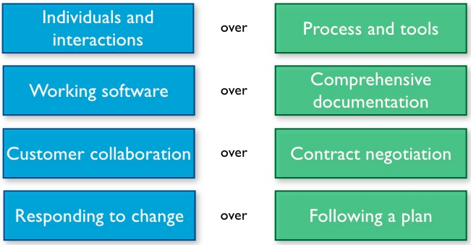
Agile and Clean Code
In 2001, seventeen software developers published the Manifesto for Agile Software Development, among others Jeff Sutherland, Ken Schwaber, and Alistair Cockburn.
In 2009, a movement by Robert C Martin (Uncle Bob) wrote an extension of software development principles: Clean Code: A Handbook of Agile Software Craftsmanship

Slide 4
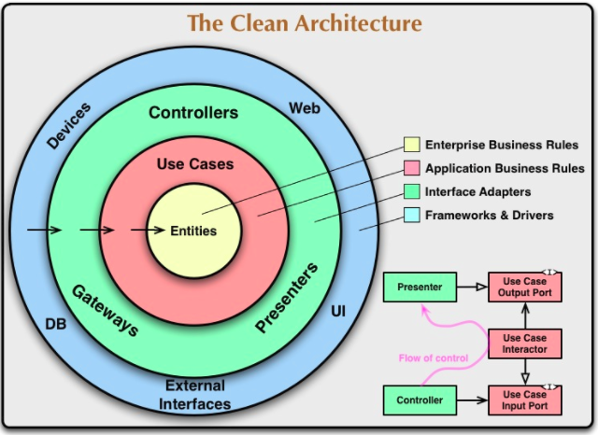
The SW architecture have to achieve the separation of concerns. They all achieve this separation by dividing the software into layers to be more Clean

Slide 5
System Architecture: How Would You Build a City?
Optimize Decision Making
Modularity and separation of concerns to make decentralized management: no one can make all the decisions
Scaling Up
Software systems can grow incrementally, if we maintain the proper separation of concerns. Whether you are designing systems or individual modules, never forget to use the simplest thing that can possibly work
Separate Constructing a System from Using It
Software systems should separate the startup process, when the application objects are constructed and the dependencies are “wired” together, from the runtime logic that takes over after startup

Slide 6
Functions: The First Line of Organization in any Program
Reading Code from Top to Bottom: The Stepdown Rule
Code has to be readable like a top-down narrative. Every function has to be followed by those at the next level of abstraction so the program can be read descending one level of abstraction at a time
Small
Files, Functions and Code Lines have to be small
Do One Thing and Have No Side Effects
Functions should do one thing and they should do it well without side effects
Structured Programming and Input/Output Arguments
Every function, and every block within a function, should have one entry and one exit
The ideal number of arguments for a function is zero, followed by 1 and 2. Three or more arguments should be avoided where possible
In general output arguments should be avoided. If your function must change the state of something, have it change the state of its owning object
Don’t Repeat Yourself
Duplication is dangerous and it has to be eliminated

Slide 7
Objects and Data Structures
Law of Demeter (LoD)
The principle of least knowledge means that an object should not expose its internal structure through accessors because to do so is to expose, rather than to hide, its internal structure
General Guidelines
Objects expose behavior and hide data. This makes it easy to add new kinds of objects without changing existing behaviors

Slide 8
Error Handling: If it obscures logic, it’s wrong!
Define the Normal Flow
Use separation between your business logic and your error handling
Use Exceptions Rather Than Return Codes
The problem returning error code is that the caller must check for errors immediately after the call. Unfortunately, it’s easy to forget. For this reason it is better to throw an exception when you encounter an error. The calling code is cleaner. Its logic is not obscured by error handling
Don’t use null
It’s better to don’t pass or return null value

Slide 9
Name Convention: Names are everywhere in software!
Use Descriptive and Intention-Revealing Names
Don’t be afraid to make a name long. A long descriptive name is better than a short enigmatic name and it’s better than a long descriptive comment. Use a naming convention that allows multiple words to be easily read in the function names, and use those multiple words to give the function a name that says what it does
Don’t Be Cute and Avoid Disinformation
If names are too clever, they will be memorable only to people who share the author’s sense of humor, and only as long as these people remember the joke
Programmers must avoid leaving false clues that obscure the meaning of code. We should avoid words whose entrenched meanings vary from our intended meaning
Use Pronounceable and Searchable Names and Avoid Encodings
Single-letter names and numeric constants have a particular problem in that they are not easy to locate across a body of text
Encoded names are seldom pronounceable and are easy to mis-type
Pick One Word per Concept and Don’t Pun
Pick one word for one abstract concept and stick with it. For instance, it’s confusing to have fetch, retrieve, and get as equivalent methods of different classes
Avoid using the same word for two purposes. Using the same term for two different ideas is essentially a pun

Slide 10

Don’t be afraid of Re-Factor the code and remember the Boy Scout Rule: «Leave the campground cleaner than you found it.”

Slide 11
Let’s Start to Play
Programming a virtual OS in a Structured Language

Slide 12
Exercise 2 part 1
Read the Exercise documentation
./ComputerProgrammingBasic/exercise2/Exercise_2.pptx
Read FileSystem documentation
Read Driver documentation
Read Scheduler documentation
Run the Shell and try all the commands (start with help)
Run the shell of the virtual OS and try to execute all the commands (use "help" to list all the available commands)

Slide 13
Exercise 2 part 2
Review the File System commands code
./ComputerProgrammingBasic/exercise2/filesystem.py
Review the OS commands code
./ComputerProgrammingBasic/exercise2/operativesystem.py
Update _create_directory(.) adding the right File System API
./ComputerProgrammingBasic/exercise2/operativesystem.py
Add a mkdir command that create new folder
Implement mkdir using filesystem API

Slide 14

Thank you very much for your time
If you have any questions about this document please don’t hesitate to contact me at:
fin.antonio@gmail.com

