Slide 1
Zoomba

Slide 2
Zoomba
A telepresence robot you can build in a day

Slide 3
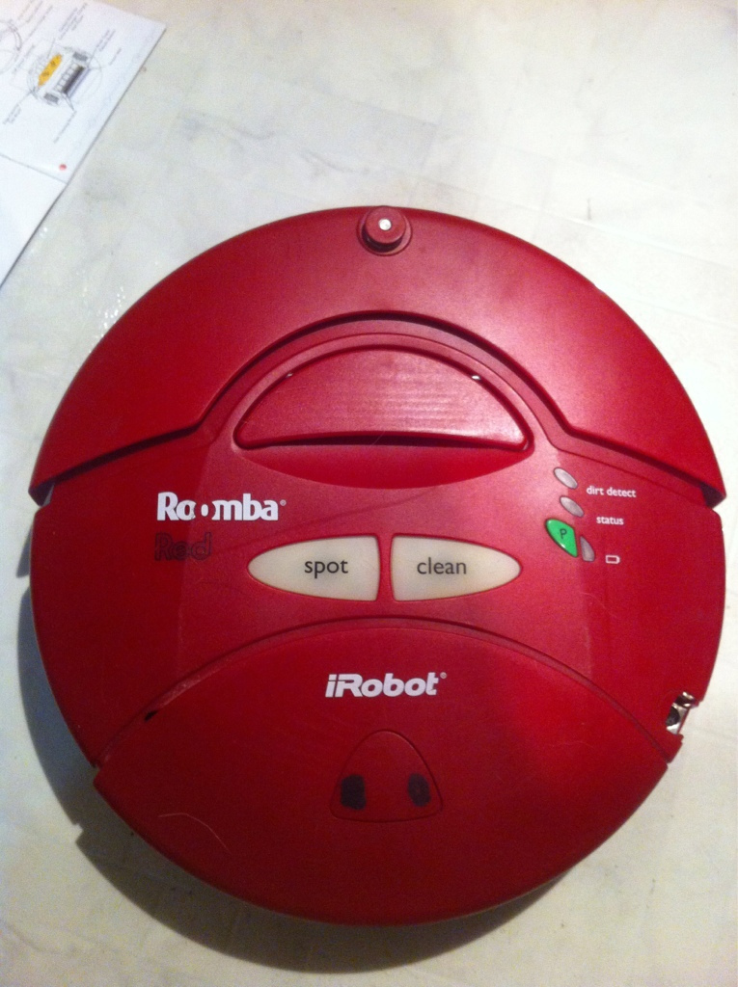
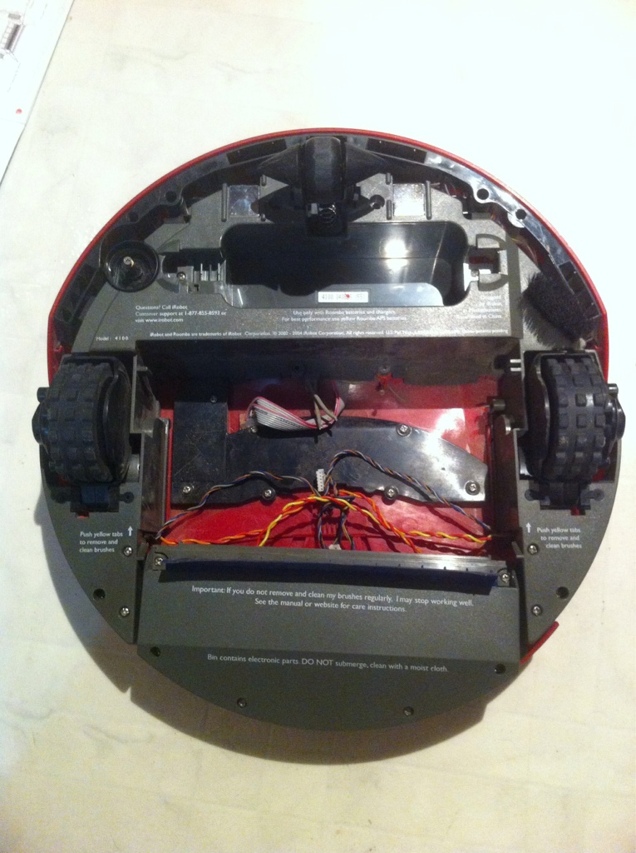
a used Roomba has
Motors and wheels
A castor wheel
Some nice sensors
Maybe a working battery

Slide 4
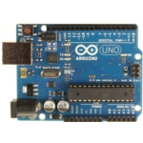
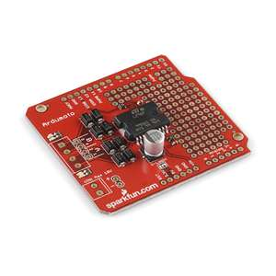
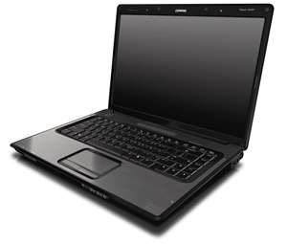
You Also Need
An Arduino
A Laptop
A Motor Driver Shield
Miscellaneous fasteners and connectors and a battery if your roomba battery is dead

Slide 5
You’ll see how to
Prepare a roomba
Make a motor driver shield (or buy one)
Hook it up
Program it, Play in it
Make it self-driving
Notes:
Prepare a roomba
5-10 slides of deconstruction, getting the motor connections, test the motors, drill connection holes
Make a motor driver shield (or buy one)
4 slides on how to make on 1 slide on where to buy
Hook it up
assemble and connect
Program it, Play in it
load firmatta,
get processing code,
load on two machines
Make it self-driving
Add python, and OpenCV, connect roomba sensors to Arduino, add sensors
This is the lowest cost telepresence and computer vision platform anywhere.
Your living room will never be the same again

Slide 6
Lets Get Started

Slide 7
a used Roomba has
Motors and wheels
A castor wheel
Some nice sensors
Maybe a working battery

