Slide 1
Zoomba

Slide 2
Zoomba
A telepresence robot you can build in a day

Slide 3
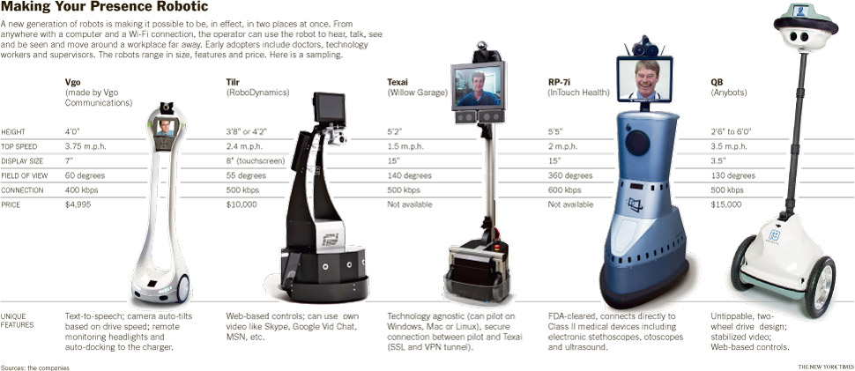
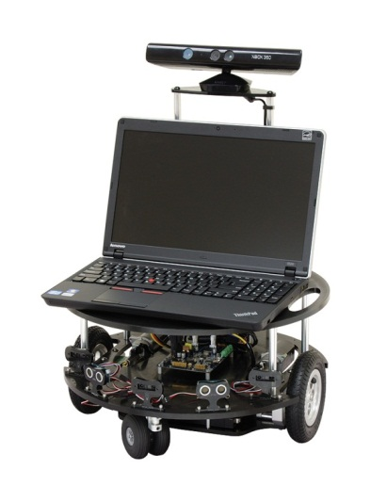
The Killer App?
Parallax Eddie
$1,250

Slide 4
Demo
This is the lowest cost telepresence and computer vision platform anywhere.
Your living room will never be the same again

Slide 5
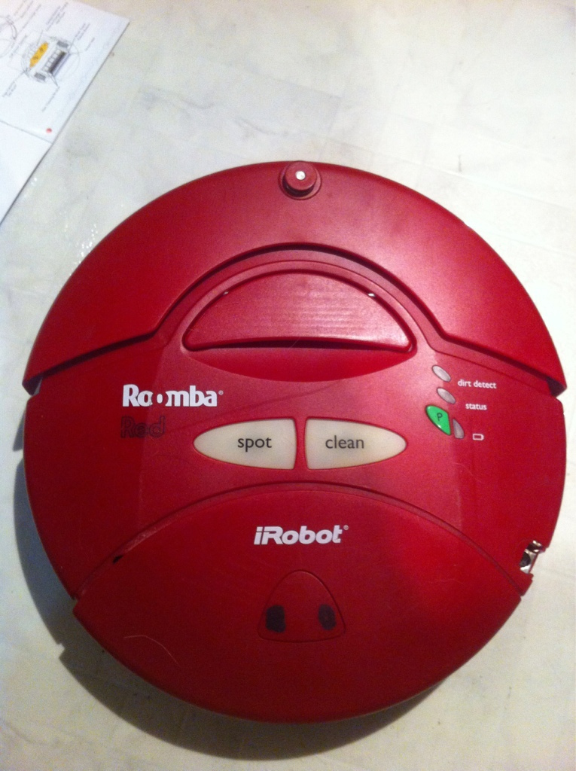
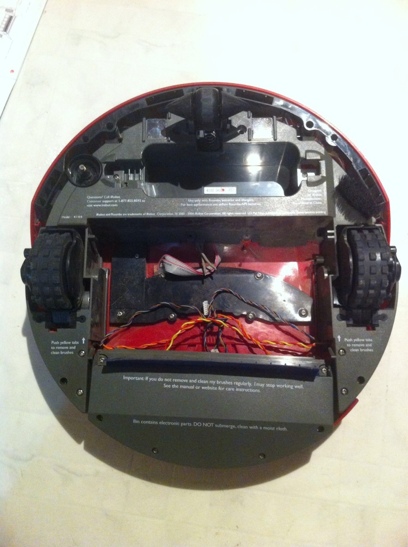
a used Roomba has
Motors and wheels
A castor wheel
Some nice sensors
Maybe a working battery

Slide 6
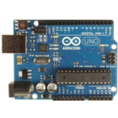
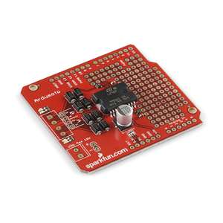
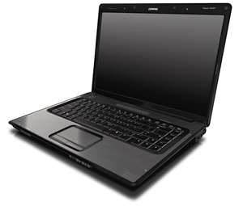
You Also Need
An Arduino
A Laptop
A Motor Driver Shield
Miscellaneous fasteners and connectors and a battery if your roomba battery is dead

Slide 7
Today You’ll See How To
Prepare a roomba
Make a motor driver shield (or buy one)
Hook it up
Program it, Play in it
Make it self-driving
Notes:
Prepare a roomba
5-10 slides of deconstruction, getting the motor connections, test the motors, drill connection holes
Make a motor driver shield (or buy one)
4 slides on how to make on 1 slide on where to buy
Hook it up
assemble and connect
Program it, Play in it
load firmatta,
get processing code,
load on two machines
Make it self-driving
Add python, and OpenCV, connect roomba sensors to Arduino, add sensors

Slide 8
Lets Get Started

Slide 9
a used Roomba has
Motors and wheels
A castor wheel
Some nice sensors
Maybe a working battery

Slide 10
Let’s Hack it
Tear out this that and the other thing to get to the motor leads

Slide 11
Make or buy a motor driver shield

Slide 12
Hook it all up

Slide 13
Program it!
Get processing: http://processing.org/
Get my code: https://github.com/antfriend/Tele

Slide 14
Play!
Run the server (robot) app
Run the client app
Run Skype or Lync

Slide 15
Autonomy
Use your laptop as a robotics platform
http://opencv.willowgarage.com/wiki/

