Slide 1
Zoomba

Slide 2
Zoomba
A telepresence robot you can build in a day

Slide 3
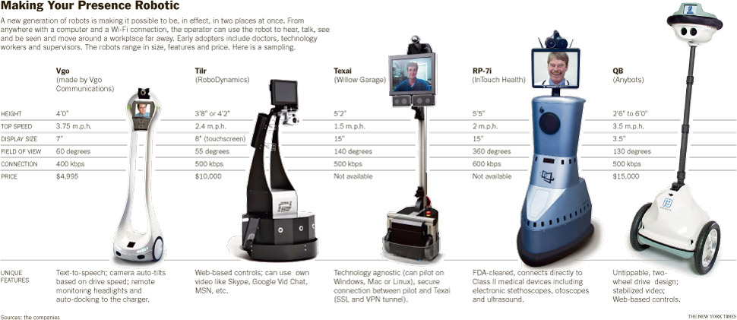
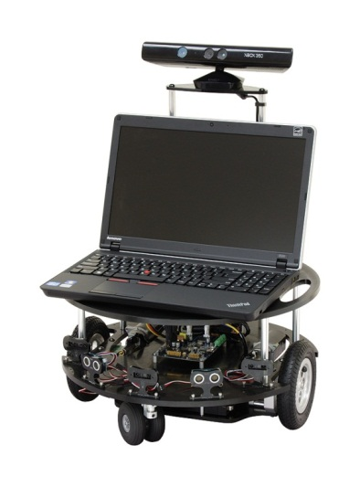
The Killer App?
Parallax Eddie
$1,250

Slide 4
Demo
This is the lowest cost telepresence and computer vision platform anywhere.
Your living room will never be the same again!

Slide 5
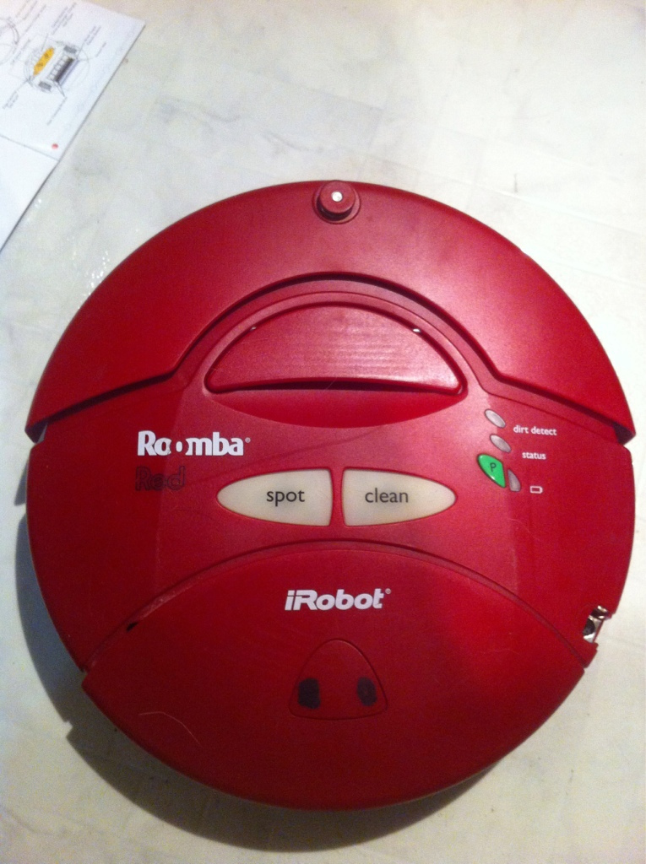
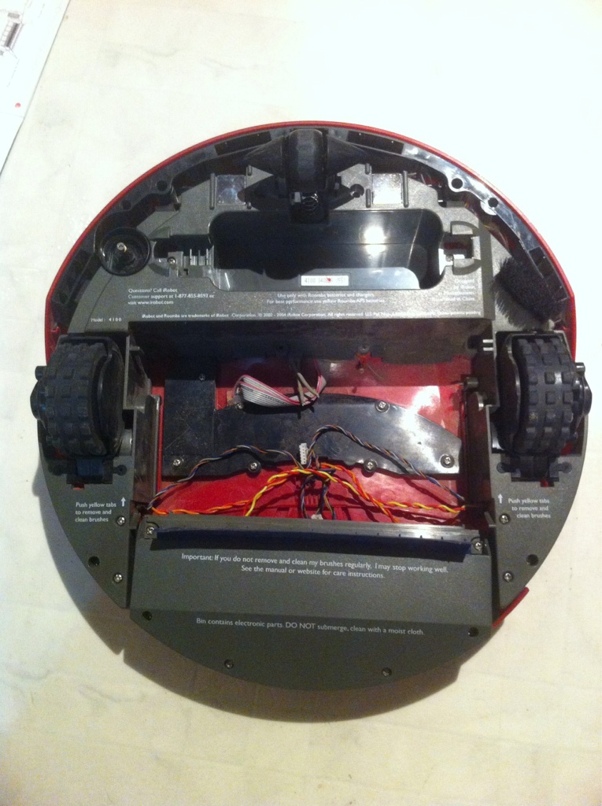
a used Roomba has
Motors and wheels
A castor wheel
Some nice sensors
Maybe a working battery

Slide 6
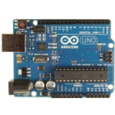
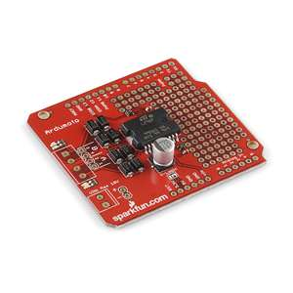
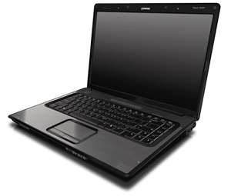
You Also Need
An Arduino
A Laptop
A Motor Driver Shield
Miscellaneous fasteners and connectors and a battery if your roomba battery is dead

Slide 7
Today You’ll See How To
Prepare a roomba
Make a motor driver shield (or buy one)
Hook it up
Program it, Play in it
Make it self-driving
Notes:
Prepare a roomba
5-10 slides of deconstruction, getting the motor connections, test the motors, drill connection holes
Make a motor driver shield (or buy one)
4 slides on how to make on 1 slide on where to buy
Hook it up
assemble and connect
Program it, Play in it
load firmatta,
get processing code,
load on two machines
Make it self-driving
Add python, and OpenCV, connect roomba sensors to Arduino, add sensors

Slide 8
Lets Get Started

Slide 9
The Roomba hack
Remove bottom screws
Remove vacuum
Unplug motors
Replace screws

Slide 10
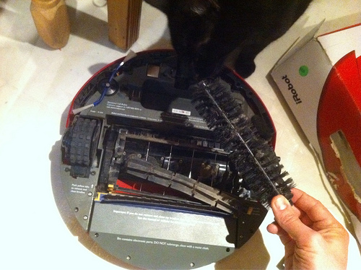
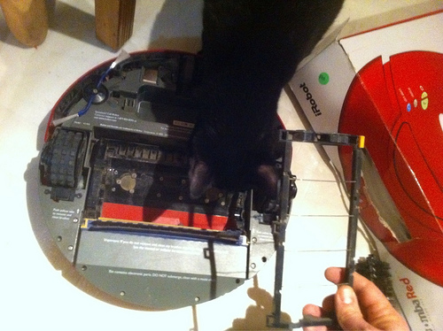
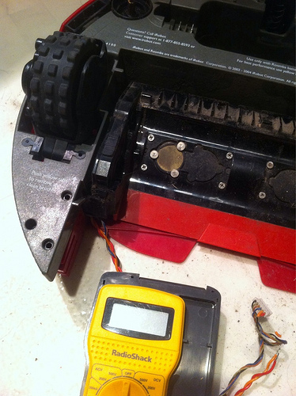
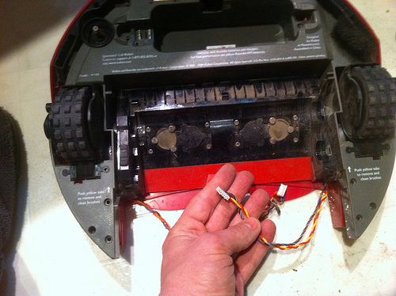

Slide 11

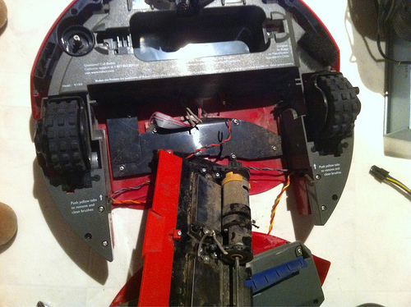
Spacious without the vacuum

Slide 12
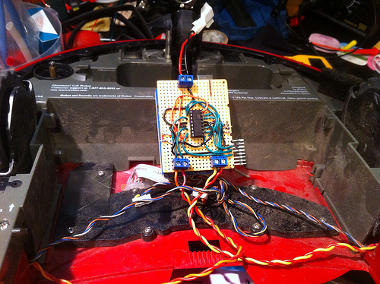
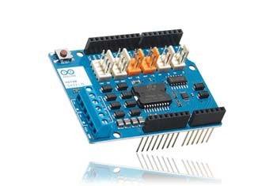
Make or buy a motor driver shield

Slide 13
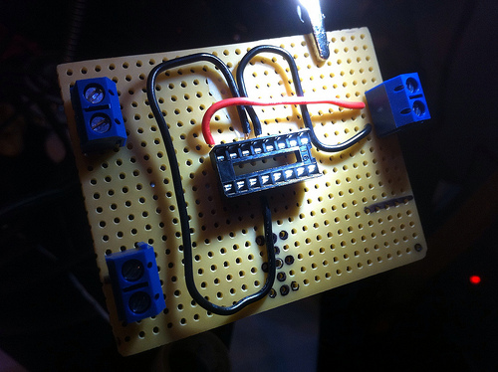
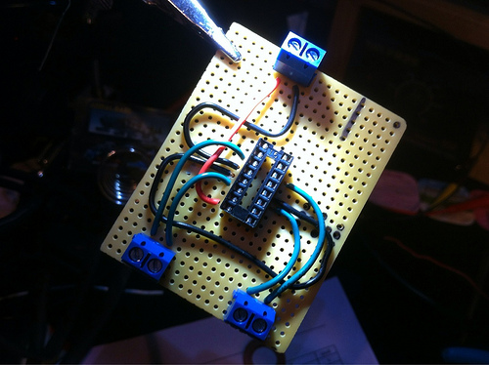
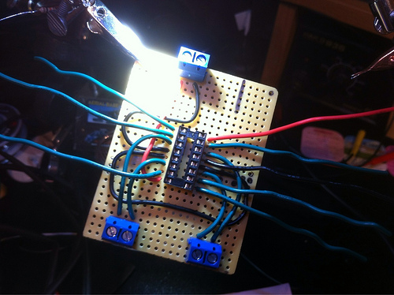
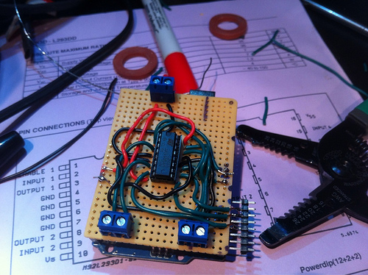

Slide 14
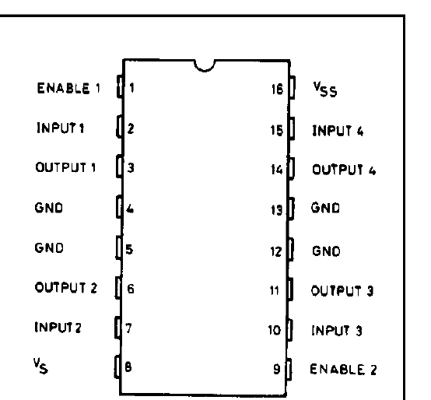
Just follow the L293D Datasheet
http://www.datasheetcatalog.org/datasheet/SGSThomsonMicroelectronics/mXyzuxsr.pdf
Motor

Slide 15
Hook it all up
Power
Motor
Motor

Slide 16
Program it!
Get Arduino: http://arduino.cc/ (downloads)
Load “Firmatta”
Get processing: http://processing.org/
Get my code: https://github.com/antfriend/Tele

Slide 17
Play! Work!
Run the server (robot) app
Run the client app
Run Skype or Lync
Away you go!
For connecting from one home to another, you can use a free vpn like: https://secure.logmein.com/products/hamachi/

Slide 18
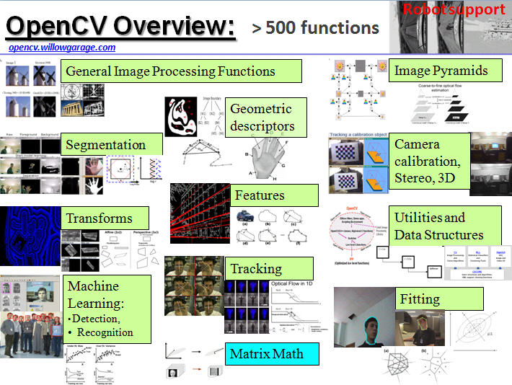
Use your zoomba as an autonomous robotics platform
http://opencv.willowgarage.com/wiki/

Slide 19
Thank you!

