Slide 1
AI in HR Workshop: Ideation and Prioritization
Notes:
Presenter's Name
Presenter's Name

Slide 2
Introduction
Read and delete this box after editing.
This introduction section is for workshop preparation. Remove these slides before the workshop.

Slide 3
How to Use This Tool
Toolkit Goal:
This tool is intended to help HR leaders run a workshop for generating and prioritizing AI use-case ideas.
Directions for Use:
Select a workshop facilitator to run the workshop (see the next slide for guidance on their activities).
Customize the slides with information specific to your organization, where required.
Read the instructional red boxes for directions on how to use and edit/customize the slide.
Remove the instructional red boxes before the workshop.
Share the prework slides and preread details at least a week before the workshop.
Disclaimer:
Note the following when using this tool:
AI changes very rapidly, and some of the topic introductions and use cases might evolve.
This presentation covers possible use cases, but the list is not exhaustive.

Slide 4
Select a Workshop Facilitator
Key Tasks | Expected Actions
Set Up Logistics Before the Session | Share necessary prework (see the next section) with participants at least one week prior to the session. Have the required materials available based on your planned activities (participant handouts printed, breakout teams scheduled if virtual, markers, whiteboard, etc.). Customize this deck, modifying the agenda, industry use cases, ideation exercises and other materials.
Gain Situational Awareness | Be thorough preparing the scope, agenda and proposed sequence of activities in the session. Understand exceptions (if any) to the ideation session template. For example, revise the plans if there are more participants or if resources are not available to conduct a specific exercise.
Manage Discussion Flow | Set clear ground rules for participation and ensure adherence to the agenda. If you have a lot of participants, break them into working groups of four to six people. For a virtual setting, preassign breakout sessions for the exercises. Guard the discussion from drifting to unproductive topics. Ensure the focus remains on AI and not on broader HR technology use cases. Summarize and restate key points at regular intervals to ensure participants don’t lose track of the discussion. Note duplicate and related ideas while facilitating ideation.
Facilitate Participation | Read the facilitator guidance (last section of this presentation). Plan for the risk of groupthink (i.e., let’s follow the others; they know more than me). Have questions ready to challenge thinking or add new ideas. Remain neutral while trying to balance out conflicting points of view. Provide context to facilitate an informed resolution of any conflicting opinions. Prepare to be inclusive of participants that not speaking up. Ask their thoughts or reframe questions to drive participation.

Slide 5
Participant Prework
Read and delete this box after editing.
Edit this section and send to all participants at least one week before the workshop along with links to essential readings and/or PDF downloads of the content (see Slide 10). Remove before workshop.

Slide 6
Purpose of Prework and Upcoming Workshop
Purpose of Prework
To prepare for this critical and interactive session, complete two prework activities, which should take no longer than 30 to 45 minutes of your time:
Prework #1 — ask of you: Read through the Prereading Resources that consist of an introduction to AI, AI use-case essential readings (attached and/or linked in the following slides), deployment variations, and how to approach your use-case evaluation.
Prework #2 — ask of you: Using the AI use-case essential reading materials in this pack, document two to three use cases that resonate with you using the template provided.
Purpose of the Workshop
Conduct an interactive ideation session to identify, evaluate and prioritize AI use cases in HR. Decide on which use cases to progress.
Confirm any additional new use cases (if any) and agree on their prioritization.

Slide 7
Introduction to AI: General Terms
Artificial intelligence (AI) uses advanced techniques like machine learning, deep learning and prescriptive analytics to identify patterns, predict outcomes, make and execute decisions, and generate content. AI augments human decision making and automating routine and nonroutine tasks. Within the HR domain, we see AI used to provide predictive insights, execute tasks, create and personalize content, and offer a conversational user interface.
Generative AI (GenAI) can generate new derived versions of content, strategies, designs and methods by learning from large repositories of original source content. GenAI has profound business impacts, including on content discovery, creation, authenticity and regulations; automation of human work; and customer and employee experiences.
Machine learning (ML) is an AI discipline that solves business problems by utilizing statistical models to extract knowledge and patterns from data. ML techniques, when applied to HR, translate most frequently into data-driven recommendations and predictive insights in domains such as recruiting, learning, employee engagement, compensation, benefits, HR service management and career development.

Slide 8
Introduction to AI: Now Introducing AI Agency
The terms “AI assistants,” “AI agents,” and “agentic AI” are often used interchangeably in the market. However, Gartner sees them as distinct:
AI Assistants | Specialized applications or modules in a wider system that incorporate AI techniques to support or carry out tasks as requested, specified and led by external (human) actors through a (conversational) interface.
AI Agents | Autonomous or semiautonomous software entities that use AI techniques to perceive, make decisions, take actions and achieve goals in digital or physical environments.
Agentic AI | An approach to building AI solutions that is based on the use of one or multiple software entities that classify completely or at least partially as AI agents (as defined by Gartner), possibly combined with other non-AI elements.

Slide 9
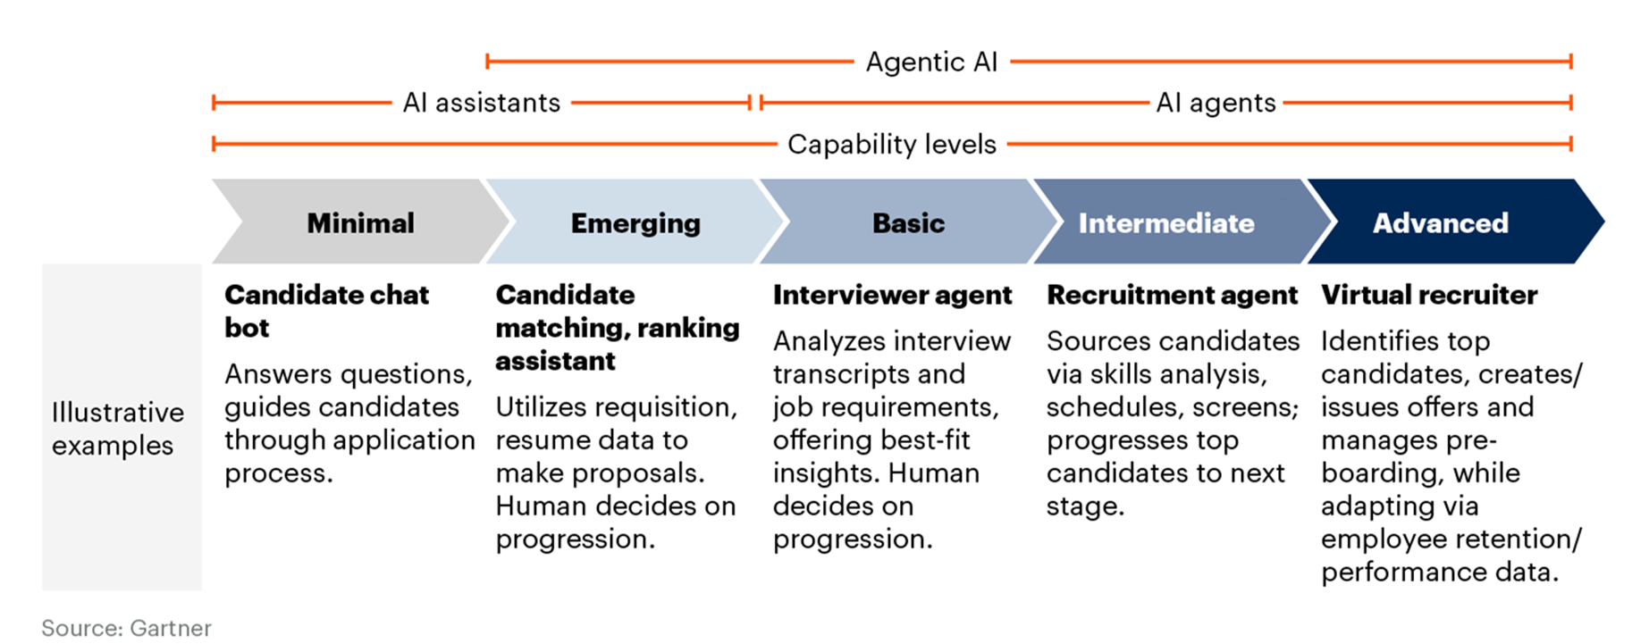
AI Evolution: Assisted to Augmented to Powered
Please see the Notes section for further information.
Notes:
This slide illustrates the growing complexity of recruitment capabilities along the agentic AI spectrum, progressing from low to high agency utility. The spectrum of AI agent capabilities is defined by the degree of “agency” they have:
Low agency systems (minimal and emerging) are able to perform specific tasks under narrowly defined conditions. Tasks tend to be simple, and AI agents execute them primarily under human supervision.
In high agency systems (basic, intermediate, and advanced) AI agents can perform more adaptive, complex tasks with greater autonomy. In such cases, organizations grant rights to AI solutions to act on their behalf, entrusting them to make decisions and take action.
When an AI agent achieves high agency, it is able to act fully, with minimal or no human supervision — while learning, adapting and predicting — to achieve complex goals. As AI agents progress toward full autonomy, they will incorporate these advancing technology capabilities including: Decreased degree of supervision, increased complexity of tasks, and more adaptable behavior.

Slide 10
The “Prework” Essential Readings
AI Use-Case Assessment for HR
Why it's essential: Provides definitions of use cases based on business value and feasibility rankings for the top 16 AI use cases in HR
AI in HR Hype Cycle
Why it's essential: Provides details for AI use cases in HR, including market presence, maturity, business impact and sample vendors
AI Agent Essentials for CHROs
Why it's essential: Provides the fundamentals of AI agents, navigates vendor hype and facilitates C-suite discussions about AI agents

Slide 11
AI in HR Deployment Variations
While evaluating AI use cases, HR leaders must decide, for each individual use case, whether they will build or buy the capability. HR leaders can follow multiple paths to use AI by doing one of the following:
Consume: Using the features already deployed within their existing HR technology stack (e.g., ATS, CRM). This scenario is common for many use cases listed in the AI use-case materials.
Buy: Purchasing new HR technology point solutions that incorporate an AI feature or features. In general, point solutions will be tailored to a single or narrow set of use cases.
Join in: Partnering with the IT function to leverage enterprisewide AI investments. This path will be the most common for HR services use cases such as HR virtual assistants (e.g., through Copilot).
Build: Building capabilities directly in HR teams. This path requires the HR team to include roles for AI and application design and delivery, which will be rare.

Slide 12
The “Prework” Exercise
Reflect on the high-level AI use cases for your HR organization, consider them for your team or area of HR, and pick up to three relevant use cases where AI can play a key enabling role.
Review the AI use-case template and the sections (see next slide).
Try to envisage how AI can transform the work for your HR team.
Sketch out up to three use cases in the template (see next slide) — at minimum, focus on Expected Value and Benefits at this stage.
Be prepared to refine, present and share them with the other attendees.
The tasks including the use-case creation should hopefully take no longer than 30 to 45 minutes of your time.

Slide 13
TEMPLATE — Use-Case Name:
Business Value Added
For example: Improve employee and/or candidate experience; increased HR productivity; drive innovation
Initiator(s) Name
[Your name here]
Benefit (High/Medium/Low)
High
Medium
Low
Description (Include Objective)
Objective:
For example:
“As an X, I need Y in order to achieve Z.”
How to Implement
For example:
Consume through preexisting HR tech vendor
Buy new HR tech product with built-in capability
Work with IT to build it for HR
Impact on Stakeholders
For example:
Impact on external stakeholders, for example, employee experience and candidate experience
Impact on internal HR stakeholders
Expected Value and Benefits
For example:
Increase HR productivity
Reduce costs in operations, etc.
Potential Risks
For example:
Data accuracy, reliability, and transparency
Ability to mitigate potential risks
Resistance from employees
Notes:
AI Use-Case Assessment for HR

Slide 14
Phase 1:
Inspiration
Read and delete this box after editing.
This section will generally be conducted by the workshop facilitator. It includes some Gartner materials. You can tailor to your industry context.

Slide 15
Sample Agenda for the Session
Read and delete this box after editing.
Modify this agenda slide for your own workshop, considering some of the best practices in the call-out boxes.
Time | Agenda
11:00 a.m. | Introduction Welcome audience Ice breaker (optional) Set session expectations
11:15 a.m. | Inspiration Session — 1 What is AI? Use cases for HR Q&A
12:15 p.m. | Break
12:45 p.m. | Ideation Session — 2 Idea generation exercise Group discussion of use cases
1:45 p.m. | Prioritization Session — 3 Idea prioritization Group discussion on ranking
2:45 p.m. | Conclude Summarize key findings Clarify the next steps
Keep the agenda concise, not exceeding three hours for a virtual session.
Set the expectation to turn on video to simulate an in-person meeting experience (if virtual).
Avoid the “cold-start” problem by showing the art of the possible in AI.
Plan restroom breaks to avoid multitasking or disruptions.
Break down the participants into groups of four to six people to facilitate exercises.
Consider splitting the session across multiple days to provide sufficient time for brainstorming.
Clarify next steps to maintain idea momentum.

Slide 16



Ideation and Prioritization Workshop: Three Phases
Inspiration Show what is possible
Ideation Generate many ideas
Prioritization Rank at a high level
1
2
3

Slide 17
Introduction to AI: General Terms
Artificial intelligence (AI) uses advanced techniques like machine learning, deep learning and prescriptive analytics to identify patterns, predict outcomes, make and execute decisions, and generate content. AI augments human decision making and automating routine and nonroutine tasks. Within the HR domain, we see AI used to provide predictive insights, execute tasks, create and personalize content, and offer a conversational user interface.
Generative AI (GenAI) can generate new derived versions of content, strategies, designs and methods by learning from large repositories of original source content. GenAI has profound business impacts, including on content discovery, creation, authenticity and regulations; automation of human work; and customer and employee experiences.
Machine learning (ML) is an AI discipline that solves business problems by utilizing statistical models to extract knowledge and patterns from data. ML techniques, when applied to HR, translate most frequently into data-driven recommendations and predictive insights in domains such as recruiting, learning, employee engagement, compensation, benefits, HR service management and career development.

Slide 18
Introduction to AI: Now Introducing AI Agency
The terms “AI assistants,” “AI agents,” and “agentic AI” are often used interchangeably in the market. However, Gartner sees them as distinct:
AI Assistants | Specialized applications or modules in a wider system that incorporate AI techniques to support or carry out tasks as requested, specified and led by external (human) actors through a (conversational) interface.
AI Agents | Autonomous or semiautonomous software entities that use AI techniques to perceive, make decisions, take actions and achieve goals in digital or physical environments.
Agentic AI | An approach to building AI solutions that is based on the use of one or multiple software entities that classify completely or at least partially as an AI agent (as defined by Gartner), possibly combined with other non-AI elements.

Slide 19
AI Evolution: Assisted to Augmented to Powered
Please see the Notes section for further information.
Notes:
This slide illustrates the growing complexity of recruitment capabilities along the agentic AI spectrum, progressing from low to high agency utility. The spectrum of AI agent capabilities is defined by the degree of “agency” they have:
Low agency systems (minimal and emerging) are able to perform specific tasks under narrowly defined conditions. Tasks tend to be simple, and AI agents execute them primarily under human supervision.
In high agency systems (basic, intermediate, and advanced) AI agents can perform more adaptive, complex tasks with greater autonomy. In such cases, organizations grant rights to AI solutions to act on their behalf, entrusting them to make decisions and take action.
When an AI agent achieves high agency, it is able to act fully, with minimal or no human supervision — while learning, adapting and predicting — to achieve complex goals. As AI agents progress toward full autonomy, they will incorporate these advancing technology capabilities including: Decreased degree of supervision, increased complexity of tasks, and more adaptable behavior.

Slide 20
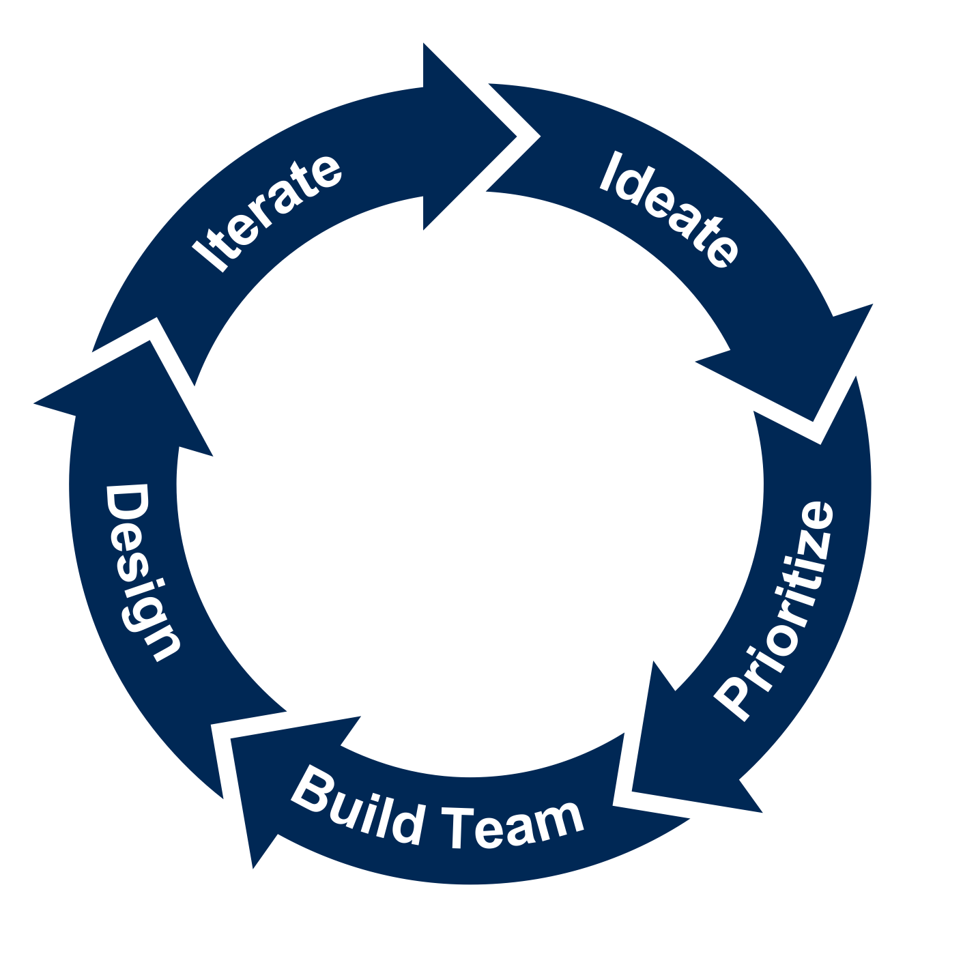
AI Pilot Life Cycle
Deliver minimum functionality. Stop, refine or scale.
Generate many use-case ideas.
5
1
Define a deployment approach and risk mitigation plan.
AI Pilot
Prioritize no more than a few.
4
2
3
Assemble a cross-functional team.
Source: Gartner

Slide 21
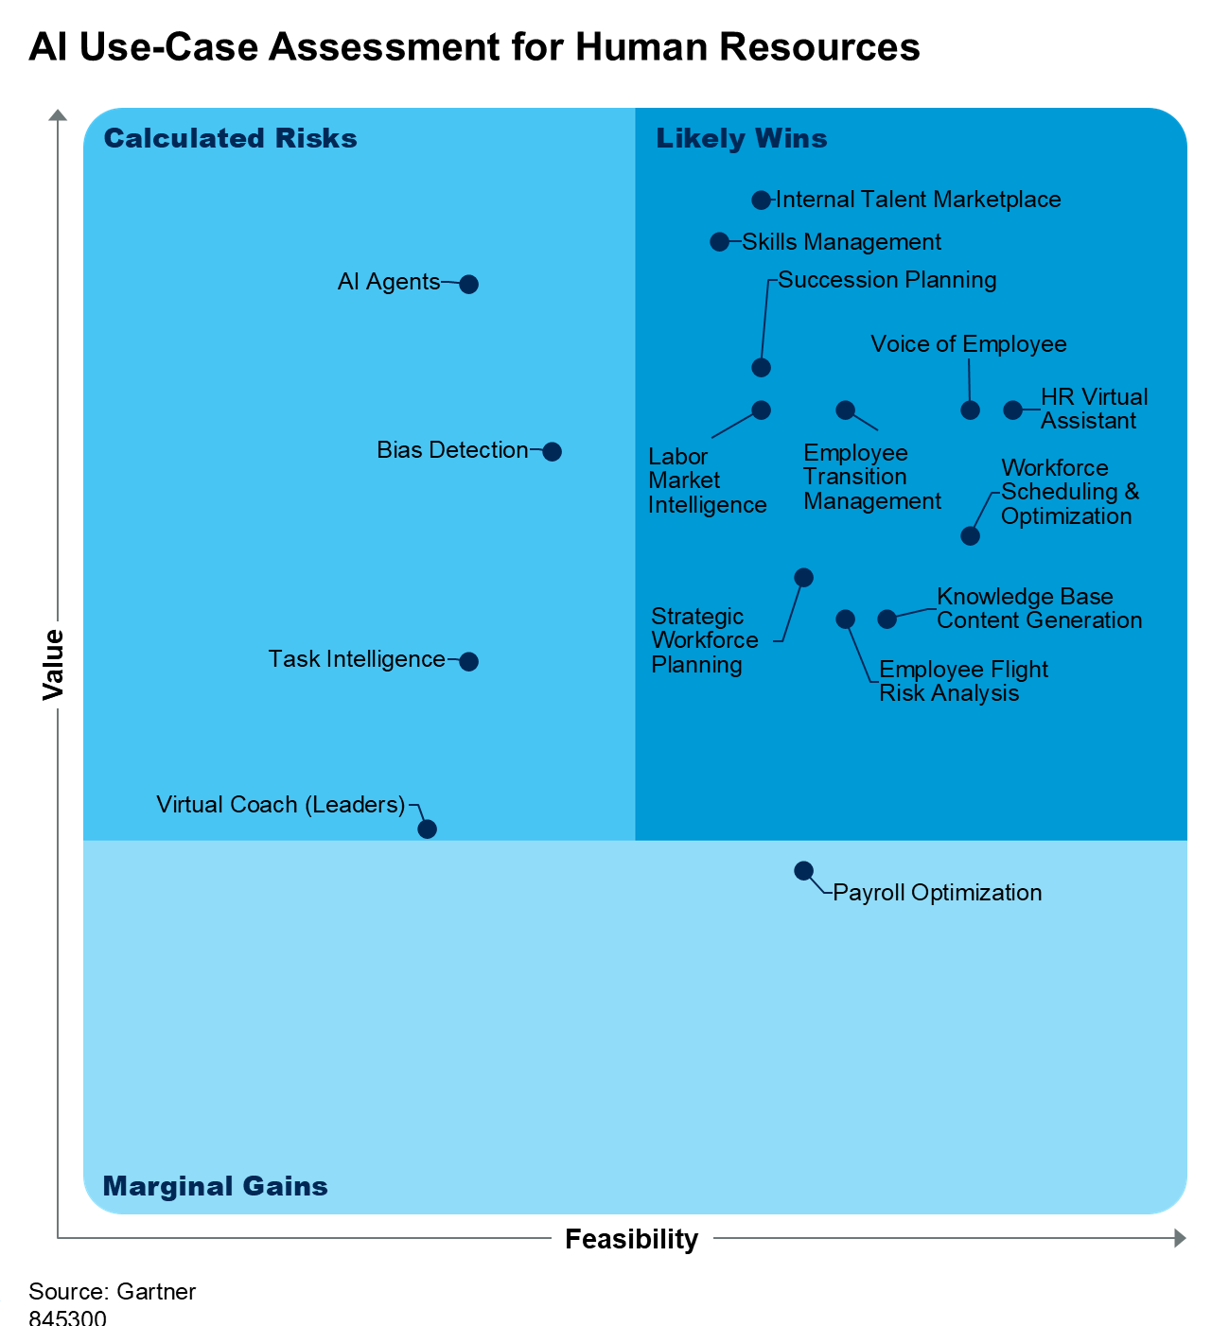
AI Use Cases in HR
For detailed use-case insights, refer to the following:
AI Use-Case Assessment for HR
AI in HR Hype Cycle
Quick Answer: AI Agent Essentials for CHROs

Slide 22
AI in HR Deployment Variations
While evaluating AI use cases, HR leaders must decide, for each individual use case, whether they will build or buy the capability. HR leaders can follow multiple paths to use AI by doing the following:
Consume: Using the features already deployed within their existing HR technology stack (e.g., ATS, CRM). This scenario is common for many use cases listed in the AI use-case materials.
Buy: Purchasing new HR technology point solutions that incorporate an AI feature or features. In general, point solutions will be tailored to a single or narrow set of use cases.
Join in: Partnering with the IT function to leverage enterprisewide AI investments. This path will be the most common for HR services use cases such as HR virtual assistants (e.g., through Copilot).
Build: Building capabilities directly in HR teams. This path requires the HR team to include roles for AI and application design and delivery, which will be rare.

Slide 23
Phase 2: Ideation Exercises
Read and delete this box after editing.
If the audience includes more than 10 participants, break them up into groups of five participants each to facilitate discussion.

Slide 24
AI Pilot Life Cycle
Deliver minimum functionality. Stop, refine or scale.
Generate many use-case ideas.
5
1
Define a deployment approach and risk mitigation plan.
AI Pilot
Prioritize no more than a few.
4
2
3
Assemble a cross-functional team.
Source: Gartner

Slide 25

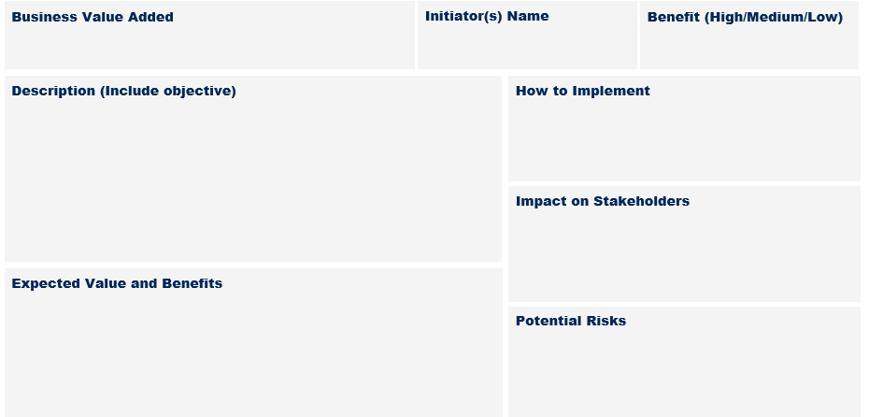
Step 1: Individual Ideation
10 minutes
Use the template provided to produce potential use-case ideas individually.
(Note: This will have been done during the prework phase. Take this time to review your content and prepare to share.)

Slide 26
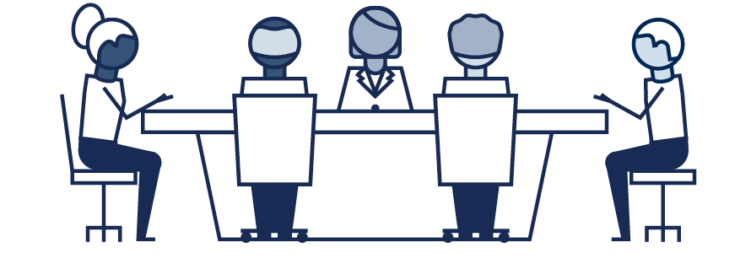
Step 2: Group Discussion
20 minutes
Discuss each individual’s use-case ideas as a group.
Pick up to fiuve use cases from the group to be presented to the whole room.

Slide 27
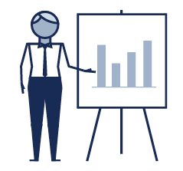

Step 3: Group Presentation
45 minutes
Each group presents to the room the key use cases that came out of their ideation session (five to 10 minutes per group).
Summarize findings.

Slide 28
Phase 3:
Prioritization
Read and delete this box after editing.
This exercise is only for a high-level ranking of AI use cases. A detailed prioritization should be conducted later for the most promising ones.

Slide 29
AI Pilot Life Cycle
Deliver minimum functionality. Stop, refine or scale.
Generate many use-case ideas.
5
1
Define a deployment approach and risk mitigation plan.
AI Pilot
Prioritize no more than a few.
4
2
3
Assemble a cross-functional team.
Source: Gartner

Slide 30
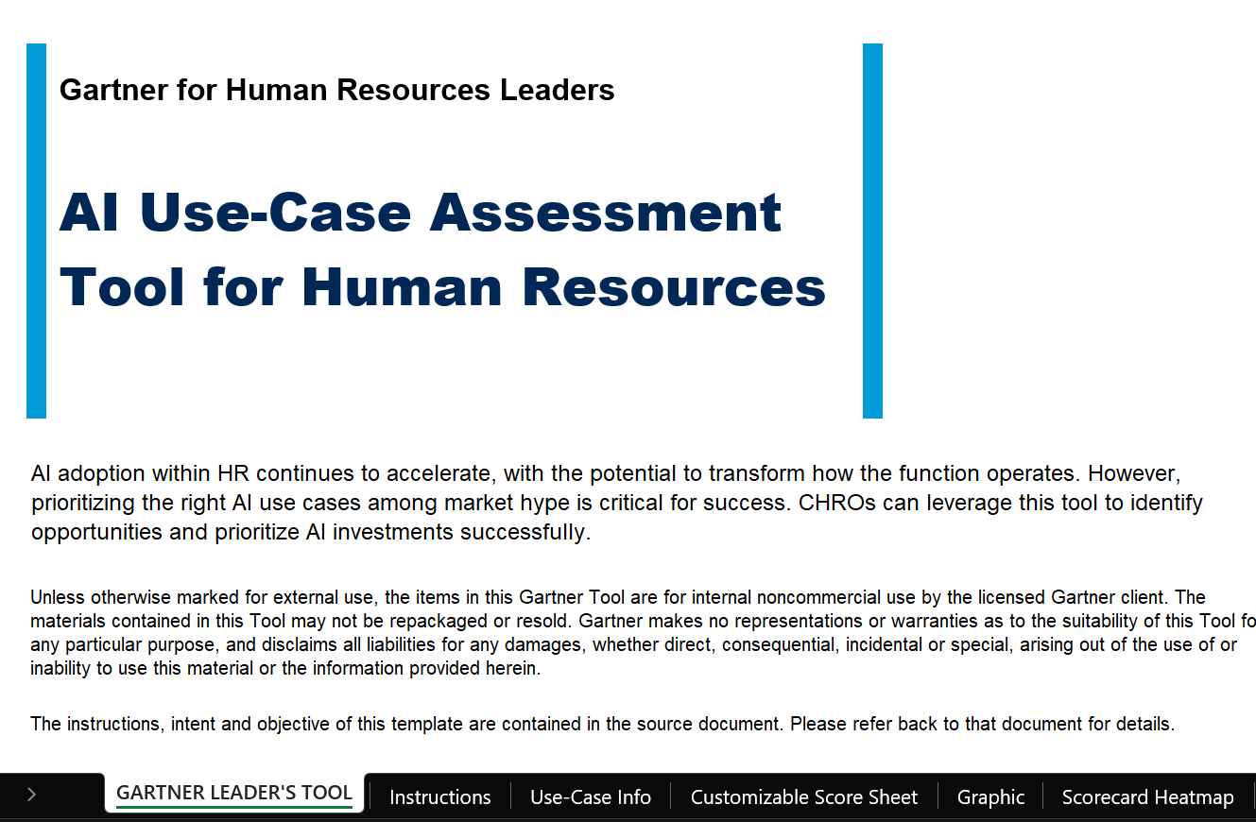
Utilize Tool: AI Use-Case Assessment for HR

Slide 31
Use-Case Dimensions for Scoring Business Value
Dimension | Explanation
Experience | The potential of the use case to meet or exceed the users’ goals for using the capability, leading to positive perceptions and related feelings with regard to interactions with the employer
Efficiency | The potential of the use case to meet or exceed performance goals with equal or fewer resources, resulting in reduced costs and increased productivity
Employer Brand/Employee Value Proposition (EVP) | The potential of the use case to create agility to respond to current and future labor market constraints and opportunities and effectively articulate and manage its EVP to attract, develop and retain the right talent

Slide 32
Use-Case Dimensions for Scoring Feasibility
Dimension | Explanation
Technical | The organization’s ability to meet the technical requirements of a use case. Considerations include the core capabilities of the AI technology itself, the availability of vendor support, the current state of the organization’s technology infrastructure and the technical talent required by the use case.
Internal | The organization’s ability and openness to use and incorporate the potential use case. This includes the willingness of internal stakeholders to understand, trust and effectively execute the use case.
External | The extent to which the environment outside of the organization is conducive to successful execution of the potential use case. This includes consideration of the legal and regulatory environment; public opinion of the use case; and the digital access, literacy and customer engagement required by the use case.

Slide 33
Complete Customizable Scoring Tab for Business Value Dimensions in Tool
As a group, discuss the potential business value dimension scores for each use case, focusing on areas of disagreement. Per use case, award a 0 to 4 score for each dimension based on the below rubric. You may add whole or half-integers (e.g., 3 or 3.5).
Business Value Scoring:
0 or 0.5: None. Doubtful that the organization will gain any value; not intended to create any value.
1 or 1.5: Low. Offers slight process improvement but difficult to translate into more revenue or cost savings.
2 or 2.5: Moderate. Offers incremental process improvements, meaning increased revenue and/or cost savings.
3 or 3.5: High. Enables new ways of performing HR services, resulting in a significant increase in revenue and/or reduction in costs.
4: Transformational. Enables new ways of doing business, resulting in major dynamic shifts.
For business value dimensions that don’t seem applicable for a use case, award a 0 (because it adds no value).

Slide 34
Complete Customizable Scoring Tab for Feasibility Dimensions in Tool
As a group, discuss the potential feasibility dimension scores for each use case, focusing on areas of disagreement. Per use case, award a 0 to 4 score for each dimension based on the below rubric. You may add whole or half-integers (e.g., 3 or 3.5).
Feasibility Scoring:
0 or 0.5: Impossible. No to very low chance of being able to implement.
1 or 1.5: Challenging. Possible but must overcome significant barriers.
2 or 2.5: Complicated. Can be implemented while facing moderate obstacles.
3 or 3.5: Doable. Can be implemented while facing minor obstacles.
4: Easy. Within the capabilities of the organization to adapt; no obstacles.
For feasibility dimensions that don’t seem applicable, award a 4 (because there is no barrier).

Slide 35

Assess Use-Case Graphic in Tool
Navigate to the Graphic tab. This is the graphic plotting the use cases based on their scores and dimension weights.
Use cases are placed into one of three categories:
Calculated risks offer medium-to-high business value but low-to-medium feasibility. They represent riskier options.
Likely wins offer both medium-to-high feasibility and business value, making them wins in most circumstances.
Marginal gains offer variable feasibility but are defined by their low value, making them better for opting in, if needed.

Slide 36
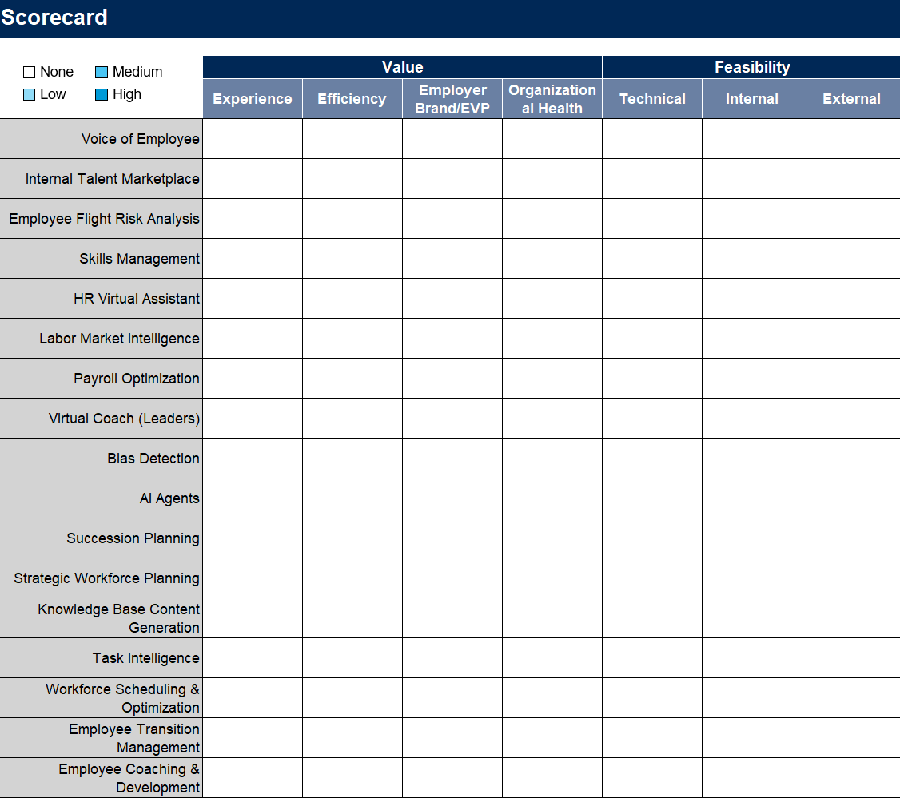
Assess Scorecard Heat Map in Tool
Navigate to the Scorecard Heat Map tab. This is a heat map graphic conveying a slightly simplified view of each use case's scores for each dimension. Scores of 0 to 4 are mapped to one of four colors based on this rubric:
>2.66 and <4.01 = High
>1.33 and <2.67 = Medium
>0 and <1.34 = Low
0 = None

Slide 37
As a group, reflect on the positioning of the AI use cases and their scorings and decide which three to five use cases you want to proceed with.

Slide 38
Participant Handouts
Read and delete this box after editing.
Print the slides in this section beforehand and share with participants for active use during the workshop.

Slide 39
TEMPLATE — Use-Case Name:
Business Value Added
For example: Improve employee and/or candidate experience; increased HR productivity; drive innovation
Initiator(s) Name
[Your name here]
Benefit (High/Medium/Low)
High
Medium
Low
Description (Include Objective)
Objective:
For example:
“As an X, I need Y in order to achieve Z.”
How to Implement
For example:
Consume through preexisting HR tech vendor
Buy new HR tech product with built in capability
Work with IT to build it for HR
Impact on Stakeholders
For example:
Impact on external stakeholders, for example, employee experience and candidate experience
Impact on internal HR stakeholders
Expected Value and Benefits
For example:
Increase HR productivity
Reduce costs in operations, etc.
Potential Risks
For example:
Data accuracy, reliability, and transparency
Ability to mitigate potential risks
Resistance from employees

Slide 40
Use-Case Dimensions for Scoring Business Value
Dimension | Explanation
Experience | The potential of the use case to meet or exceed the users’ goals for using the capability, leading to positive perceptions and related feelings with regards to interactions with the employer
Efficiency | The potential of the use case to meet or exceed performance goals with equal or fewer resources, resulting in reduced costs and increased productivity
Employer Brand/Employee Value Proposition (EVP) | The potential of the use case to create agility to respond to current and future labor market constraints and opportunities and effectively articulate and manage its EVP to attract, develop and retain the right talent

Slide 41
Use-Case Dimensions for Scoring Feasibility
Dimension | Explanation
Technical | The organization’s ability to meet the technical requirements of a use case. Considerations include the core capabilities of the AI technology itself, the availability of vendor support, the current state of the organization’s technology infrastructure and the technical talent required by the use case.
Internal | The organization’s ability and openness to use and incorporate the potential use case. This includes the willingness of internal stakeholders to understand, trust and effectively execute the use case.
External | The extent to which the environment outside of the organization is conducive to successful execution of the potential use case. This includes consideration of the legal and regulatory environment; public opinion of the use case; and the digital access, literacy and customer engagement required by the use case.

Slide 42
Facilitator Guidance
Read and delete this box after editing.
The slides in this section are for the facilitator only. Remove this section before the workshop.

Slide 43
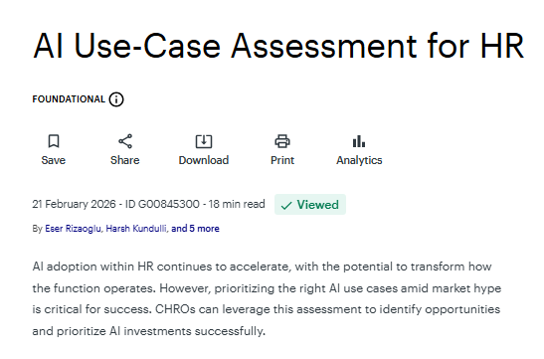
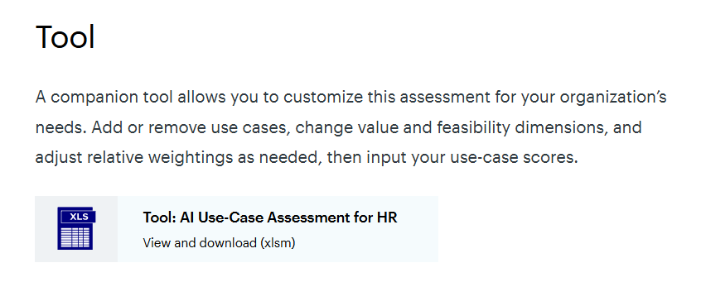
Access Tool: AI Use-Case Assessment for HR
Navigate to AI Use-Case Assessment for HR and download the Excel tool under the Tool section.

Slide 44
Facilitation Challenges
Common Facilitation Challenges
Participation Issues
Discussion Management Issues
What Does It Mean? Participants are hesitant to contribute ideas freely.
What Does It Mean? Facilitator struggles to keep the discussion productive.

Slide 45
Tactics to Overcome Participation Issues
Challenge | Facilitator Action | Description of Action | Tips and Language to Use
Participants are hesitant to expand thinking and fully share new ideas with the group. | Validating | Acknowledge the legitimacy and value of what participants are saying. Note: One does not have to agree to validate an idea or opinion. | Use “yes and” versus “yes but” language. “I see where you’re coming from.” “We want to get as many ideas on the table as possible.”
Participants are not familiar or comfortable with one another. | Strengthen Relationships | Suggest an exercise to help participants see others’ points of view. | Sample exercise: Each person in the group is asked to submit the one question that they’d want to know about the group and their positions or motivations that would allow them to proceed more confidently in the discussion. Read out the questions and actually have group members answer them to strengthen the relationships through mutual understanding of intent.
Participants struggle to identify their opinion on an issue in order to contribute. | Past Experience | Encourage participants to recall past experiences and reflect upon them to formulate opinions. | “Often we’ve seen companies struggle with X. Has this ever manifested in your world?” “Think about the last time you were .… ”

Slide 46
Tactics to Overcome Discussion Management Issues (1/2)
Challenge | Facilitator Action | Description of Action | Tips and Language to Use
A participant makes a valid point but uses an inappropriate or antagonizing tone. | Mirroring | Repeat what the participant said, using a more inclusive and accepting tone so that others feel more comfortable responding to the point. | When repeating a point, clarify that this is a participant view, using the participant’s words and replacing “I” language with “you” language.
Participant’s comments are unclear. | Paraphrasing | Clarify participant’s comments to allow the group to better understand. In your own words, repeat what the speaker said and confirm you got it right. | “It sounds like you’re saying .…” “I think I understand; let me try to say it in my own words.”
Participants are intimidated, not engaged, or not participating in the discussion. | Encourage and Make Room | Encourage everyone to participate. Keep a close eye on those who are not vocal, looking for signs they may want to speak and invite them to do so. | “Who else has an idea?” “Would you like to add anything?”
A participant introduces a new idea before agreement and understanding have been reached on the current idea. | Parking Lot | “Park” ideas that are useful for the group to discuss. Set these ideas aside and be sure to come back to them later. Summarize discussions and secure agreement before moving forward to “parked” ideas. | “That’s a great idea, but let’s make sure we close out the previous discussion and come to agreement. We’ll park that idea and come back to it.”

Slide 47
Tactics to Overcome Discussion Management Issues (2/2)
Challenge | Facilitator Action | Description of Action | Tips and Language to Use
Powerful and/or loud voices are interrupting others and monopolizing the conversation. | Stacking | Identify who is interested in speaking on a particular point Create an order Call on individuals in turn Ask if anyone else would like to speak | “It seems like we have a lot of opinions on this issue. Let’s take turns. I’ll establish an order.”
The minority opinion is not being heard. | Expand and Amplify | Play devil’s advocate to get a conversation going that reveals all sides. Call on a participant to share views based on what they shared on previous communications. | “Let me play devil’s advocate for a moment. What would you say to .…” “X, would you like to comment? Based on some of our previous discussions, I think you had some good ideas on this topic.”
Two or more participants disagree. | Establish Common Ground | Clearly articulate the areas where the two participants are actually in alignment and those where there is a disconnect, and have them discuss the more narrow disagreement. | “Let me tell you where I see the two of you are actually in agreement.” “In the past, working with customer X, I learned you can also look at it from this perspective.”
Participants find it difficult to understand each other’s point of view. | If I Were You | Create a shared context by asking the participant to pretend to represent another participant. | “If you were in X’s shoes, what would your main concern or goal be?”

