Slide 1
Develop an HR-Focused AI Strategy
Unless otherwise marked for external use, the items in this Gartner Tool are for internal noncommercial use by the licensed Gartner client. The materials contained in this Tool may not be repackaged or resold. Gartner makes no representations or warranties as to the suitability of this Tool for any particular purpose, and disclaims all liabilities for any damages, whether direct, consequential, incidental or special, arising out of the use of or inability to use this material or the information provided herein.
The instructions, intent and objective of this template are contained in the source document. Please refer back to that document for details.
Notes:
Ver 2024-1204
Presenter's Name
Presenter's Name

Slide 2
About This Tool
This tool provides foundational guidance with templates to construct an AI strategy document for your HR function. It contains the key components of an HR-focused AI strategy and guidance to tailor them to your requirements.
This tool will require inputs from external stakeholders and alignment to the broader enterprise AI strategy as well as your HR function and HR technology strategies to be a fully completed document.
Please note:
An HR-focused strategy is one of six capabilities for a successful HR AI program. Leverage our Tool: AI Roadmap for HR for support in all activities surrounding building an AI strategy for the HR function and in the other capabilities.
This research provides guidance in setting HR’s AI strategy for your function. However, it does not cover HR’s role in supporting your organization’s broader AI strategy (see Top Insights on AI for CHROs).

Slide 3
Before Getting Started
An effective HR-focused AI strategy is the product of alignment with the broader enterprise strategy, collaboration within HR, and inputs from IT, legal and compliance.
We recommend the following:
Read this document in full prior to diving in. You may decide to work on components in parallel.
Define a dedicated AI product owner within HR (this can be a part-time role) with strengths in leadership, transformation, business acumen and technology.
Ensure the stakeholder team is current on AI trends and the impact of AI on the HR function. Leverage Gartner resources and/or connect with your account team if an Executive Presentation on How to Deploy AI in HR would support grounding and alignment.
Have the HR-focused AI product owner plan a kickoff and a series of working meetings with your core stakeholder group. Share the slide(s) in advance of these sessions, including related Gartner resources as applicable as prework.
Obtain your organization’s enterprise-level AI, HR function and HR technology strategies to use as reference points and ensure alignment.
Avoid rushing into use-case selection and execution phases — save this for your roadmap.
Plan to revisit your HR-focused AI strategy at least yearly and more often if there are major changes to your business strategy.

Slide 4
Who Needs to Be Involved
Your AI product owner for HR (may be a part-time responsibility or full-time role) should lead and facilitate the process.
Identify the stakeholders who should be a part of building your AI strategy for the HR function. Leverage these individuals in supporting strategy meetings or working sessions. Include HR leaders from each HR pillar as well as IT, legal and compliance. Include individuals whose responsibilities involve ensuring alignment to the overall enterprise AI, HR function and HR technology strategies.
Use the template on the next slide to document the stakeholder group, following the example below. Please note the below table is illustrative and not exhaustive.
Name | Title | Role and responsibility
 | HR-Focused AI Product Owner | Drives the collaboration and completion of HR’s AI strategy elements by the defined stakeholder group.
 | CHRO | Provides strategic vision and leadership, ensuring alignment with business objectives, championing AI adoption and fostering collaboration across the function.
 | IT Partner | Supports the HR’s AI product owner and ensures alignment with the enterprisewide AI strategy and approach.
 | HR Technology Leader | Ensures alignment to the HR technology alignment, including the selection of appropriate tech and implementation.
 | HR Center of Excellence (COE) Leads | Brings COE-specific knowledge and goals while supporting the implementation across their area.

Slide 5
Template: Who Needs to Be Involved
Name | Title | Role and responsibility

Slide 6
Components of an HR-Focused AI Strategy
How do we intend to use AI?
Vision
Alignment
Value
Does my HR-focused AI strategy align with our other strategies?
What role should AI play in HR?
HR-focused AI strategy
Adoption
Risk
What are the key capabilities required, and how will we ensure utilization?
What are the main risks related to the use of AI in the HR function?
Note: These are not sequential steps; rather, they are components that come together to create a complete strategy and can be worked on concurrently.

Slide 7
Checklist of Tasks Across All Components
Vision
Conduct visioning session
Create vision statement
Define guiding principles
Value
Conduct an “art of the possible” workshop
Set goals and example use cases
Determine which metrics will support monitoring of AI’s value creation
Define your AI ambition level
Risk
Formulate a risk assessment and action plan
Adoption
Form an HR-focused AI fusion team
Recognize your adoption stage
Define AI’s impact on the HR function
Plan for building HR’s AI literacy and digital skills
Alignment
Align HR business and HR technology strategies
Align to enterprise AI strategy

Slide 8
Vision: Overview of Activities
Vision
Conduct a stakeholder AI-vision-setting workshop.
Formulate the vision statement.
Define the guiding principles.
Alignment
Value
HR-focused AI strategy
Adoption
Risk

Slide 9
Vision: Conduct a Vision-Setting Workshop
The HR-focused AI product owner should lead stakeholders through a discussion, with the goal of determining AI’s importance to HR, given its business goals. The product owner should ensure all participants are current on AI trends and the impact of AI in HR. (Refer to advisement in “Before Getting Started” on Slide 2.)
Use the following questions to guide the conversation:
What level of priority is AI for the HR organization?
What role should AI play in HR (i.e., increase efficiencies and/or employee engagement, where do we want to be more “high touch”)?
To which HR subfunctions is AI strategy most relevant?
How can AI augment and align to my organization, HR and HR technology strategies?

Slide 10
Vision: Create the Vision Statement
Use the output from the visioning session and craft a vision statement that:
Includes AI’s role and priority in the HR function.
Is ambitious but practical.
Is an articulation of prioritized business outcomes.
Aligns with the overall HR function and HR technology strategies.
Is easy to understand and communicate and is both inspiring and energizing.
Optional:
Refer to AI maturity or adoption levels (see the “Adoption” section of this AI strategy).
Keep your AI vision statement separate or include within your HR technology one.

Slide 11
Vision: Sample Vision Statements
AI is a key enabler in making HR both more efficient and more resilient. The use of AI will be laser-focused on “where real business value can be achieved.”
AI is a competitive differentiator in our industry. We will use AI at scale in HR to relentlessly improve the employee experience and constantly innovate our services.
AI is a game changer that is vital to the future of HR. AI must become part of our DNA, enabling new business models that will transform our industry.

Slide 12
Vision: Define Guiding Principles
Leverage the stakeholder visioning session to define guiding principles that at a minimum address goals, value, risks, adoption and alignment.
A sample follows:
We will:
Lead the transformation of HR through innovative AI solutions, optimizing efficiencies, enhancing decision making and improving employee engagement.
Align strategic AI goals with the business strategy and identify interdependencies and opportunities for synergy with respect to IT or other complementary strategies.
Communicate and champion our AI vision and related strategic goals.
Create value with AI by focusing its effective use on what is most relevant to our scope.
Identify key risks to mitigate for ethical, compliant, secure and sustainable AI use.
Set adoption goals.

Slide 13
Value: Overview of Activities
Vision
Conduct an “art of the possible” session.
Set goals and example use cases.
Determine which metrics will support monitoring of AI’s value creation.
Define your AI ambition level.
Alignment
Value
HR-focused AI strategy
Adoption
Risk

Slide 14
Value: Conduct “Art of the Possible” Sessions
An ideation workshop is a great way to educate the stakeholder team in AI.
The HR-focused AI product owner (and, as applicable, in partnership with the IT leader) should conduct “art of the possible” sessions to educate key stakeholders on the outcomes that your organization can achieve with AI.
Gartner has a tool you may wish to leverage with informative prework to support the workshop (see Tool: AI in HR Workshop: Ideation and Prioritization).
Follow instructions for “Phase 1: Inspiration.” (The subsequent phases are for later when you begin roadmapping the capabilities.)
The output from this workshop should be goals and example use cases. Refer to subsequent slides for samples and a blank template.

Slide 15
Value: Set Goals and Example AI Use Cases
Define primary goals and sample use cases to pursue as an output from the ideation workshop. A blank template follows on the next slide.
Goal | Example AI use cases to pursue
Improve employee experience | Internal talent marketplace Employee self-service agent
Increase productivity | Case triage and routing Candidate screening and prioritization
Improve self-service availability | Employee self-service agent FAQ chatbot
Increase talent agility | Suggested learning AI-driven skills-based talent management

Slide 16
Value: Goals and Example AI Use-Case Template
Goal | Example AI use cases to pursue

Slide 17
Value: Metrics to Monitor AI Value Creation
Define metrics for measuring the benefits achieved for each goal. Samples provided below:
Goal | Metric | Success value
Improved employee experience | Employee satisfaction score Net Promoter Score Turnover rate
Reduce costs | Cost per hire Error rate
Improved self-service availability | First-contact resolution rate Case deflection rate
Focus on skills and talent | Talent retention rate Internal mobility rate
Note: Gartner’s Tool: HR Technology Metrics and Measurement Map can help you identify best-fit metrics.

Slide 18
Value: Metrics Template
Goal | Metric | Success value

Slide 19
Value: Define Your AI Ambition Level
It’s important to have a clear focus on how HR intends to leverage AI. Deciding how far HR wants to go with AI is what Gartner calls an AI ambition.
The HR-focused AI product owner and IT leader should lead a conversation on how aggressive to be with the opportunities, whether to leverage existing HR or enterprise tech or go custom, and the organization’s risk appetite.
The “what”
+
The “how”
+
The “how far”
What are the top opportunities and how to prioritize?
How do we execute to drive the greatest business value?
How far do we take our automation efforts within our risk appetite?
Productivity
Leverage our HR tech
Safe bets
Employee experience
Adapt enterprise tech
Responsible automation
AI first and everywhere
Build custom tech
Speed ahead

Slide 20
Risk: Overview of Activities
Vision
Formulate a risk assessment and action plan.
Alignment
Value
HR-focused AI strategy
Adoption
Risk

Slide 21
Risk: Formulate Risk Assessment and Action Plan
Leverage your stakeholder team, ensuring you’re including the appropriate legal and/or compliance representatives to formulate a risk assessment plan.
If your organization has an AI COE, determine whether a risk assessment plan already exists and if it includes HR-specific risks.
You may leverage Gartner’s Tool: Identify and Mitigate Top GenAI Usage Risks and Communicating AI Talent Risks: A Guide for CHROs to complete a broader risk assessment plan.
Examples have been provided on the subsequent slides, followed by a blank template.

Slide 22
Risk: Identify Main Categories and Risks
Below are sample risks to guide you in formulating your risk plan:
Human impact | Process
Resistance to change Fear surrounding AI | Accuracy Biased outputs/fairness Outdated information
Security and data | Other
Sensitive information leakage Fraud Unauthorized information access | Regulatory shifts Legal implications Employee AI abuse Limited vendor liabilities

Slide 23
Risk: Example Risk Assessment and Action Plan
Risk | Risk category | Priority | Owner | Mitigation strategies
Biased outputs | Process | High | AI product owner | Informing users: Provide notice to users of algorithmic or data bias. Testing: Rigorously test to understand if bias is applicable. Choosing appropriate GenAI solutions: Specifically review training data in internal solutions or ask vendors how models are trained. Continuous feedback loops: Establish feedback loop that pertains to bias incidents.
Regulatory shifts | Other | Critical | Legal, compliance | Designate responsibility: Assign clear accountability for regulatory compliance within the organization. Regulatory scanning and analysis: Establish processes for continually scanning the regulatory landscape for new developments. Continuous education and training: Implement ongoing education programs for staff to keep abreast of new regulations and understand their implications.
Fear of AI | Human impact | High | HR | Engagement and communication: Engage with all stakeholders about AI deployment. Keep employees informed about the role in the organization and support their transition to new roles. Reskilling and upskilling: Invest in training programs to equip employees with skills that complement AI, increasing adaptability and enhancing their ability to work with AI technologies.

Slide 24
Risk: Risk Assessment and Action Plan Template
Risk | Risk category | Priority | Owner | Mitigation strategies

Slide 25
Adoption: Overview of Activities
Vision
Form an HR-focused AI fusion team.
Recognize your adoption stage.
Define AI’s impact on the HR function.
Plan for building HR’s AI literacy and digital skills.
Alignment
Value
HR-focused AI strategy
Adoption
Risk

Slide 26
Adoption: Form an HR-Focused AI Fusion Team
The fusion team within HR helps to propel the program forward, effectively leveraging AI to drive the right priorities and business value, while managing risks. Beyond an identified AI program leader, it typically includes representation across the HR functions and IT as well as tangential relationships with legal, compliance and internal communication.
Roles and responsibilities include:
Sponsor: C-level, applies budget to effort.
Leadership: Evangelize, set priorities.
Member roles: Representation from each HR subfunction and IT, ensuring they have strength in HR transformation. Avoid novices or less committed workers.
Tangential roles: Legal, compliance and internal communication.

Slide 27
Adoption: Recognize Your Adoption Phase
Successful AI programs require an element of experimentation. As organizations move into each phase, they find themselves requiring different approaches, structures and resourcing.
Planning
mode
Experimentation mode
Stabilization mode
Expansion
mode

Slide 28
Adoption: Define AI’s Impact on the HR Function and Roles
Identify strategic questions that will affect AI adoption. We have provided a list for you that you may leverage and/or amend. Use these impacts as part of the broader roadmap or implementation planning as part of adoption planning or change management activities. See Resource Guide for AI People and Culture in HR for deeper support.
Strategic questions | Your answer
What specific HR processes and functions can benefit most from AI integration?
How will AI-driven insights be integrated into strategic HR decision making?
How will AI adoption affect current HR roles, and what new skills or roles will be required?
What measures will be implemented to ensure data privacy and security?
How will we measure the success and ROI of AI initiatives in HR, and what metrics will we use to track progress and impact?
How will we change our employment model based on this change?

Slide 29
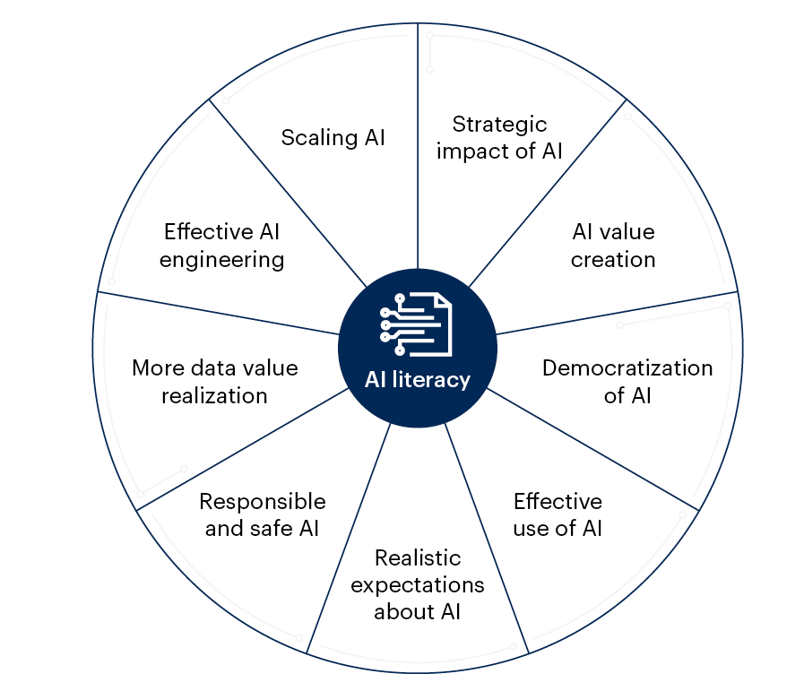
Adoption: Plan for Building HR’s AI Literacy and Digital Skills
An organization’s AI literacy level can make or break its AI investments. Knowledge must go beyond technical skills to include an understanding of AI in its business and social context.
Key benefits of
AI literacy

Slide 30
Adoption: Plan for Building HR’s AI Literacy and Digital Skills
Required knowledge and skill levels will vary across goals. Leverage this illustrative model and document current and required literacy levels for your roles.
AI foundations:
Concepts, applications, techniques, methods and practices
AI value:
Use cases, benefits, costs, effective use, change management and culture
AI designing:
Design, build or buy decisions; validation, deployment; monitoring and analytics
AI governance:
Regulations, policies, ethics, risk management, trust, explainability and data governance
Minimal
Basic
Intermediate
Full
HR leader
HR staff
AI champions
Note: You may leverage Gartner’s Create an AI Literacy Roadmap to Drive Responsible and Productive AI and Develop AI-Ready HR Talent Beyond AI Literacy Foundations for further guidance on building AI literacy and skills.

Slide 31
Alignment: Overview of Activities
Vision
Align to other organizational strategies:
HR business and HR technology
Enterprise
Alignment
Value
HR-focused
AI strategy
Adoption
Risk

Slide 32
Alignment: Hierarchical Relationship of Strategies
These strategies should not exist in isolation. Rather, they should support and enhance one another as they become more detailed and specific.
Consider and address the following questions:
What are your enterprise business and AI strategies?
How does your HR functional strategy align with and support the enterprise strategy?
In what ways does your HR technology strategy facilitate the accomplishment of your HR objectives?
What role does AI play in your HR technology strategy, and how do these elements enable and enhance each other?
Enterprise
HR function
HR technology
HR-focused AI

Slide 33
Alignment: HR Business and Technology Strategy
Leverage your stakeholders to decide on key outcomes that AI can support. Some organizations may wish to ensure this is bidirectional, infusing AI into the HR technology strategy as well or in subsequent years merging into a single strategy document.
Phase 1
Defining business outcomes
Phase 2
Capture gaps and requirements
Phase 3
Determine best-fit future state
Phase 4
Develop
roadmap
Articulate outcomes that AI can generate to support your HR vision.
Capture unique and critical AI-related needs as well (bias mitigation, explainability, etc.).
Assess how AI can enhance the chosen future-state HR technology portfolio option.
Capture AI readiness and implementation initiatives on the roadmap across people, process, tech and data aspects.
Clarity on
destination
Distinctive gaps
And needs
Best-fit technology portfolio
Path for transformation

Slide 34
Alignment: Enterprise-Level AI Strategy
Partner with the broader, enterprise-level leader (who may be in IT or part of a centralized AI COE) to ensure each component of your HR-focused AI strategy aligns with the organization’s needs and goals.
Doing so ensures:
Consistent implementation and usage policies.
Use-case prioritization by enterprise demand and risk tolerance.
Support with technical requirements and GenAI washing (bad actors).
Vision
Alignment
Value
Enterprise-level
AI strategy
Alignment
HR-focused AI strategy
Adoption
Risk

Slide 35
What’s Next?
Vision
I’ve defined my strategy … what’s next?
Revisit and evolve your HR-focused AI strategy at least annually as part of your business and HR technology strategy planning.
Embed AI initiatives into your HR technology roadmap.
Leverage Gartner’s HR AI roadmap and AI maturity tools for broader HR to further establish your AI strategy and other roadmap capability maturity (see next slide for details).
Alignment
Value
HR-focused AI strategy
Adoption
Risk

Slide 36
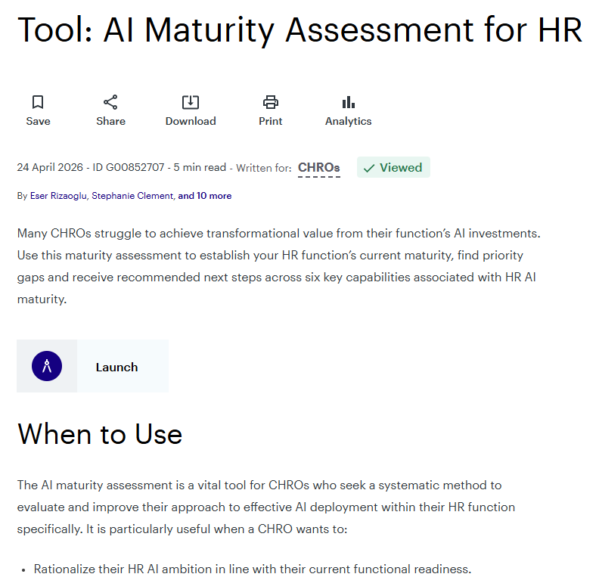
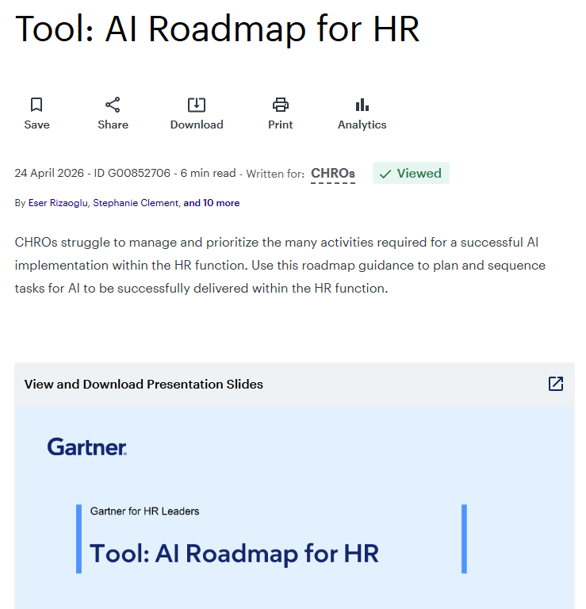
Gartner’s Two Tools to Support You on Your AI in HR Journey
1
2
Tool: AI Maturity Assessment for HR
Tool: AI Roadmap for HR

