Slide 1
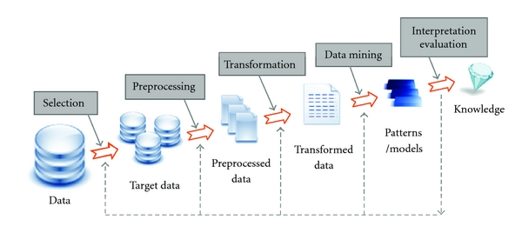
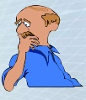
Knowledge Discovery and Data Mining Process
Outcome of DM analysis need to be evaluated and interpreted so as the acquired knowledge to be valuable to end-users
Data Mining Algorithm is utilized for descriptive (discover patterns, rules and trends) or predictive tasks
Transform preprocessed data to be in a suitable format to Data Mining algorithms
Preprocess the target data removing missing values, detecting outliers and inconsistences
Interpretation - Evaluation
Data Mining
Data are gathered to DB Systems. Selecting data is necessary for analysis
Knowledge
Transformation
Preprocessing
Patterns/ models
Transformed Data
Understanding
Selection
Preprocessed Data
Target Data
Data

