Slide 1
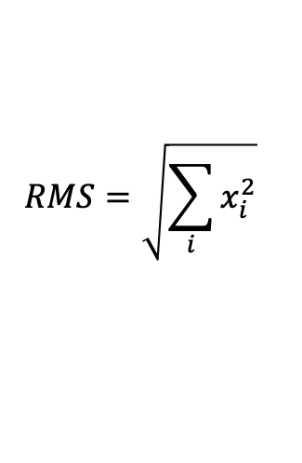
$$RMS=\sqrt{\sum_{i}{x_{i}^{2}}}$$
Let’s agree on the definition!
Note: I take out 1/n otherwise comparing train and test becomes biased driven by different dataset length
CODE:
>> #NEW RMSE STUFF
>> #train
>> rms_train.append(np.sqrt(np.mean(np.square(Y_train_denorm))))
>> diff_train = Y_train_denorm - train_forecast
>> rms_diff_train.append(np.sqrt(np.mean(np.square(diff_train))))
>> #test
>> rms_test.append(np.sqrt(np.mean(np.square(Y_test_denorm))))
>> diff_test = Y_test_denorm - test_forecast
>> rms_diff_test.append(np.sqrt(np.mean(np.square(diff_test))))

Slide 2
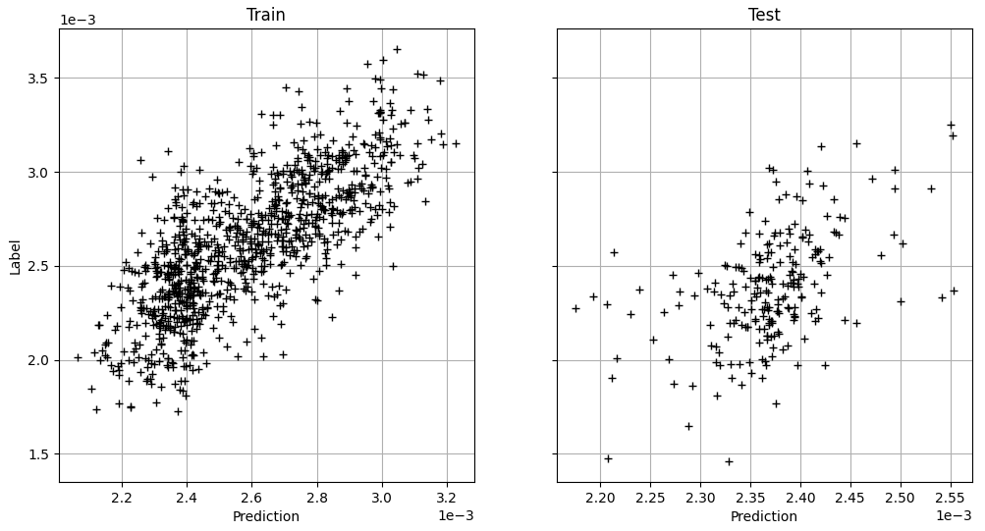
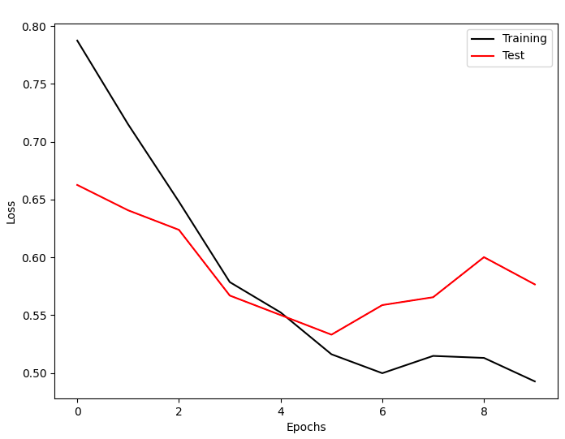
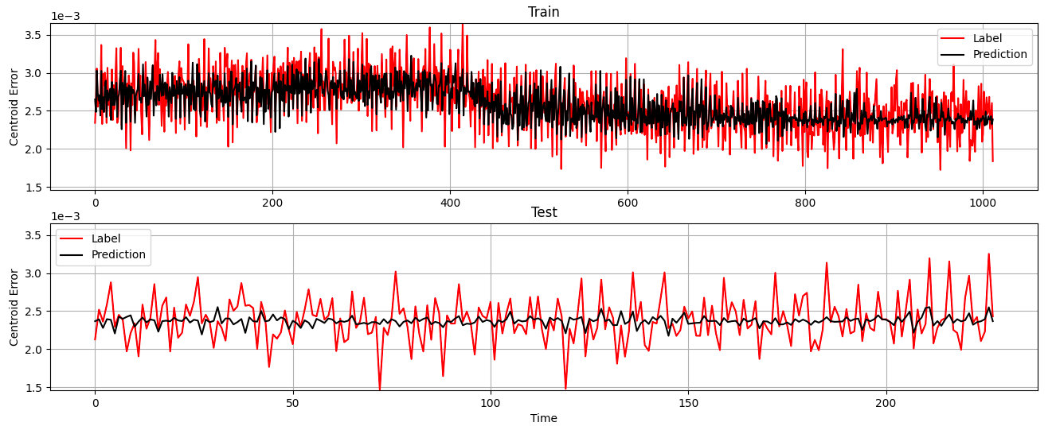
Poorly trained methods
Buncher OFF - Open Loop on the GUN
Train:
RMS RealDataser → 2.64e-03
RMS (RealDataser - Prediction) → 4.26e-04
Test:
RMS RealDataser → 2.40e-03
RMS (RealDataser - Prediction) → 3.02e-04

Slide 3
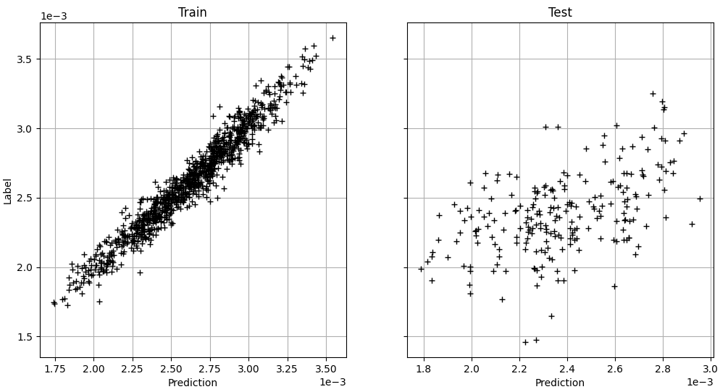
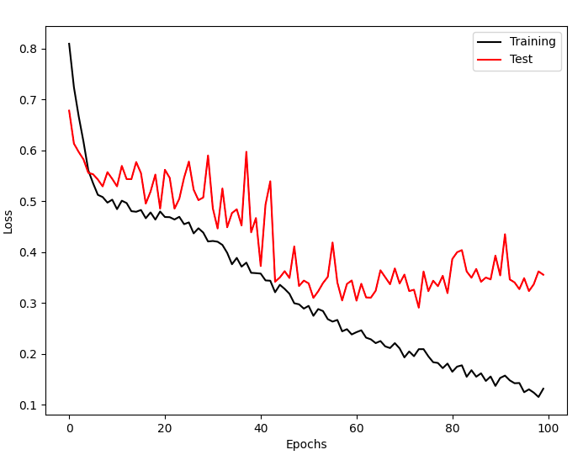
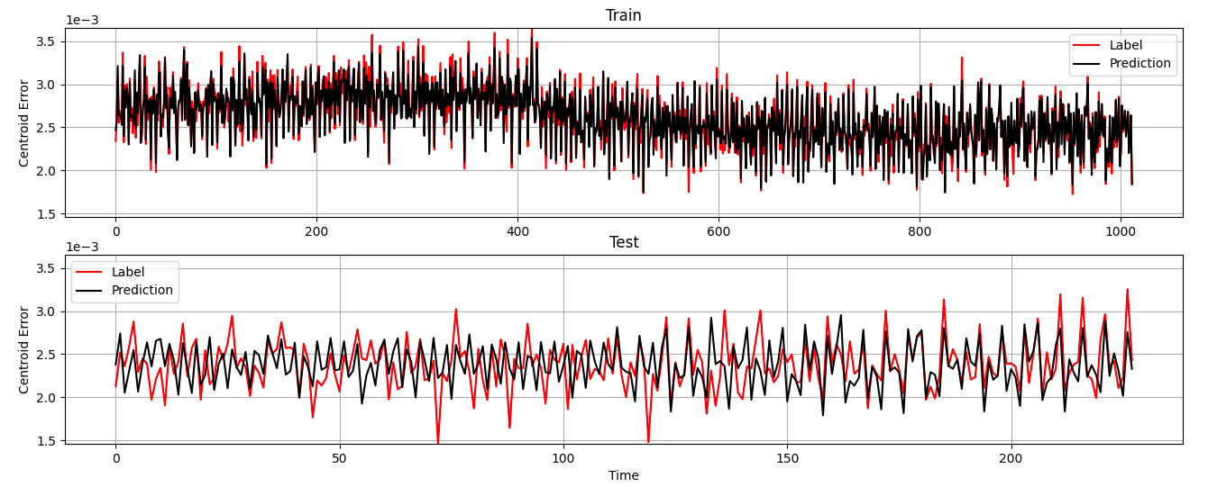
Poorly trained methods
Buncher OFF - Open Loop on the GUN
Train:
RMS RealDataser → 2.64e-03
RMS (RealDataser - Prediction) → 4.72e-04
Test:
RMS RealDataser → 2.40e-03
RMS (RealDataser - Prediction) → 3.51e-04

