Slide 1
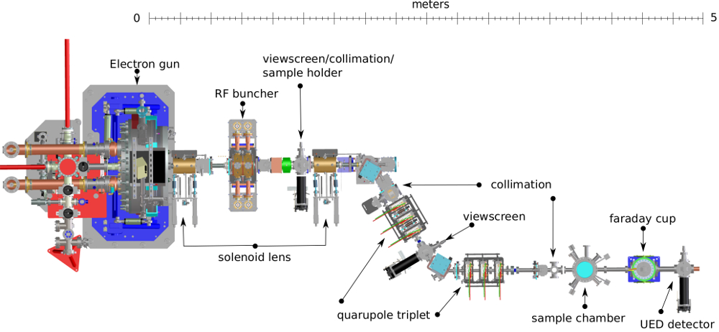
ML applied to HiRES:
Energy Stability
ANTONIO GILARDI
03/18/2022

Slide 2
OUTLINE:
Issues with CLOSE Loop
Metrics
Next steps

Slide 3
OUTLINE:
Issues with CLOSE Loop
Metrics
Next steps

Slide 4
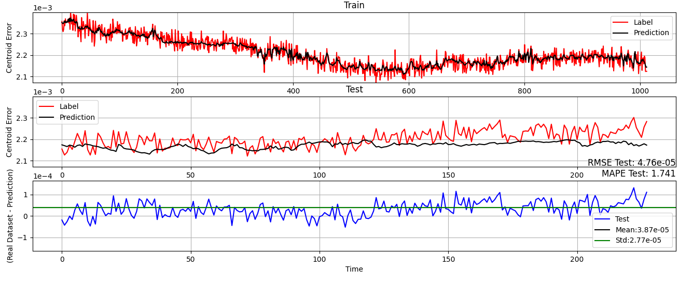
OUTLINE:
Issues with CLOSE Loop
Metrics
Next steps
LSTM

Slide 5
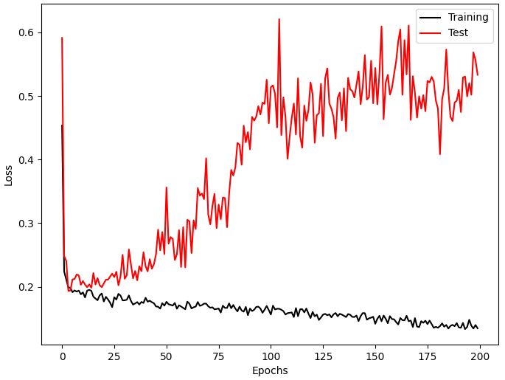
OUTLINE:
Issues with CLOSE Loop
Metrics
Next steps
LSTM

Slide 6
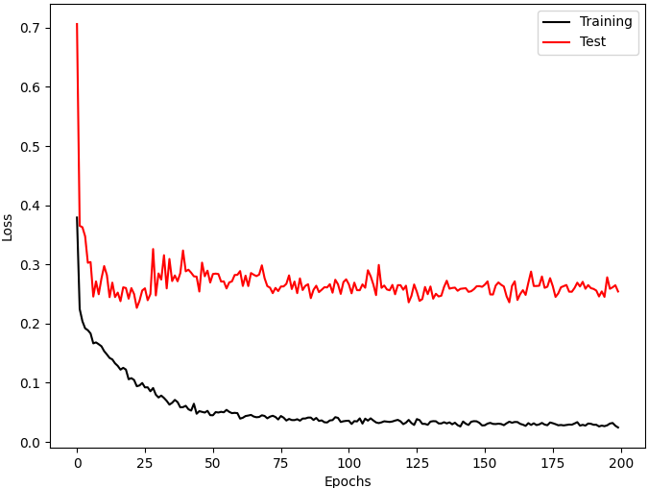
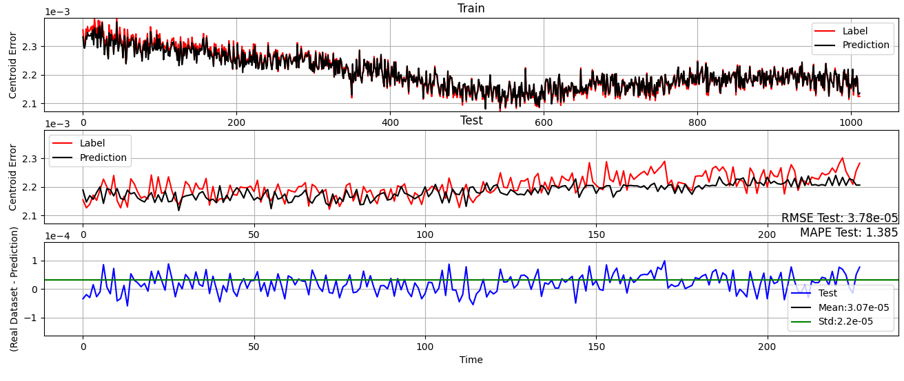
OUTLINE:
Issues with CLOSE Loop solved
Metrics
Next steps
Probably the other NN was not able to properly capture the trend
CNN

Slide 7
OUTLINE:
Issues with CLOSE Loop solved
Metrics
Next steps

Slide 8
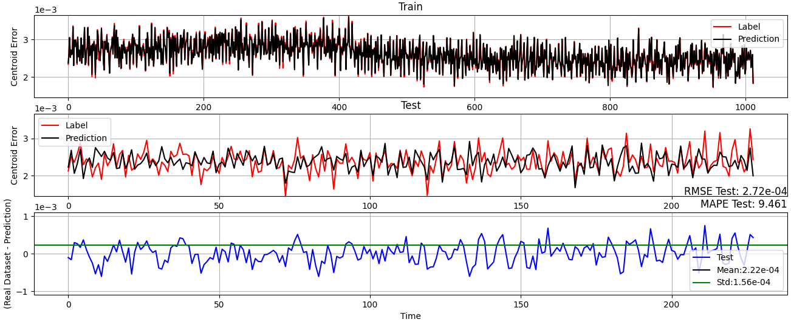
OUTLINE:
Issues with CLOSE Loop solved
Metrics
Next steps
MLP

Slide 9
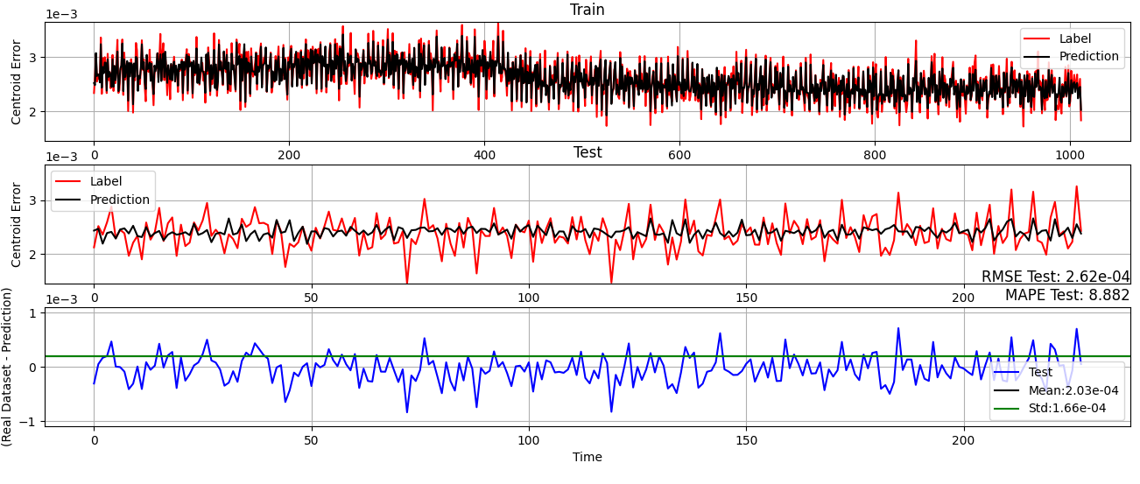
OUTLINE:
Here the STD is comparable to the one before, clearly performing better…. Is the STD the right metrics?
Issues with CLOSE Loop solved
Metrics
Next steps
Random Forest

Slide 10
OUTLINE:
Issues with CLOSE Loop solved
Metrics
Next steps
Improve Plotting
On going → GRID SEARCH → DONE
Make alive GPU PC

Slide 11
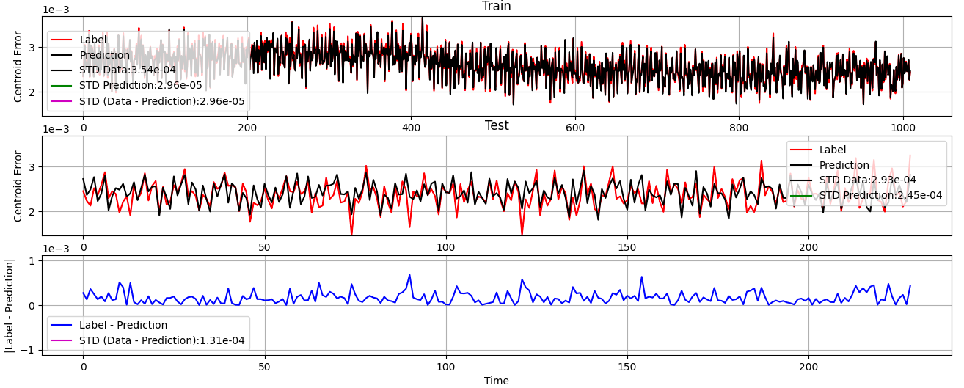
OUTLINE:
Issues with CLOSE Loop solved
Metrics
Next steps
Improve Plotting
On going → GRID SEARCH → DONE
Make alive GPU PC
-------------------------------------- TRAIN --------------------------------------
STD RealDataser -----------------------------------> ['3.54e-04']
STD (|RealDataser - Prediction|) --------------------> ['3.44e-05']
RMSE Prediction -----------------------------------> ['5.41e-05']
-----------------------------------------------------------------------------------
--------------------------------------- TEST ---------------------------------------
STD RealDataser -----------------------------------> ['2.93e-04']
STD (|RealDataser - Prediction|) -------------------> ['1.30e-04']
RMSE Prediction -----------------------------------> ['2.13e-04']
-----------------------------------------------------------------------------------

Slide 12
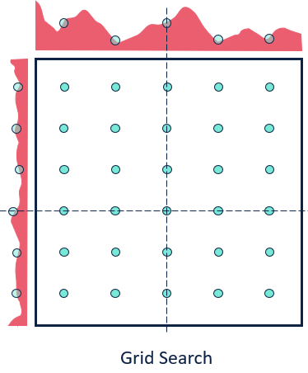
OUTLINE:
Issues with CLOSE Loop solved
Metrics
Next steps
Improve Plotting
On going → GRID SEARCH → DONE
Make alive GPU PC
-------------------------------------- TRAIN --------------------------------------
STD RealDataser -----------------------------------> ['3.54e-04']
STD (|RealDataser - Prediction|) --------------------> ['3.44e-05']
RMSE Prediction -----------------------------------> ['5.41e-05']
-----------------------------------------------------------------------------------
--------------------------------------- TEST ---------------------------------------
STD RealDataser -----------------------------------> ['2.93e-04']
STD (|RealDataser - Prediction|) -------------------> ['1.30e-04']
RMSE Prediction -----------------------------------> ['2.13e-04']
-----------------------------------------------------------------------------------

Slide 13
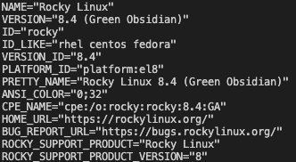
OUTLINE:
Issues with CLOSE Loop solved
Metrics
Next steps
Improve Plotting
On going → GRID SEARCH → DONE
Make alive GPU PC
-------------------------------------- TRAIN --------------------------------------
STD RealDataser -----------------------------------> ['3.54e-04']
STD (|RealDataser - Prediction|) --------------------> ['3.44e-05']
RMSE Prediction -----------------------------------> ['5.41e-05']
-----------------------------------------------------------------------------------
--------------------------------------- TEST ---------------------------------------
STD RealDataser -----------------------------------> ['2.93e-04']
STD (|RealDataser - Prediction|) -------------------> ['1.30e-04']
RMSE Prediction -----------------------------------> ['2.13e-04']
-----------------------------------------------------------------------------------
Current OS
My PC: 122 seconds
My Server: 78 seconds
Your Server: 45 second

