Slide 1
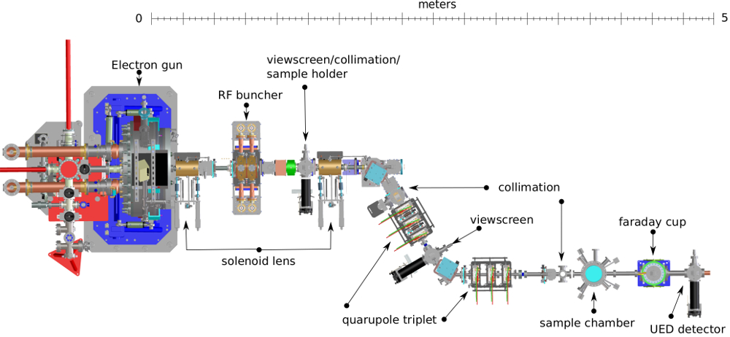
Intermediate analysis of ML applied to HiRES data
Case study: Energy Stability
ANTONIO GILARDI
03/02/2022

Slide 2
Time windows series
TRAIN
TEST
Methodology adopted:
0
800
1000
Further divided in small windows:
Variable definition:
X → All the info used in the training
Y → Beam Centroid to be identified
Interation 2
1
1
2
3
Interation 1
BLUE → REAL Y
ORANGE → REAL X
PURPLE → OLD PREDICTED Y
BLACK → LAST PREDICTED
1
1
2
Interation 0
1
1
0
800
1000

Slide 3
Legend:
Function – Setting variable – Setting variable value – Data
CODE:
>> OL_phs, OL_amp, ILmOL_phs, ILmOL_amp, laser_Phs, laser_amp, Egain, cam = loading(InOrOut = "OutLoop")
>> percentage = 80
>> fit_or_proj = "fit"
>> past_history = 30
>> forecast_horizon = 1
>> normalization_method = 'zscore’
>> targetShift = -2
>> fetureSelection = 1
>> feature_names = ['Cam', ‘RF Amplitude', 'RF Phase']
>> shouldIplot = 0 >> loadboth = 0
Approach tried:
Decision Tree – Linear Regressor – Random Forest (in different flavor) – MLP – LSTM
Best performance achieved with:
LSTM – XGBRegressor (Random Forest like)

Slide 4
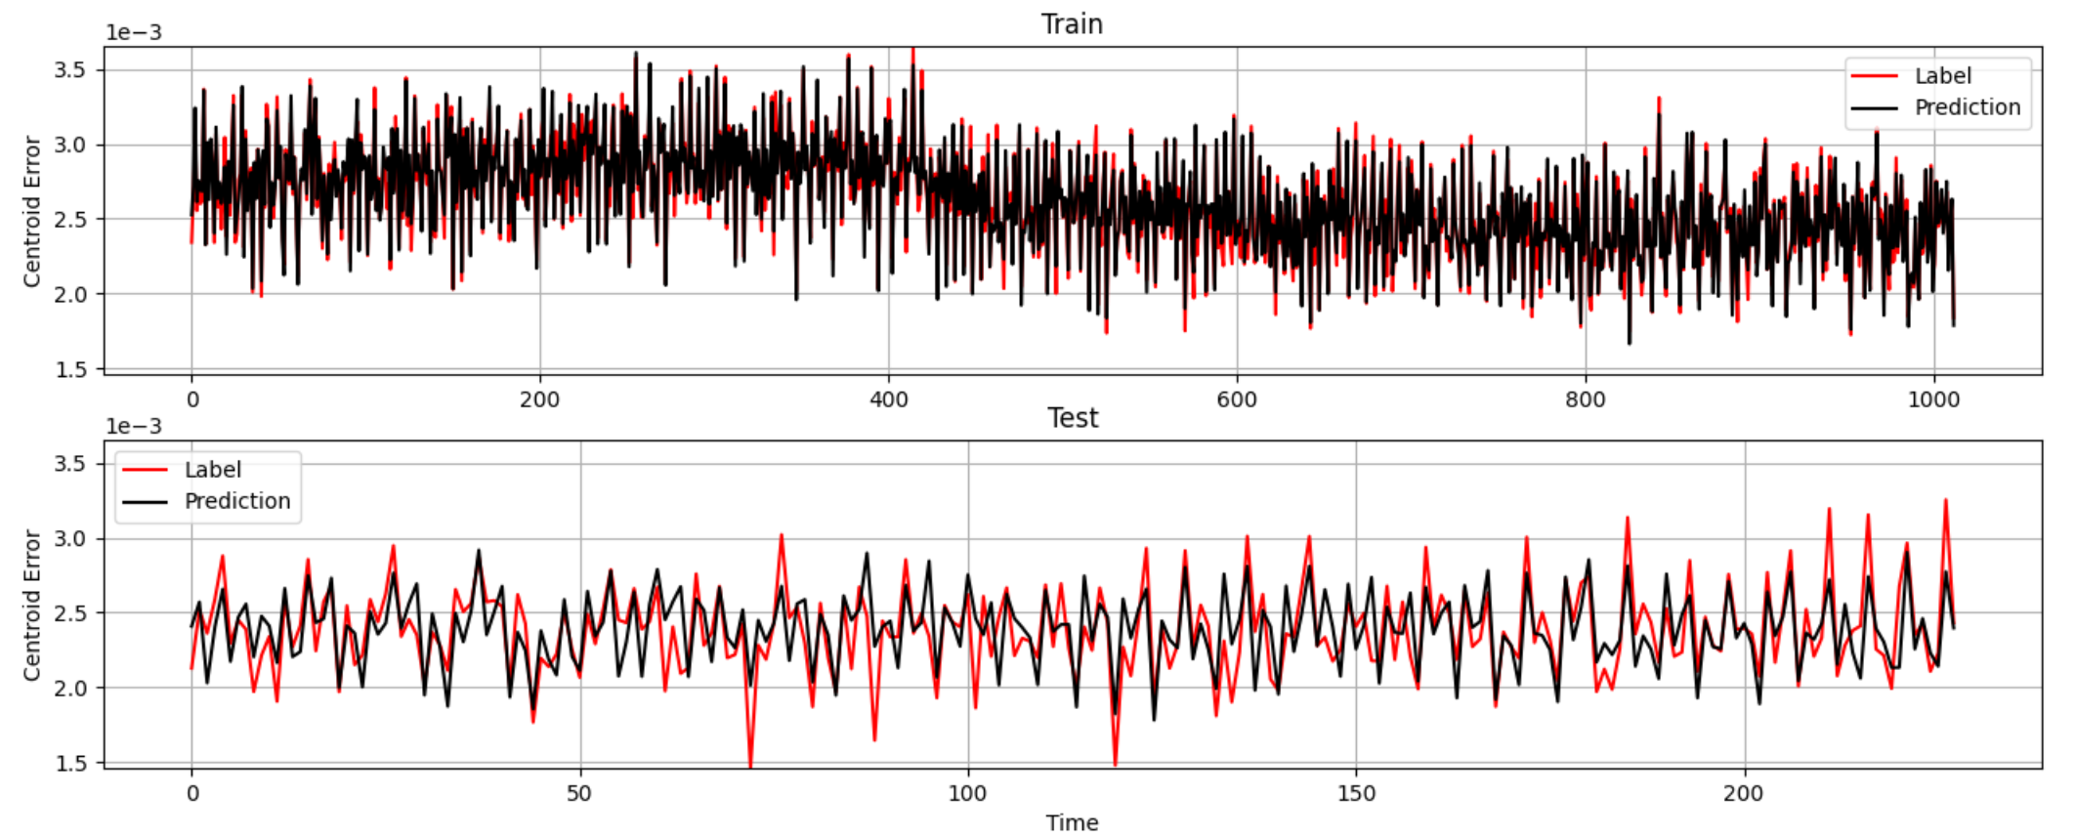
Buncher OFF - Open Loop on the GUN
Training RMSE ['8.45e-05']
Test RMSE ['2.09e-04']

Slide 5
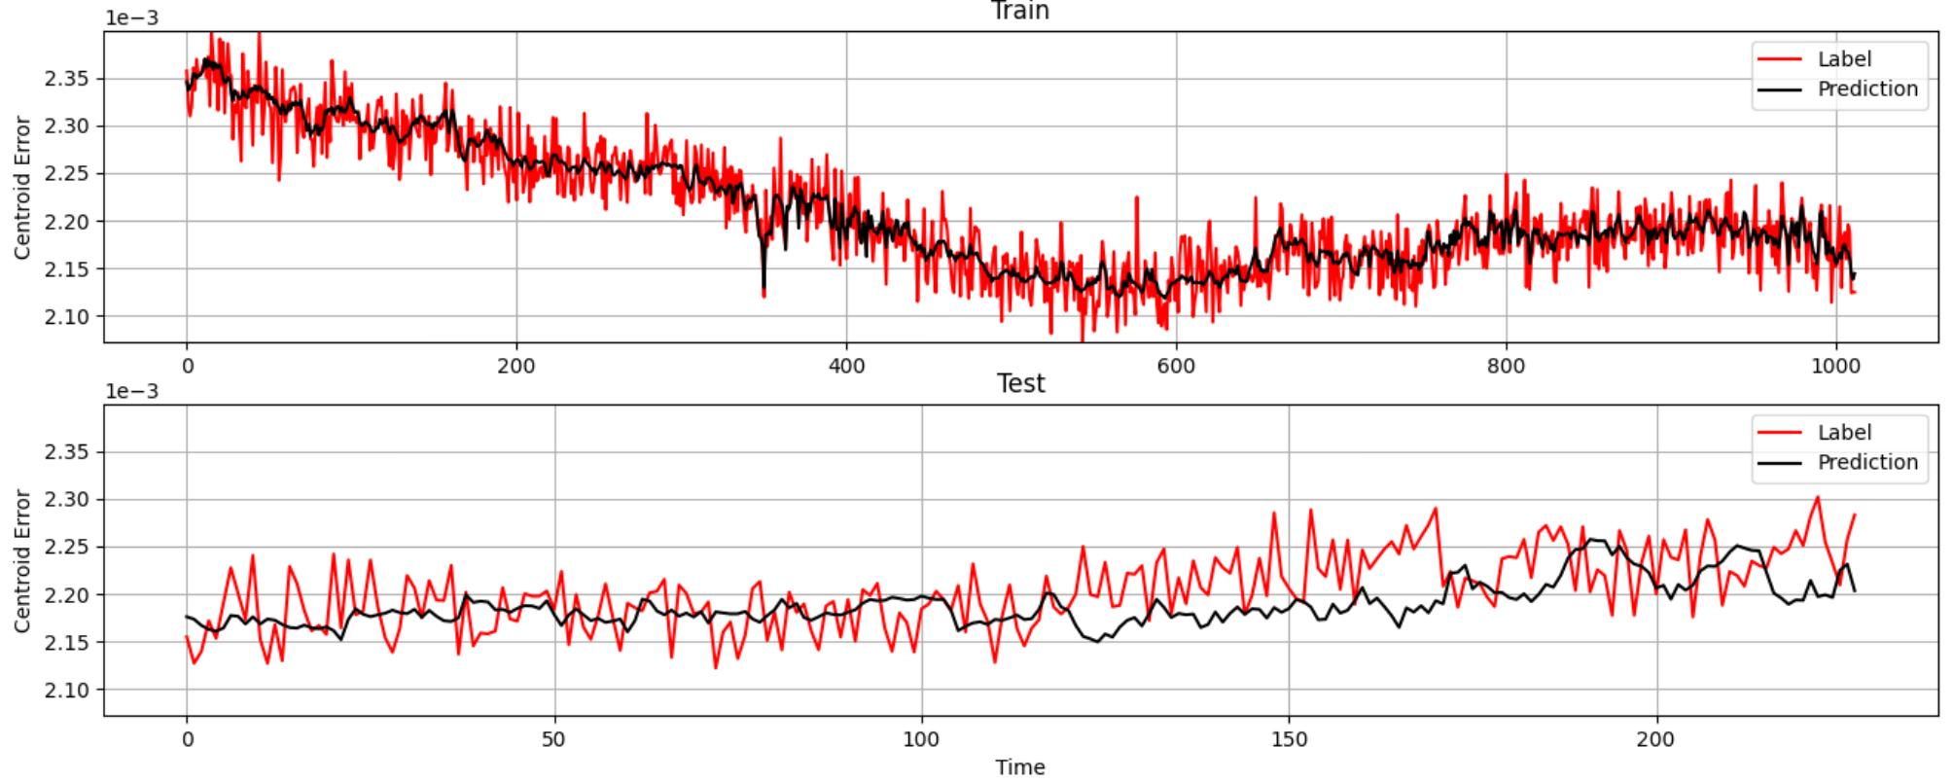
Buncher OFF - Close Loop on the GUN
Training RMSE ['2.28e-05']
Test RMSE ['3.99e-05']

