Slide 1
YAS!
“Any negative polls are fake news, just like the CNN, ABC, NBC polls in the election” - Trump

Slide 2
Introduction
Fake news & Misinformation
Motivation: A healthy democracy requires a well informed citizenry.
Democratic backsliding in countries start off with authoritarian leaders causing mistrust of established media.
Worst case: Public health risks, i.e. Covid.
Can fake news be predicted efficiently by title alone?
If the most skeptical cannot trust their leaders, trust computers?

Slide 3
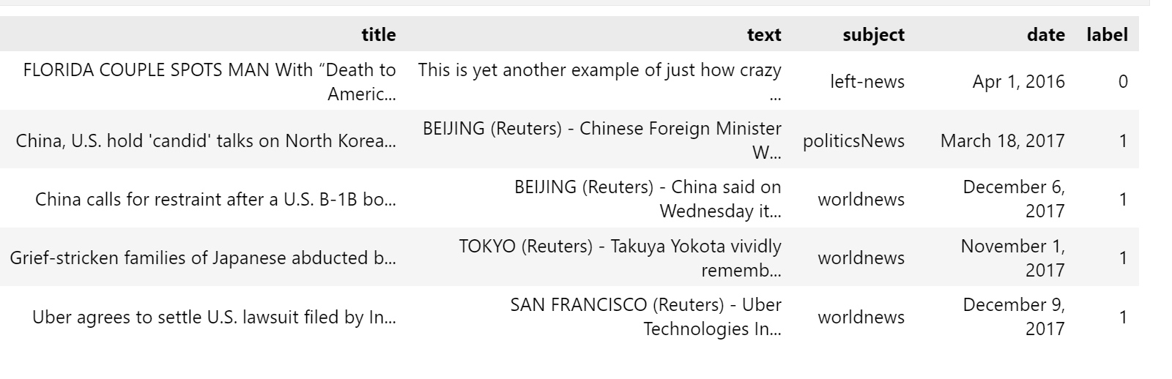
Dataset
We are using an open-source dataset for fake news and real news.
Fake news: 23481, Real news: 21417
Total: 44898

Slide 4
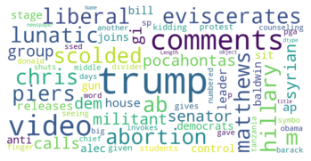
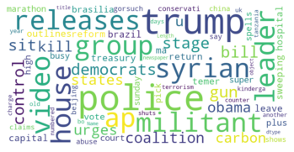
Method:
Baseline Model: TF-IDF Logistic Regression
Fake news word cloud
Real news word cloud

Slide 5
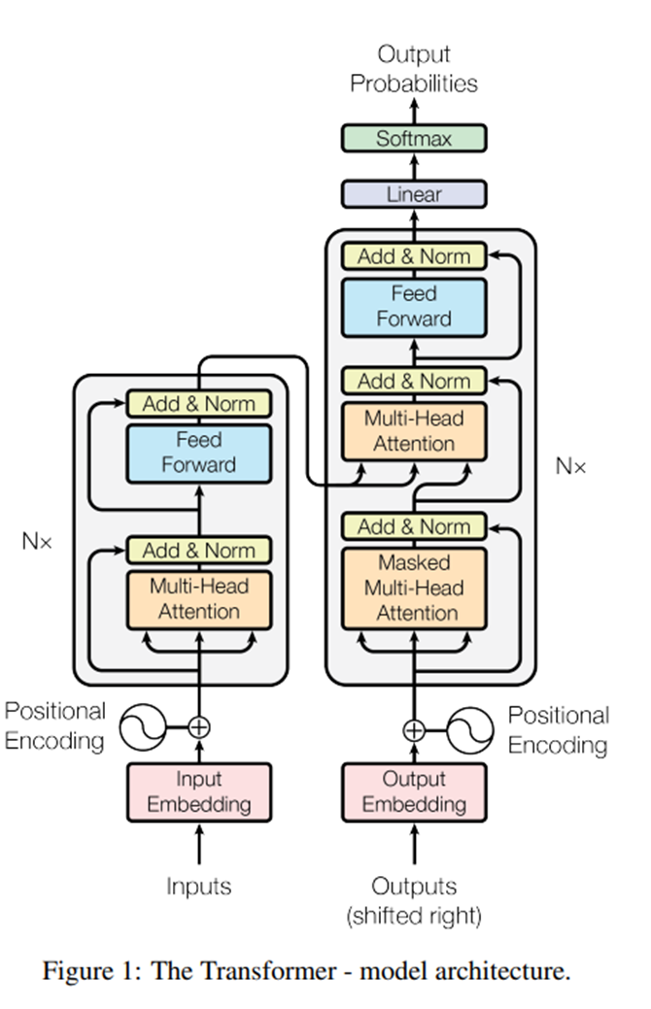
Method
BERT:
Bidirectional Encoder Representations from Transformers
Common applications:
Text Classification,
Next Sentence Prediction,
Sentiment Analysis
Resource
Webpage on BERT:
https://towardsdatascience.com/bert-explained-state-of-the-art-language-model-for-nlp-f8b21a9b6270
Google Paper:
https://arxiv.org/pdf/1706.03762.pdf

Slide 6
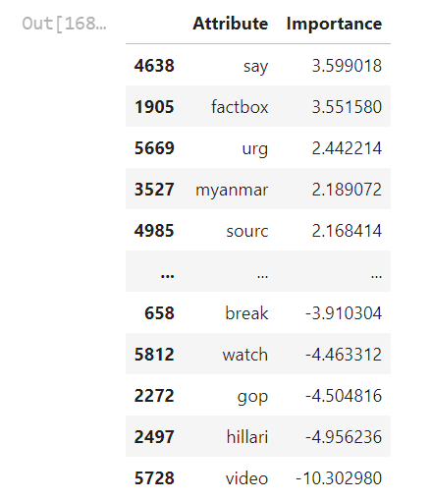
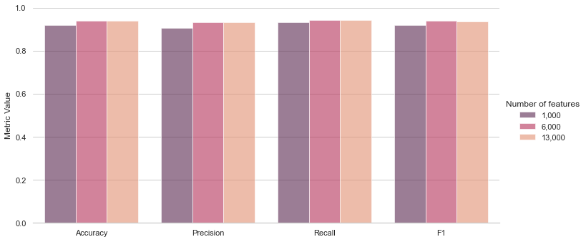
Experiment Setup & Results
Baseline Model: TF-IDF Logistic Regression

Slide 7
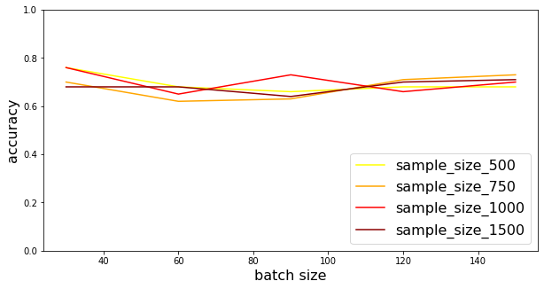
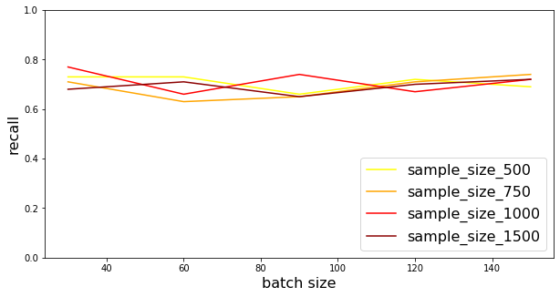
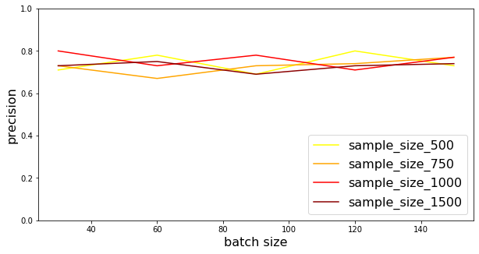
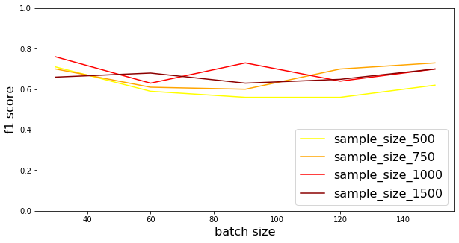
Experiment Setup & Results
BERT best performance: 88% accuracy (sample size: 30000, batch size = 32)

Slide 8
Conclusion & Key Lessons
Complexity vs Accuracy
Pre-training can be helpful
No free lunch
Computing resources
Data Drift

