Slide 1
BITCOIN prediction (NN)

Slide 2
What is bitcoin
A crptocurrency
Form of electronic cash
Similar to stock

Slide 3
Why bitcoin?
It can convert into USD
Per bitcoin right now is 5146.90
Highest peak was 20,000

Slide 4
goal
Analyze data
Create a prediction

Slide 5
tools
Binance.client
Datetime
numpy
Pandas
Matplotlib
Normalization( MinMaxScaler)
tensorflow

Slide 6
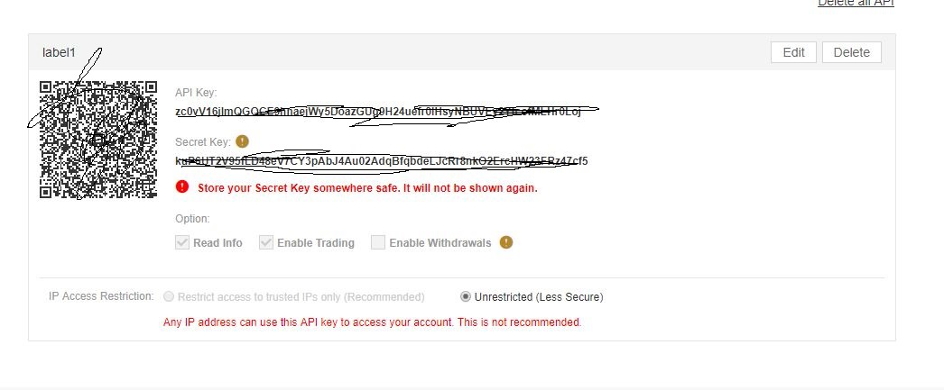
data
Binance exchange api

Slide 7
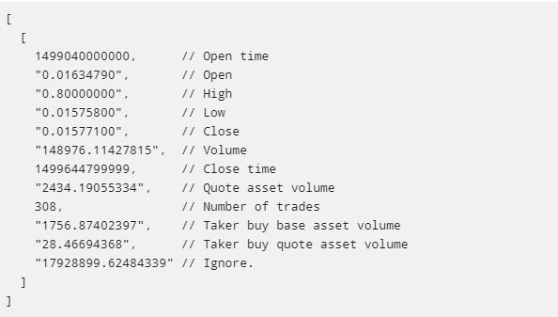
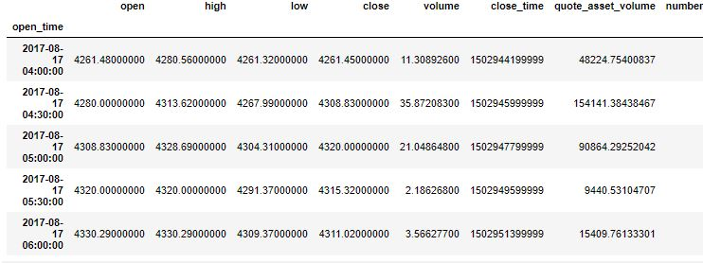
30minutes
4 years

Slide 8
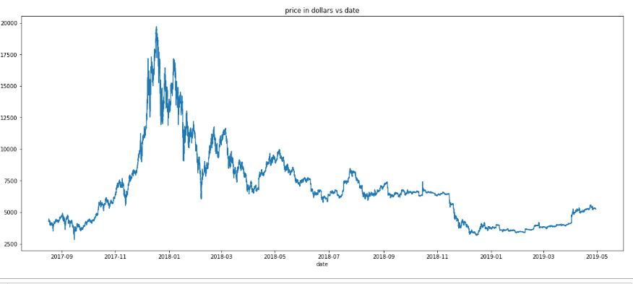
Analyze
Current= 5,146.90
Peak = almost 20,000.00

Slide 9
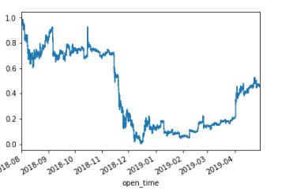
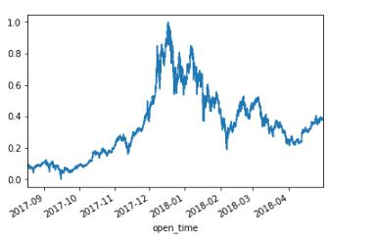
Correlation by years

Slide 10
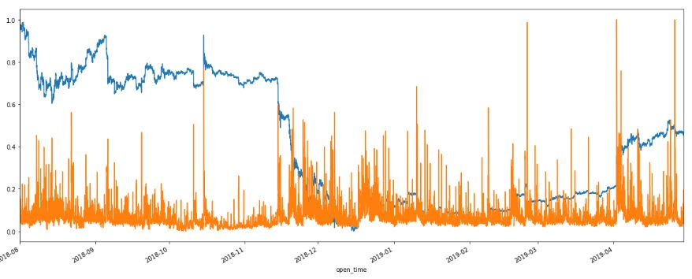
Close vs number of trades

Slide 11
usuage
Simply time series

Slide 12
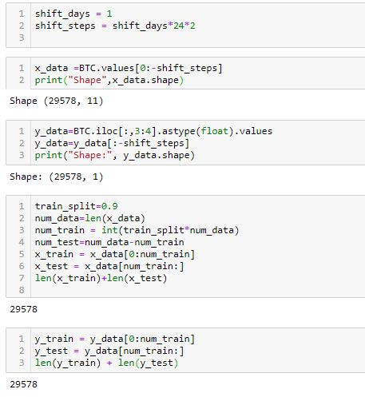

Slide 13
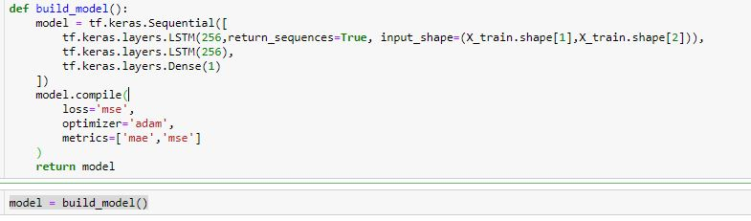

Slide 14
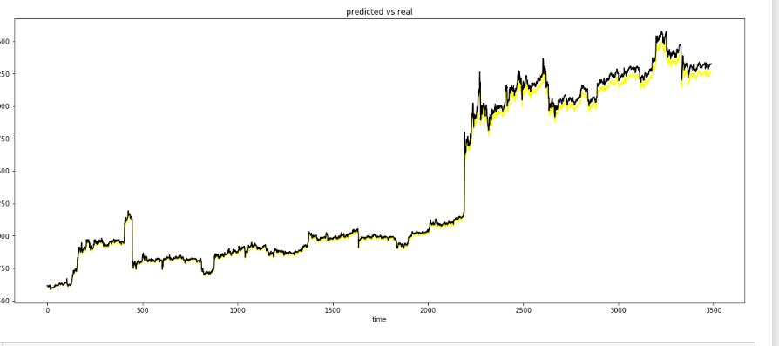

Slide 15
improvement
Improve time series by using simple exponential smoothing
Use twitter data
Create more relation to feed into tensorflow.

