Slide 1

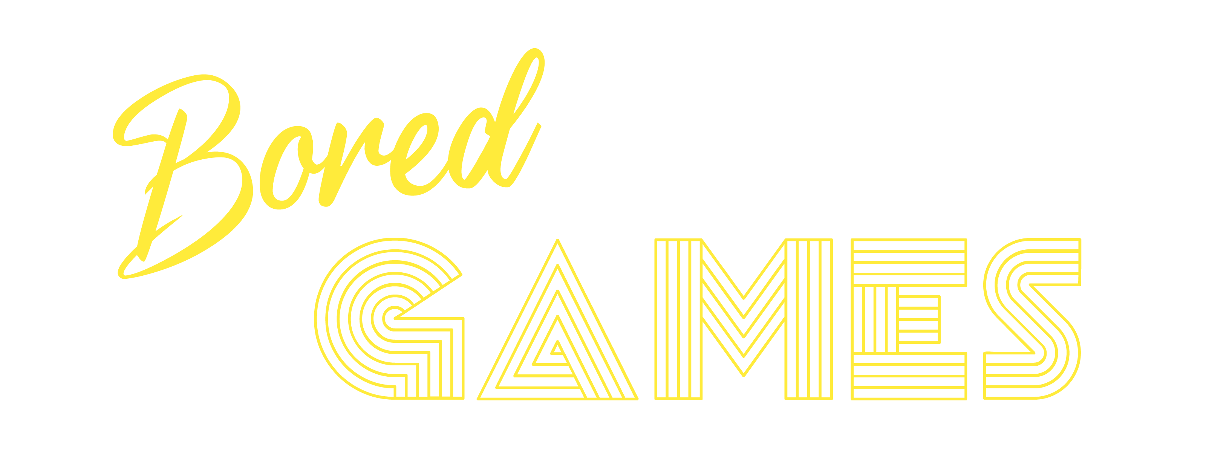
Distributed systems, COMP411
Kapenekakis antheas,
Margaritis Georgios
Instr. V. Samoladas

Slide 2
Architecture
MongoDB
Replica set
Gamemaster
Zookeeper
MongoDB
Replica set
Playmaster
Playmaster
Playmaster
AUTH
NGINX+UI
MySQL
User1
User2
User3

Slide 3


Authentication
Written in PHP with external MySQL DB
Served by NGINX+php-fpm
Uses JWT tokens with RS256 asymmetric encryption as AUTH bearer:
UI submits user credentials (through REST)
Auth validates user credentials
Auth issues JWT signed token (with expiration) and refresh token
Protected service validates JWT using public key (no API call to AUTH needed)
If JWT expires (once every 20 minutes) the refresh token is used to generate a new one

Slide 4
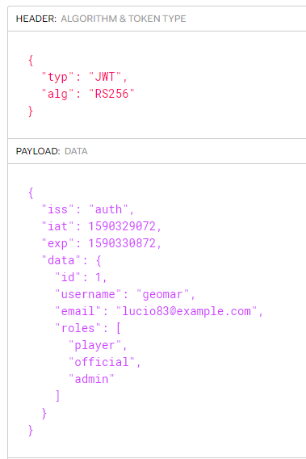
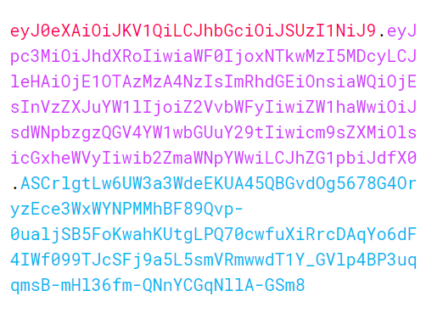
AUTHENTICATION: JWT Example
Issuer
Issued at
Expiration date
Original
Base 64 decoded

Slide 5
Authentication: Api
/create?username=#&password=#&email=#&secret=#
Creates a user with a username, password and a user secret
/login?username=#&password=#
Logins the user and returns a signed JWT and a refresh token on success
/change_role?jwt=#&roles[]=admin&roles[]=official&username=#
Changes the role of a specified user (can only be performed by an admin)
/forgot?username=#&password=#&secret=#
Used to reset the user password given the secret answer
/refresh_token?refresh_token=#
Returns a new (valid) JWT token for the user with the specified refresh token

Slide 6
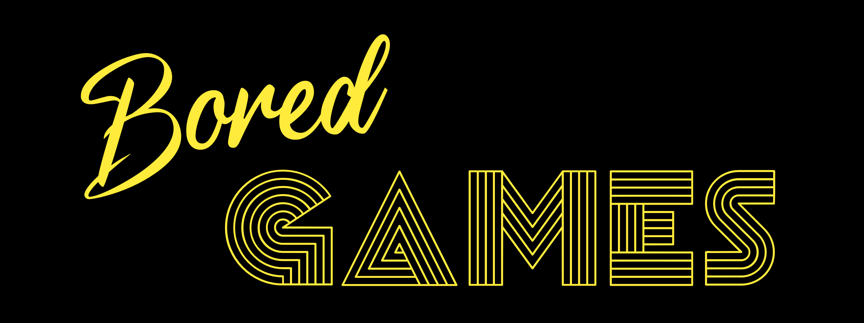


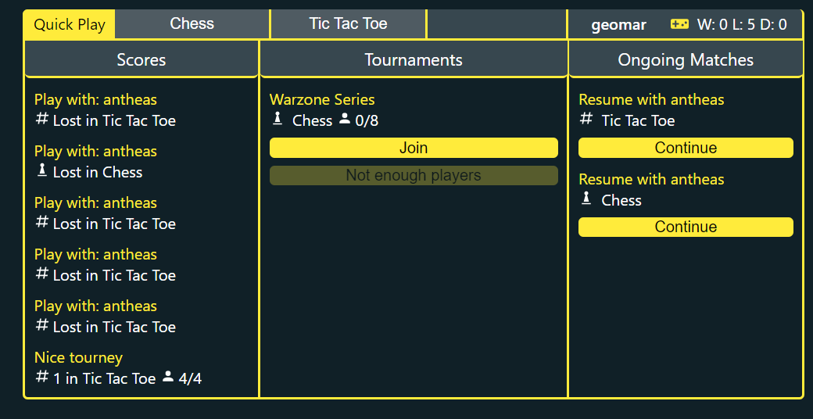
User interface
Simple Logo created in Illustrator
Comes in different styles
For Favicon, Header, and Logo
App Written in React as a PWA
Styled completely using SASS and CSS3 (flexbox)
without the use of a component library such as bootstrap
Packaged using Webpack
Implements code bundling, chunking, minification and code splitting
Games are downloaded only when the user joins a play and cached
Can support hundreds of different games without slowdowns!
Completely Static Resources with NO SSR!
Can be served by NGINX or CDN for pennies per month

Slide 7
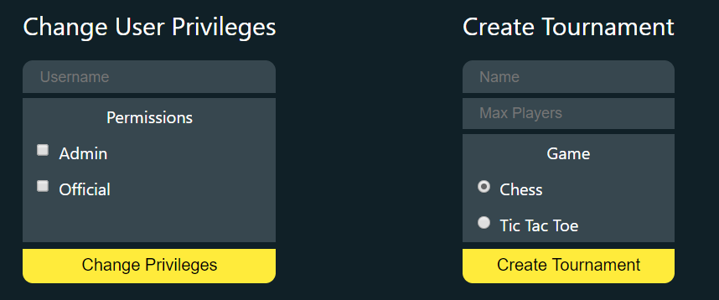
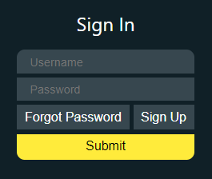
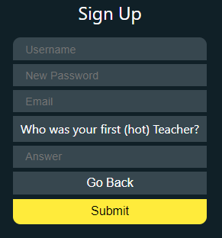
User interface Logic
Written in React as a PWA (Progressive Web App) with a Model-View-Controller Architecture
Uses redux to create a local Model with app data
Redux sagas implement a background thread (Controller) which mutates the Model
React binds the Model to the UI
Architecture allows for complex logic such as refreshing the tokens, matchmaking and communicating with multiple services client-side
Uses Websockets (socket.io) to communicate with Playmaster
Websockets provide instant response during the game, allowing fast moves, smooth gameplay, and access to Chat

Slide 8
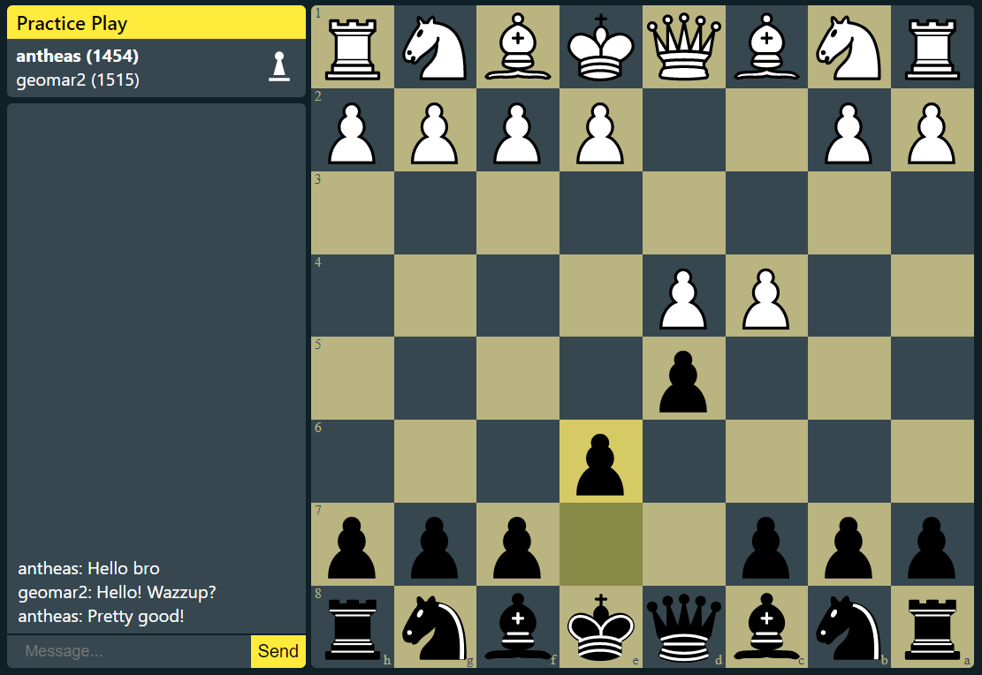
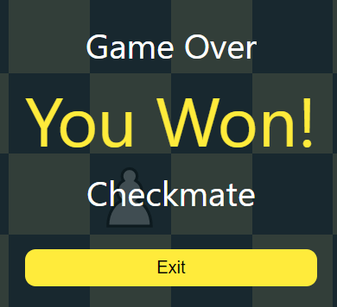
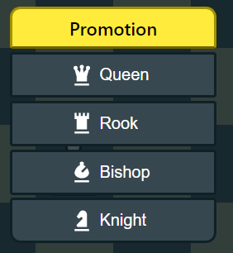
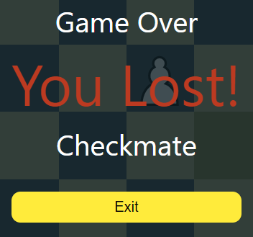
Chess
Uses Chess.js library both on client and server for move validation
Possible moves are highlighted when hovering a piece
All Chess moves and game endings are supported, including promotion with any piece, en passant, and stalemate
Revalidation of moves on server prevents cheating
Source of truth of the play progress stays on the server and written to a replicated database every round
Even if a Playserver dies progress is online so no exploit is possible
Backed by Chessboard.jsx, piece moves are animated

Slide 9
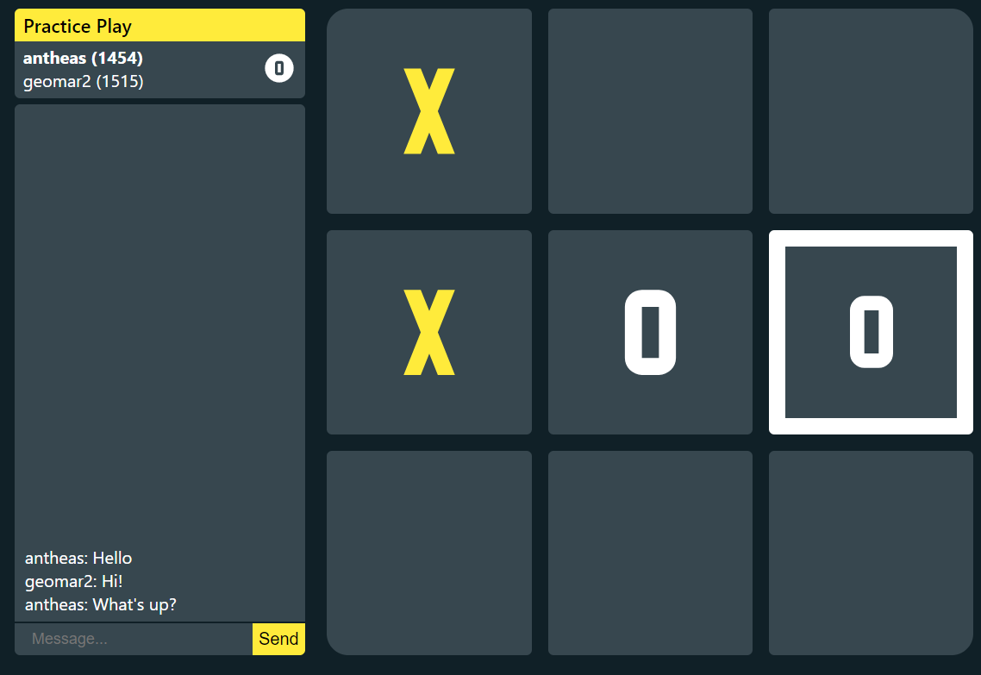
Tic-Tac-Toe
Uses custom-made validator on both server and client
Provides the same standard of security as Chess
UI made from scratch

Slide 10
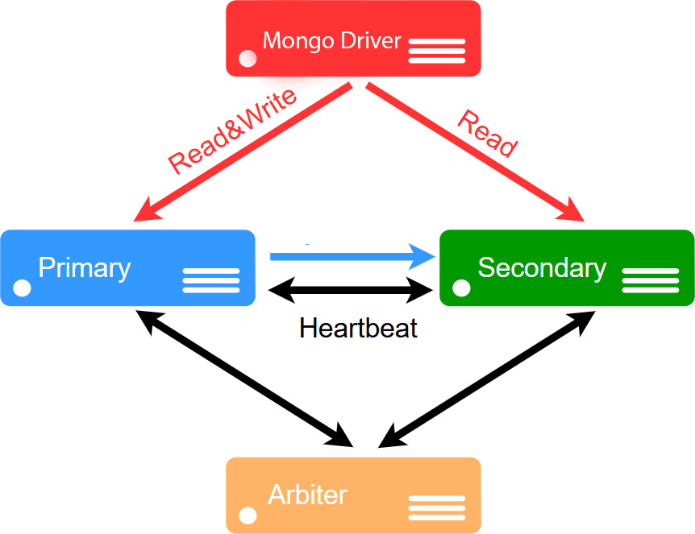
Mongodb Replica set
Replica set consists of the following nodes:
Primary (Reads/Writes/Transactions)
Secondary (Reads)
Arbiter (participates in master election)
More Secondaries can be added
Can use sharding for horizontal scalability
Schema was designed with it in mind
When Primary dies:
New Primary is elected
Driver redirects reads/writes to new Primary
Replication

Slide 11
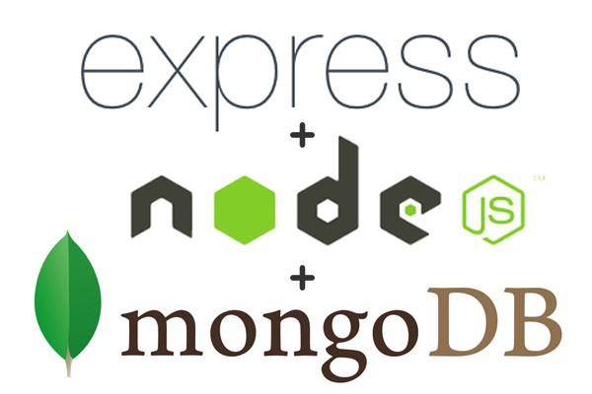

Gamemaster
Written in NodeJS
Utilizes Express framework for REST API implementation
Communicates with Zookeeper to assign plays to Playmasters
Uses a MongoDB replicated cluster for persistent storage
Responsibilities:
Tournament creation & Management
Tournament pairing & winner announcing
Matchmaking (practice plays, tournaments)
Player stats (game scores, tournament scores, number wins/losses/ties, ELO)
Uses de-normalized schema for faster reads
Writes use MongoDB Primary Node and frequent reads use MongoDB Secondary node
Can be very easily replicated (stateless container)

Slide 12

Gamemaster: tournaments
An official creates a new tournament
The tournament becomes visible to all connected users
Users join the tournament
When at least 4 users has joined, the official can start the tournament
Let’s say that there are n players. Then in the first round:
Only $A=2n −2^{\left\lceil \log_{2}{n}\right\rceil }$ players are paired.
Out of those, the $\frac{A}{2}$winners pass to round 2 (draw leads to a rematch)
The rest $n−A$ players instantly pass to round 2
This way next rounds will have power of 2 players ⟶ Fairness
Rounds continue until only 2 players are left
In the last round:
The 2 remaining players play for 1st+2nd position
The last 2 eliminated players play for 3rd +4th position

Slide 13
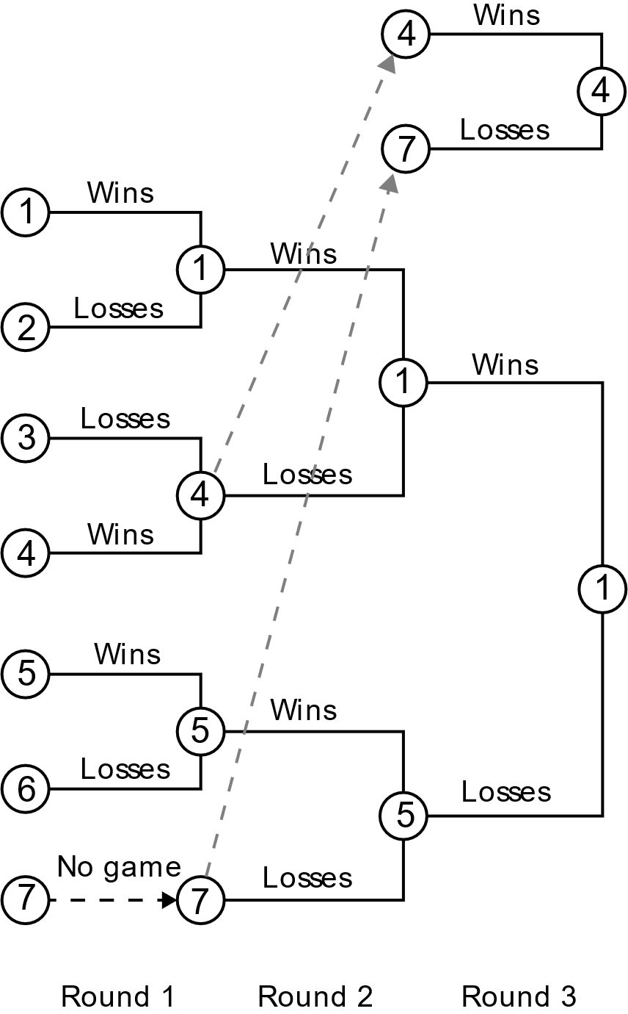
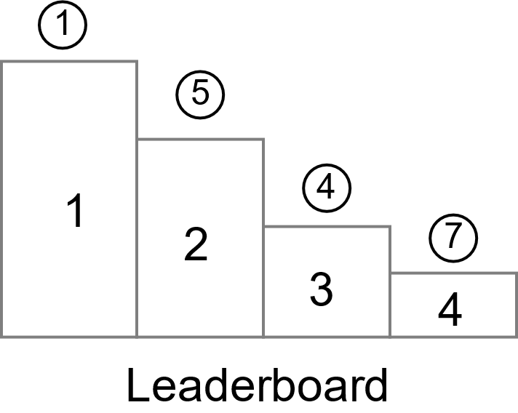
Tournament Example

Slide 14
GAMEMASTER: Api (1)
/tournament/list?jwt=#&mode=active|future|past
Lists the tournaments (active, future or past)
/tournament/info?jwt=#&id={tournament_id}
Retrieves information about a specific tournament (rounds, games, leaderboard e.t.c)
/tournament/create?jwt=#&name=#&game_type=chess|tic-tac-toe
Creates a new tournament (requires official role)
/tournament/register?jwt=#&tournament_id=#
Joins an existing tournament

Slide 15
GAMEMASTER: Api (2)
/me/match_history?jwt=#
Returns the match history of a specific user (total wins-losses-ties-ELO)
/me/active_games?jwt=#
Returns the active games of a user
/user/stats?jwt=#&username=geomar
Retrieves the stats of a user
/practice/join_queue?jwt=#&game_type=chess|tic-tac-toe
Join matchmaking Queue
/join_game?jwt=#&game_id=#
Joins an existing active game by id

Slide 16

Playmaster
Written in ΝodeJS
Uses replicated mongoDB cluster to store last game positions
Registers itself to Zookeeper during initialization
Uses socket.io for communication with clients (web socket based) and includes chat
Designed with load-balancing in mind:
Games are assigned to Playmasters with less games
Fault tolerant (will be explained later)
If a Playmaster dies, the game is assigned to a new one

Slide 17
Playmaster
Playmaster creates a sequential emphemeral node in zookeeper containing:
Playmaster ID
Playmaster IP suffix -> 10.0.7.XX
Number of active games
When the user wants to join a game the Gamemaster:
Checks if the game is assigned to a Playmaster
If it is assigned and the Playmaster is alive ⟶ the Playmaster is returned
If it is not assigned or the Playmaster is dead:
Gamemaster queries zookeeper
Gamemaster finds Playmaster with least plays and assigns the play to it

Slide 18
Zookeeper
Used for Playmaster service discovery & load balancing
Contains 2 root Znodes:
/playmasters ⟶ Each playmaster creates a sequential ephemeral node:
Node name: Playmaster IDs (e.g. id0000002)
Node value: Last segment of their IPs
/load_balancing ⟶ Each playmaster creates an ephemeral node:
Node name: playmaster ID + Playmaster number of games
Find playmaster with least games in a single zookeeper call

Slide 19
Fault tolerance: playmaster is down
Consider the scenario: “Playmaster of an active game dies”
The followings steps are followed:
UI socket connection times out ⟶ UI detects Playmaster is down
UI waits for Zookeeper session timeout (3 sec)
UI requests from Gamemaster to re-join the game
Gamemaster checks zookeeper to see if Playmaster is dead
Gamemaster queries zookeeper to get a new Playmaster (with the least active games)
Gamemaster returns the new Playmaster
Users join the new Playmaster
The new Playmaster loads the game progress from the shared MongoDB cluster
If the Playmaster loses connection with Zookeeper it severs all of its connections and restarts with a new ID, acting like it died. That way, consistency is maintained.

Slide 20
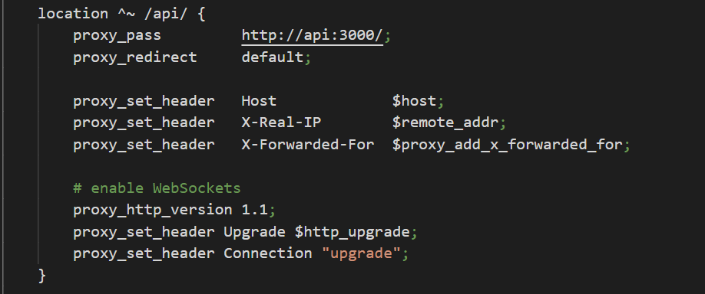
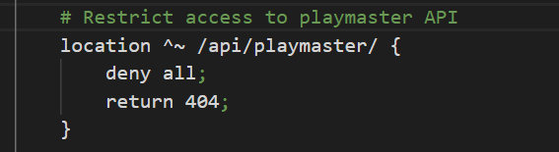
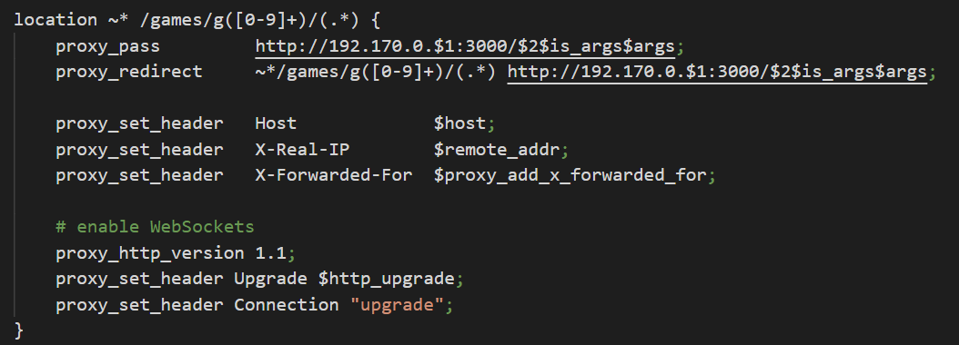
Nginx
Serves the complete Frontend UI
All traffic from the outside world passes through NGINX
Solves CORS issues
Limits access to internal services to a specified port and protocol
Used as reverse proxy for:
Connection with Playmaster (sockets + REST)
Connection with Gamemaster
Authentication service
Proxy-redirect rules:
/games/g# ⟶ 192.170.0.#:3000
/auth ⟶ http://auth
/api ⟶ http://api:3000
One is enough per Datacenter (can saturate uplink connection)
If the Node containing it fails, it can be moved to another one

Slide 21
Benchmarks, UI
NGINX Capacity: 2GB/s
Can fully saturate a 1gbps uplink 16 times
Asset Size: 400kB + 200kB Chess + 20kB Tic Tac Toe
Asset name contains hash -> can cache until asset update or 30 days
At 1gbps we can serve assets to 700k unique users per hour
A CDN plan of 400gB/month for 5$ can serve 400k users
Estimated Cost: 0.00002$ per user per month for bandwidth

Slide 22
Benchmarks, authentication
Authentication server can handle 1800 login/refresh requests per second
Each user makes a request only during initial load and every 20 minutes afterwards
Worst case: 10 Requests per hour (User reloads website often)
Can be limited to 4 by storing access token as a cookie as well
Performance: 650k users per hour
PHP container is stateless, can be replicated for horizontal scaling
MYSQL Database cannot be replicated for scalability
All requests write to it
Refresh token changes and is written to database on every access token request

Slide 23
Benchmarks, Gamemaster
Gamemaster runs on Node.JS -> Single Threaded
Each instance uses one vCPU
Performance: 500-1500 requests per second (depending on request) for one instance
By caching lobby polling requests we can reduce requests to worst case 100 per user per hour
User only makes REST requests on lobby load, joining games, and using the admin form
Total Performance: 18k Active Users per vCPU/instance
Horizontal Scaling is an option since Gamemaster is stateless
Database can be scaled using Sharding

Slide 24
Benchmarks, Playmaster
Playmaster uses sockets and cannot be benchmarked using Apache Bench
Hard Limit: 65k sockets over all Playmasters due to sharing a single NGINX interface
Ongoing plays are limited to 20k ongoing simultaneously
TCP Requests use sockets as well
Solution: a domain name, HTTPS, proper CORS headers, and reserving multiple IPv4 IPs
reverse proxies can then be set up for multiple banks of Playmasters in subdomains

Slide 25
Project Directory Structure
Authentication: ./auth
Gamemaster: ./api
Playmaster: ./game
Web Interface: ./web
To run consult README.md for instructions

Slide 26
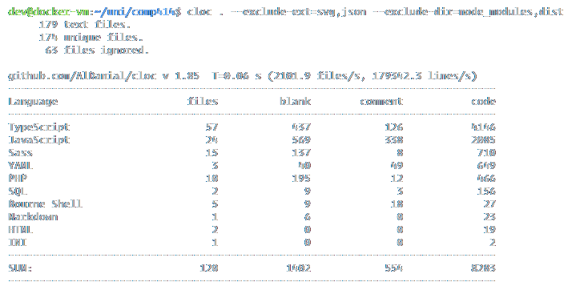
Code Lines Overview

Slide 27
Thanks for your attention
“A distributed system is one in which the failure of a computer you didn't even know existed can render your own computer unusable” — Leslie Lamport

