Slide 1




Generative Bridge Models Improve Financial Forecasting by Foundation Models
RefineBridge
Presenter: Anthony Bolton
Anthony Bolton ⋆ Wuyang Zhou ⋆
Zehua Chen Giorgos Iacovides Danilo Mandic
Notes:
Good afternoon. I'm Anthony from Imperial College London. The work I will be presenting today is RefineBridge, a Schrödinger-Bridge-based post-processing module that refines time-series foundation model forecasts on financial data.

Slide 2
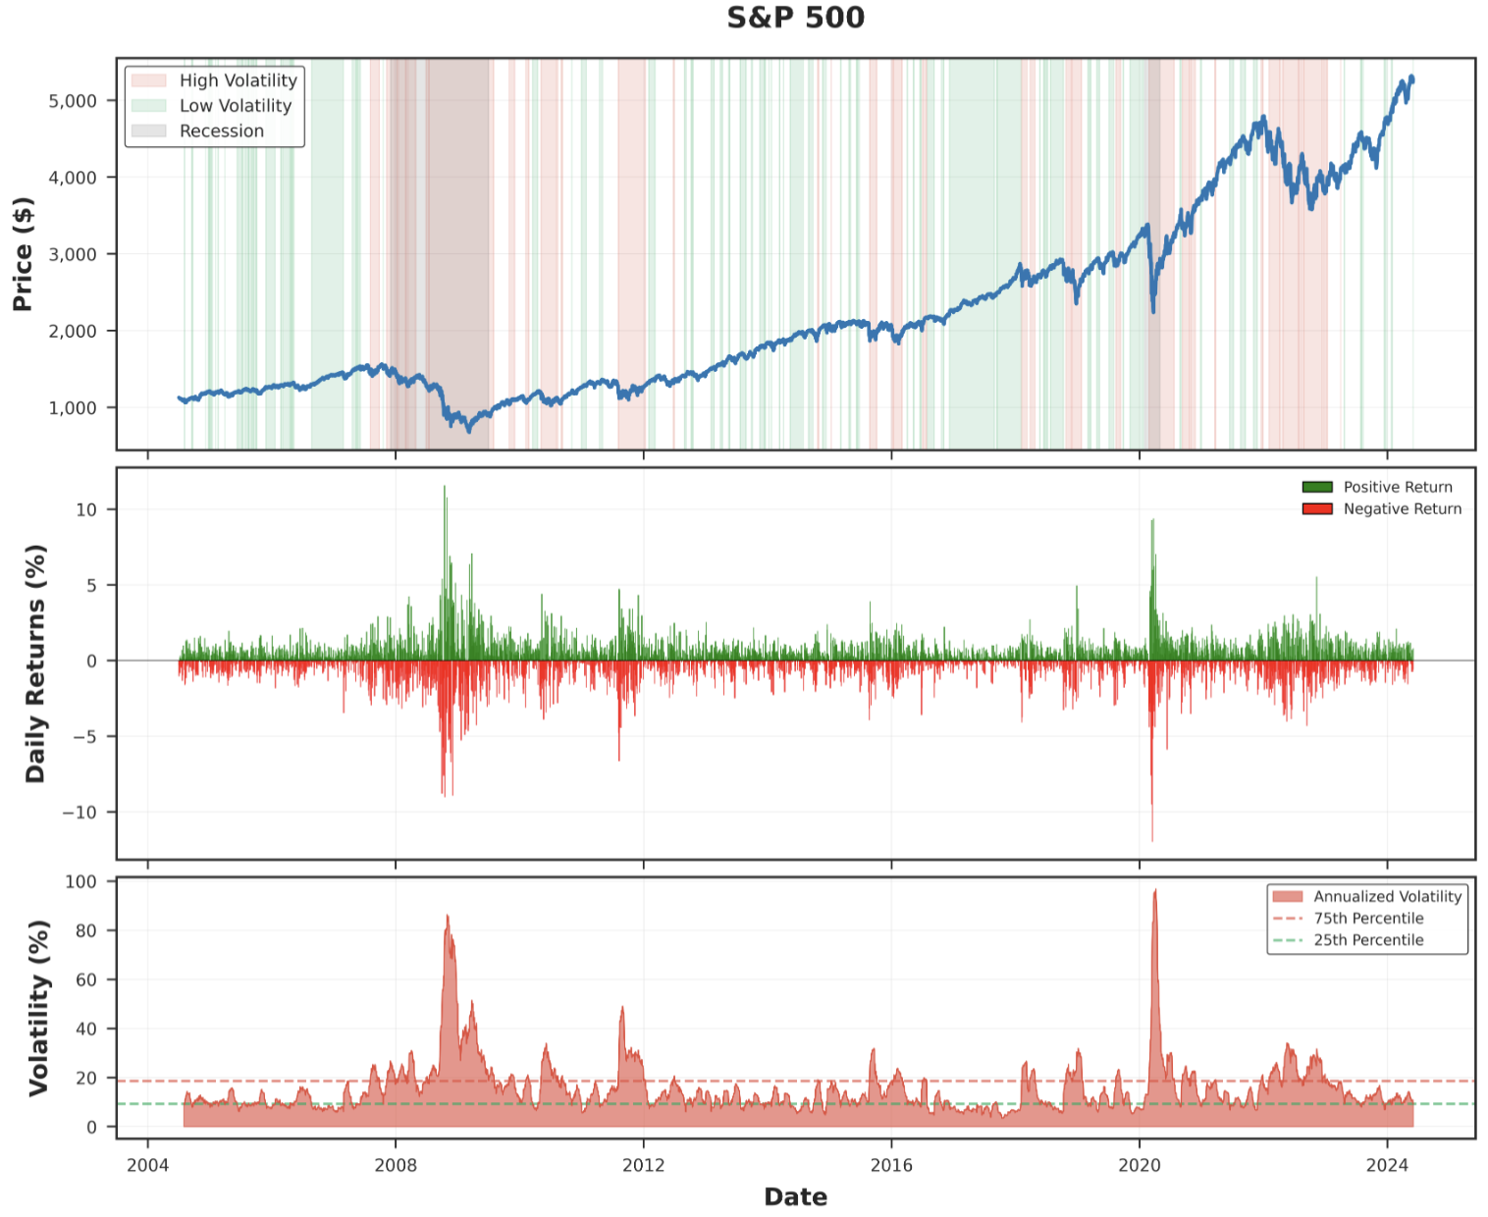
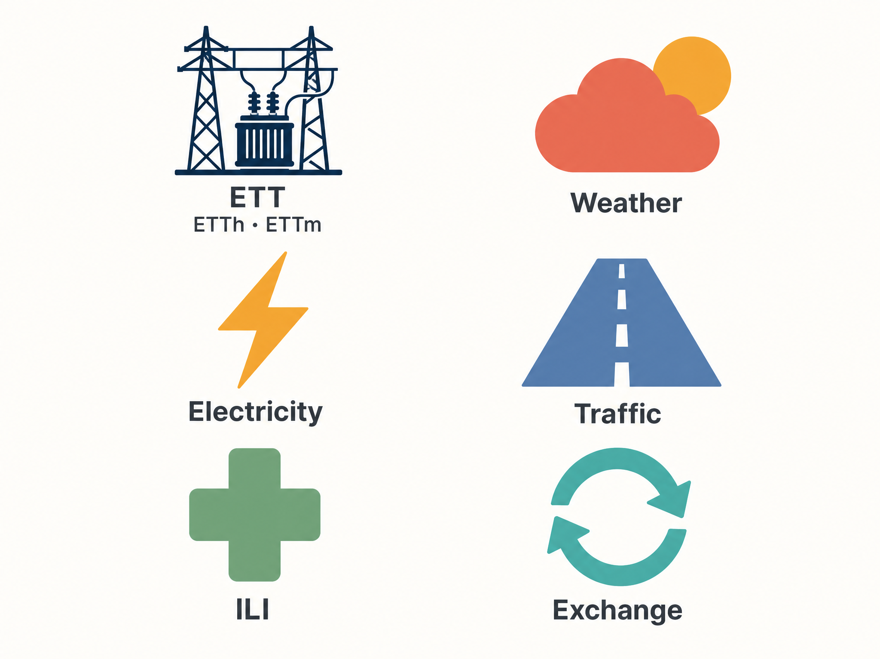
TSFMs on finance: a different problem
Standard benchmarks
Financial data: a different beast
Three structural properties standard benchmarks don’t test:
Non-stationary regimes
Heavy-tailed distributions
High frequency noise
Notes:
Foundation models for time series are typically trained and benchmarked on data like -- Electricity, Weather, Traffic, Medical data, and Exchange rates. These signals are relatively more stationary, with strong autocorrelations, and are less noisy.
The right is the S&P 500 from 2004 to 2024 — we have on the top panel its price, in the middle daily returns which is the percentage change in price, and on the bottom we have the measured volatility, with high-volatility regimes shaded.
The series is non-stationary, returns have near-zero autocorrelation and heavy tailed distribution, and volatility clusters with high frequency noise. So a fundamentally different statistical object from what these models were optimized on.

Slide 3
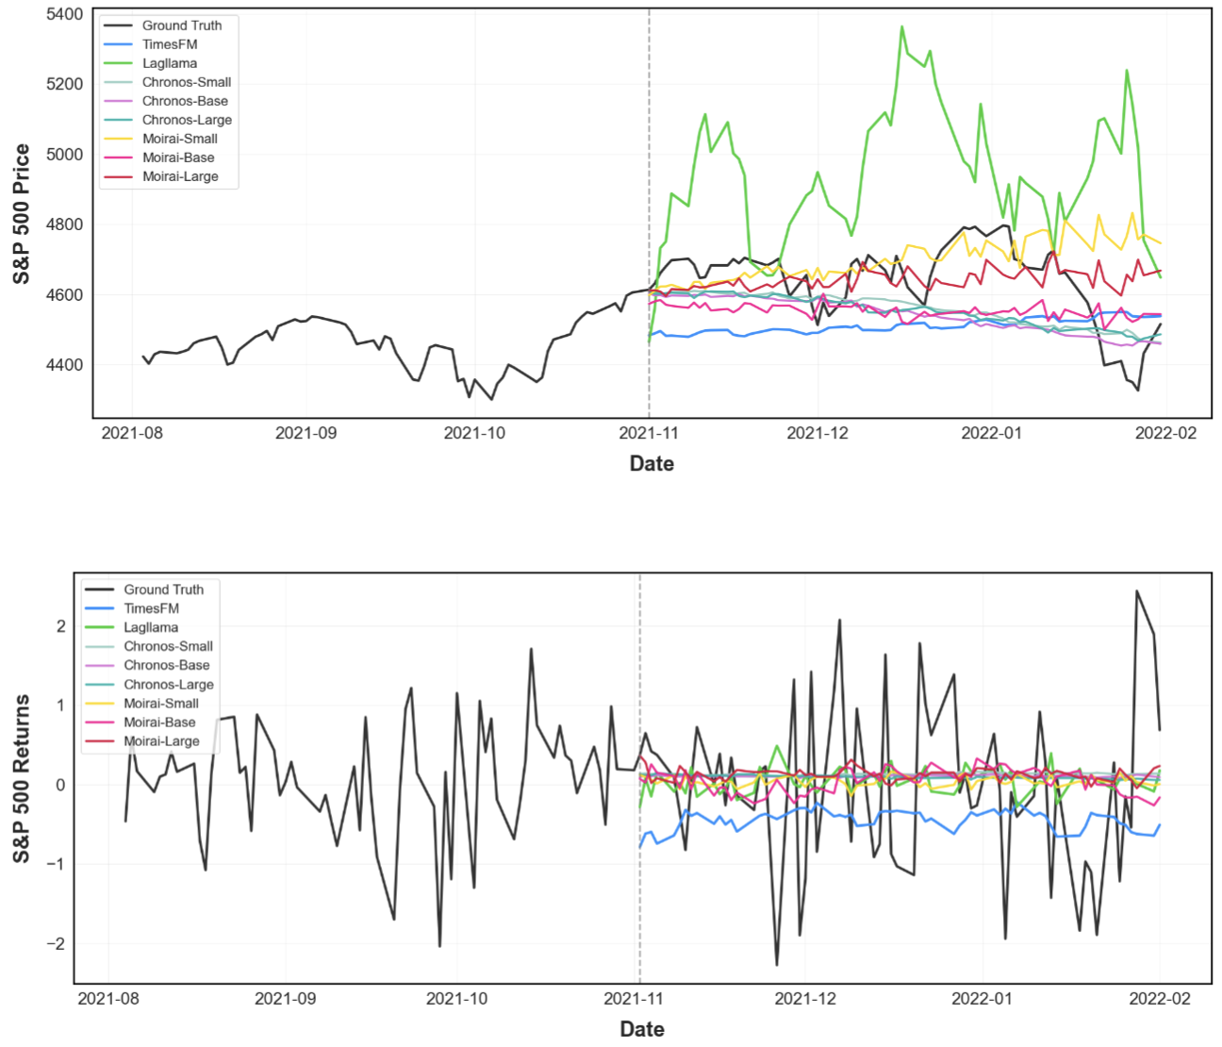
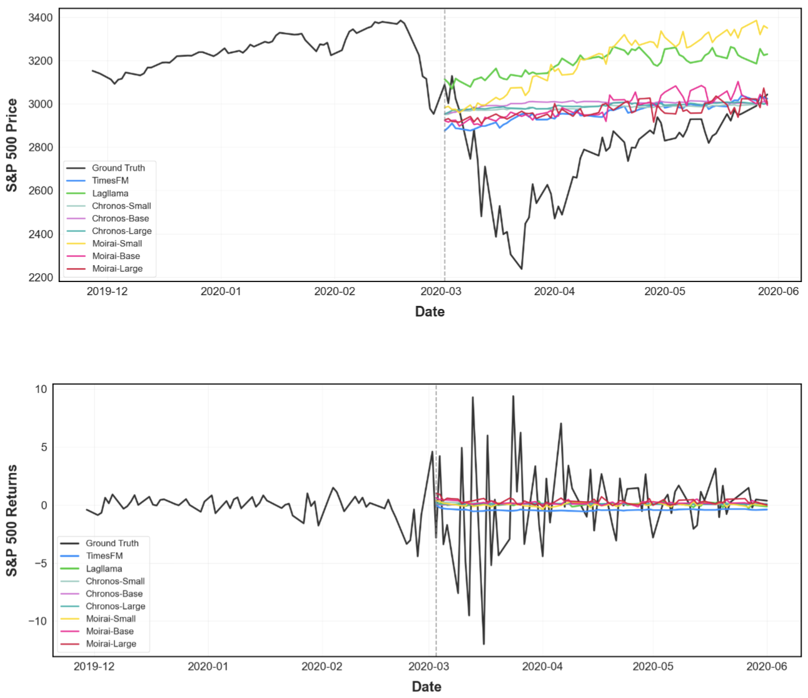
Universal failure: calm markets and crashes alike
8 TSFMs
Chronos S/B/L · Moirai S/B/L · TimesFM · Lag-Llama Context window 252 days · Forecast horizon 63 days · S&P 500
NORMAL TRADING DAY
COVID-19 CRASH · MARCH 2020
Even in calm markets, predictions diverge architecturally
S&P 500 falls 35% in 23 days — every model predicts flat or upward
Top: prices · Bottom: returns · Black = ground truth
Top: prices · Bottom: returns · Black = ground truth
Different architectures. Different scales. Same failure.
Notes:
We ran a stress test — eight TSFMs in total. Chronos in three sizes, Moirai in three sizes, plus TimesFM and Lag-Llama. The examples we are currently showing is with 252-day context, 63-day forecast horizon on the S&P 500, and at the top we are forecasting price and bottom returns
The left panel is a normal trading day — calm market, low volatility, nothing structurally interesting going on. Each model wanders off in a different direction. Chronos drifts down, Moirai up, the others go flat. Even in calm conditions, the architectures can't agree on what 'flat' should look like.
The right panel is the COVID crash, March 2020 — the S&P falls 35% in 23 days. Every architecture, every scale, predicts flat or upward, none of them catches the directional change and for returns they seem to all produce a straight line, which if we look at the context, looks a lot like the historical mean.
Different architectures, different scales, different training corpora — they all fail in the same way. So there is something that the model shares here.

Slide 4
Diagnosis: three losses, one shared smoothing pressure
TSFM | What it optimizes | What it converges to on noisy data
Chronos | token cross-entropy on quantized bins | most-probable bin → context mean
Moirai | mixture-distribution log-likelihood | mean of the predictive mixture
Time-MoE | multi-resolution Huber regression | robust mean (Huber down-weights tails)
Three different objectives. All converge toward the mean.
Notes:
What they share is the loss function family. Chronos optimizes a categorical cross-entropy over a quantized vocabulary — it adapts the T5 architecture from NLP almost directly, and tokenizes the time series values into a fixed vocabulary so that forecasting becomes next-token prediction. Moirai optimizes a mixture distribution log-likelihood. Time-MoE uses a Huber loss. Three completely different formulations — but on noisy data, all three converge toward the conditional mean.
Financial returns are roughly mean-zero, so a forecast that predicts the mean predicts zero change. That's why every model goes flat in a crisis — the loss steers it there, and the same pattern is applied to price prediction as well.

Slide 5
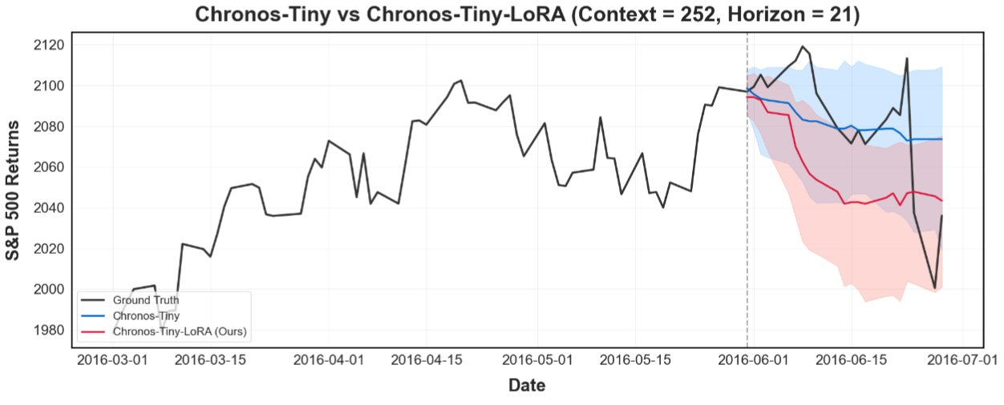
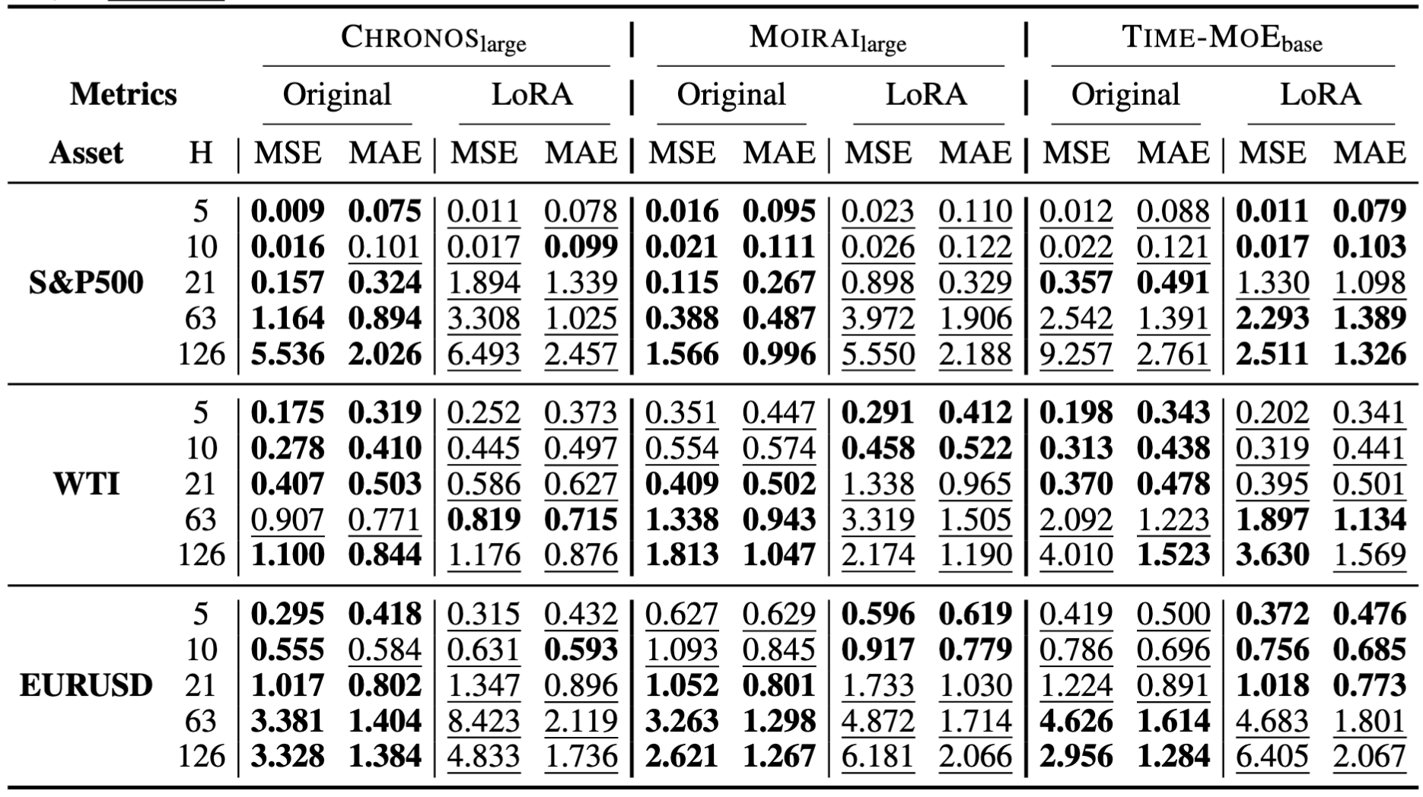
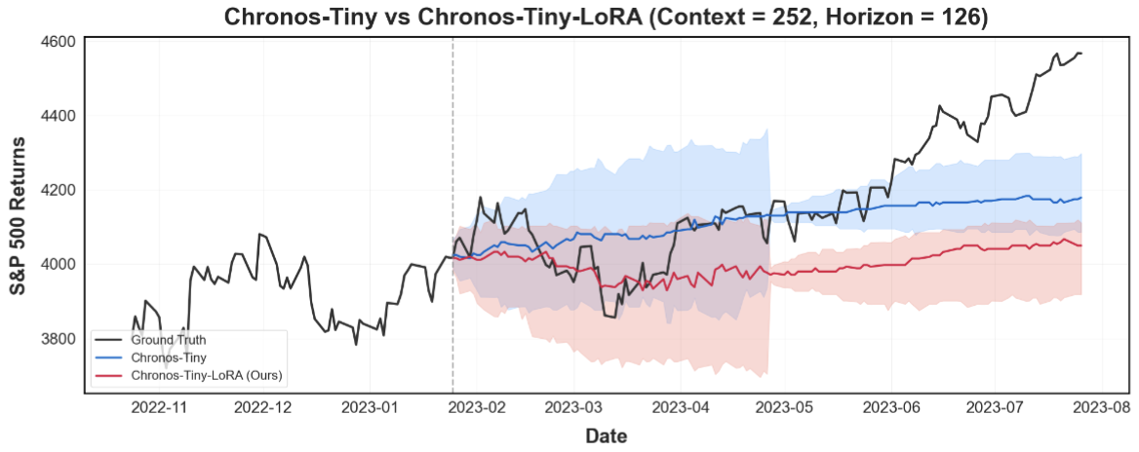
The natural follow-up: just fine-tune?
We fine-tune each TSFM with LoRA on financial data — and benchmark against the original frozen model across all 45 configurations.
ILLUSTRATIVE EXAMPLE · CHRONOS-TINY ON S&P 500
FULL BENCHMARK · ORIGINAL vs LoRA
LoRA shifts the prediction further from ground truth
Three TSFMs · three assets · five horizons
Horizon = 21 days · Context = 252 days · Shaded band = 10–90% confidence interval
Bold = better in row · Underlined = worse
Horizon = 63 days · Same setup, longer horizon
LoRA degrades performance in 29 of 45 configurations.
Notes:
The next natural thing to try is fine-tuning for domain adaptation, so maybe if we include more financial data in the pre-training dataset, it will work. LoRA is the standard parameter-efficient method, so we tested it across all 45 configurations.
On the left, two illustrative forecasts on Chronos-Tiny, S&P 500. Black is ground truth, blue is the base model, red is the LoRA-tuned result. At both 21-day and 63-day horizons, LoRA doesn't give any obvious improvement — performance stays roughly the same as the base model.
The full table on the right makes it stronger: LoRA actually degrades the zero-shot prediction in 29 of 45 configurations. Fine-tuning here isn't just unhelpful — it's hurting more often than not.

Slide 6
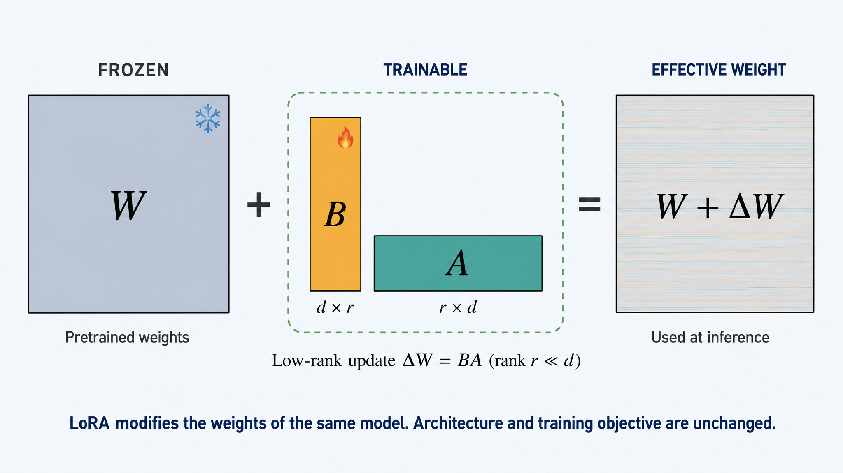
LoRA inherits the smoothing pressure
Fine-tuning adjusts the weights — but keeps every other structural choice that biases the model toward smoothing.
THE LoRA UPDATE
WHAT FINE-TUNING CAN'T CHANGE
A low-rank perturbation added to the same frozen weights
Three structural inheritances
Same architecture
LoRA preserves the transformer stack — the same inductive bias toward smooth, mean-reverting outputs.
Same training objective
Token-CE / Huber / mixture-likelihood — all still reward predicting the conditional mean.
Same family of solutions
ΔW perturbs the weights, but the model can only reach outputs the original architecture and loss can produce.
LoRA is a small perturbation on a model that fundamentally doesn't want to predict financial dynamics.
Notes:
Why does fine-tuning make things worse? It's a counter-intuitive result, and the reason is structural.
LoRA decomposes the weight update as a low-rank product on top of the frozen base, so the architecture and the training objective are both unchanged. We're now applying that same mean-seeking objective to noisier, more non-stationary data than the base model was originally trained on — so the smoothing pressure that produced the failure gets reinforced rather than corrected. LoRA is a small perturbation on a model that fundamentally isn't built to predict financial dynamics.

Slide 7
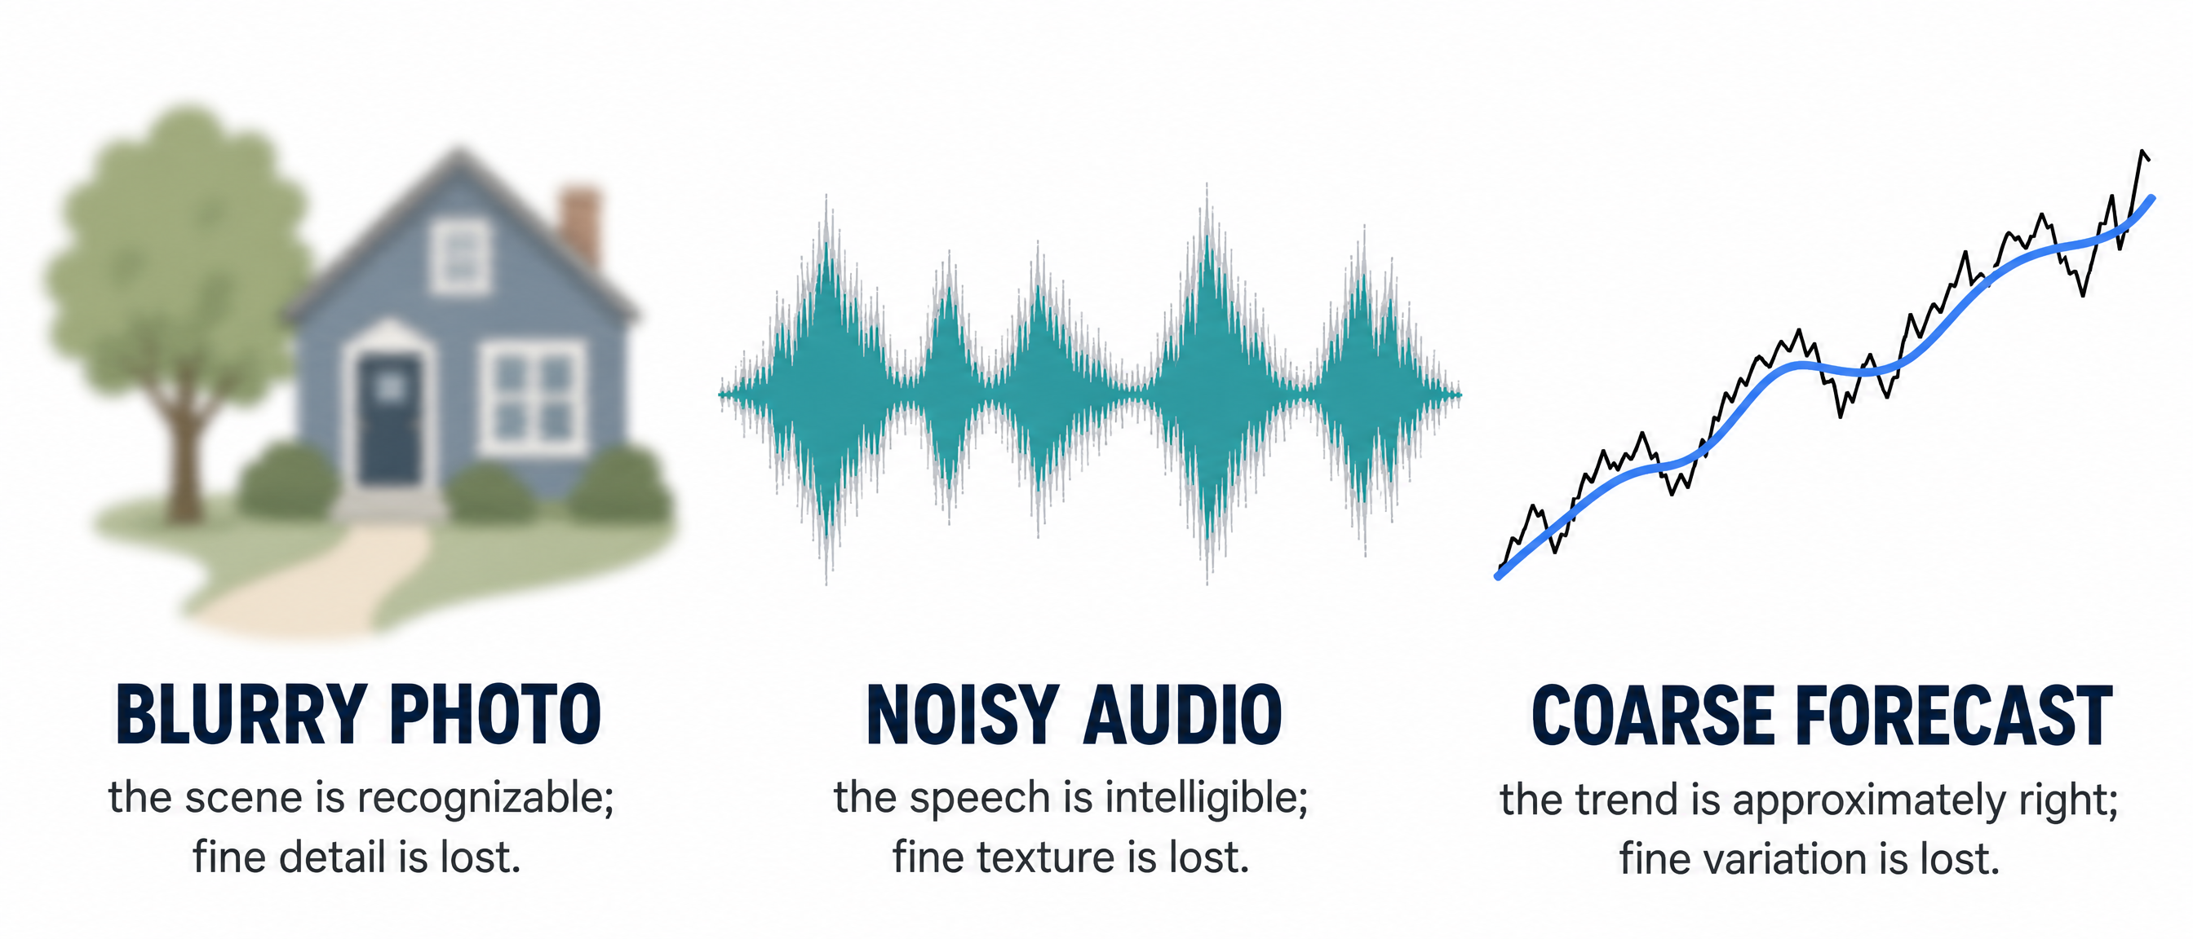
TSFM forecasts: suboptimal but informative
The forecast isn't noise. It's a coarse signal — wrong in predictable ways, useful in others.
01
02
03
Predictable failure modes
Real signal underneath
A starting point worth refining
Wrong in specific, structural ways — smoothing, mean reversion. Not random noise.
Trend direction and scale are usually approximately right. Exploitable information.
Better than the unconditional mean. Worth using as input to a separate refinement.
Don't change the model — repair its output.
Notes:
So let's look at this from a different angle. [pause] That is, information can be partial without being absent. The TSFM forecast is the same kind of object. It captures the simpler, more orderly temporal structure of the financial series — the broad trend, the slow direction — but it fails on the high-frequency noise and the non-stationary regime shifts. Which are exactly the parts that matter most in finance.
So we'll call the TSFM output a neural prior: a partial, coarse-grained forecast that reflects the orderly part of the data.
As a result, that changes the framing of the problem. The TSFM output isn't a final prediction — it can be a starting point.

Slide 8
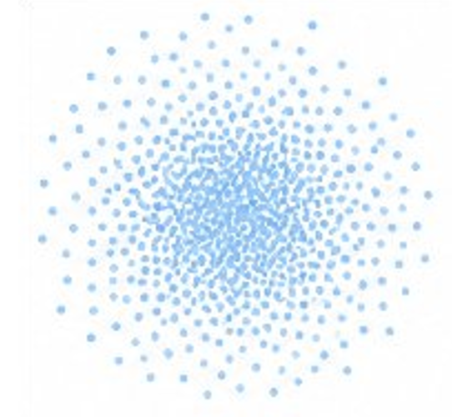
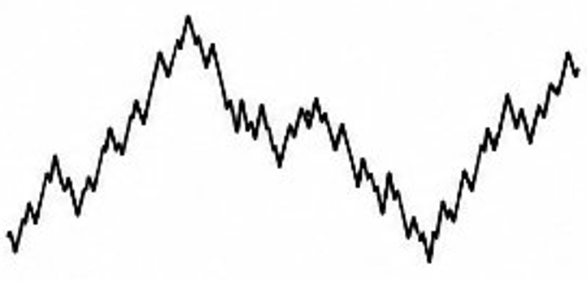
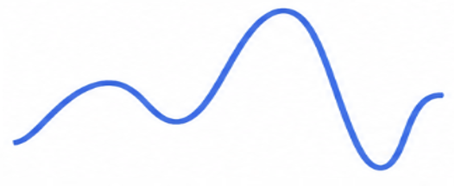
We propose RefineBridge
A Schrödinger Bridge module that transports a frozen TSFM forecast toward the data distribution. The foundation model never moves; only the bridge is trained.
OUR PROPOSAL · ONE TRAINED BRIDGE OVER A FROZEN FOUNDATION MODEL
RefineBridge
A small Schrödinger Bridge learns the optimal transport from a coarse-but-informative TSFM forecast toward the data distribution — only the bridge is trained.
WHY A SCHRÖDINGER BRIDGE · SAME MACHINERY AS DIFFUSION, BUT THE PRIOR IS NOT NOISE
Pure noise · N(0, I)
reverse a known forward noising
Data
DIFFUSION
The model must invent every structural feature of the data from scratch.
learn KL-minimal optimal transport
SCHRÖDINGER BRIDGE
TSFM forecast · any prior
Data
The prior already has trend and scale roughly right — the bridge only learns the residual.
Same generative machinery — but starting from an informative prior, the bridge has far less to learn.
Notes:
That's the motivation for RefineBridge. [pause] We train a small Schrödinger Bridge to transport a coarse FM forecast toward the true data distribution, conditioned on the historical context. The FM itself stays frozen — only the bridge is trained. Which makes it a post-processing module, not a fine-tuning method.
Why a Schrödinger Bridge specifically? The cleanest comparison is with diffusion. [pause] In a standard diffusion model — the top lane — you start from pure noise, a Gaussian, and reverse a known noising process to land on a true data distribution. The model has to invent every structural feature of the financial signal from scratch — trend, scale, autocorrelation, all of it. That's a hard learning problem.
In a Schrödinger Bridge — the bottom lane — you start from any prior distribution. The FM forecast plays that role for us — an imperfect prediction, but one that already carries the slower-moving structure of the signal. We then learn the KL-minimal optimal transport from that prior to the true data distribution. [pause]
So for diffusion and SB, we have the same generative machinery underneath. But the starting point is doing some work for the bridge. Instead of learning the full signal from noise, the bridge is learning the residual between the prior and the truth — which is a smaller problem, and which is why a small network suffices. Our model is 2.3 million parameters — smaller than each of the LoRA adapters we benchmarked against.

Slide 9
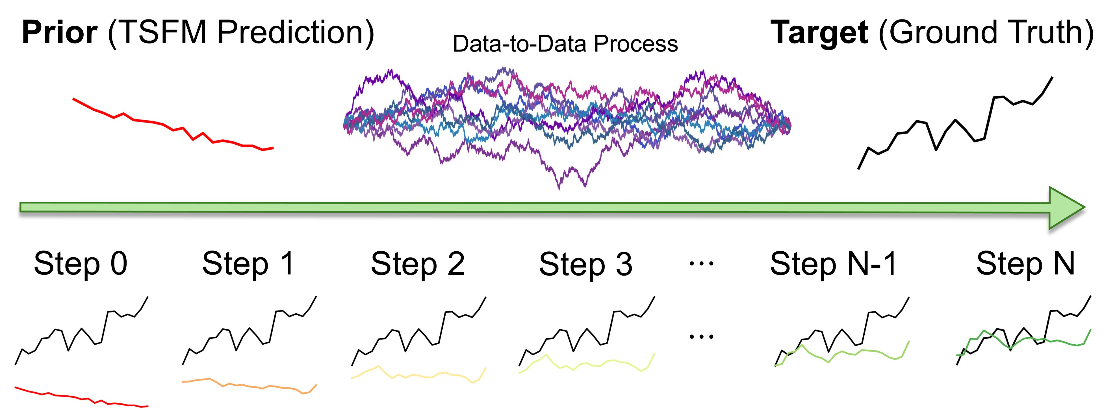
The Schrödinger Bridge, formally
Among all stochastic processes that bridge prior → data, the SB is the one closest to a reference Brownian motion.
WHAT THE BRIDGE LEARNS · THE OPTIMIZATION PROBLEM
Read it as: among all path measures π that bridge prior → data, pick the one closest in KL divergence to a reference Brownian motion.
A LEARNED TRAJECTORY · STEP 0 = TSFM PRIOR (RED), STEP N = DATA (BLACK), BROWNIAN-LIKE TRANSPORT IN BETWEEN
SB keeps what the prior already got right — the model only learns the residual to data.
Notes:
Formally. [pause]
Among all stochastic path measures connecting the FM prior at one endpoint and the data distribution at the other, the Schrödinger Bridge is the one closest in KL divergence to a reference Brownian motion. So two endpoint constraints — prior and data — and a regularizer that says: don't deviate from Brownian motion any more than necessary.
The trajectory below visualizes this. Step zero is the TSFM prior, which is the red curve. Step N is the ground truth, in black. The intermediate marginals are sequential refinements that interpolate between them by the denoising bridge process.
The bridge keeps what the prior already got correct and only learns the residual to the ground truth data distribution.

Slide 10
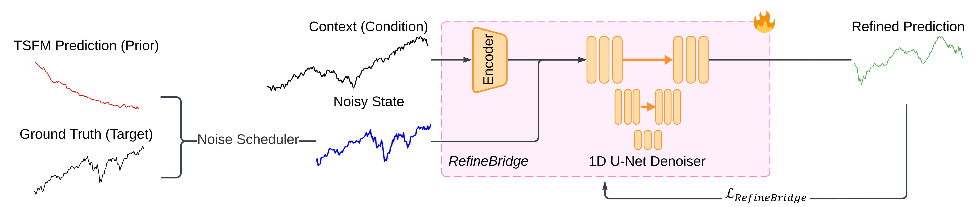
Training RefineBridge
The Schrödinger bridge made concrete: a conditional 1D U-Net learns the transport from a frozen TSFM forecast to ground truth.
THE TRAINING PIPELINE · PRIOR + GROUND TRUTH → INTERPOLANT → DENOISER → REFINED PREDICTION
WHAT TO NOTICE · THREE DESIGN CHOICES THAT MAKE IT WORK
01
02
03
Stochastic interpolant
Context conditioning
Frozen TSFM, trained bridge
The noise scheduler interpolates between TSFM prior and ground truth, producing a noisy state along the bridge path.
A learned encoder embeds the historical window — the denoiser sees what came before, not just the noisy interpolant.
The foundation model never moves. Only the encoder and 1D U-Net are updated against the ground truth.
The bridge learns the residual. The foundation model never moves — train once, deploy across any TSFM forecast.
Notes:
How is this trained in practice? [pause]
On the left, two inputs — the TSFM prediction (our prior) and the ground truth target (the actual future). A noise scheduler interpolates between them at a random time, producing the noisy state. The historical context — the lookback window — runs through an encoder. Both feed into a 1D U-Net, which is the bridge denoiser.
The design has three pieces worth highlighting here, which is the stochastic interpolant connects prior and target, and we also have context conditioning makes the bridge aware of history. And the TSFM stays frozen — so we train once, deploy across any FM forecast.
Therefore, The bridge learns the residual and the foundation model never gets touched.

Slide 11
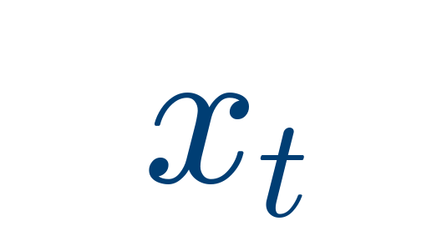
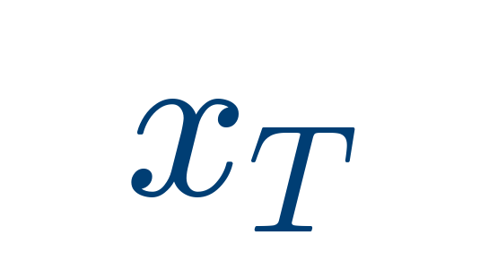
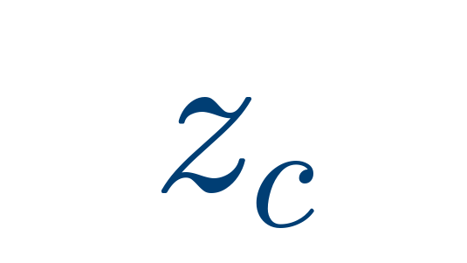
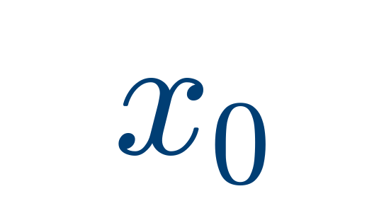
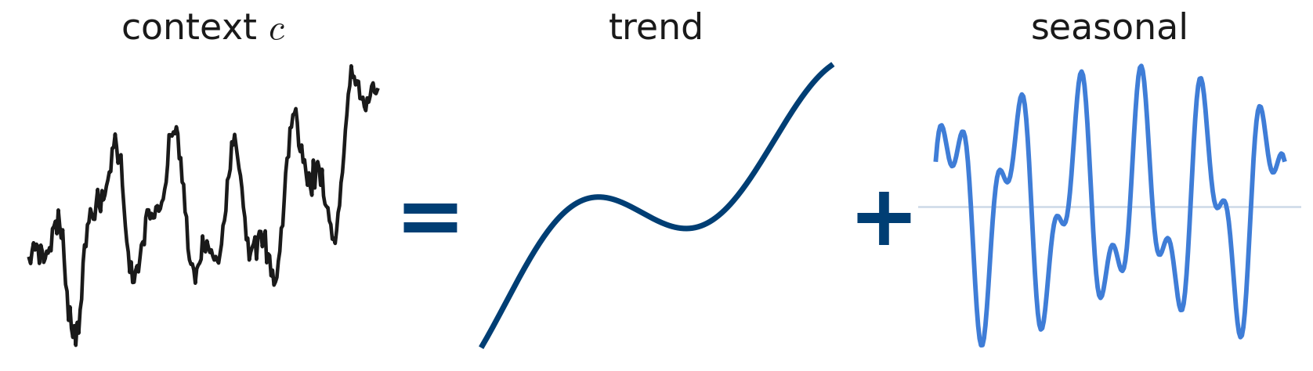
Training objective: one loss for both networks
The pipeline above is trained with a single loss — conditional denoising on the bridge marginal.
THE LOSS · CONDITIONAL DENOISING ON THE BRIDGE MARGINAL
Bridge marginal — a noisy interpolation between prior and target at random time t.
TSFM prior — the frozen forecast that anchors one endpoint of the bridge.
Encoded context — DLinear features of the historical window c.
Ground truth target — the actual future the bridge transports toward.
THE CONTEXT ENCODER · DLINEAR DECOMPOSITION
Dlinear [1] splits the historical context into a trend (moving-average smoothing) and a seasonal (residual) component. Each is mapped through its own linear projection.
The recombined latent provides one feature vector per refinement step, conditioning the U-Net at every step of the bridge.
One loss trains both: the U-Net directly, the DLinear encoder implicitly — gradients flow through the same backward pass.
Notes:
Our training objective here trains two networks at once — the U-Net directly, and the encoder implicitly through the same backward pass.
The bridge marginal x_t is a noisy interpolation between the prior and the target at a random time. x_T is the frozen TSFM prior, which that sets one endpoint of the bridge. z_c is the encoded context, encoded directly borrowing the deep linearing MLP model Dlinear, and extracts the historical window. And x_0 is the ground truth, the target we're transporting toward.
The DLinear encoder does something specific and quite straight forward. It splits the historical context into a slow trend and a seasonal residual, it projects each of them through its own linear map, and recombines it. The output is one feature vector per refinement step, so the U-Net stays context-aware throughout.

Slide 12
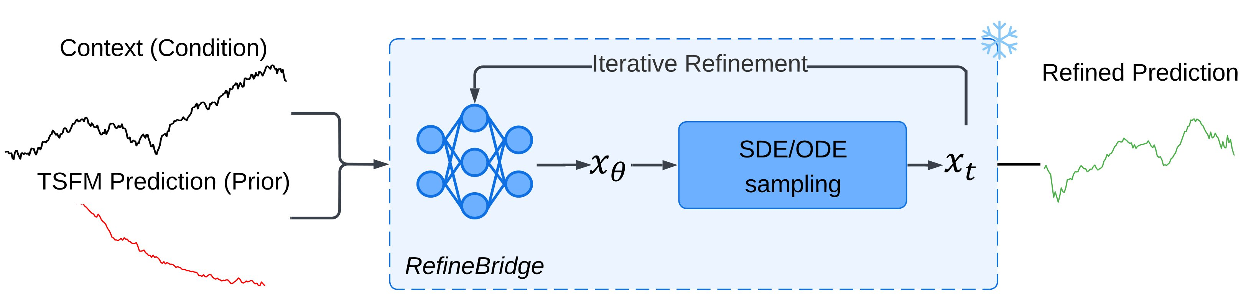
Inference: iterative refinement
A single trained bridge — frozen at test time — refines any TSFM prior step by step. Context plus prior in, polished forecast out.
THE INFERENCE LOOP · CONTEXT + PRIOR → BRIDGE → REFINED PREDICTION
01
INITIALISE
02
STEP
03
EMIT
Initialise the bridge state with the TSFM prior at s = 1. The encoder produces context z_c from the historical window.
The network predicts the target — the x_θ output. The sampler then takes one ODE or SDE update.
Iterate the schedule from s = 1 down to s = 0. The final state is the refined forecast.
Notes:
At inference time, everything is frozen — including the bridge itself. [pause]
We feed in the historical context and the FM prior. The sampler starts with the TSFM prior as the initial state. At each step, the U-Net predicts the target, the sampler takes one step, and the state moves slightly closer to data. We iterate until the schedule completes, and that final state is the refined forecast.

Slide 13
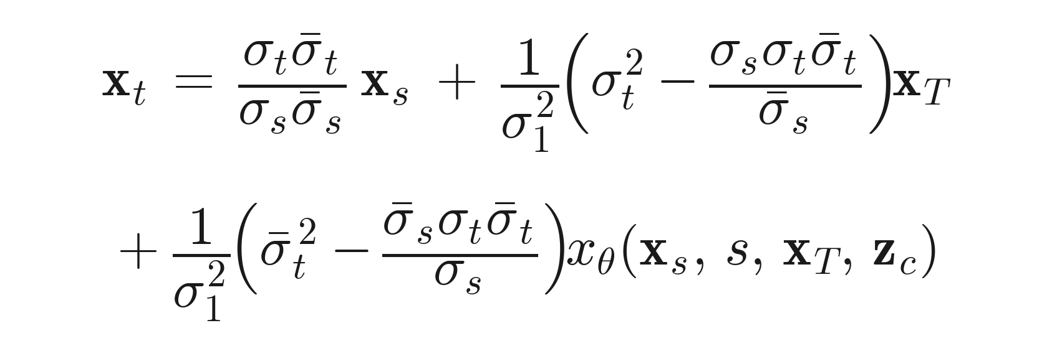
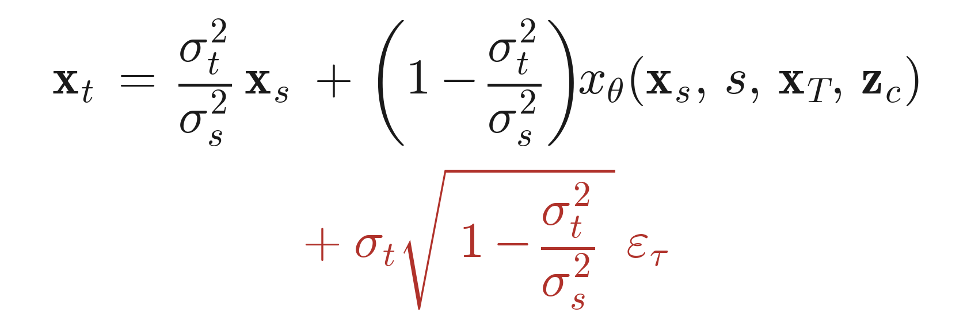
Two samplers, one frozen bridge
Same network, two ways to step. ODE walks deterministically toward the target; SDE adds calibrated noise to escape misleading priors.
PAPER EQUATIONS 7 & 8 · EULER DISCRETISATIONS OF THE BRIDGE SDE
ODE
· deterministic refinement
SDE
· stochastic refinement
Eq. 7 · ODE sampler
Eq. 8 · SDE sampler
At each step the network predicts where the target lies (the xθ term). The update walks deterministically toward that prediction, anchored by the prior — same input, same trajectory.
Same per-step prediction, plus Gaussian noise scaled by σt at every step. The randomness frees the trajectory to explore — recovers from priors that point the wrong way.
SHORT HORIZONS · H ∈ {5, 10} · 1–10 STEPS
LONG HORIZONS · H ∈ {21, 63, 126} · 10–1000 STEPS · τ ∈ [0.01, 2.0]
Notes:
Two ways to take that step that we just mentioned. Same trained network, same frozen weights, but different samplers. [pause]
On the left, the ODE is fully deterministic. At each step, the network predicts where the target lies, and the update walks straight toward that prediction, drawing on the prior. Same input gives the same trajectory every time. We use it for short horizons — five and ten days — with one to ten steps. It's fast, and at that range the prior is usually trustworthy enough.
On the right, we have the SDE sampler. The same per-step prediction, but with calibrated Gaussian noise added at each step. That randomness lets the trajectory deviate from the prior — which becomes critical at long horizons, 21, 63, 126 days, where the prior is much more likely to point the wrong way and the deterministic update wouldn't move far enough away from it.

Slide 14
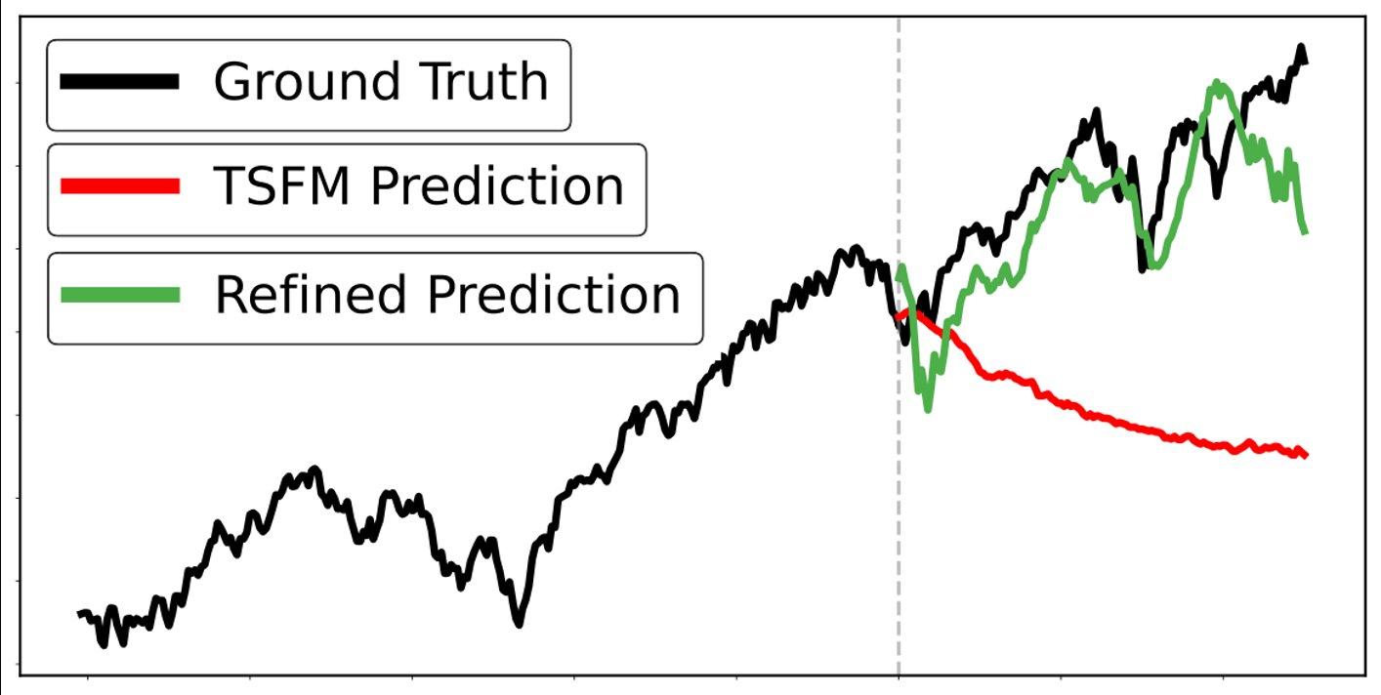
Recovering from a misleading prior
When the TSFM points the wrong way, the SDE sampler can still recover the trend. Here, Chronos-large predicts a sustained decline; RefineBridge tracks the actual rise.
S&P 500 · CONTEXT 252 DAYS · HORIZON 126 DAYS · CHRONOS-LARGE · SDE SAMPLER
Vertical dashed line marks the context / forecast boundary. Time axis: trading days.
GROUND TRUTH
TSFM PRIOR · Chronos-large
REFINED · RefineBridge
S&P 500 continues its upward trend through the entire 126-day prediction window — index moves higher across the right-hand panel.
Predicts a sustained decline. Direction is entirely wrong — effectively an uninformative prior.
Recovers the trend within the first few steps and tracks the actual rise. The SDE sampler's noise lets the bridge escape the wrong-pointing prior.
Notes:
A concrete case where the prior is far from the target is shown here. [pause]
The black line is the ground truth — an upward trend over the prediction window. The red line is the Chronos prior which as we can see if predicting a sustained decline. The direction is entirely wrong — this is a misinforming prior, not just an uninformative one. And it matters because most Schrödinger Bridge applications assume the prior is at least directionally close to the target; RefineBridge is robust to the opposite case.
The green line is the refined output. In the first few steps, the bridge pulls the trajectory away from the red prediction, toward the trend implied by the historical context. By the end of the window, it tracks the actual rise quite closely. The SDE noise is essential here — it lets the bridge deviate substantially from the prior, which the deterministic ODE update wouldn't allow at this horizon.

Slide 15
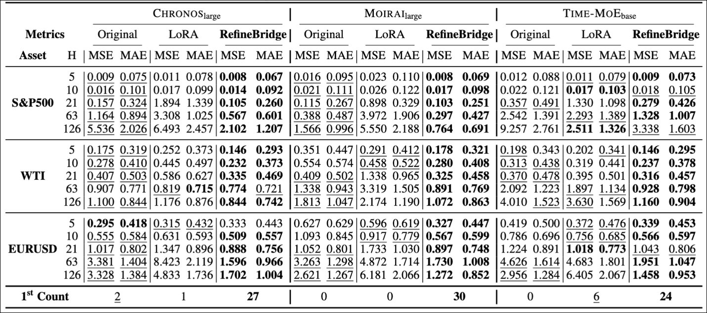
Quantitative results
Forecasting MSE and MAE for three TSFM backbones, three financial assets, and five prediction horizons. Lower is better.
TABLE 1 · CHRONOS / MOIRAI / TIME-MoE · S&P 500, WTI, EUR/USD · H ∈ {5, 10, 21, 63, 126} · AVERAGED OVER 5 RUNS
81 / 90
29 / 45
−11% → −62%
BEST RESULTS
WHERE LoRA FAILS
MSE REDUCTION GROWS WITH H
across all cells (3 TSFMs × 3 assets × 5 horizons × MSE/MAE)
configurations where LoRA degrades the zero-shot prediction
Chronos on S&P 500, prediction horizon H = 5 vs. H = 126
Notes:
The current Table shown covers three TSFMs, three financial assets, five horizons, and and we use the average MSE to report the performance. We have ninety cells in total. RefineBridge wins 81 of them.
In contrast, LoRA degraded performance on 29 of 45 settings, which we discussed earlier. That gap matters. It suggests what's working in RefineBridge isn't just having more capacity or more training — it's specifically the choice to frame refinement as a separate generative problem rather than as fine-tuning of the same model with the same objective.
The horizon effect is also worth pulling out. For Chronos on the S&P 500, MSE reduction is around 11 percent at horizon 5 and 62 percent at horizon 126. TSFMs are autoregressive, so errors compound over time — which means longer horizons are exactly where the prior is weakest, and where the bridge has the most signal to recover.

Slide 16
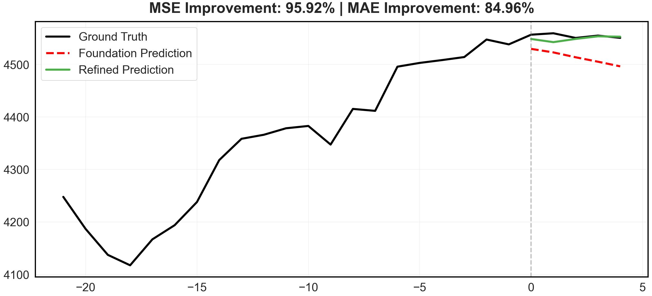
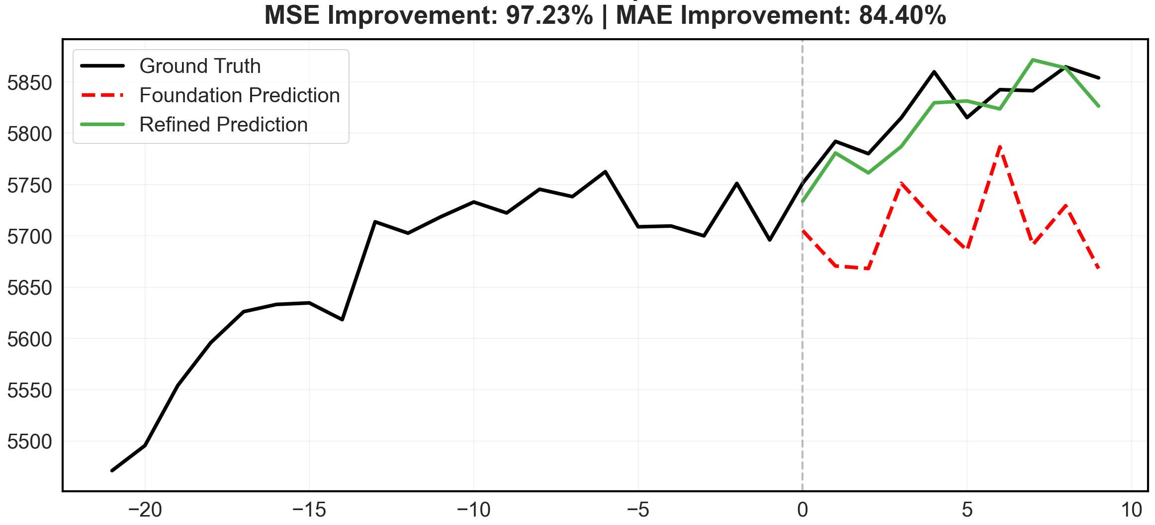
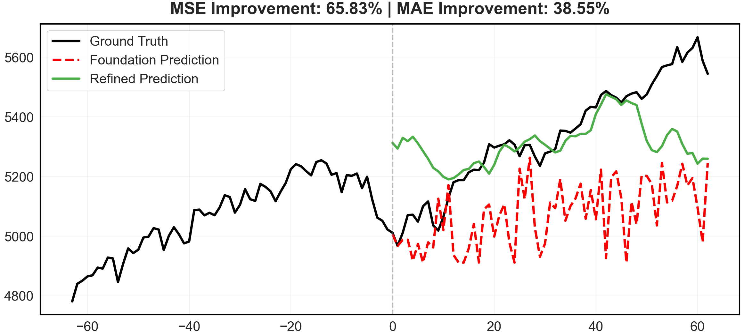
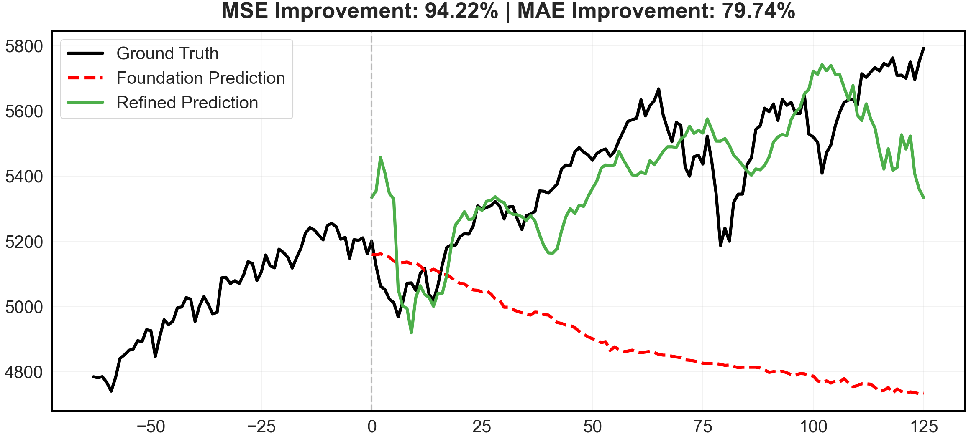
Qualitative refinements
Four S&P 500 examples spanning Chronos & MOIRAI, short to long horizons.
QUALITATIVE EXAMPLES
Ground truth
TSFM prior
RefineBridge
EXAMPLE 01
CHRONOS · 21-day context → 5-day horizon
EXAMPLE 02
MOIRAI · 21-day context → 10-day horizon
EXAMPLE 03
MOIRAI · 252-day context → 63-day horizon
EXAMPLE 04
CHRONOS · 252-day context → 126-day horizon
Notes:
Here we have four more examples on the S&P 500 for us to see visually.
Top-left, Chronos at a five-day horizon. The prior is essentially flat, and the bridge picks up the small upward move that actually occurs — 96% MSE improvement.
Top-right, Moirai at ten days prediction. Similar story, and we have a 97% improvement on the MSE.
The bottom row goes to longer horizons. Bottom-left, Moirai at 63 day prediction — more structure to work with, and the bridge is tracking the trajectory rather than just the level.
Bottom-right, Chronos at 126 day prediction, where the bridge picks up multiple turning points the prior misses entirely.
[pause]

Slide 17
Conclusion
Bridge-based refinement improves frozen foundation-model forecasts on finance — no fine-tuning of the backbone, no architectural changes.
CONTRIBUTIONS
A new method.
RefineBridge: a Schrödinger Bridge module that refines frozen TSFM predictions on financial time series. Each TSFM prediction is treated as a coarse-but-informative prior — the bridge transports it to the data distribution learned from history.
Distinct from LoRA.
RefineBridge is an independent post-hoc module, not weight-level fine-tuning. The training objective uses the TSFM prediction as conditioning and learns to capture the target distribution, in contrast to LoRA's mean-seeking objective.
Empirical results.
Across three TSFMs (Chronos, Moirai, Time-MoE), three finance assets (S&P 500, WTI, EUR/USD), and five horizons, RefineBridge achieves the best result in 81 of 90 metric cells and improves over LoRA at every backbone.
Refine, don't replace — a small bridge transforms a coarse foundation-model prior into a forecast that tracks the data.
Notes:
So to conclude — RefineBridge is a Schrödinger Bridge module that refines frozen TSFM forecasts, treating each forecast as a neural prior rather than a final answer. The key distinction from LoRA is that we're not modifying the foundation model — we're introducing a complementary training objective that captures the data distribution rather than inheriting the foundation model's mean-seeking one. Across three TSFMs, three assets, and five horizons, this gives the best result on 81 of 90 configurations.

Slide 18
Future work and limitations
Where the framework could go next, and the practical caveats of the current design we are most aware of.
FUTURE WORK
LIMITATIONS
→
Schrödinger Bridges across time-series problems.
—
Fixed prediction window.
RefineBridge is one instance of data-to-data optimal transport on time series. The same machinery applies wherever paired distributions exist — imputation, denoising, super-resolution, domain adaptation.
The current DLinear / MLP-based encoder fixes the refinement horizon at training time. Adapting to arbitrary horizons at test time would require either retraining or a horizon-conditional encoder.
→
A foundation model built on the bridge.
—
Per-asset training.
Replace the external TSFM prior with the bridge itself — train a Schrödinger Bridge directly as a generative time-series foundation model rather than as a refiner of one. Conditional generation and asset transfer become natural.
A separate RefineBridge is trained for each asset. The method does not yet generalise zero-shot to unseen assets — addressing this is what motivates the universal-refiner direction on the left.
→
Probabilistic refinement.
—
Inference cost at long horizons.
The SDE sampler already produces samples, not just point predictions. Aggregating these into calibrated predictive distributions — useful for risk, VaR, and option pricing — is a direct extension.
The SDE sampler can use up to 1000 steps for H = 126. Each step is cheap, but total latency is non-trivial relative to a single TSFM forward pass; sampler distillation or fewer-step schedules would help.
Work in progress — the bridge framework opens more questions than it closes.
Notes:
At last
In terms of potential future work. RefineBridge is one instance of data-to-data optimal transport on time series — the same machinery should apply to imputation, denoising, super-resolution, and domain adaptation. We think the bridge model has potential and expressiveness in more time series work in general.
A more ambitious direction is to replace the external TSFM prior with the bridge itself — training a Schrödinger Bridge directly as a generative time-series foundation model rather than as a refiner; conditional generation and cross-asset transfer become natural in that setting. And the SDE sampler already produces samples, so aggregating them into calibrated predictive distributions for risk and option pricing could be a direct extension.
On the right, we also have the limitations we're aware of. The MLP-based encoder fixes the refinement horizon at training time, so handling arbitrary horizons at test time would need a horizon-conditional encoder, as we currently train a separate RefineBridge per asset. which is what motivates the universal-refiner direction in the future work column. And the SDE sampler can take up to a thousand steps at the longest horizon — each step is cheap, but total latency if you add it up can be non-trivial relative to a single TSFM forward pass; so sampler distillation or shorter schedules would be helpful.

Slide 19
Thank You
Department of Electrical and Electronic Engineering
Imperial College London, United Kingdom
Notes:
Thank you for listening.

