Slide 1

Global Terrorism
Data Warehouse
Konstantina Georgiopoulou
(p2822004)
Stavros Kasiaris
(p2822022)
Anastasios Theodorou
(p2822007)

Slide 2
Business Goals - Description of the problem
Main Goal: Using descriptive analytics to understand Global Terrorism Events and analyze the consequences.
Are terrorist attacks increasing or decreasing over the years?
Are there months that the number of terrorist attacks are significantly more?
In which locations do the terrorist attacks mainly take place?
What are the main types of the attacks?
What weapons are used more in each attack?
What are the consequences of each attack type?
Is there any difference in the consequences across the regions?
What has happened to our country across the years concerning terrorist attacks?

Slide 3
Description of Data Source
Global Terrorism Database from Kaggle.
The aim is to analyze and draw conclusions about worldwide terrorism
It contains more than 180,000 terrorist attacks from 1970 until 2017 (except 1993) and it has over 100 variables on location, tactics, perpetrators, targets and outcomes

Slide 4
Data cleansing- Data Transformation
We used Python, R and SQL to clean and transform our data in order to load them into SQL Management Studio.
Challenges:
Filtering: Remove columns with meaningless content and too little information
Merge multiple columns into a single column (Time/ Criteria)
Replacing values (e.g. -99 to 0)
Missing Values: Fill them, from blank to null
Encoding some values (cities, perpetrator’s names/subnames)/ Different names for the same attribute
From 135 columns we ending with 41 columns in the Fact Table

Slide 5
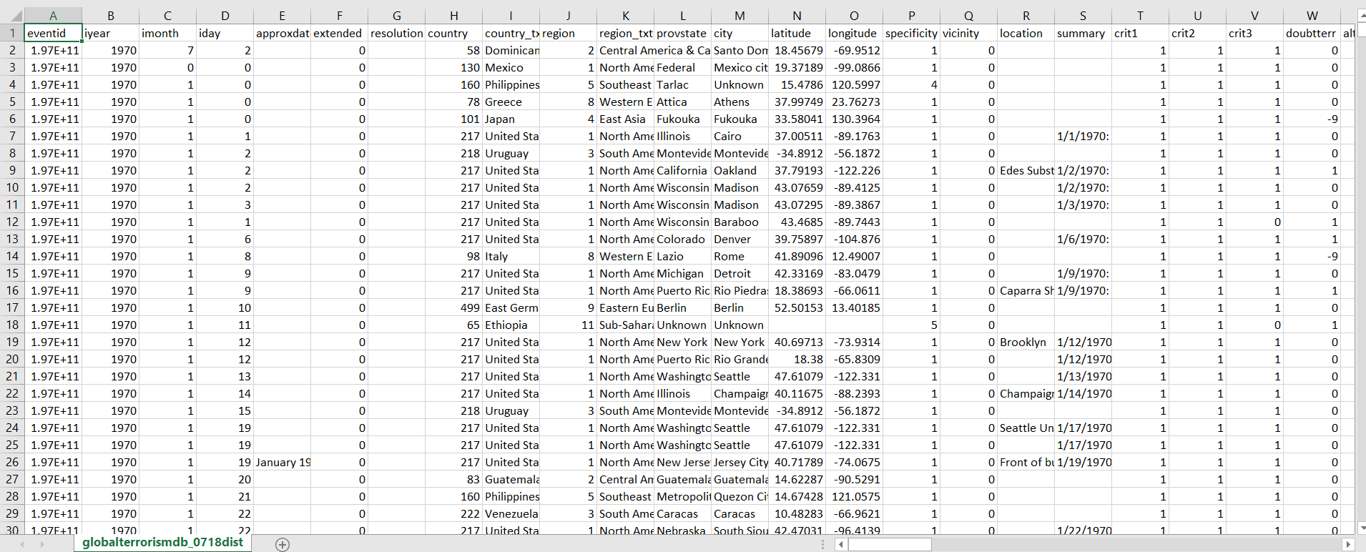
Dataset preview
The first look of the dataset
Notes:
Here we see some useful columns with data

Slide 6
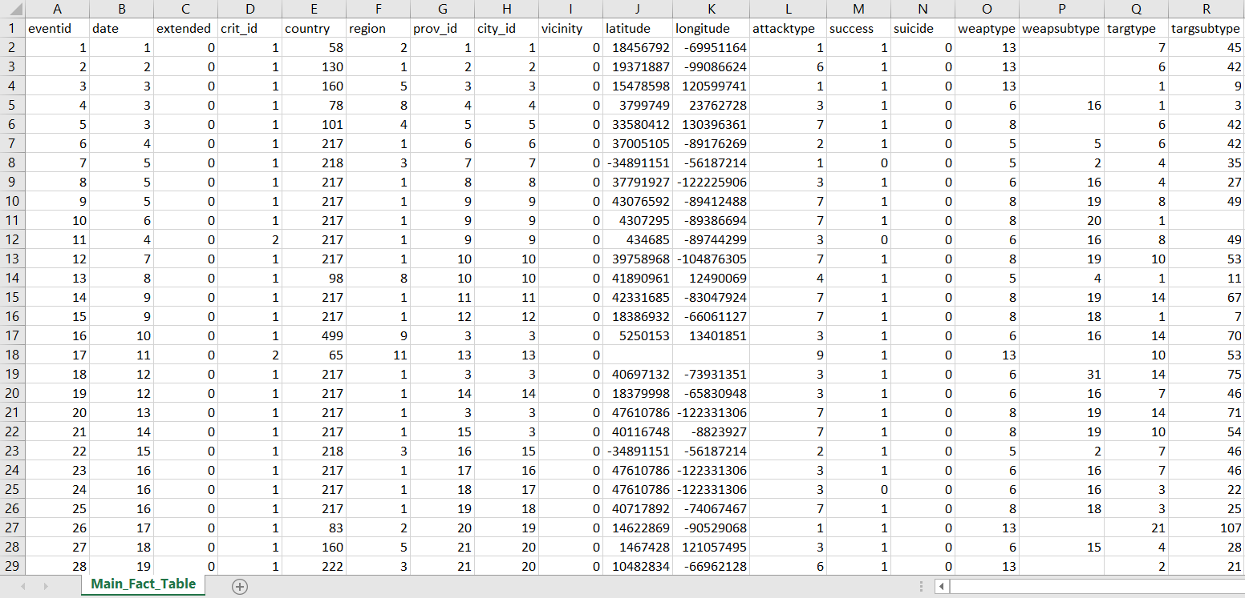
ETL
Creation of the Fact Table using Python and R
Turn dimensions into numeric values (e.g Attack type Assassination is 1)

Slide 7
Load & Snowflake schema creation
Creation of the database in SQL Management Studio
Import the fact table and all the dimensional tables with the respective properties
Set all the primary and foreign keys
Confirm that everything works well
Export the final snowflake schema

Slide 8
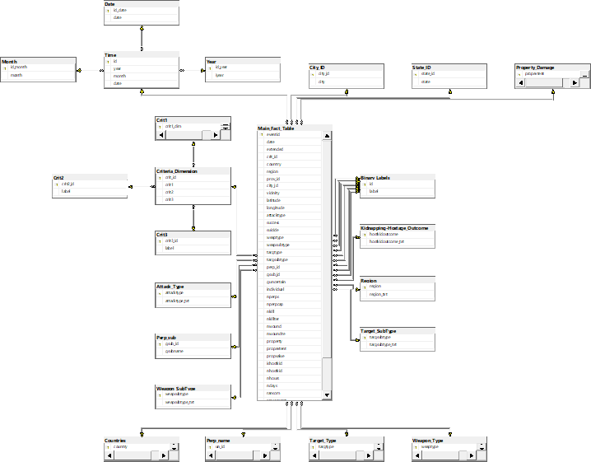
Snowflake schema

Slide 9
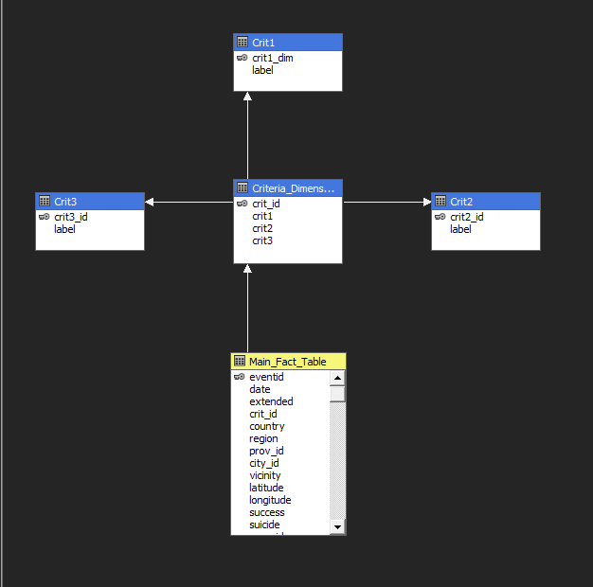
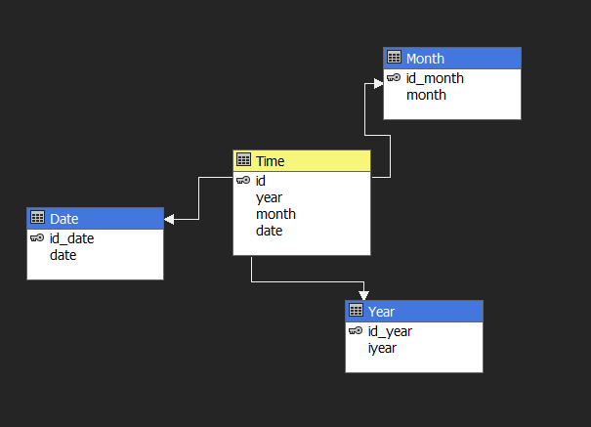
Cube design
(Time and Criteria Cube)

Slide 10
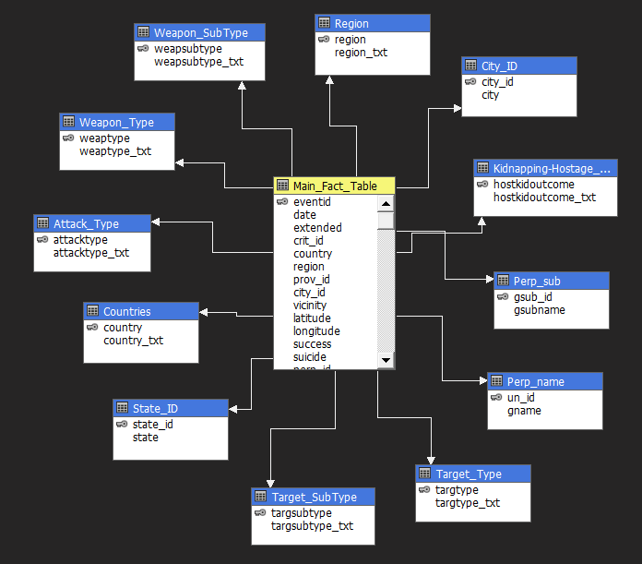
Cube design (Consequences Cube)
We added:
Two more measures (Maximum Deaths & Wounded) and
Six calculated measures (Average Kills, Wounded, Hostages, Terrorists and Ransom per count of Terrorist Attacks)

Slide 11
OLAP Reports
Some OLAP (Online Analytical Processing) Reports through Excel, that come from SSAS are:
Roll up,
Drill down,
Slice and dice,
Ranking and
Pivot

Slide 12
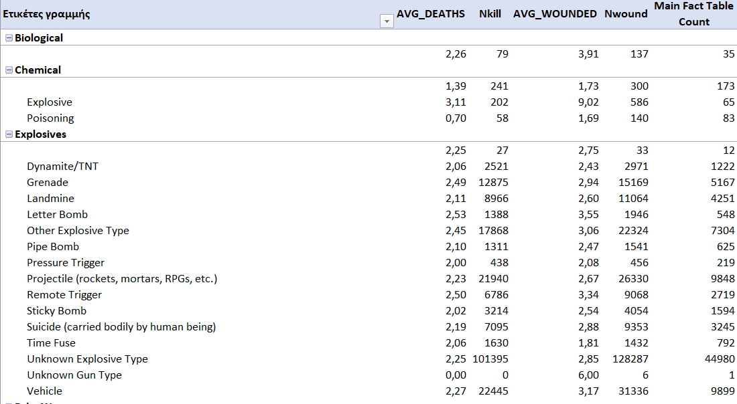
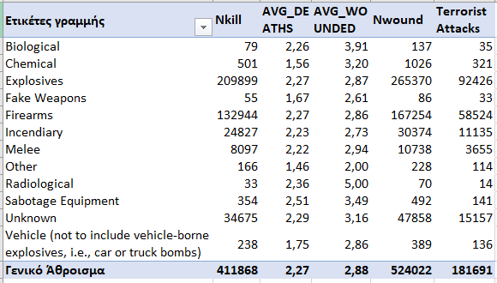
OLAP Reports
Drill down

Slide 13
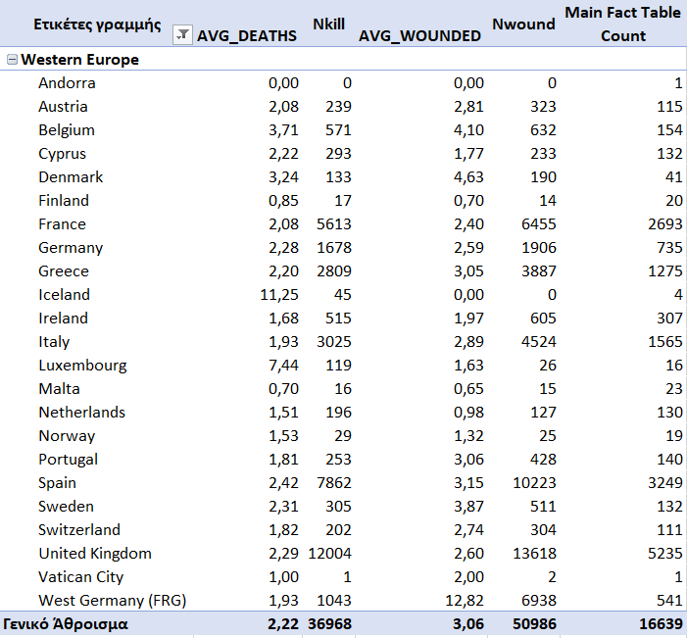
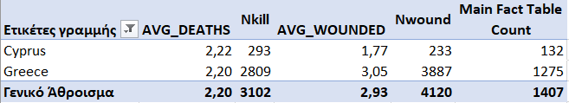
OLAP Reports
Slice and Dice

Slide 14
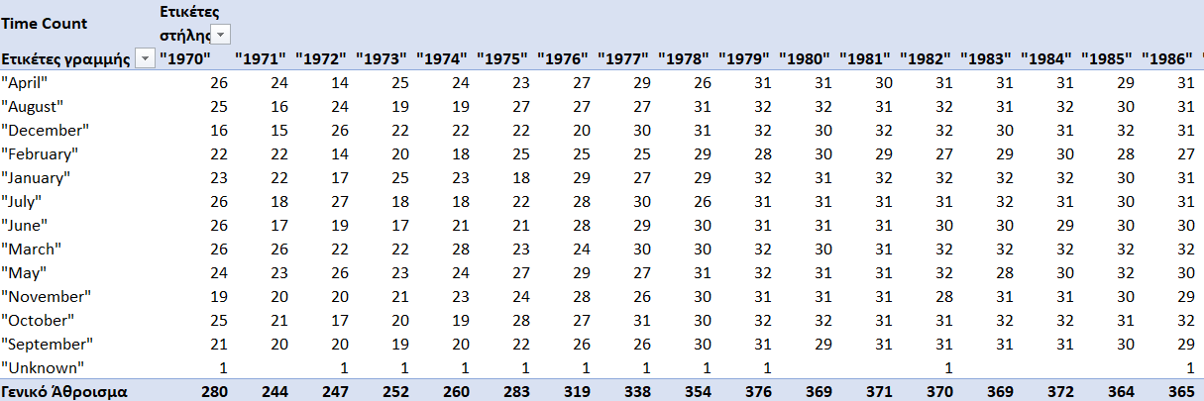
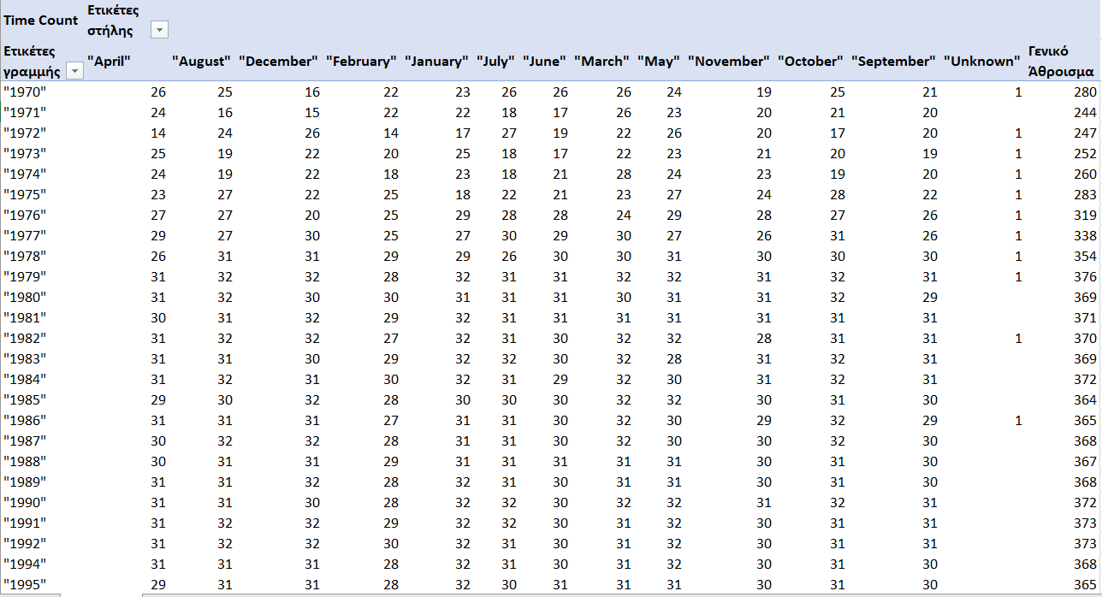
OLAP Reports
Pivot

Slide 15
Results and Visualization with Power BI
Use of Power BI in order to visualize the outcome of our analysis and to depict the points of interest.
We focus on the most useful information like:
Different curves for deaths across countries or regions,
Attack types,
Weapon types used,
Wounded etc

Slide 16
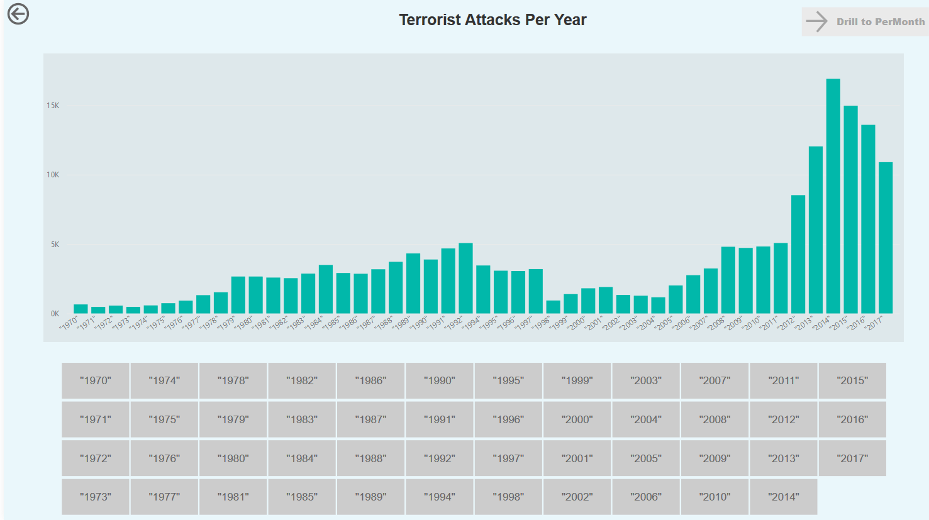
Visualization examples
Terrorist Attacks Per Year

Slide 17
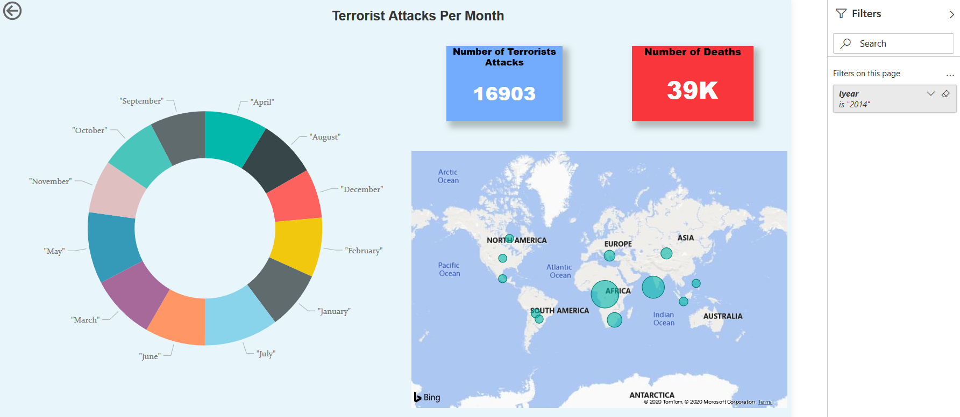
Drill Down Report
(From Year to Month)

Slide 18
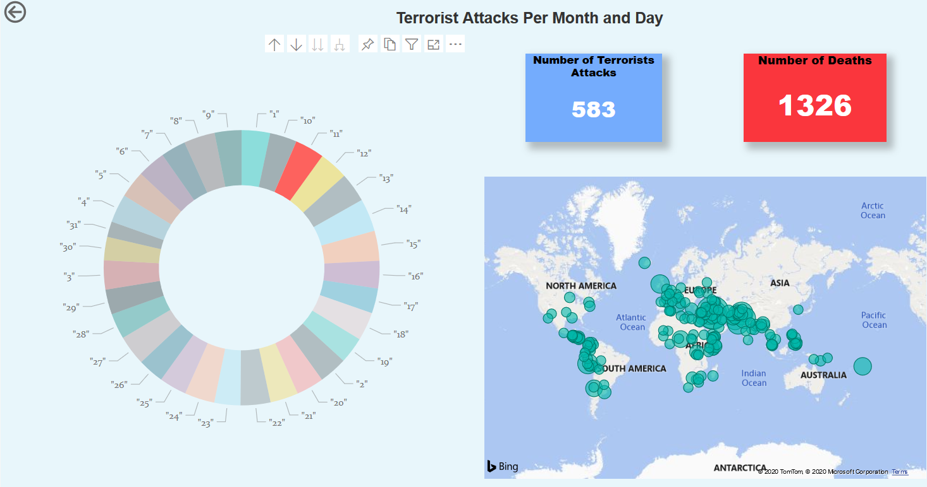
Drill Down Report
(From Month to Day)

Slide 19
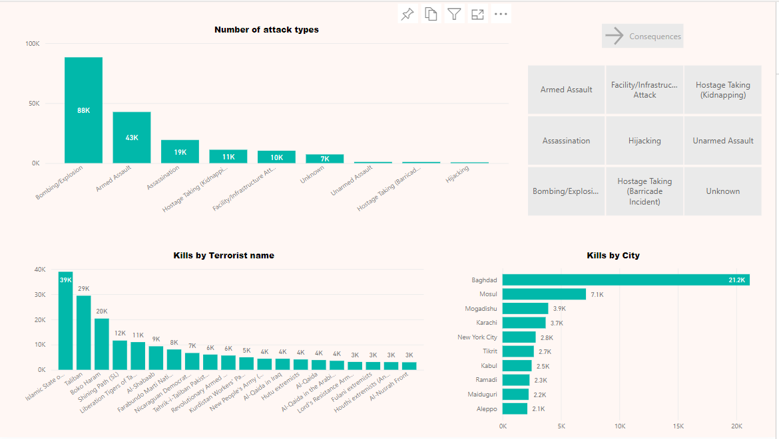
Top attack types, Kills by Terrorist name and Kills by City

Slide 20
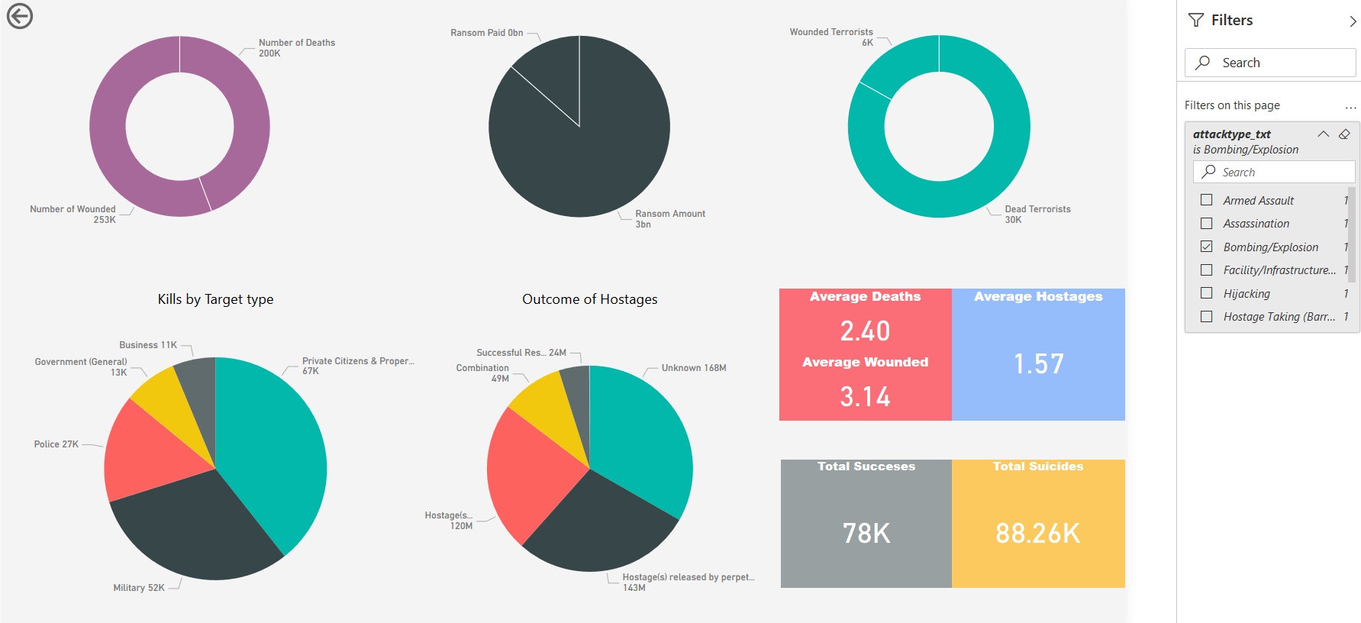
Consequences

Slide 21
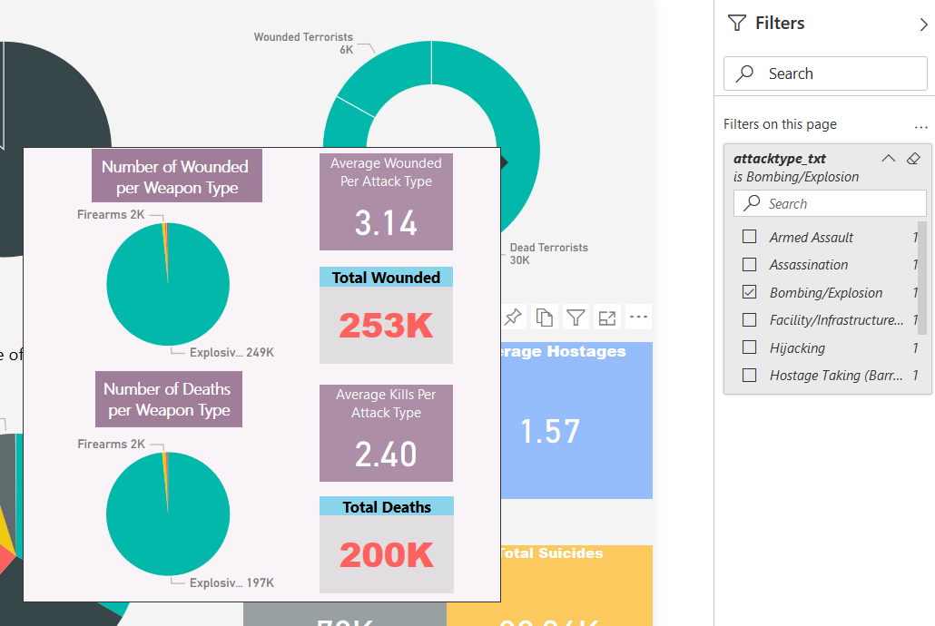
Drill through from Attack Type

Slide 22
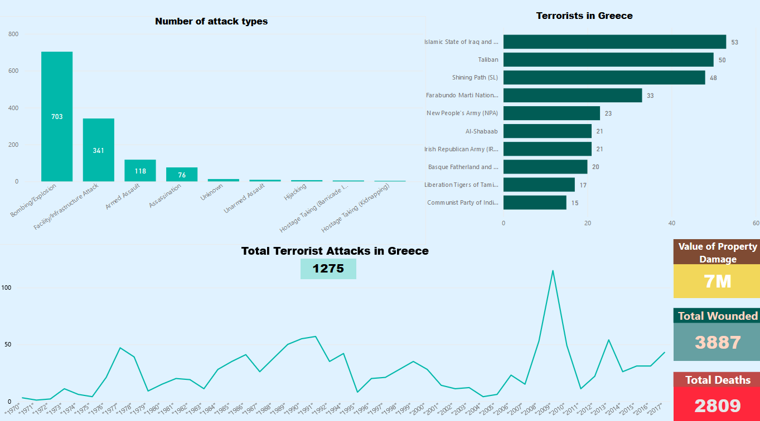
Overview for Greece

Slide 23
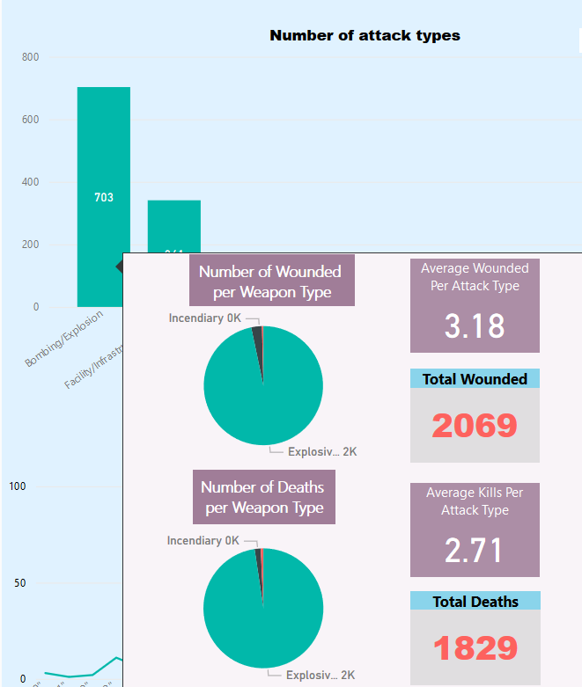
Interesting points about Greece
Total number of attacks: 1275
Most frequent attack types are bombing/explosion and facility/infrastructure.
Pick year: 2008-2009
Total deaths: 1829

Slide 24
Conclusions
The number of attacks is increasing since 2012. The year with the most attacks is 2014, with a total number of 16.903 events.
The most Terrorism attacks occurred in the Middle East & North Africa, with a total number of 50.474.
The 2 types with most attacks are Bombing/Exploisoning and Armed Assault.
The most effective attack is Armed Assault because in each event the average number of deaths and wounded is more (2.44 average number of deaths and 3.18 average number of wounded).
The Islamic State of Iraq and the Levant (ISIL) and Taliban are those terrorists that kill most people.
Baghdad and Mosul are the cities in where most people are killed.

Slide 25

Thank You!

