Slide 1
Message-Passing Computing
Chapter 2
Slides for Parallel Programming Techniques & Applications Using Networked Workstations & Parallel Computers 2nd Edition, by B. Wilkinson & M. Allen, © 2004 Pearson Education Inc. All rights reserved.
2.<number>

Slide 2
In this chapter, we outline the basic concepts of message-passing computing.
The structure of message-passing programs is introduced and how to specify message-passing between processes.
One specific system, MPI (message-passing interface
How to evaluate message-passing parallel programs, both theoretically and in practice.
Slides for Parallel Programming Techniques & Applications Using Networked Workstations & Parallel Computers 2nd Edition, by B. Wilkinson & M. Allen, © 2004 Pearson Education Inc. All rights reserved.
2.<number>

Slide 3
BASICS OF MESSAGE-PASSING PROGRAMMING
Programming Options
  Designing a special parallel programming language. (occam in transputer)
  Extending the syntax/reserved words of an existing sequential high-level language to handle message-passing. (High Performance Fortran (HPF))
  Using an existing sequential high-level language and providing a library of external procedures for message-passing. (Fortran M)
It is also possible to use a special parallelizing compiler to convert a program written in a sequential programming language into executable parallel code. (not practical)
Slides for Parallel Programming Techniques & Applications Using Networked Workstations & Parallel Computers 2nd Edition, by B. Wilkinson & M. Allen, © 2004 Pearson Education Inc. All rights reserved.
2.<number>

Slide 4
Message-Passing Programming using User-level Message-Passing Libraries
Two primary mechanisms needed:
1. A method of creating separate processes for execution on different computers
2. A method of sending and receiving messages
Slides for Parallel Programming Techniques & Applications Using Networked Workstations & Parallel Computers 2nd Edition, by B. Wilkinson & M. Allen, © 2004 Pearson Education Inc. All rights reserved.
2.<number>

Slide 5
Process Creation (1)
Process
  more than one process may be mapped onto a single processor.
  we will assume that one process is mapped onto each processor and use the term process rather than processor.
Two methods of creating processes are:
  Static process creation
  Dynamic process creation
Slides for Parallel Programming Techniques & Applications Using Networked Workstations & Parallel Computers 2nd Edition, by B. Wilkinson & M. Allen, © 2004 Pearson Education Inc. All rights reserved.
2.<number>

Slide 6
Process Creation (2)
In static process creation, all the processes are specified before execution and the system will execute a fixed number of processes.
In dynamic process creation, processes can be created and their execution initiated during the execution of other processes.
In most applications, the processes are neither all the same nor all different.
  Master process
  Slaves or workers process
  process identification (ID)
  The processes are defined by programs written by the programmer.
Slides for Parallel Programming Techniques & Applications Using Networked Workstations & Parallel Computers 2nd Edition, by B. Wilkinson & M. Allen, © 2004 Pearson Education Inc. All rights reserved.
2.<number>

Slide 7
Multiple program, multiple data (MPMD) model
Master program
Slave program
Source
Source
fi
le
fi
le
Compile to suit
processor
Executable
Processor 0
Processor
p
- 1
Slides for Parallel Programming Techniques & Applications Using Networked Workstations & Parallel Computers 2nd Edition, by B. Wilkinson & M. Allen, © 2004 Pearson Education Inc. All rights reserved.
2.<number>

Slide 8
Single Program Multiple Data (SPMD) model
Different processes merged into one program. Control statements select different parts for each processor to execute. All executables started together - static process creation
Source
fi
le
Basic MPI way
Compile to suit
processor
Ex
ecutab
les
Processor 0
Processor
p
-
1
Slides for Parallel Programming Techniques & Applications Using Networked Workstations & Parallel Computers 2nd Edition, by B. Wilkinson & M. Allen, © 2004 Pearson Education Inc. All rights reserved.
2.<number>

Slide 9

Multiple Program Multiple Data (MPMD) Model
Separate programs for each processor. One processor executes master process. Other processes started from within master process - dynamic process creation.
Process 1
PVM
Star
t e
x
ecution
spawn();
of process 2
Process 2
Time
Slides for Parallel Programming Techniques & Applications Using Networked Workstations & Parallel Computers 2nd Edition, by B. Wilkinson & M. Allen, © 2004 Pearson Education Inc. All rights reserved.
2.<number>

Slide 10
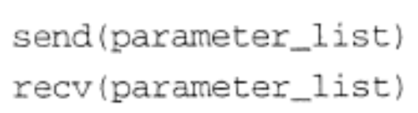


Message-Passing Routines
Basic Send and Receive Routines
  Send and receive message-passing library calls often have the form:
  send() is placed in the source process originating the message, and recv() is placed in the destination process to collect the messages being sent.
  The simplest set of parameters would be the destination ID and message in send() and the source ID and the name of the location for the receiving message in recv().
  x and y must be of the same type and size.
Slides for Parallel Programming Techniques & Applications Using Networked Workstations & Parallel Computers 2nd Edition, by B. Wilkinson & M. Allen, © 2004 Pearson Education Inc. All rights reserved.
2.<number>

Slide 11
Basic “point-to-point”
Send and Receive Routines
Passing a message between processes using send() and recv() library calls:
Process 1
Process 2
x
y
Mo
v
ement
send(&x, 2);
of data
recv(&y, 1);
Generic syntax (actual formats later)
Slides for Parallel Programming Techniques & Applications Using Networked Workstations & Parallel Computers 2nd Edition, by B. Wilkinson & M. Allen, © 2004 Pearson Education Inc. All rights reserved.
2.<number>

Slide 12
Synchronous Message Passing
Routines that actually return when message transfer completed.
Synchronous send routine
Waits until complete message can be accepted by the receiving process before sending the message.
Synchronous receive routine
Waits until the message it is expecting arrives.
Synchronous routines intrinsically perform two actions: They transfer data and they synchronize processes.
Synchronous send and receive operations do not need message buffer storage.
Slides for Parallel Programming Techniques & Applications Using Networked Workstations & Parallel Computers 2nd Edition, by B. Wilkinson & M. Allen, © 2004 Pearson Education Inc. All rights reserved.
2.<number>

Slide 13
Synchronous send() and recv() using 3-way protocol
Process 1
Process 2
Time
send();
Request to send
Suspend
Ac
kno
wledgment
process
recv();
Both processes
Message
contin
ue
(a) When
send()
occurs bef
ore
recv()
Process 1
Process 2
Time
recv();
Request to send
Suspend
send();
process
Both processes
Message
contin
ue
Ac
kno
wledgment
(b) When
recv()
occurs bef
ore
send()
Slides for Parallel Programming Techniques & Applications Using Networked Workstations & Parallel Computers 2nd Edition, by B. Wilkinson & M. Allen, © 2004 Pearson Education Inc. All rights reserved.
2.<number>

Slide 14
Asynchronous Message Passing
Routines that do not wait for actions to complete before returning. Usually require local storage for messages.
More than one version depending upon the actual semantics for returning.
In general, they do not synchronize processes but allow processes to move forward sooner. Must be used with care.
Slides for Parallel Programming Techniques & Applications Using Networked Workstations & Parallel Computers 2nd Edition, by B. Wilkinson & M. Allen, © 2004 Pearson Education Inc. All rights reserved.
2.<number>

Slide 15
Blocking and Nonblocking
Message-Passing
The term blocking was formerly also used to describe routines that do not allow the process to continue until the transfer is completed.
The terms synchronous and blocking were synonymous.
The term nonblocking was used to describe routines that return whether or not the message had been received.
A message buffer is needed between the source and destination to hold messages
Slides for Parallel Programming Techniques & Applications Using Networked Workstations & Parallel Computers 2nd Edition, by B. Wilkinson & M. Allen, © 2004 Pearson Education Inc. All rights reserved.
2.<number>

Slide 16
How message-passing routines return before message transfer completed
Process 1
Process 2
Time
Message b
uff
er
send();
Contin
ue
recv();
process
Read
message b
uff
er
Slides for Parallel Programming Techniques & Applications Using Networked Workstations & Parallel Computers 2nd Edition, by B. Wilkinson & M. Allen, © 2004 Pearson Education Inc. All rights reserved.
2.<number>

Slide 17
MPI Definitions of Blocking and Non-Blocking
Blocking - return after their local actions complete, though the message transfer may not have been completed.
Non-blocking - return immediately.
Assumes that data storage used for transfer not modified by subsequent statements prior to being used for transfer, and it is left to the programmer to ensure this.
These terms may have different interpretations in other systems.
Slides for Parallel Programming Techniques & Applications Using Networked Workstations & Parallel Computers 2nd Edition, by B. Wilkinson & M. Allen, © 2004 Pearson Education Inc. All rights reserved.
2.<number>

Slide 18
Asynchronous (blocking) routines changing to synchronous routines
Once local actions completed and message is safely on its way, sending process can continue with subsequent work.
Buffers only of finite length and a point could be reached when send routine held up because all available buffer space exhausted.
Then, send routine will wait until storage becomes re-available - i.e then routine behaves as a synchronous routine.
Slides for Parallel Programming Techniques & Applications Using Networked Workstations & Parallel Computers 2nd Edition, by B. Wilkinson & M. Allen, © 2004 Pearson Education Inc. All rights reserved.
2.<number>

Slide 19
Message Selection
the destination ID is given as a parameter in the send routine and the source ID is given as a parameter in the receive routine.
A special symbol or number may be provided as a wild card in place of the source ID to allow the destination to accept messages from any source.
Slides for Parallel Programming Techniques & Applications Using Networked Workstations & Parallel Computers 2nd Edition, by B. Wilkinson & M. Allen, © 2004 Pearson Education Inc. All rights reserved.
2.<number>

Slide 20
Message Tag
Used to differentiate between different types of messages being sent.
Message tag is carried within message.
If special type matching is not required, a wild card message tag is used, so that the recv() will match with any send().
The Message tag msgtag is typically a user-chosen positive integer.
Problem: programmer control.
Slides for Parallel Programming Techniques & Applications Using Networked Workstations & Parallel Computers 2nd Edition, by B. Wilkinson & M. Allen, © 2004 Pearson Education Inc. All rights reserved.
2.<number>

Slide 21
Message Tag Example
To send a message, x, with message tag 5 from a source process, 1, to a destination process, 2, and assign to y:
Process 1
Process 2
x
y
Mo
v
ement
send(&x,2,
5
);
of data
recv(&y,1,
5
);
W
aits f
or a message from process 1 with a tag of 5
Slides for Parallel Programming Techniques & Applications Using Networked Workstations & Parallel Computers 2nd Edition, by B. Wilkinson & M. Allen, © 2004 Pearson Education Inc. All rights reserved.
2.<number>

Slide 22
“Group” message passing routines
Have routines that send message(s) to a group of processes or receive message(s) from a group of processes
Higher efficiency than separate point-to-point routines although not absolutely necessary.
Broadcast, Gather, and Scatter
Slides for Parallel Programming Techniques & Applications Using Networked Workstations & Parallel Computers 2nd Edition, by B. Wilkinson & M. Allen, © 2004 Pearson Education Inc. All rights reserved.
2.<number>

Slide 23
Broadcast
Sending same message to all processes concerned with problem.
Multicast - sending same message to defined group of processes.
root
Process 0
Process 1
Process
p
-
1
data
data
data
Action
buf
MPI f
or
m
bcast();
bcast();
bcast();
Code
the broadcast action does not occur until all the processes have executed their broadcast routine. The broadcast operation will have the effect of synchronizing the processes.
Slides for Parallel Programming Techniques & Applications Using Networked Workstations & Parallel Computers 2nd Edition, by B. Wilkinson & M. Allen, © 2004 Pearson Education Inc. All rights reserved.
2.<number>

Slide 24
Scatter
Sending each element of an array in root process to a separate process. Contents of ith location of array sent to ith process.
Process 0
Process 1
Process
p
-
1
data
data
data
Action
buf
scatter();
scatter();
scatter();
Code
MPI f
or
m
Slides for Parallel Programming Techniques & Applications Using Networked Workstations & Parallel Computers 2nd Edition, by B. Wilkinson & M. Allen, © 2004 Pearson Education Inc. All rights reserved.
2.<number>

Slide 25
Gather
Having one process collect individual values from set of processes.
Process 0
Process 1
Process
p
-
1
data
data
data
Action
buf
gather();
gather();
gather();
Code
MPI f
or
m
Slides for Parallel Programming Techniques & Applications Using Networked Workstations & Parallel Computers 2nd Edition, by B. Wilkinson & M. Allen, © 2004 Pearson Education Inc. All rights reserved.
2.<number>

Slide 26
Reduce
Gather operation combined with specified arithmetic/logical operation.
Example: Values could be gathered and then added together by root:
Process 0
Process 1
Process
p
-
1
data
data
data
Action
buf
+
reduce();
reduce();
reduce();
Code
MPI f
or
m
Slides for Parallel Programming Techniques & Applications Using Networked Workstations & Parallel Computers 2nd Edition, by B. Wilkinson & M. Allen, © 2004 Pearson Education Inc. All rights reserved.
2.<number>

Slide 27
USING A CLUSTER OF COMPUTERS
Software Tools
  There have been several software packages for cluster computing, originally described as for networks of workstations.
  Perhaps the first widely adopted software for using a network of workstations as a multicomputer platform was PVM (parallel virtual machine) developed in the late 1980s and used widely in the 1990s.
  PVM provides a software environment for message-passing between homogeneous or heterogeneous computers and has a collection of library routines that the user can employ with C or Fortran programs. (http://www.netlib.org/pvm3/)
Slides for Parallel Programming Techniques & Applications Using Networked Workstations & Parallel Computers 2nd Edition, by B. Wilkinson & M. Allen, © 2004 Pearson Education Inc. All rights reserved.
2.<number>

Slide 28
Message routing between computers done by PVM daemon processes installed by PVM on computers that form the virtual machine.
W
or
kstation
PVM
Can ha
v
e more than one process
daemon
ru
nning on each computer
.
Application
prog
r
am
(e
x
ecutab
le)
Messages
sent through
W
or
kstation
netw
or
k
W
or
kstation
PVM
daemon
Application
PVM
prog
r
am
daemon
(e
x
ecutab
le)
Application
prog
r
am
(e
x
ecutab
le)
MPI implementation w
e use is similar
.
Slides for Parallel Programming Techniques & Applications Using Networked Workstations & Parallel Computers 2nd Edition, by B. Wilkinson & M. Allen, © 2004 Pearson Education Inc. All rights reserved.
2.<number>

Slide 29
MPI
(Message Passing Interface)
A group of academics and industrial partners came together to develop what they hoped would be a "standard" for message-passing systems. (MPI, Message-Passing Interface)
  MPI provides library routines for message-passing and associated operations.
  MPI has a large number of routines (over 120 and growing), although we will discuss only a subset of them.
  An important factor in developing MPI is the desire to make message-passing portable and easy to use.
  The first version of MPI, version 1.0, was finalized in May 1994.
  There have been enhancements to version 1.0 in version 1.2. Version 2.0 (MPI-2) was introduced in 1997
Slides for Parallel Programming Techniques & Applications Using Networked Workstations & Parallel Computers 2nd Edition, by B. Wilkinson & M. Allen, © 2004 Pearson Education Inc. All rights reserved.
2.<number>

Slide 30
  The large number of functions, even in version I, is due to the desire to incorporate features that applications programmers can use to write efficient code.
  However, programs can be written using a very small subset of the available functions. (six of 120 functions)
  Function calls are available for both C and Fortran.
  All MPI routines start with the prefix MPI_ and the next letter is capitalized. (ex. MPI_Send())
  Several free implementations of the MPI standard exist, including MPICH.
  http://www-unix.mcs.anl.gov/mpi/
Slides for Parallel Programming Techniques & Applications Using Networked Workstations & Parallel Computers 2nd Edition, by B. Wilkinson & M. Allen, © 2004 Pearson Education Inc. All rights reserved.
2.<number>

Slide 31

MPI
Process Creation and Execution
Creating and starting MPI processes is purposely not defined in the MPI standard and will depend upon the implementation.
  static process creation was supported in MPI version 1.
  MPI version 2 introduced dynamic process creation as an advanced feature and has a spawn routine, MPI_Comm_spawn().
  Typically, an executable MPI program will be started on the command line.
  Mapping processes onto processors is not defined in the MPI standard.
Slides for Parallel Programming Techniques & Applications Using Networked Workstations & Parallel Computers 2nd Edition, by B. Wilkinson & M. Allen, © 2004 Pearson Education Inc. All rights reserved.
2.<number>

Slide 32
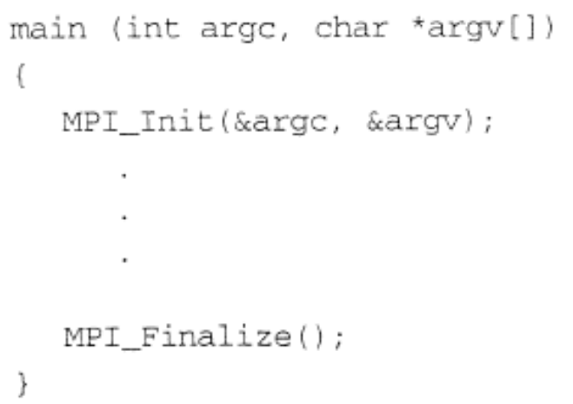
Before any MPI function call, the code must be initialized with MPI_Init(), and after all MPI function calls, the code must be terminated with MPI_Finalize().
&argc, argument count, provides the number of arguments, and &argv, argument vector, is a pointer to an array of character strings.
Slides for Parallel Programming Techniques & Applications Using Networked Workstations & Parallel Computers 2nd Edition, by B. Wilkinson & M. Allen, © 2004 Pearson Education Inc. All rights reserved.
2.<number>

Slide 33
Initially, all processes are enrolled in a "universe" called MPI_COMM_WORLD, and each process is given a unique rank, a number from 0 to p-1, where there are p processes.
In MPI terminology, MPI_COMM_WORLD is a communicator that defines the scope of a communication operation, and processes have ranks associated with the communicator.
Slides for Parallel Programming Techniques & Applications Using Networked Workstations & Parallel Computers 2nd Edition, by B. Wilkinson & M. Allen, © 2004 Pearson Education Inc. All rights reserved.
2.<number>

Slide 34
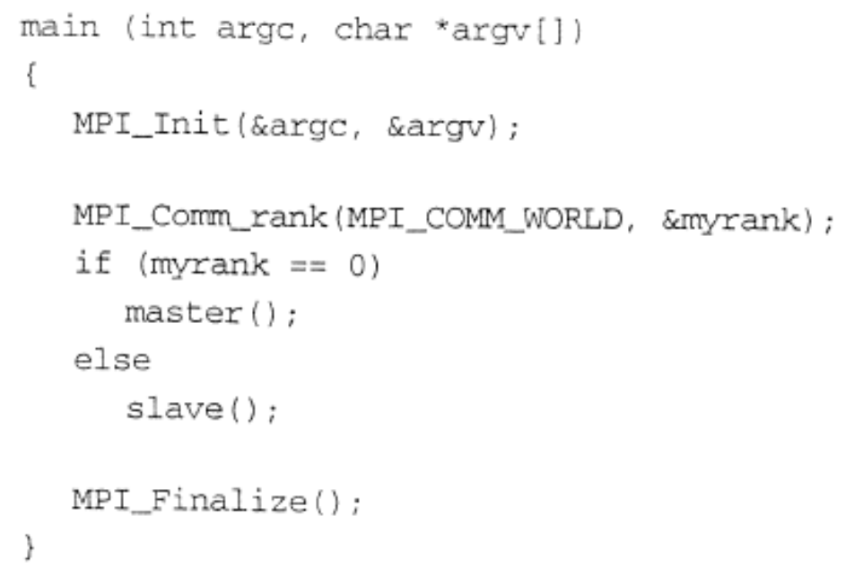
Using SPMD Computational Model
The SPMD model is ideal where each process will actually execute the same code.
master() and slave() are procedures to be executed by the master process and slave process, respectively.
Slides for Parallel Programming Techniques & Applications Using Networked Workstations & Parallel Computers 2nd Edition, by B. Wilkinson & M. Allen, © 2004 Pearson Education Inc. All rights reserved.
2.<number>

Slide 35
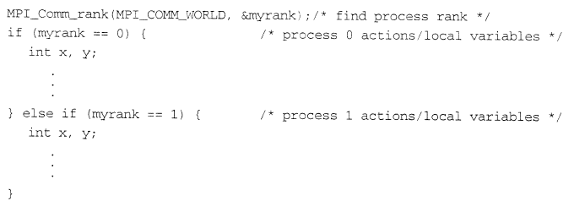
any global declarations of variables will be duplicated in each process. Variables that are not to be duplicated could be declared locally.
Slides for Parallel Programming Techniques & Applications Using Networked Workstations & Parallel Computers 2nd Edition, by B. Wilkinson & M. Allen, © 2004 Pearson Education Inc. All rights reserved.
2.<number>

Slide 36
Message-Passing Routines
An intent of MPI is to provide a safe communication environment. (nonsafe in practice)
each send/recv pair has matching source and destination, incorrect message-passing occurs.
Communicators are used in MPI for all point-to-point and collective MPI message­passing communications. A communicator is a communication domain that defines a set of processes that are allowed to communicate with one another.
Slides for Parallel Programming Techniques & Applications Using Networked Workstations & Parallel Computers 2nd Edition, by B. Wilkinson & M. Allen, © 2004 Pearson Education Inc. All rights reserved.
2.<number>

Slide 37
Unsafe message passing - Example
Process 0
Process 1
Destination
send(…,1,…);
lib()
send(…,1,…);
Source
(a) Intended behavior
recv(…,0,…);
lib()
recv(…,0,…);
Process 0
Process 1
send(…,1,…);
(b) Possible behavior
lib()
send(…,1,…);
recv(…,0,…);
lib()
recv(…,0,…);
Unsafe communication
Slides for Parallel Programming Techniques & Applications Using Networked Workstations & Parallel Computers 2nd Edition, by B. Wilkinson & M. Allen, © 2004 Pearson Education Inc. All rights reserved.
2.<number>

Slide 38
Each process has a rank within the communicator, an integer from 0 to p-1, where there are p processes.
Two types of communicators are available, an intra-communicator for communicating within a group, and an inter-communicator for communication between groups.
A group is used to define a collection of processes for these purposes.
A process has a unique rank in a group (an integer from 0 to m-1, where there are m processes in the group)
A process could be a member of more than one group.
Slides for Parallel Programming Techniques & Applications Using Networked Workstations & Parallel Computers 2nd Edition, by B. Wilkinson & M. Allen, © 2004 Pearson Education Inc. All rights reserved.
2.<number>

Slide 39
A default intracommunicator, MPI_COMM_WORLD, exists as the first communicator for all the processes in the application.
A set of MPI routines exists for forming communicators from existing communicators, see Appendix A.
Slides for Parallel Programming Techniques & Applications Using Networked Workstations & Parallel Computers 2nd Edition, by B. Wilkinson & M. Allen, © 2004 Pearson Education Inc. All rights reserved.
2.<number>

Slide 40
MPI – message passing interface
Communicators
  Communicators: opaque object that provides message- passing environment for processes
  MPI_COMM_WORLD
    Default communicator
    Includes all processes
  Create new communicators
    MPI_Comm_create()
    MPI_Group_incl()
1.<number>

Slide 41
Communicators
Communicator Name
Communicator
MPI_COMM_WORLD
Processes
0
5
Ranks
2
1
4
3
1.<number>

Slide 42
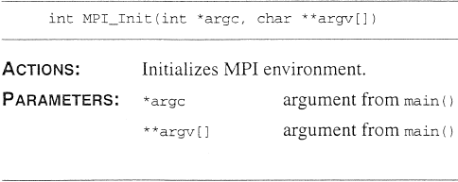
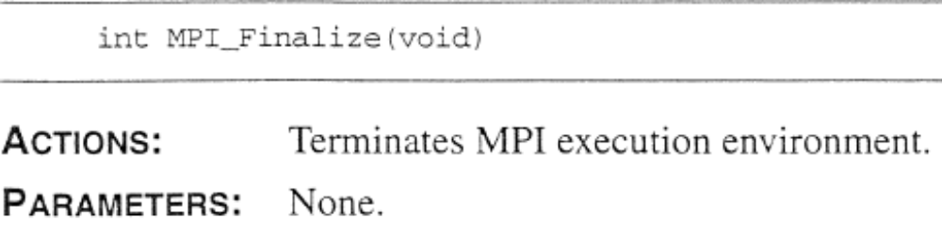
Basic MPI Routines -PRELIMINARIES
Slides for Parallel Programming Techniques & Applications Using Networked Workstations & Parallel Computers 2nd Edition, by B. Wilkinson & M. Allen, © 2004 Pearson Education Inc. All rights reserved.
2.<number>

Slide 43
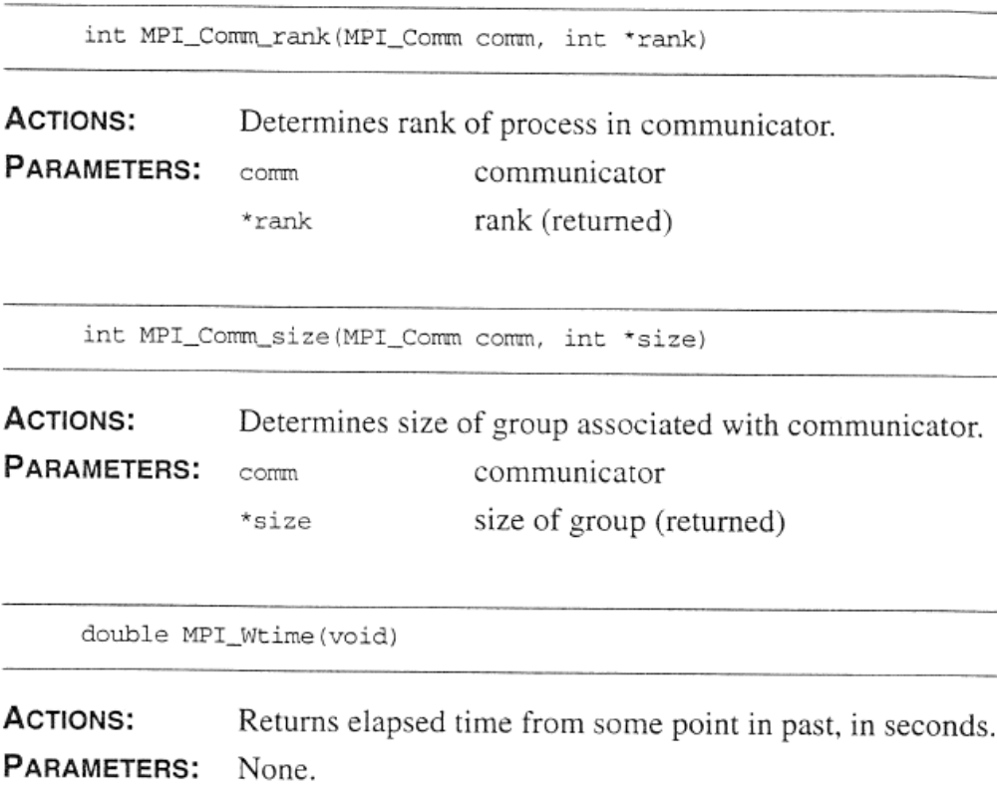
Slides for Parallel Programming Techniques & Applications Using Networked Workstations & Parallel Computers 2nd Edition, by B. Wilkinson & M. Allen, © 2004 Pearson Education Inc. All rights reserved.
2.<number>

Slide 44
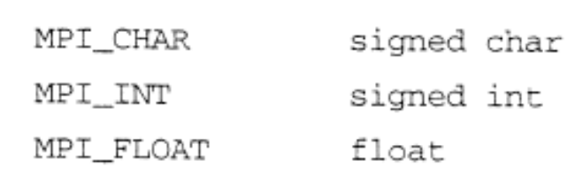
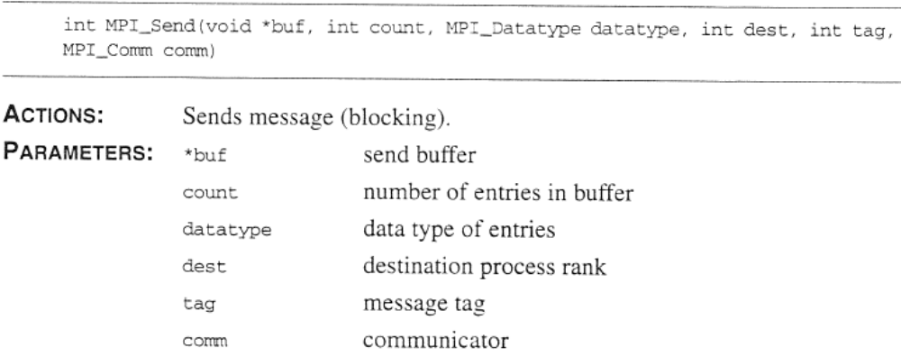
Basic MPI Routines - POINT-TO-POINT MESSAGE-PASSING
Slides for Parallel Programming Techniques & Applications Using Networked Workstations & Parallel Computers 2nd Edition, by B. Wilkinson & M. Allen, © 2004 Pearson Education Inc. All rights reserved.
2.<number>

Slide 45
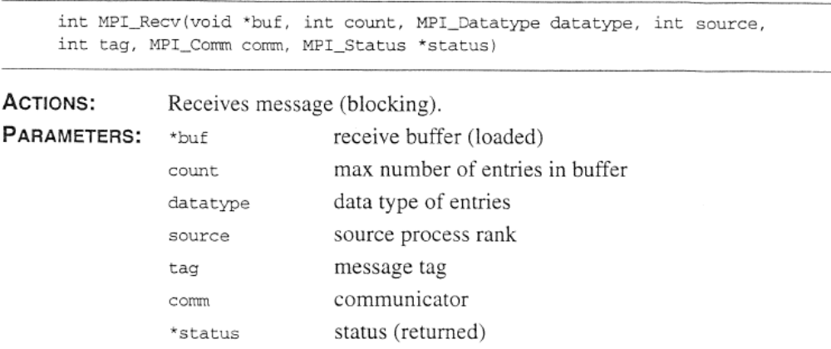
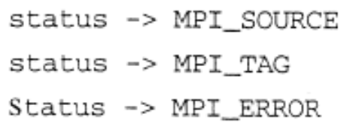
Slides for Parallel Programming Techniques & Applications Using Networked Workstations & Parallel Computers 2nd Edition, by B. Wilkinson & M. Allen, © 2004 Pearson Education Inc. All rights reserved.
2.<number>

Slide 46
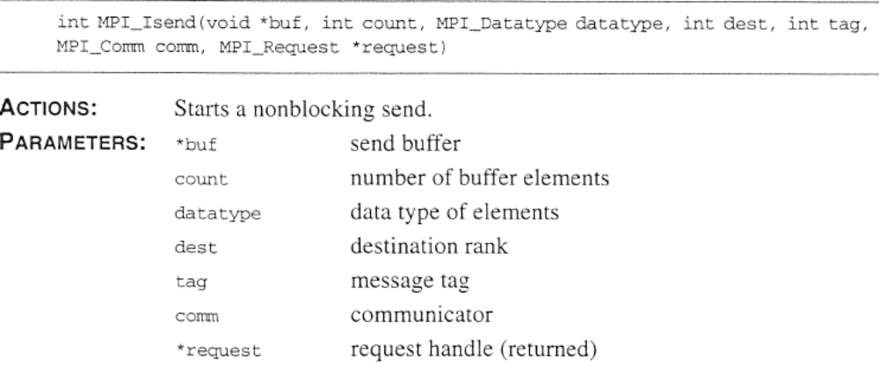
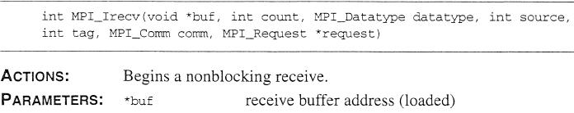
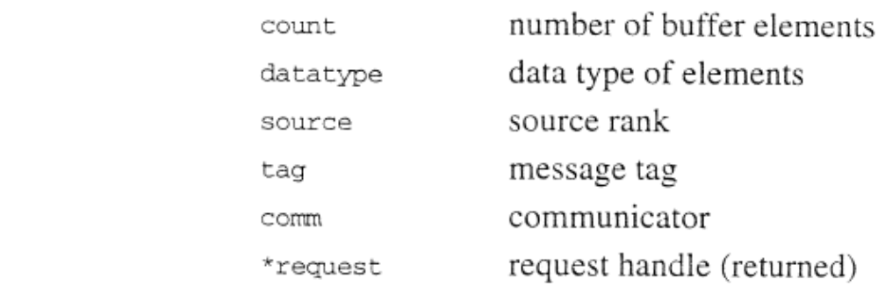
Slides for Parallel Programming Techniques & Applications Using Networked Workstations & Parallel Computers 2nd Edition, by B. Wilkinson & M. Allen, © 2004 Pearson Education Inc. All rights reserved.
2.<number>

Slide 47
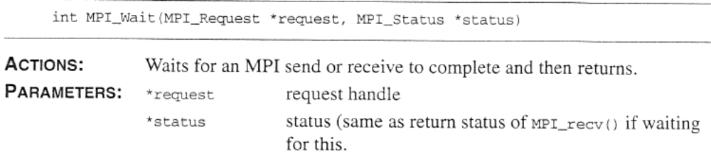
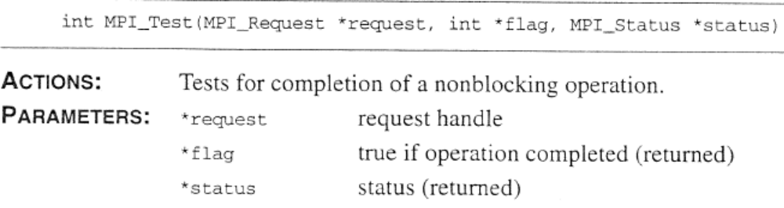
Slides for Parallel Programming Techniques & Applications Using Networked Workstations & Parallel Computers 2nd Edition, by B. Wilkinson & M. Allen, © 2004 Pearson Education Inc. All rights reserved.
2.<number>

Slide 48
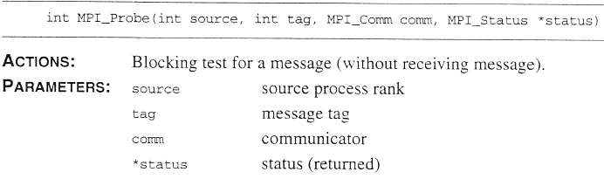
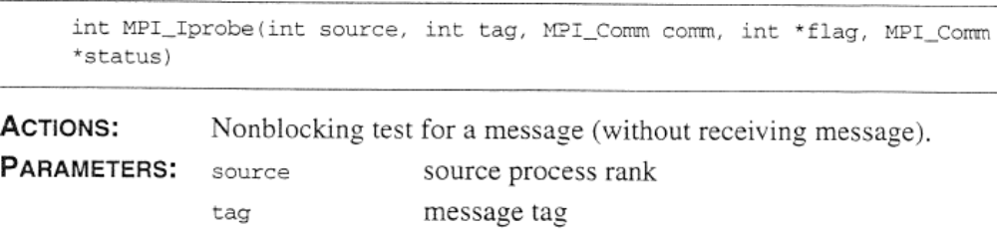

Slides for Parallel Programming Techniques & Applications Using Networked Workstations & Parallel Computers 2nd Edition, by B. Wilkinson & M. Allen, © 2004 Pearson Education Inc. All rights reserved.
2.<number>

Slide 49
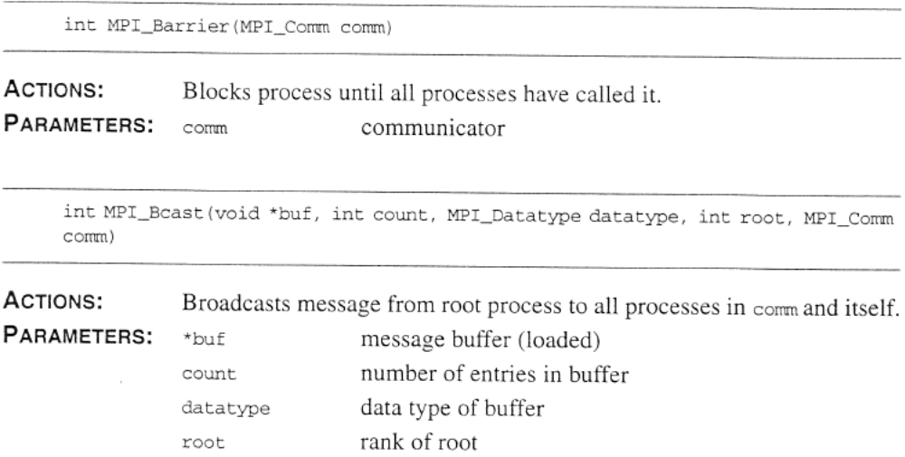
Basic MPI Routines –
GROUP ROUTINES
Slides for Parallel Programming Techniques & Applications Using Networked Workstations & Parallel Computers 2nd Edition, by B. Wilkinson & M. Allen, © 2004 Pearson Education Inc. All rights reserved.
2.<number>

Slide 50
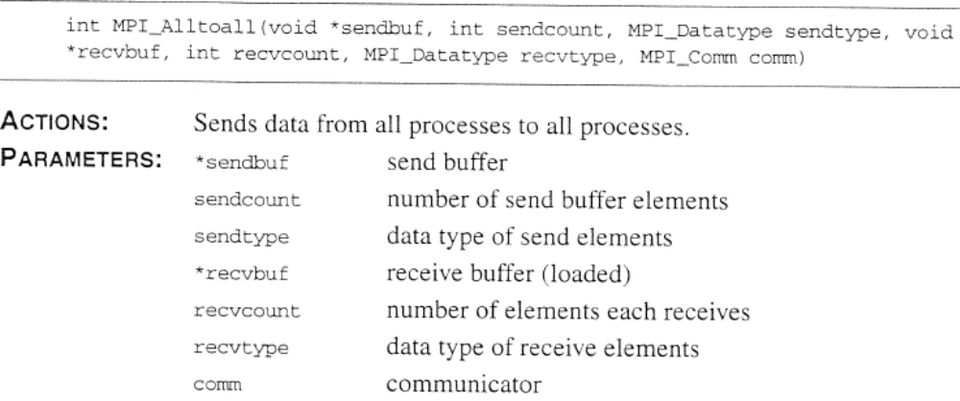
Slides for Parallel Programming Techniques & Applications Using Networked Workstations & Parallel Computers 2nd Edition, by B. Wilkinson & M. Allen, © 2004 Pearson Education Inc. All rights reserved.
2.<number>

Slide 51
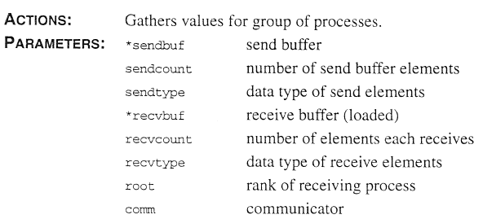
Slides for Parallel Programming Techniques & Applications Using Networked Workstations & Parallel Computers 2nd Edition, by B. Wilkinson & M. Allen, © 2004 Pearson Education Inc. All rights reserved.
2.<number>

Slide 52
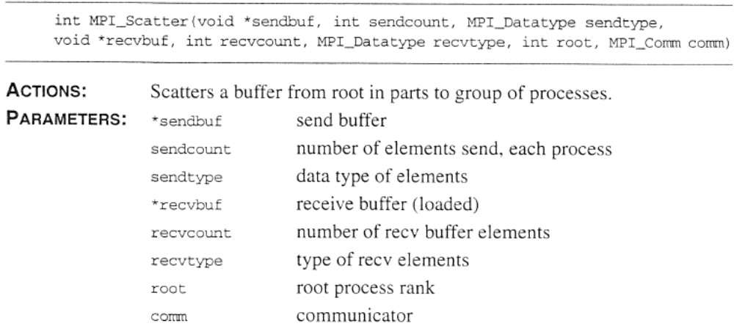
Slides for Parallel Programming Techniques & Applications Using Networked Workstations & Parallel Computers 2nd Edition, by B. Wilkinson & M. Allen, © 2004 Pearson Education Inc. All rights reserved.
2.<number>

Slide 53
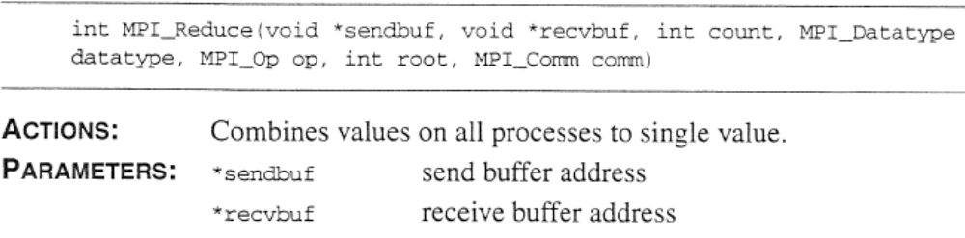
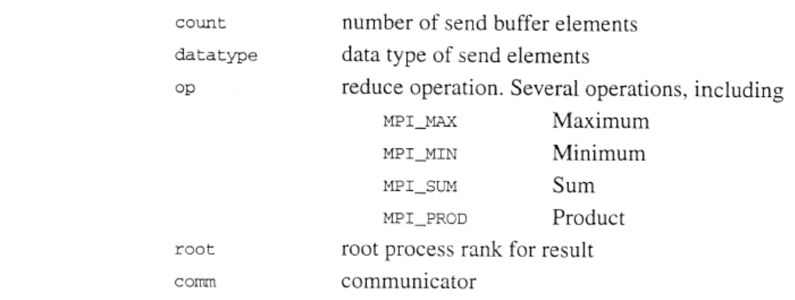
Slides for Parallel Programming Techniques & Applications Using Networked Workstations & Parallel Computers 2nd Edition, by B. Wilkinson & M. Allen, © 2004 Pearson Education Inc. All rights reserved.
2.<number>

Slide 54
MPI Point-to-Point Communication
Message-passing is done by the familiar send and receive calls. Message tags are present, and wild cards can be used in place of the tag (MPI_ANY_TAG) and in place of the source ID in receive routines (MPI_ANY_SOUECE).
The datatype of the message is defined in the send/receive parameters. The datatype can be taken from a list of standard MPI datatypes (MPI_INT, MPI_FLOAT, MPI_CHAR, etc.) or can be user created.
Slides for Parallel Programming Techniques & Applications Using Networked Workstations & Parallel Computers 2nd Edition, by B. Wilkinson & M. Allen, © 2004 Pearson Education Inc. All rights reserved.
2.<number>

Slide 55
MPI – message passing interface
Basic data types
  MPI_CHAR – char
  MPI_UNSIGNED_CHAR – unsigned char
  MPI_BYTE – like unsigned char
  MPI_SHORT – short
  MPI_LONG – long
  MPI_INT – int
  MPI_FLOAT – float
  MPI_DOUBLE – double
  ……
1.<number>

Slide 56
Completion
There are several versions of send and receive. The concepts of being locally complete and globally complete are used in describing the variations.
Slides for Parallel Programming Techniques & Applications Using Networked Workstations & Parallel Computers 2nd Edition, by B. Wilkinson & M. Allen, © 2004 Pearson Education Inc. All rights reserved.
2.<number>

Slide 57
MPI Blocking Routines
In MPI, blocking send or receive routines return when they are locally complete.
  A blocking send will send the message and return.
  A blocking receive routine will also return when it is locally complete, which in this case means that the message has been received into the destination location and the destination location can be read.
Note that a maximum message size is specified in MPI_Recv().
Slides for Parallel Programming Techniques & Applications Using Networked Workstations & Parallel Computers 2nd Edition, by B. Wilkinson & M. Allen, © 2004 Pearson Education Inc. All rights reserved.
2.<number>

Slide 58
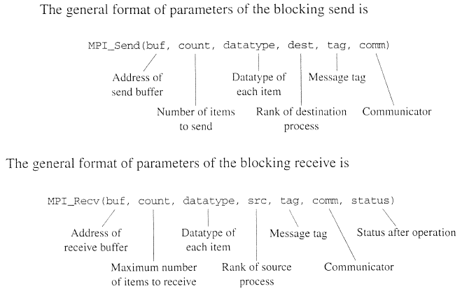
Slides for Parallel Programming Techniques & Applications Using Networked Workstations & Parallel Computers 2nd Edition, by B. Wilkinson & M. Allen, © 2004 Pearson Education Inc. All rights reserved.
2.<number>

Slide 59
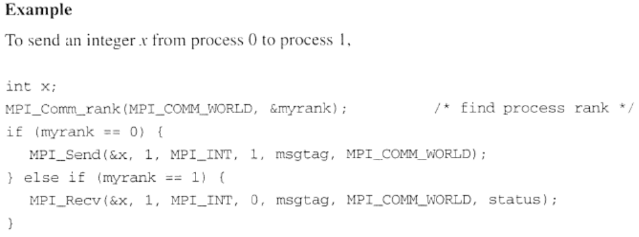
Slides for Parallel Programming Techniques & Applications Using Networked Workstations & Parallel Computers 2nd Edition, by B. Wilkinson & M. Allen, © 2004 Pearson Education Inc. All rights reserved.
2.<number>

Slide 60
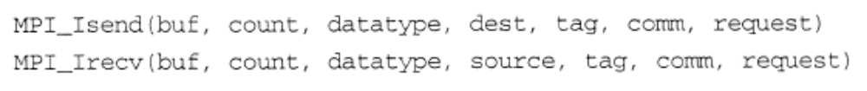
MPI Nonblocking Routines
A nonblocking routine returns immediately; that is, allows the next statement to execute, whether or not the routine is locally complete.
  The nonblocking send, MPI_Isend(), where I refers to the word immediate, will return even before the source location is safe to be altered.
  The nonblocking receive, MPI_Irecv() , will return even if there is no message to accept.
Slides for Parallel Programming Techniques & Applications Using Networked Workstations & Parallel Computers 2nd Edition, by B. Wilkinson & M. Allen, © 2004 Pearson Education Inc. All rights reserved.
2.<number>

Slide 61
Completion can be detected by separate routines, MPI_Wait() and MPI_Test().
  MPI_Wait() waits until the operation has actually completed and will return then.
  MPI_Test() returns immediately with a flag set indicating whether the operation has completed at that time.
Slides for Parallel Programming Techniques & Applications Using Networked Workstations & Parallel Computers 2nd Edition, by B. Wilkinson & M. Allen, © 2004 Pearson Education Inc. All rights reserved.
2.<number>

Slide 62
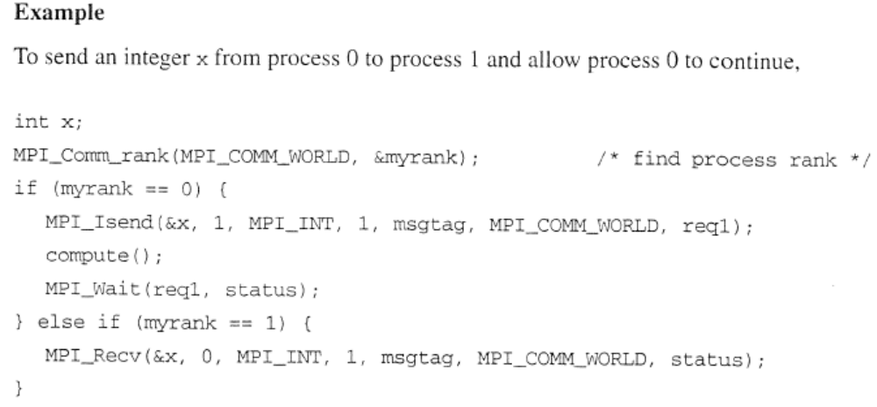
Slides for Parallel Programming Techniques & Applications Using Networked Workstations & Parallel Computers 2nd Edition, by B. Wilkinson & M. Allen, © 2004 Pearson Education Inc. All rights reserved.
2.<number>

Slide 63
MPI – message passing interface
6 basic MPI functions
  MPI_Init – initialize MPI environment
  MPI_Finalize – shutting down MPI environment
  MPI_Comm_size – determine number of processes
  MPI_Comm_rank – determine process rank
  MPI_Send – blocking data send
  MPI_Recv – blocking data receive
1.<number>

Slide 64
Send Communication Modes
Standard Mode Send - Not assumed that corresponding receive routine has started. Amount of buffering not defined by MPI. If buffering provided, send could complete before receive reached.
Buffered Mode - Send may start and return before a matching receive. Necessary to specify buffer space via routine MPI_Buffer_attach().
Synchronous Mode - Send and receive can start before each other but can only complete together.
Ready Mode - Send can only start if matching receive already reached, otherwise error. Use with care.
Slides for Parallel Programming Techniques & Applications Using Networked Workstations & Parallel Computers 2nd Edition, by B. Wilkinson & M. Allen, © 2004 Pearson Education Inc. All rights reserved.
2.<number>

Slide 65
Each of the four modes can be applied to both blocking and nonblocking send routines.
Only the standard mode is available for the blocking and nonblocking receive routines.
Any type of send routine can be used with any type of receive routine.
Slides for Parallel Programming Techniques & Applications Using Networked Workstations & Parallel Computers 2nd Edition, by B. Wilkinson & M. Allen, © 2004 Pearson Education Inc. All rights reserved.
2.<number>

Slide 66
Collective Communication
Collective communication, such as broadcast, involves a set of processes, as opposed to point-to-point communication.
The processes are those defined by an intra-communicator. Message tags are not present.
The processes involved are those in the same communicator.
Slides for Parallel Programming Techniques & Applications Using Networked Workstations & Parallel Computers 2nd Edition, by B. Wilkinson & M. Allen, © 2004 Pearson Education Inc. All rights reserved.
2.<number>

Slide 67
Principal collective operations:
MPI_Bcast() - Broadcast from root to all other processes
MPI_Gather() - Gather values for group of processes
MPI_Scatter() - Scatters buffer in parts to group of processes
MPI_Alltoall() - Sends data from all processes to all processes
MPI_Reduce() - Combine values on all processes to single value
MPI_Reduce_scatter() - Combine values and scatter results
MPI_Scan() - Compute prefix reductions of data on processes
Slides for Parallel Programming Techniques & Applications Using Networked Workstations & Parallel Computers 2nd Edition, by B. Wilkinson & M. Allen, © 2004 Pearson Education Inc. All rights reserved.
2.<number>

Slide 68
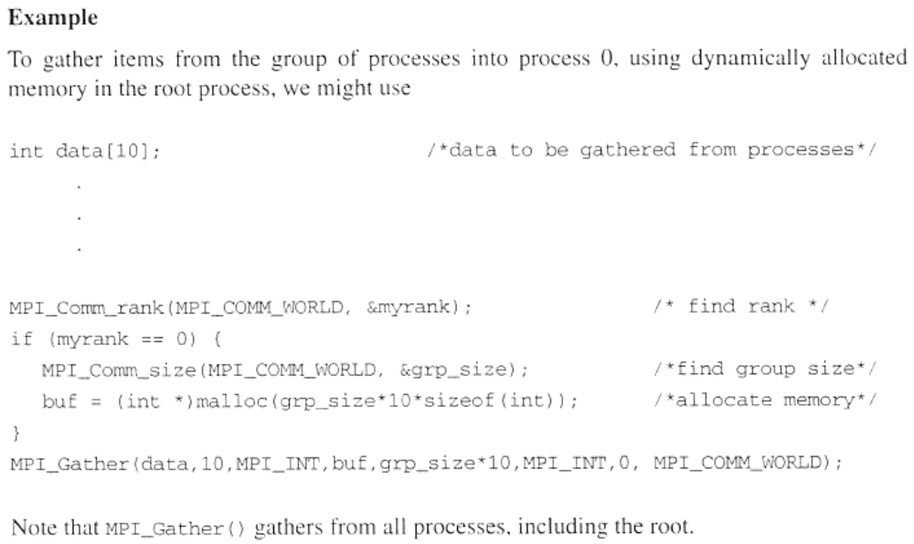
Slides for Parallel Programming Techniques & Applications Using Networked Workstations & Parallel Computers 2nd Edition, by B. Wilkinson & M. Allen, © 2004 Pearson Education Inc. All rights reserved.
2.<number>

Slide 69
Barrier routine
A means of synchronizing processes by stopping each one until they all have reached a specific “barrier” call.
Slides for Parallel Programming Techniques & Applications Using Networked Workstations & Parallel Computers 2nd Edition, by B. Wilkinson & M. Allen, © 2004 Pearson Education Inc. All rights reserved.
2.<number>

Slide 70
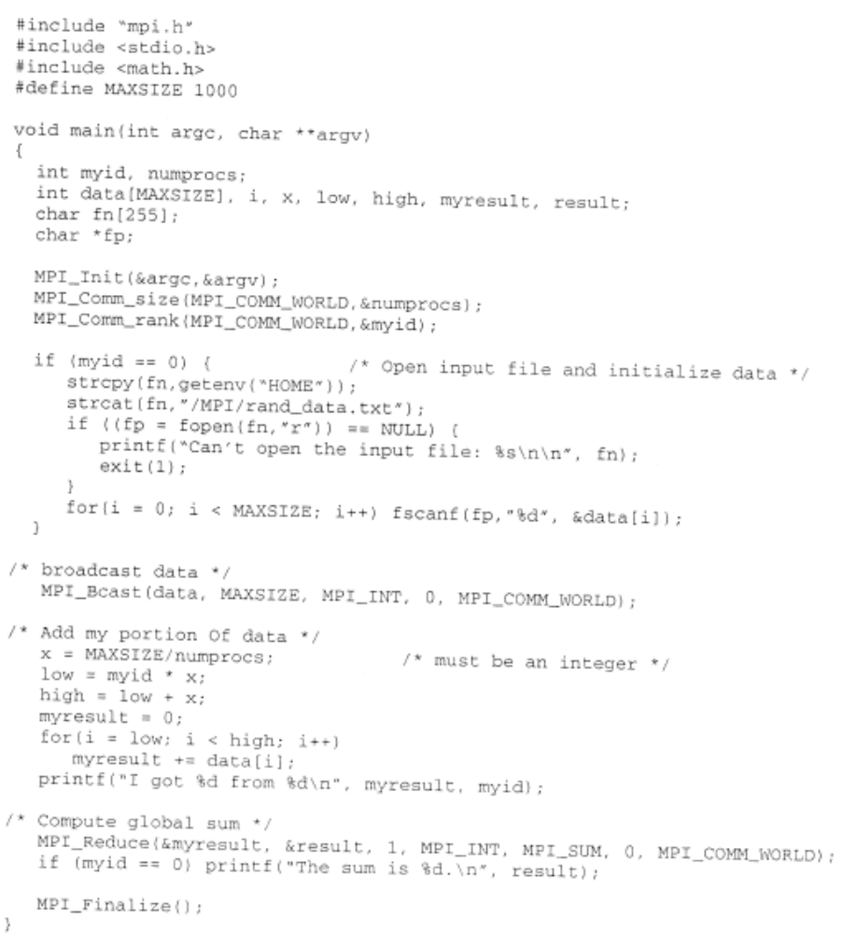
Slides for Parallel Programming Techniques & Applications Using Networked Workstations & Parallel Computers 2nd Edition, by B. Wilkinson & M. Allen, © 2004 Pearson Education Inc. All rights reserved.
2.<number>

Slide 71


Pseudocode Constructs
Slides for Parallel Programming Techniques & Applications Using Networked Workstations & Parallel Computers 2nd Edition, by B. Wilkinson & M. Allen, © 2004 Pearson Education Inc. All rights reserved.
2.<number>

Slide 72
Evaluating Parallel Programs
Slides for Parallel Programming Techniques & Applications Using Networked Workstations & Parallel Computers 2nd Edition, by B. Wilkinson & M. Allen, © 2004 Pearson Education Inc. All rights reserved.
2.<number>

Slide 73
Equations for Parallel Execution Time
Sequential execution time, t_{s}: Estimate by counting computational steps of best sequential algorithm.
Parallel execution time, t_{p}: In addition to number of computational steps, t_{comp}, need to estimate communication overhead, t_{comm}:
t_{p} = t_{comp} + t_{comm}
Slides for Parallel Programming Techniques & Applications Using Networked Workstations & Parallel Computers 2nd Edition, by B. Wilkinson & M. Allen, © 2004 Pearson Education Inc. All rights reserved.
2.<number>

Slide 74
Computational Time
Count number of computational steps.
When more than one process executed simultaneously, count computational steps of most complex process. Generally, function of n and p, i.e.
t_{comp} = f (n, p)
Often break down computation time into parts. Then
t_{comp} = t_{comp1} + t_{comp2} + t_{comp3} + …
Analysis usually done assuming that all processors are same and operating at same speed. (may not be true for cluster, heterogeneous)
Slides for Parallel Programming Techniques & Applications Using Networked Workstations & Parallel Computers 2nd Edition, by B. Wilkinson & M. Allen, © 2004 Pearson Education Inc. All rights reserved.
2.<number>

Slide 75
Communication Time
Many factors, including network structure and network contention. As a first approximation, use
t_{comm} = t_{startup} + wt_{data}
t_{startup} is startup time, essentially time to send a message with no data. Assumed to be constant. (dominate the communication time)
t_{data} is transmission time to send one data word, also assumed constant, and there are w data words.
The equation ignores the fact that the source and destination may not be directly linked in a real system so that the message must pass through intermediate nodes.
Slides for Parallel Programming Techniques & Applications Using Networked Workstations & Parallel Computers 2nd Edition, by B. Wilkinson & M. Allen, © 2004 Pearson Education Inc. All rights reserved.
2.<number>

Slide 76

Idealized Communication Time
Star
tup time
Number of data items (
n
)
Slides for Parallel Programming Techniques & Applications Using Networked Workstations & Parallel Computers 2nd Edition, by B. Wilkinson & M. Allen, © 2004 Pearson Education Inc. All rights reserved.
2.<number>

Slide 77
Final communication time, t_{comm}
Summation of communication times of all sequential messages from a process, i.e.
t_{comm} = t_{comm1} + t_{comm2} + t_{comm3} + …
Communication patterns of all processes assumed same and take place together so that only one process need be considered.
Both t_{startup} and t_{data}, measured in units of one computational step, so that can add t_{comp} and t_{comm} together to obtain parallel execution time, t_{p}.
Slides for Parallel Programming Techniques & Applications Using Networked Workstations & Parallel Computers 2nd Edition, by B. Wilkinson & M. Allen, © 2004 Pearson Education Inc. All rights reserved.
2.<number>

Slide 78
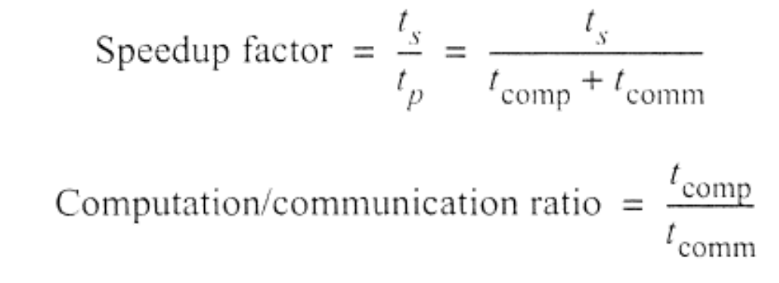
Benchmark Factors
With t_{s}, t_{comp}, and t_{comm}, can establish speedup factor and computation/communication ratio for a particular algorithm/implementation:
Both functions of number of processors, p, and number of data elements, n.
t_{startup}>>t_{data}>>t_{comp for one data}
Slides for Parallel Programming Techniques & Applications Using Networked Workstations & Parallel Computers 2nd Edition, by B. Wilkinson & M. Allen, © 2004 Pearson Education Inc. All rights reserved.
2.<number>

Slide 79
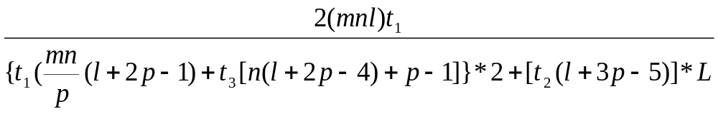
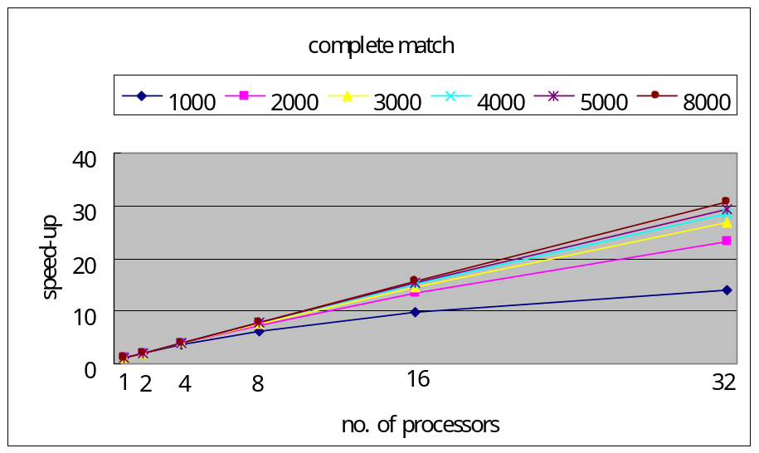
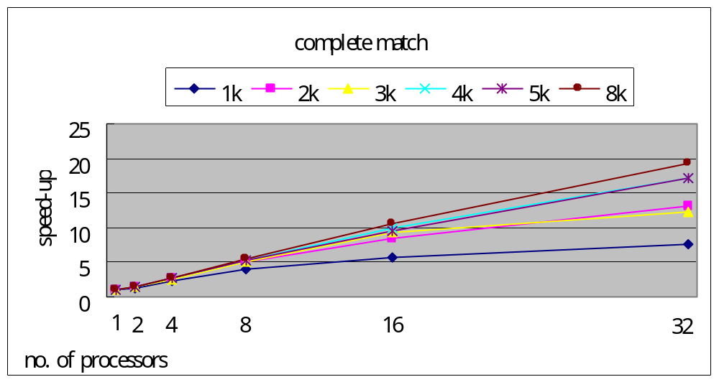
t₁: computation time
t₂: startup time
t₃: transmission time
n, m, l: length for sequence
p: number of processors
t1= 44.7 ns (match)
t2 = 56us
t3 = 50 ns
Speed-up ratio =
Slides for Parallel Programming Techniques & Applications Using Networked Workstations & Parallel Computers 2nd Edition, by B. Wilkinson & M. Allen, © 2004 Pearson Education Inc. All rights reserved.
2.<number>

Slide 80
Factors give indication of scalability of parallel solution with increasing number of processors and problem size.
Computation/communication ratio will highlight effect of communication with increasing problem size and system size.
For ease of analysis, it will be assumed that the system is a homogeneous system. Every processor is identical and operating at the same speed.
division requires the same time as addition.
Any additional operations necessary in the formation of the program, such as counting iterations, are not considered.
Slides for Parallel Programming Techniques & Applications Using Networked Workstations & Parallel Computers 2nd Edition, by B. Wilkinson & M. Allen, © 2004 Pearson Education Inc. All rights reserved.
2.<number>

Slide 81
Latency Hiding
One way to ameliorate the situation is to overlap the communication with subsequent computations; that is, by keeping the processor busy with useful work while waiting for the communication to be completed, which is known as latency hiding. (nonblocking send routines)
Slides for Parallel Programming Techniques & Applications Using Networked Workstations & Parallel Computers 2nd Edition, by B. Wilkinson & M. Allen, © 2004 Pearson Education Inc. All rights reserved.
2.<number>

Slide 82

Time Complexity
As with sequential computations, a parallel algorithm can be evaluated through the use of time complexity (notably the O notation - "order of magnitude," "big-oh")
space complexity
When using the notations for execution time, we start with an estimate of the number of computational steps, considering all the arithmetic and logical operations to be equal and ignoring other aspects of the computation, such as computational tests.
Slides for Parallel Programming Techniques & Applications Using Networked Workstations & Parallel Computers 2nd Edition, by B. Wilkinson & M. Allen, © 2004 Pearson Education Inc. All rights reserved.
2.<number>

Slide 83
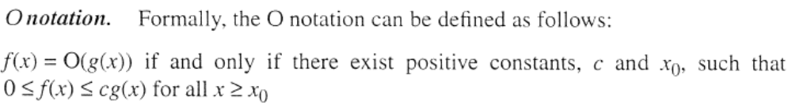
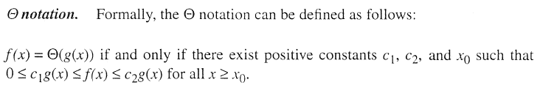
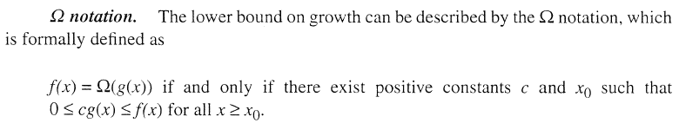
Slides for Parallel Programming Techniques & Applications Using Networked Workstations & Parallel Computers 2nd Edition, by B. Wilkinson & M. Allen, © 2004 Pearson Education Inc. All rights reserved.
2.<number>

Slide 84
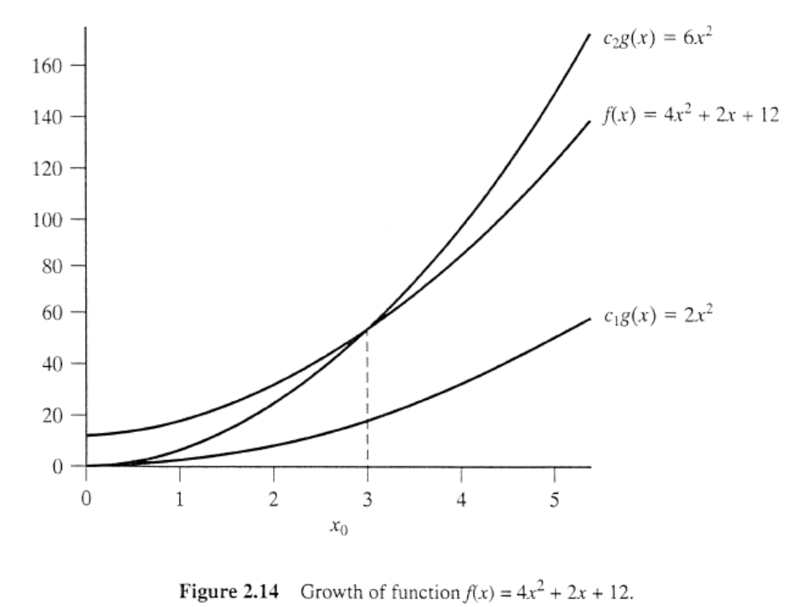
Slides for Parallel Programming Techniques & Applications Using Networked Workstations & Parallel Computers 2nd Edition, by B. Wilkinson & M. Allen, © 2004 Pearson Education Inc. All rights reserved.
2.<number>

Slide 85
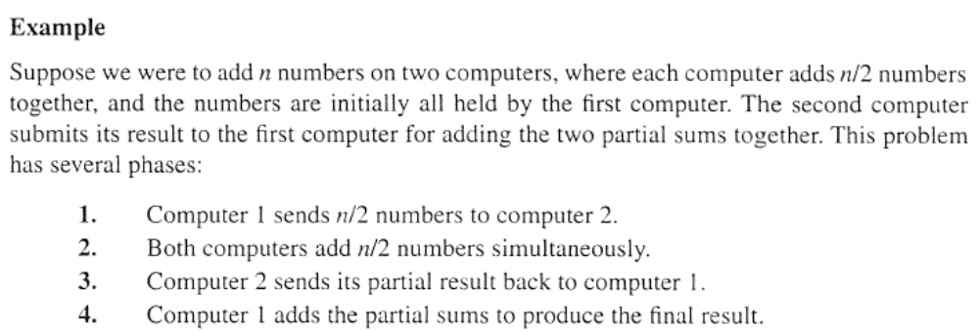
Time Complexity of a Parallel Algorithm
If we use time complexity analysis, which hides lower terms, t_{comm} will have a time complexity of O(n). The time complexity of t_{p} will be the sum of the complexity of the computation and the communication.
Slides for Parallel Programming Techniques & Applications Using Networked Workstations & Parallel Computers 2nd Edition, by B. Wilkinson & M. Allen, © 2004 Pearson Education Inc. All rights reserved.
2.<number>

Slide 86
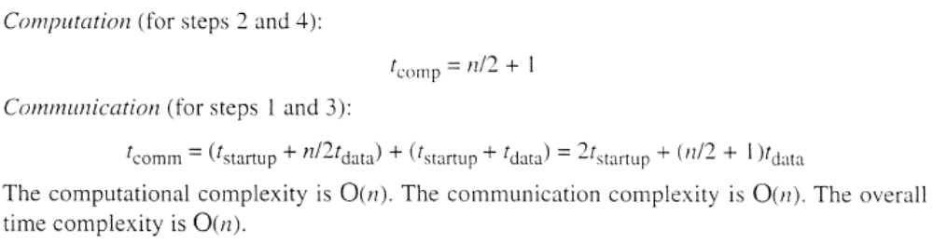
Computation/Communication Ratio
  Normally, communication is very costly. If both the computation and communication have the same time complexity, increasing n is unlikely to improve the performance. Ideally, the time complexity of the computation should be greater than that of the communication
Slides for Parallel Programming Techniques & Applications Using Networked Workstations & Parallel Computers 2nd Edition, by B. Wilkinson & M. Allen, © 2004 Pearson Education Inc. All rights reserved.
2.<number>

Slide 87
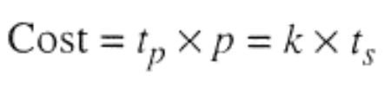
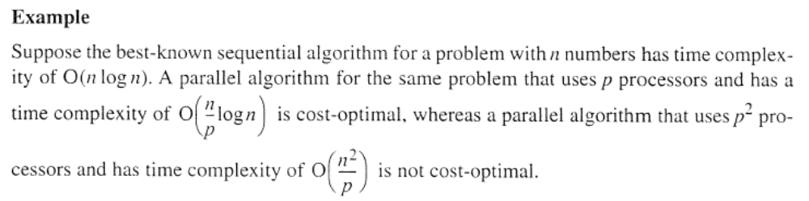
Cost and Cost-Optimal Algorithms
Slides for Parallel Programming Techniques & Applications Using Networked Workstations & Parallel Computers 2nd Edition, by B. Wilkinson & M. Allen, © 2004 Pearson Education Inc. All rights reserved.
2.<number>

Slide 88


Comments on Asymptotic Analysis
the time complexity notation is much less useful for evaluating the potential performance of parallel programs.
Slides for Parallel Programming Techniques & Applications Using Networked Workstations & Parallel Computers 2nd Edition, by B. Wilkinson & M. Allen, © 2004 Pearson Education Inc. All rights reserved.
2.<number>

Slide 89
Shared Memory Programs
the shared data must be accessed in a controlled fashion, causing additional delays
Slides for Parallel Programming Techniques & Applications Using Networked Workstations & Parallel Computers 2nd Edition, by B. Wilkinson & M. Allen, © 2004 Pearson Education Inc. All rights reserved.
2.<number>

Slide 90

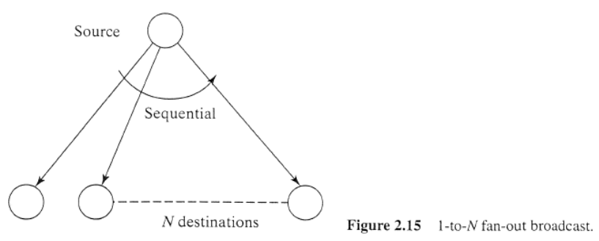

Communication Time of Broadcast/Gather
underlying architec­ture of the multicomputer
In this text, we concentrate upon using clusters.
Ethernet used a single wire connecting all computers.
1-to-N fan-out broadcast call
Slides for Parallel Programming Techniques & Applications Using Networked Workstations & Parallel Computers 2nd Edition, by B. Wilkinson & M. Allen, © 2004 Pearson Education Inc. All rights reserved.
2.<number>

Slide 91
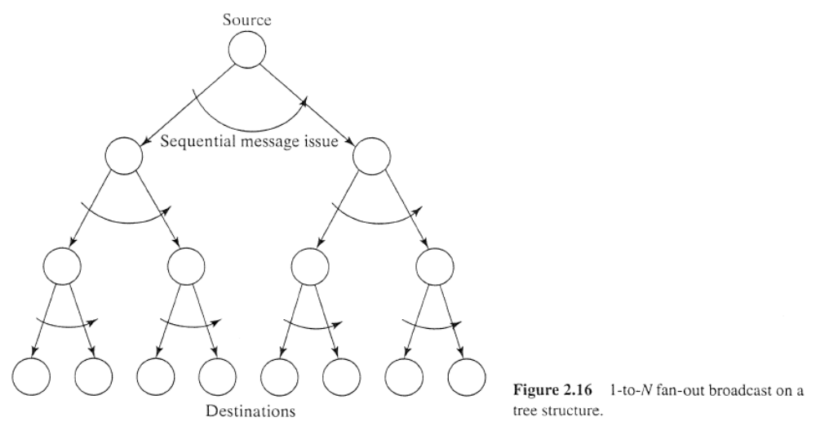

The 1-to-N fan-out broadcast applied to a tree structure
One disadvantage of a binary tree implementation of broadcast is that if a node fails in the tree, all the nodes below it will not receive the message.
Slides for Parallel Programming Techniques & Applications Using Networked Workstations & Parallel Computers 2nd Edition, by B. Wilkinson & M. Allen, © 2004 Pearson Education Inc. All rights reserved.
2.<number>

Slide 92
Debugging/Evaluating Parallel Programs Empirically
Slides for Parallel Programming Techniques & Applications Using Networked Workstations & Parallel Computers 2nd Edition, by B. Wilkinson & M. Allen, © 2004 Pearson Education Inc. All rights reserved.
2.<number>

Slide 93
In writing a parallel program, we first want to get it to execute correctly.
Low-Level Debugging
  Similar techniques could be used in parallel programs
  We should also mention that since processes might be executing on a remote computer, output from print statements may need to be redirected to a file in order to be seen at the local computer.
Slides for Parallel Programming Techniques & Applications Using Networked Workstations & Parallel Computers 2nd Edition, by B. Wilkinson & M. Allen, © 2004 Pearson Education Inc. All rights reserved.
2.<number>

Slide 94
Visualization Tools
Programs can be watched as they are executed in a space-time diagram (or process-time diagram):
Process 1
Process 2
Process 3
Computing
Time
W
aiting
Message-passing system routine
Message
Slides for Parallel Programming Techniques & Applications Using Networked Workstations & Parallel Computers 2nd Edition, by B. Wilkinson & M. Allen, © 2004 Pearson Education Inc. All rights reserved.
2.<number>

Slide 95
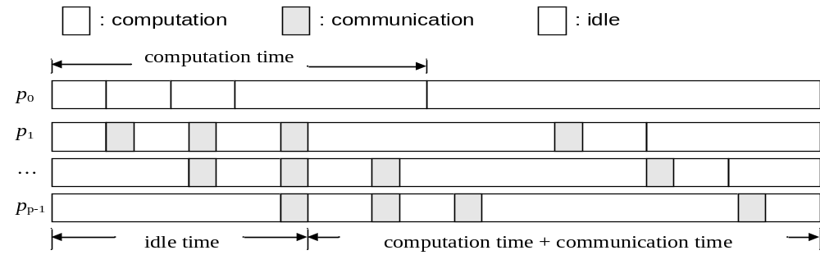
Slides for Parallel Programming Techniques & Applications Using Networked Workstations & Parallel Computers 2nd Edition, by B. Wilkinson & M. Allen, © 2004 Pearson Education Inc. All rights reserved.
2.<number>

Slide 96
Also of interest is a utilization-time diagram, which shows the amount of time spent by each process on communication, waiting, and message-passing library routines.
Slides for Parallel Programming Techniques & Applications Using Networked Workstations & Parallel Computers 2nd Edition, by B. Wilkinson & M. Allen, © 2004 Pearson Education Inc. All rights reserved.
2.<number>

Slide 97
Implementations of visualization tools are available for MPI.
An example is the Upshot program visualization system.
Slides for Parallel Programming Techniques & Applications Using Networked Workstations & Parallel Computers 2nd Edition, by B. Wilkinson & M. Allen, © 2004 Pearson Education Inc. All rights reserved.
2.<number>

Slide 98
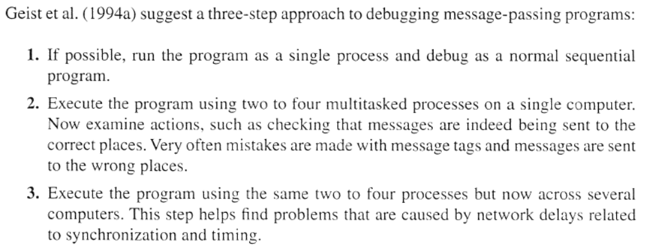
Debugging Strategies
Slides for Parallel Programming Techniques & Applications Using Networked Workstations & Parallel Computers 2nd Edition, by B. Wilkinson & M. Allen, © 2004 Pearson Education Inc. All rights reserved.
2.<number>

Slide 99
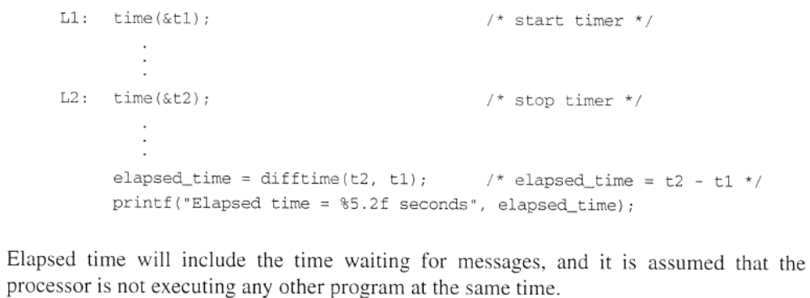
Evaluating Programs Empirically
Measuring Execution Time
Slides for Parallel Programming Techniques & Applications Using Networked Workstations & Parallel Computers 2nd Edition, by B. Wilkinson & M. Allen, © 2004 Pearson Education Inc. All rights reserved.
2.<number>

Slide 100
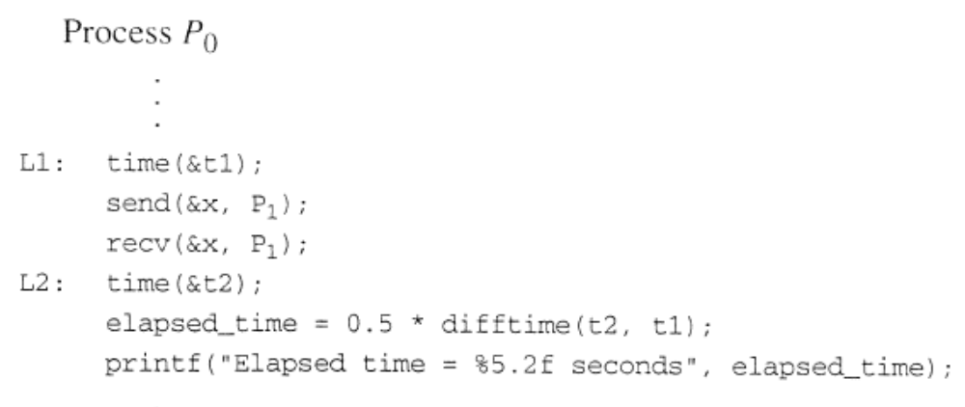
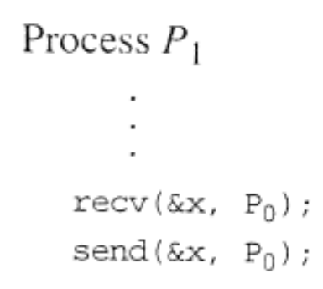
Communication Time by the Ping-Pong Method
One process, say P0, is made to send a message to another process, say P1. Immediately upon receiving the message, P1 sends the g back to P0.
Slides for Parallel Programming Techniques & Applications Using Networked Workstations & Parallel Computers 2nd Edition, by B. Wilkinson & M. Allen, © 2004 Pearson Education Inc. All rights reserved.
2.<number>

Slide 101
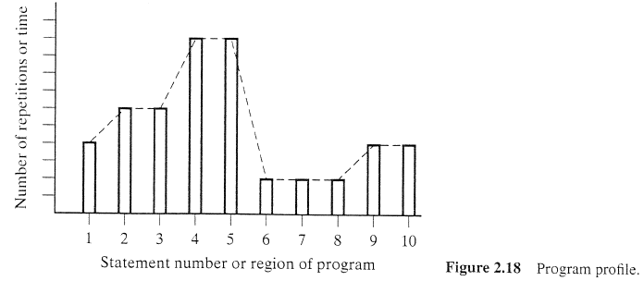
Profiling
A profile of a program is a histogram or graph showing the time spent on different parts of the program.
Profiling can be used to identify "hot spot" places in a program visited many times during the program execution.
Slides for Parallel Programming Techniques & Applications Using Networked Workstations & Parallel Computers 2nd Edition, by B. Wilkinson & M. Allen, © 2004 Pearson Education Inc. All rights reserved.
2.<number>

Slide 102
Comments on Optimizing Parallel Code
Once the performance has been measured, structural changes may need to be made to the program to improve its performance.
moving constant calculations to the outside of loops
The amount of data in the messages can be increased to lessen the effects of startup times.
recompute values locally than to send computed values
One can perform a critical path analysis on the program.
memory hierarchy (cache)
Slides for Parallel Programming Techniques & Applications Using Networked Workstations & Parallel Computers 2nd Edition, by B. Wilkinson & M. Allen, © 2004 Pearson Education Inc. All rights reserved.
2.<number>

Slide 103

Slides for Parallel Programming Techniques & Applications Using Networked Workstations & Parallel Computers 2nd Edition, by B. Wilkinson & M. Allen, © 2004 Pearson Education Inc. All rights reserved.
2.<number>

