Slide 1
Chapter 8
Programming with Shared Memory

Slide 2
In this chapter, we outline the methods of programming systems that have shared memory, including the use of processes, threads, parallel programming languages, and sequential languages with compiler directives and library routines.
  standard UNIX process
  "fork-join" model
  IEEE thread standard Pthreads
  OpenMP, a widely accepted industry standard for parallel programming on a shared memory multiprocessor.

Slide 3
Shared memory multiprocessor system
Any memory location can be accessible by any of the processors. (dual- and quad-Pentium systems, cost-effective)
A single address space exists, meaning that each memory location is given a unique address within a single range of addresses.
Generally, shared memory programming more convenient although it does require access to shared data to be controlled by the programmer (using critical sections etc.)

Slide 4
For a small number of processors, a common architecture is the single-bus architecture, in which all processors and memory modules attach to the same set of wires (the bus)
Bus contention increases with increasing numbers of processors and soon saturates the bus.
For more than a few processors, to obtain sufficient bandwidth, multiple interconnects can be used, including a full crossbar switch.

Slide 5
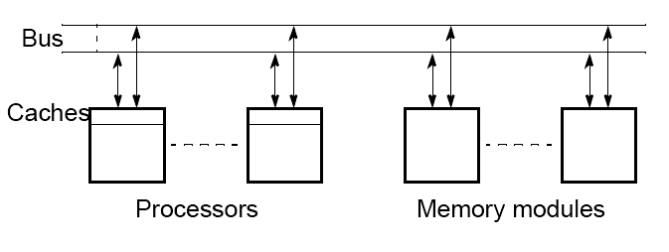
Shared memory multiprocessor
using a single bus

Slide 6
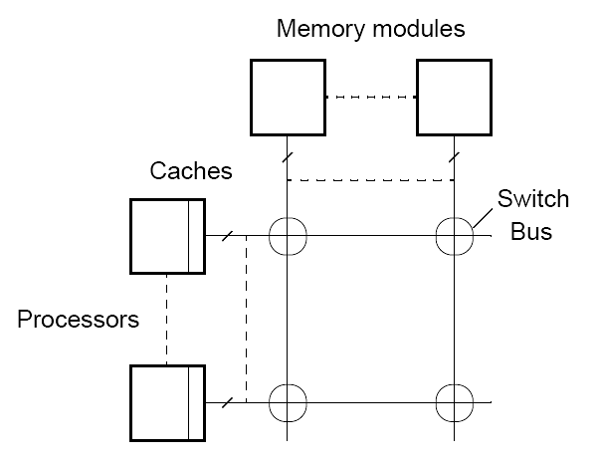
Shared memory multiprocessor
using a crossbar switch

Slide 7
Ideally, the system has uniform memory access (UMA), that is, the same high speed access time to any memory location from any processor.
Some memory is physically closer to certain processors than others (for large system).
non-uniform access (NUMA) system.
Caches

Slide 8
Alternatives for Programming Shared
Memory Multiprocessors:
• Using heavy weight processes (Unix, processes).
• Using threads. Example Pthreads
• Using a completely new programming language for
parallel programming - not popular. Example Ada.
• Using library routines with an existing sequential
programming language.
• Modifying the syntax of an existing sequential
programming language to create a parallel programming
language. Example UPC
• Using an existing sequential programming language
supplemented with compiler directives for specifying
parallelism. Example OpenMP (a special compiler is still needed)
Parallelizing compiler is not successful

Slide 9
CONSTRUCTS FOR SPECIFYING PARALLELISM
Creating Concurrent Processes
  The first example of a structure to specify concurrent processes is the FORK-JOIN group of statements, described by Conway (1963).
  FORK-JOIN constructs have been applied as extensions to FORTRAN and to the UNIX operating system.
  In the original FORK-JOIN construct, a FORK statement generates one new path for a concurrent process and the concurrent processes use JOIN statements at their ends.
  When both JOIN statements have been reached, processing continues in a sequential fashion.
  Typically a counter is used to keep a record of processes not completed.

Slide 10
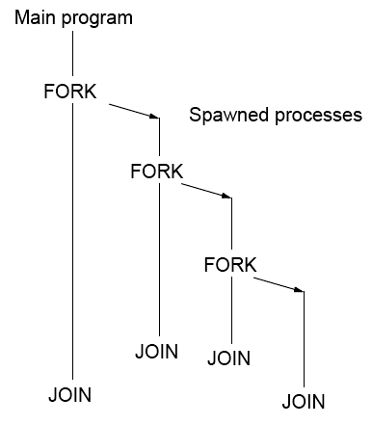

Slide 11
Using Heavyweight Processes
Operating systems (Unix) often based upon notion of a process.
Processor time shares between processes, switching from one process to another. Might occur at regular intervals or when an active process becomes delayed. (single processor)
Offers opportunity to deschedule processes blocked from proceeding for some reason, e.g. waiting for an I/O operation to complete.
On a multiprocessor, there is an opportunity to execute processes truly concurrently.
Concept could be used for parallel programming. Not much used because of overhead but fork/join concepts used elsewhere.

Slide 12
UNIX System Calls
The UNIX system call fork () creates a new process. The new process (child process) is an exact copy of the calling process except that it has a unique process ID. It has its own copy of the parent's variables.
On success, fork () returns 0 to the child process and returns the process ID of the child process to the parent process.

Slide 13
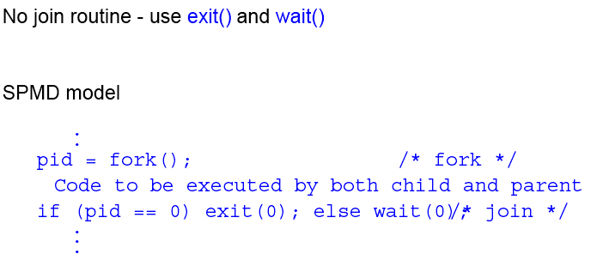
A single process can be created
The parent will wait for the slave to finish if it reaches the join point first; if the slave reaches the join point first, it will terminate.

Slide 14
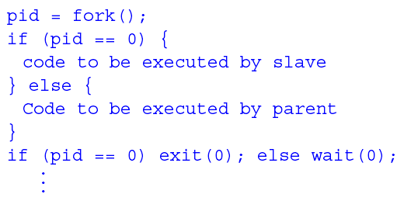
UNIX System Calls
SPMD model with different code for master process and forked slave process.
The forked process starts execution at the point of the fork.

Slide 15
Threads
The process created with UNIX fork is a "heavyweight" process; it is a completely separate program with its own variables, stack, and personal memory allocation. heavyweight processes are expensive in time and memory space.
A much more efficient mechanism is one in which independent concurrent sequences are defined within a process, so-cal1ed threads.
The threads al1 share the same memory space and global variables of the process and are much less expensive in time and memory space than the processes themselves.

Slide 16
Each thread needs its own stack and also stores information regarding registers but shares the code and other parts.
Creation of a thread can take three orders of magnitude less time than process creation.
In addition, a thread will immediately have access to shared global variables.
Equally important, threads can be synchronized much more efficiently than processes.
Multithreading also helps alleviate the long latency of message-passing

Slide 17
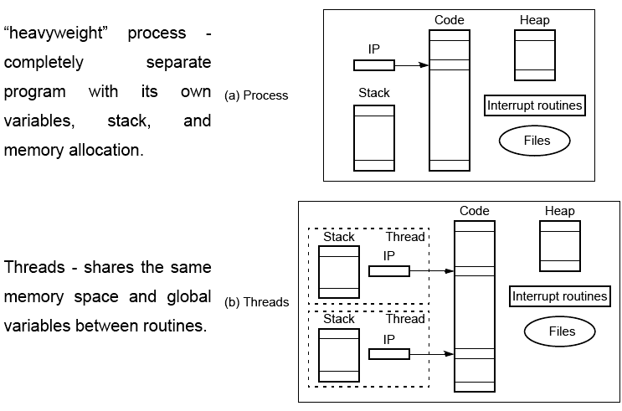
Differences between a process and threads

Slide 18
Pthreads
IEEE Portable Operating System Interface, POSIX, sec. 1003.1 standard (Appendix B, Pthread routines)
Appendix B provides an abbreviated list of Pthread routines.

Slide 19
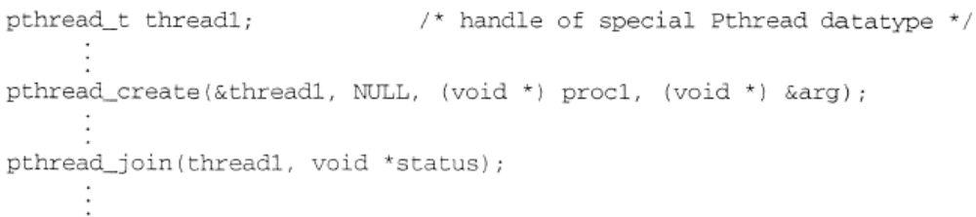
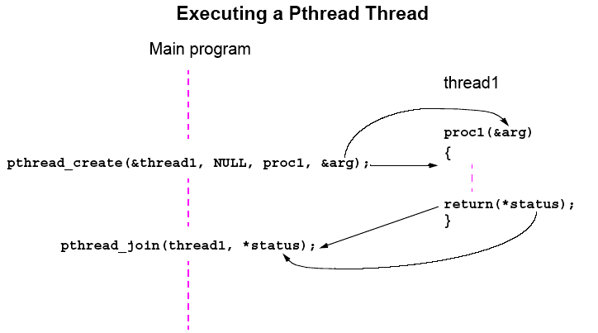

Slide 20

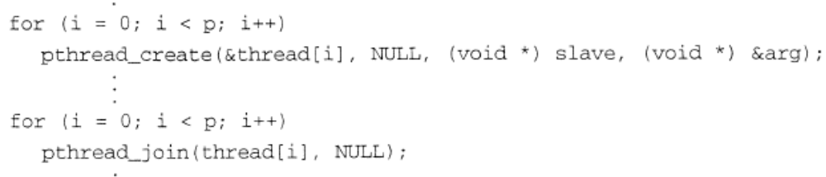
A thread will also terminate naturally at the end of its routine (return ()) and then return its status.
It can be terminated and destroyed with
It can be destroyed ("canceled") by another process, in which case the status returned is
Create a barrier waiting for all threads

Slide 21
Detached Threads
It may be that thread are not bothered when a thread it creates terminates and then a join not needed.
Threads not joined are called detached threads.
When detached threads terminate, they are destroyed and their resource released.

Slide 22
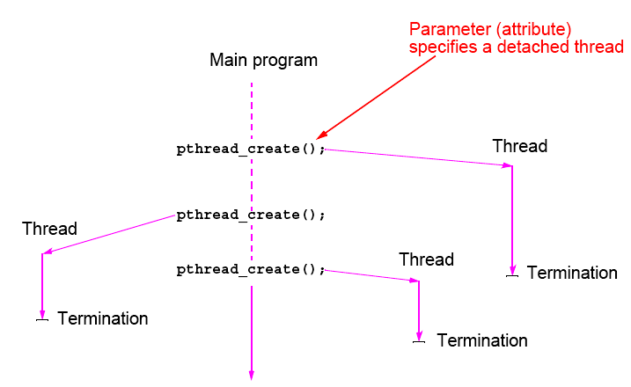
Pthreads Detached Threads

Slide 23
Thread Pools
All of the configurations that have been described for processes are applicable to threads.
A master thread can control a collection of slave threads.
A work pool of threads can be formed.
Threads can communicate through shared locations or, as we shall see, using signals.

Slide 24
Statement Execution Order
Single processor: Processes/threads typically executed until blocked. (time-shared)
Multiprocessor: Instructions of processes/threads interleaved in time.
Example
Process 1 Process 2
Instruction 1.1 Instruction 2.1
Instruction 1.2 Instruction 2.2
Instruction 1.3 Instruction 2.3
Several possible orderings, including
Instruction 1.1
Instruction 1.2
Instruction 2.1
Instruction 1.3
Instruction 2.2
Instruction 2.3
assuming instructions cannot be divided into smaller steps.
Multiprocessor

Slide 25
If two processes were to print messages, for example, the messages could appear in different orders depending upon the scheduling of processes calling the print routine.
Worse, the individual characters of each message could be interleaved if the machine instructions of instances of the print routine could be interleaved.

Slide 26
Compiler/Processor Optimizations
Compiler and processor reorder instructions for optimization.
Example
The statements
a = b + 5;
x = y + 4;
could be compiled to execute in reverse order:
x = y + 4;
a = b + 5;
and still be logically correct.
May be advantageous to delay statement a = b + 5 because a
previous instruction currently being executed in processor needs
more time to produce the value for b. Very common for processors to execute machines instructions out of order for increased speed .

Slide 27
Thread-Safe Routines
Thread safe if they can be called from multiple threads
simultaneously and always produce correct results.
Standard I/O thread safe (prints messages without interleaving the characters).
System routines that return time may not be thread safe.
Routines that access shared data may require special care to be made thread safe.

Slide 28
Creating Shared Data
The key aspect of shared memory programming is that shared memory provides the possibility of creating variables and data structures that can be accessed directly by every processor.
If UNIX heavyweight processes are to share data. additional shared memory system calls are necessary. Typically, each process has its own virtual address space within the virtual memory management system.
It is not necessary to create shared data items explicitly when using threads. Variables declared at the top of the main program (main thread) are global and are available to all threads.

Slide 29
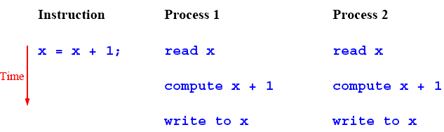
Accessing Shared Data
Accessing shared data needs careful control. (process, thread) (write is a problem)
Consider two processes each of which is to add one to a shared data item, x. Necessary for the contents of the location x to be read, x + 1 computed, and the result written back to the location:
X = 10, answer is 12, but may get 11

Slide 30
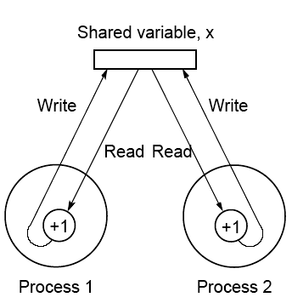
Conflict in accessing shared variable

Slide 31
Critical Section
A mechanism for ensuring that only one process accesses a particular resource at a time is to establish sections of code involving the resource as so-called critical sections and arrange that only one such critical section is executed at a time. (when a process reach a critical section…)
This mechanism is known as mutual exclusion.
This concept also appears in an operating systems.

Slide 32
Locks
Simplest mechanism for ensuring mutual exclusion of critical
sections.
A lock is a 1-bit variable that is a 1 to indicate that a process has entered the critical section and a 0 to indicate that no process is in the critical section.
Operates much like that of a door lock:
A process coming to the “door” of a critical section and finding it open may enter the critical section, locking the door behind it to prevent other processes from entering. Once the process has finished the critical section, it unlocks the door and leaves.

Slide 33
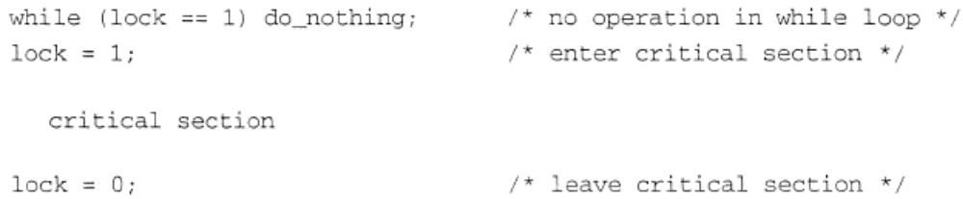
Such locks are called spin locks, and the mechanism is called busy waiting.
If more than one process is waiting for a lock to open, and the lock opens, a mechanism is necessary to choose the best or highest-priority process to enter the critical section first

Slide 34
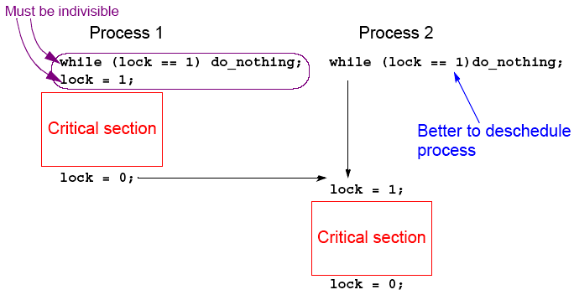
Control of critical sections through busy waiting

Slide 35
It is important to make sure that two or more processes do not simultaneously enter the critical section.
one process finds the lock open but has not yet closed it, so that another process finds it open
it must be done as one uninterruptable operation (is generally implemented in hardware)

Slide 36
Pthread Lock Routines
Locks are implemented in Pthreads with mutually exclusive lock variables, or “mutex” variables:
.
pthread_mutex_lock(&mutex1);
critical section
pthread_mutex_unlock(&mutex1);
.
If a thread reaches a mutex lock and finds it locked, it will wait for the lock to open. If more than one thread is waiting for the lock to open when it opens, the system will select one thread to be allowed to proceed. Only the thread that locks a mutex can unlock it.

Slide 37
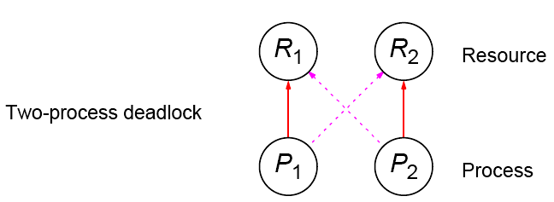
Deadlock
Can occur with two processes when one requires a resource held by the other, and this process requires a resource held by the first process.

Slide 38
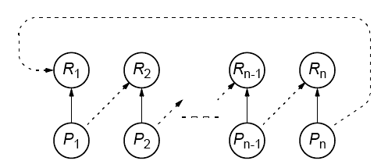
Deadlock (deadly embrace)
Deadlock can also occur in a circular fashion with several processes having a resource wanted by another.
Given a set of processes having various resource requests, a circular path between any group indicates a potential deadlock situation.

Slide 39
Pthreads
Offers one routine that can test whether a lock is actually closed without blocking the thread:
pthread_mutex_trylock()
Will lock an unlocked mutex and return 0 or will return with EBUSY if the mutex is already locked – might find a use in overcoming deadlock.

Slide 40
Semaphores
A positive integer (including zero) operated upon by two operations:
P operation on semaphore s
Waits until s is greater than zero and then decrements s by one and allows the process to continue.
V operation on semaphore s
Increments s by one and releases one of the waiting processes (if any).

Slide 41
P and V operations are performed indivisibly.
Mechanism for activating waiting processes is also implicit in P and V operations. Though exact algorithm not specified, algorithm expected to be fair. Processes delayed by P(s) are kept in abeyance until released by a V(s) on the same semaphore.
Devised by Dijkstra in 1968. Letter P is from the Dutch word passeren, meaning “to pass,” and letter V is from the Dutch word vrijgeven, meaning “to release.”)

Slide 42
Mutual exclusion of critical sections can be achieved with one
semaphore having the value 0 or 1 (a binary semaphore), which
acts as a lock variable, but the P and V operations include a process
scheduling mechanism:
Process 1 Process 2 Process 3
Noncritical section Noncritical section Noncritical section
. . .
. . .
. . .
P(s) P(s) P(s)
Critical section Critical section Critical section
V(s) V(s) V(s)
. . .
. . .
. . .
Noncritical section Noncritical section Noncritical section

Slide 43
General semaphore
(or counting semaphore)
Can take on positive values other than zero and one.
Provide, for example, a means of recording the number of “resource units” available or used and can be used to solve producer/ consumer problems. - more on that in operating system courses.
Semaphore routines exist for UNIX processes.
Not exist in Pthreads as such, though they can be written
Do exist in real-time extension to Pthreads.

Slide 44
Monitor
Suite of procedures that provides only way to access shared resource. Only one process can use a monitor procedure at any instant.
Could be implemented using a semaphore or lock to protect entry, i.e.,
monitor_proc1()
{
lock(x);
.
monitor body
.
unlock(x);
return;
}
Omission of a P or V operation, or misnaming the semaphore, would create havoc.

Slide 45
Condition Variables
Often, a critical section is to be executed if a specific global
condition exists; for example, if a certain value of a variable has been reached.
With locks, the global variable would need to be examined at
frequent intervals (“polled”) within a critical section.
Very time-consuming and unproductive exercise.
Can be overcome by introducing so-called condition variables.

Slide 46
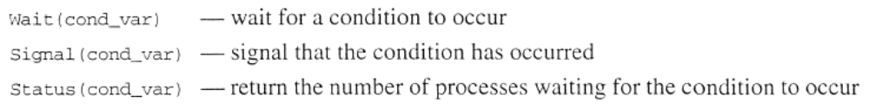
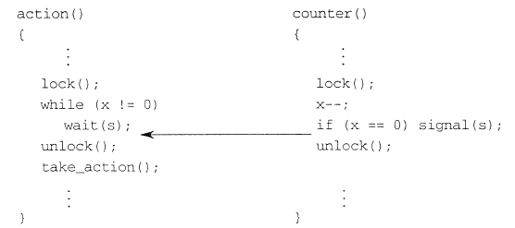

Slide 47
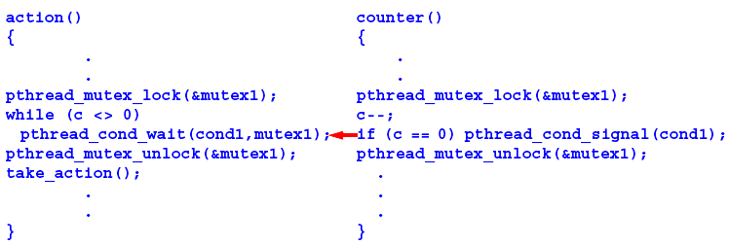
Pthread Condition Variables
Pthreads arrangement for signal and wait:
Signals not remembered - threads must already be waiting for a signal to receive it.

Slide 48
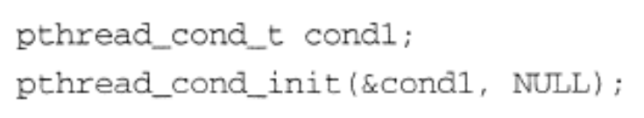
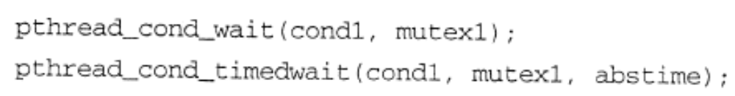
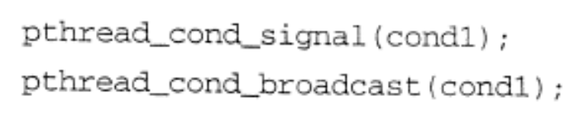

Slide 49
Barriers
process/thread synchronization is often needed in shared memory programs.
Pthreads do not have a native barrier, so barriers have to be hand-coded using a condition variable and mutex.
A global counter variable is incremented each time a thread reaches the barrier, and all the threads are released when the counter has reached a defined number of threads. The threads are released by the last thread reaching the barrier using broadcast signal

Slide 50
PARALLEL PROGRAMMING LANGUAGES AND CONSTRUCTS
Using a specially designed parallel programming language seems appealing, especially for a shared memory system. Shared memory variables can be declared and accessed in the same way as any variable in the program.
A large number of parallel programming languages have been proposed over the years, but none of them has been universally accepted.
There is continuing interesting in providing language extensions for parallel programming. A recent example is Unified Parallel C (UPC).

Slide 51
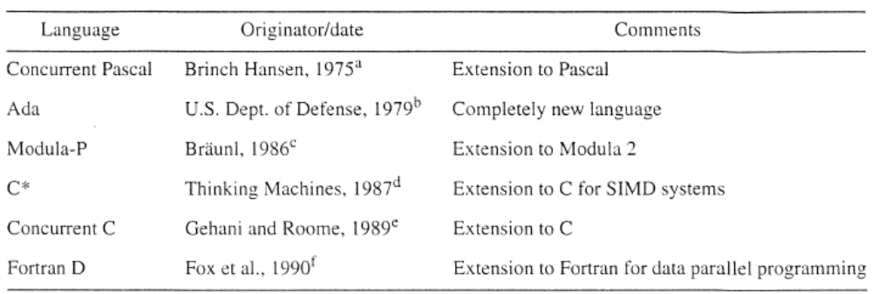

Slide 52
Language Constructs for Parallelism
Shared Data
Shared memory variables might be declared as shared with, say,
shared int x;
shared int *p;

Slide 53
par Construct
For specifying concurrent statements:
par {
S1;
S2;
.
.
Sn;
}
The keyword par indicates that statements in the body are to be executed concurrently. This is instruction-level parallelism.

Slide 54
Multiple concurrent processes or threads could be specified by listing the routines that are to be executed concurrently.
par {
proc1;
proc2;
.
.
procn;
}

Slide 55
forall Construct
To start multiple similar processes together:
forall (i = 0; i < n; i++) {
S1;
S2;
.
.
Sm;
}
which generates n processes each consisting of the statements forming the body of the for loop, S1, S2, …, Sm. Each process uses a different value of i.

Slide 56
Example
forall (i = 0; i < 5; i++)
a[i] = 0;
clears a[0], a[1], a[2], a[3], and a[4] to zero concurrently.

Slide 57
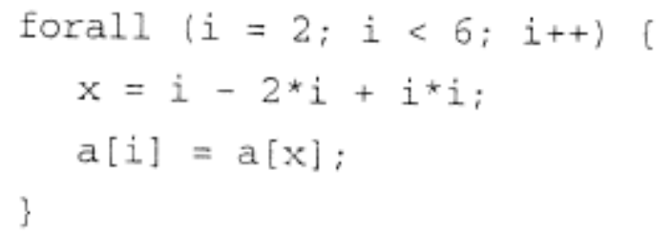
Dependency Analysis
To identify which processes could be executed together.
Example
Can see immediately in the code
forall (i = 0; i < 5; i++)
a[i] = 0;
that every instance of the body is independent of other instances and all instances can be executed simultaneously.
However, it may not be that obvious. Need algorithmic way of recognizing dependencies, for a parallelizing compiler.

Slide 58
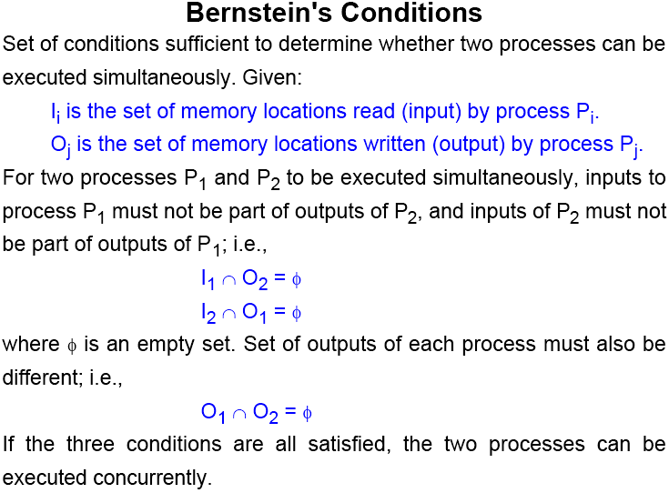

Slide 59
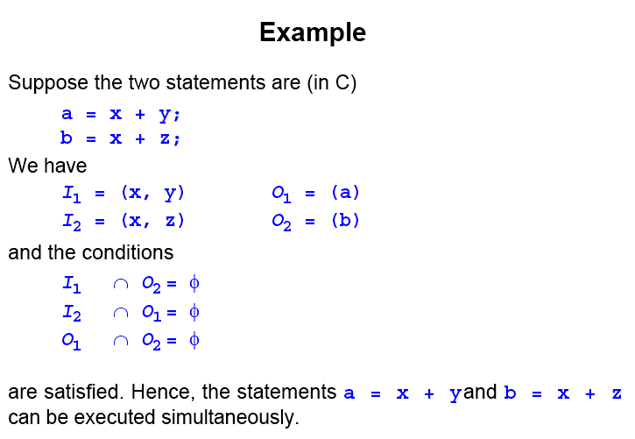

Slide 60
Another example
a= x + y;
b= a + b;
can not be executed simultaneously
The technique can be extended to determine whether several statements can be executed in parallel.

Slide 61
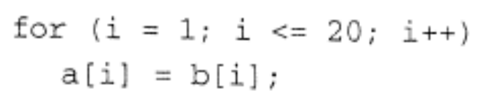
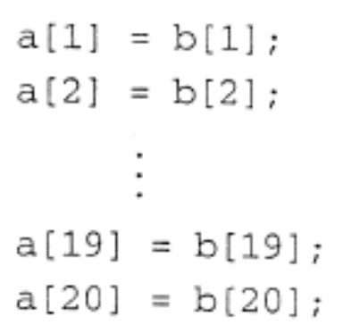
Some common programming constructs have a natural parallelism that a compiler or the programmer can utilize.

Slide 62
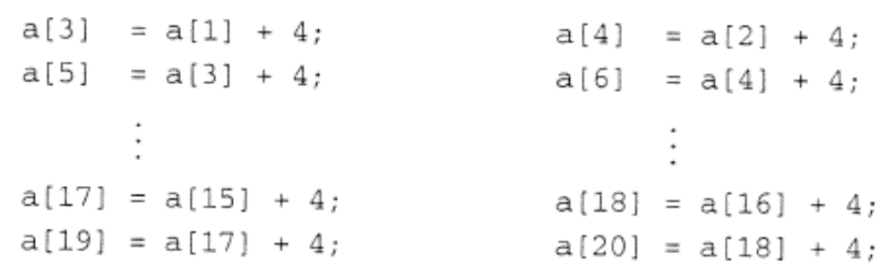
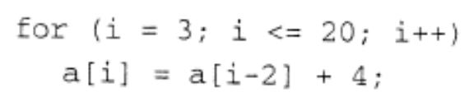
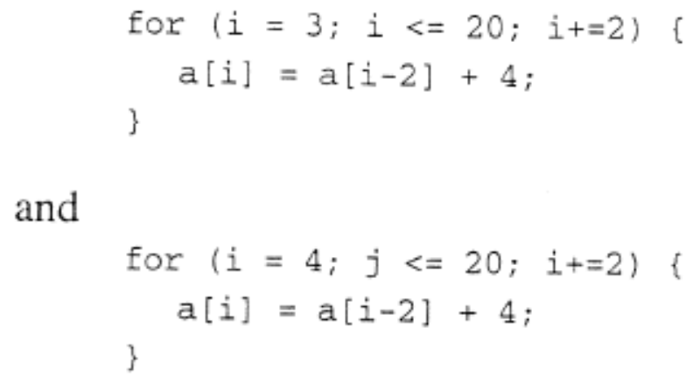
Dependencies in loops can sometimes be handled by decomposing the loop into multiple loops that are independent of each other.

Slide 63
OpenMP
An accepted standard developed in the late 1990s by a group of industry specialists.
Consists of a small set of compiler directives, augmented with a small set of library routines and environment variables using the base language Fortran and C/C++.
The compiler directives can specify such things as the par and forall operations described previously.
Several OpenMP compilers available.

Slide 64
For C/C++, the OpenMP directives are contained in #pragma
statements. The OpenMP #pragma statements have the format:
#pragma omp directive_name ...
where omp is an OpenMP keyword.
May be additional parameters (clauses) after the directive name for different options.
Some directives require code to specified in a structured block (a statement or statements) that follows the directive and then the directive and structured block form a “construct”.

Slide 65
an OpenMP compiler would create a parallel version of the same program.
Another advantage of the directive approach is that the OpenMP compiler can do dependency analysis and rearrangements.
Appendix C gives a summary of all the features and additional details for OpenMP.

Slide 66
OpenMP uses “fork-join” model but thread-based.
Initially, a single thread is executed by a master thread.
Parallel regions (sections of code) can be executed by multiple threads (a team of threads).
parallel directive creates a team of threads with a specified block of code executed by the multiple threads in parallel. The exact number of threads in the team determined by one of several ways.
Other directives used within a parallel construct to specify
parallel for loops and different blocks of code for threads.

Slide 67

Parallel Directive
#pragma omp parallel
structured_block
creates multiple threads, each one executing the specified
structured_block, either a single statement or a compound
statement created with { ...} with a single entry point and a single exit point.
There is an implicit barrier at the end of the construct.
The directive corresponds to forall construct.

Slide 68
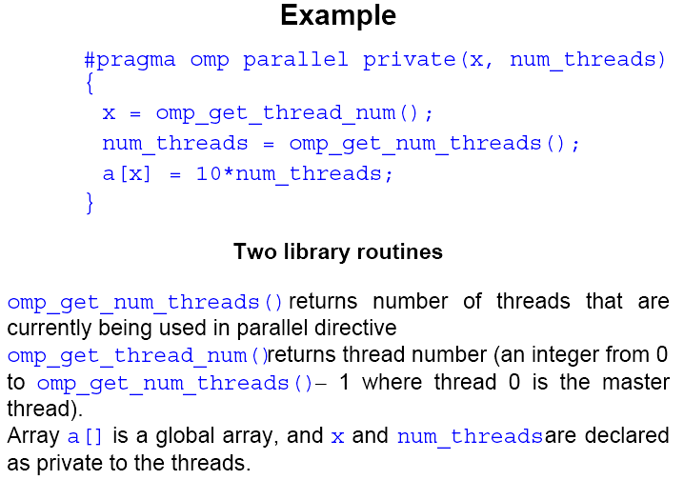

Slide 69
Number of threads in a team
Established by either:
1. num_threads clause after the parallel directive, or
2. omp_set_num_threads() library routine being previously called,
or
3. the environment variable OMP_NUM_THREADS is defined
in the order given or is system dependent if none of the above.
Number of threads available can also be altered automatically to achieve best use of system resources by a “dynamic adjustment” mechanism.

Slide 70
Work-Sharing
Three constructs in this classification:
sections
for
single
In all cases, there is an implicit barrier at the end of the construct unless a nowait clause is included.
Note that these constructs do not start a new team of threads. That done by an enclosing parallel construct.

Slide 71
Sections
The construct
#pragma omp sections
{
#pragma omp section
structured_block
#pragma omp section
structured_block
.
.
.
}
cause the structured blocks to be shared among threads in team.
#pragma omp sections precedes the set of structured blocks.
#pragma omp section prefixes each structured block.
The first section directive is optional.

Slide 72
For Loop
#pragma omp for
for_loop
causes the for loop to be divided into parts and parts shared among threads in the team. The for loop must be of a simple form.
Way that for loop divided can be specified by an additional “schedule” clause. Example: the clause schedule (static, chunk_size) cause the for loop be divided into sizes specified by chunk_size and allocated to threads in a round robin fashion.

Slide 73
Single
The directive
#pragma omp single
structured block
cause the structured block to be executed by one thread only.

Slide 74
Combined Parallel Work-sharing Constructs
If a parallel directive is followed by a single for directive, it can be combined into:
#pragma omp parallel for
for_loop
with similar effects, i.e. it has the effect of each thread executing the same for loop.

Slide 75
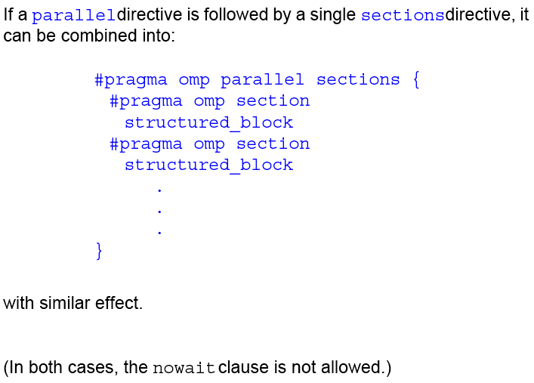

Slide 76
Master Directive
The master directive:
#pragma omp master
structured_block
causes the master thread to execute the structured block.
Different to those in the work sharing group in that there is no implied barrier at the end of the construct (nor the beginning). Other threads encountering this directive will ignore it and the associated structured block, and will move on.

Slide 77
Synchronization Constructs
Critical
The critical directive will only allow one thread execute the
associated structured block. When one or more threads reach the
critical directive:
#pragma omp critical name
structured_block
they will wait until no other thread is executing the same critical section (one with the same name), and then one thread will proceed to execute the structured block. name is optional. All critical sections with no name map to one undefined name.

Slide 78
Barrier
When a thread reaches the barrier
#pragma omp barrier
it waits until all threads have reached the barrier and then they all proceed together.
There are restrictions on the placement of barrier directive in a
program. In particular, all threads must be able to reach the barrier.

Slide 79
Atomic
The atomic directive
#pragma omp atomic
expression_statement
implements a critical section efficiently when the critical section simply updates a variable (adds one, subtracts one, or does some other simple arithmetic operation as defined by expression_statement).

Slide 80
Flush
A synchronization point which causes thread to have a “consistent” view of certain or all shared variables in memory. All current read and write operations on the variables allowed to complete and values written back to memory but any memory operations in the code after flush are not started, thereby creating a “memory fence”. Format:
#pragma omp flush (variable_list)
Only applied to thread executing flush, not to all threads in the team.
Flush occurs automatically at the entry and exit of parallel and critical directives (and combined parallel for and parallel sections directives), and at the exit of for, sections, and single (if a no-wait clause is not present).

Slide 81
Ordered
Used in conjunction with for and parallel for directives to cause an iteration to be executed in the order that it would have occurred if written as a sequential loop.
See Appendix C of textbook for further details.

Slide 82
Shared Memory Programming
Performance Issues

Slide 83
Shared Data in Systems with Caches
All modern computer systems have cache memory, high-speed memory closely attached to each processor for holding recently referenced data and code.
Cache coherence protocols
Update policy - copies of data in all caches are updated at the time one copy is altered.
Invalidate policy - when one copy of data is altered, the same data in any other cache is invalidated (by resetting a valid bit in the cache). These copies are only updated when the associated processor makes reference for it.

Slide 84
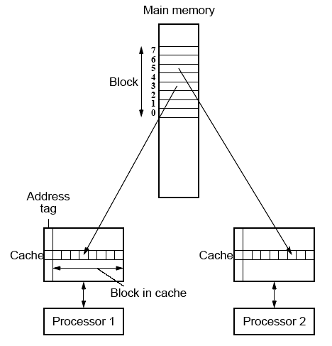
False Sharing
Different parts of block required by different processors but not
same bytes. If one processor writes to one part of the block, copies of the complete block in other caches must be updated or invalidated though the actual data is not shared.

Slide 85
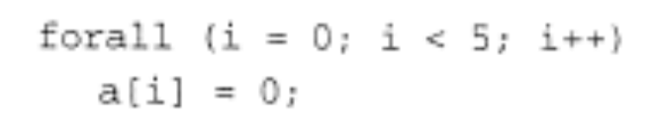
Solution for False Sharing
Compiler to alter the layout of the data stored in the main memory, separating data only altered by one processor into different blocks.

Slide 86
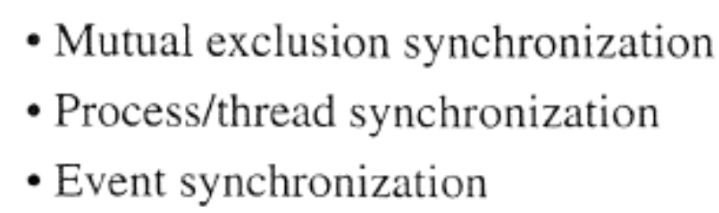
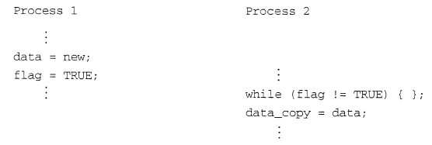
Shared Memory Synchronization
event

Slide 87
Critical Sections Serializing Code
High performance programs should have as few as possible critical sections as their use can serialize the code.
Suppose, all processes happen to come to their critical section together.
They will execute their critical sections one after the other.
In that situation, the execution time becomes almost that of a single processor.

Slide 88
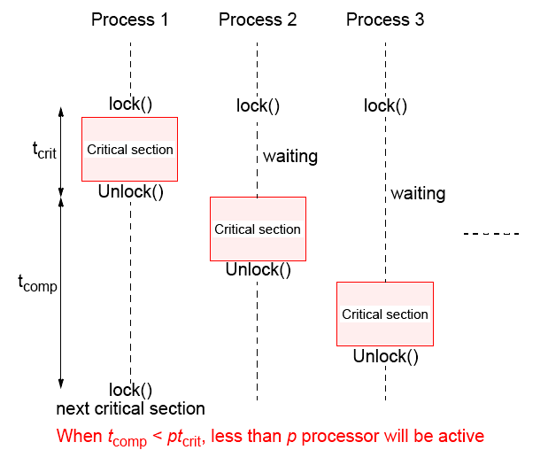
Illustration

Slide 89
Sequential Consistency
Formally defined by Lamport (1979):
A multiprocessor is sequentially consistent if the result of any execution is the same as if the operations of all the processors were executed in some sequential order, and the operations of each individual processors occur in this sequence in the order specified by its program.
i.e. the overall effect of a parallel program is not changed by any arbitrary interleaving of instruction execution in time.

Slide 90
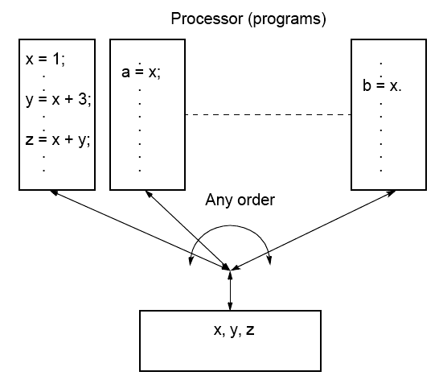
Sequential Consistency

Slide 91
Writing a parallel program for a system which is known to be sequentially
consistent enables us to reason about the result of the program.
Example
Process P1 Process 2
. .
data = new; .
flag = TRUE; .
. .
. while (flag != TRUE) { };
. data_copy = data;
. .
Expect data_copy to be set to new because we expect the
statement data = new to be executed before flag = TRUE and the
statement while (flag != TRUE) { } to be executed before data_copy
= data. Ensures that process 2 reads new data from another process
1. Process 2 will simple wait for the new data to be produced.

Slide 92
Program Order
Sequential consistency refers to “operations of each individual processor .. occur in the order specified in its program” or program order.
In previous figure, this order is that of the stored machine
instructions to be executed.

Slide 93
Example of Processor Re-ordering
Process P1 Process 2
. .
new = a * b; .
data = new; .
flag = TRUE; .
. .
. while (flag != TRUE) { };
. data_copy = data;
. .
Multiply machine instruction corresponding to new = a * b is issued for execution. The next instruction corresponding to data = new cannot be issued until the multiply has produced its result. However the next statement, flag = TRUE, is completely independent and a clever processor could start this operation before the multiply has completed leading to the sequence:

Slide 94
Process P1 Process 2
. .
new = a * b; .
flag = TRUE; .
data = new; .
. .
. while (flag != TRUE) { };
. data_copy = data;
. .
Now the while statement might occur before new is assigned to data, and the code would fail.
All multiprocessors have the option of operating under the sequential consistency model, i.e. not reorder the instructions and forcing the multiply instruction above to complete before starting subsequent instruction which depend upon its result.

Slide 95
Relaxing Read/Write Orders
Processors may be able to relax the consistency in terms of the order of reads and writes of one processor with respect to those of another processor to obtain higher performance, and instructions to enforce consistency when needed.

Slide 96
Shared Memory Program Examples

Slide 97
Program
To sum the elements of an array, a[1000]:
int sum, a[1000];
sum = 0;
for (i = 0; i < 1000; i++)
sum = sum + a[i];

Slide 98
UNIX Processes
Calculation will be divided into two parts, one doing even i and one doing odd i; i.e.,
Process 1 Process 2
sum1 = 0; sum2 = 0;
for (i = 0; i < 1000; i = i + 2) for (i = 1; i < 1000; i = i + 2)
sum1 = sum1 + a[i]; sum2 = sum2 + a[i];
Each process will add its result (sum1 or sum2) to an accumulating result, sum :
sum = sum + sum1; sum = sum + sum2;
Sum will need to be shared and protected by a lock. Shared data structure is created:

Slide 99
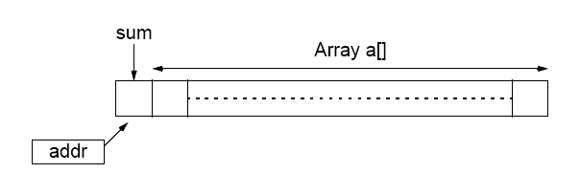
Shared memory locations for UNIX program example

Slide 100
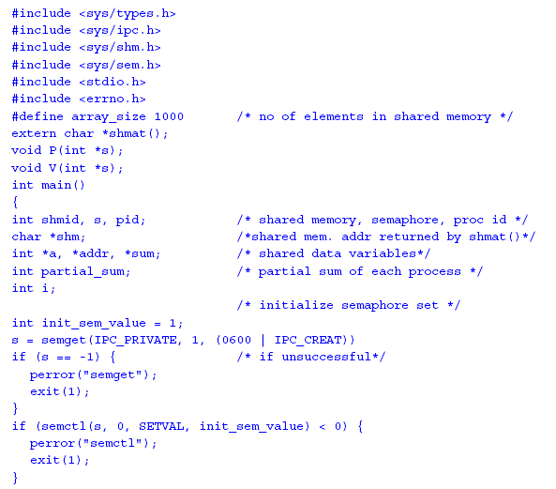

Slide 101
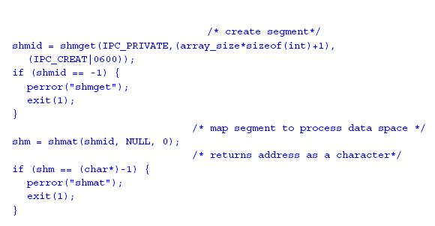

Slide 102
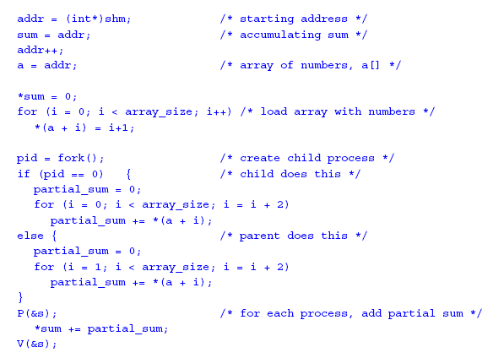

Slide 103
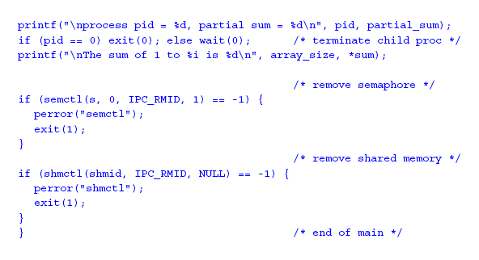

Slide 104
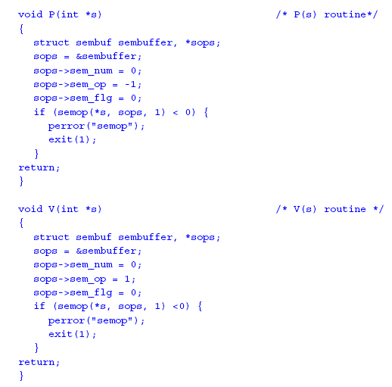

Slide 105
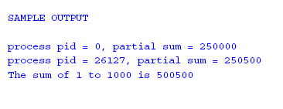

Slide 106
Pthreads Example
n threads created, each taking numbers from list to add to their
sums. When all numbers taken, threads can add their partial results to a shared location sum.
The shared location global_index is used by each thread to select the next element of a[].
After index is read, it is incremented in preparation for the next
element to be read.
The result location is sum, as before, and will also need to be
shared and access protected by a lock.

Slide 107
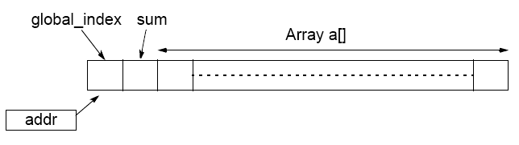
Shared memory locations for Pthreads program example

Slide 108
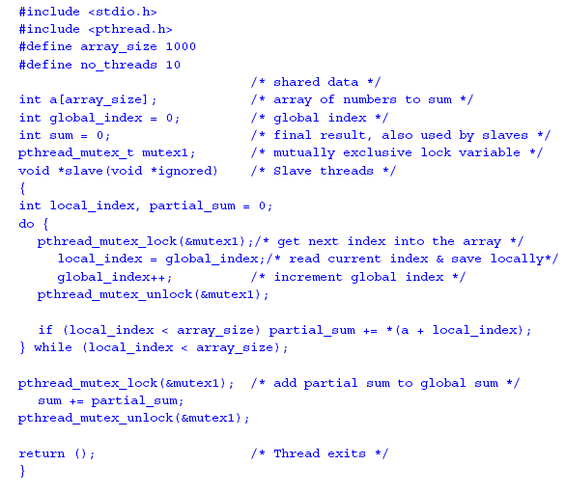

Slide 109
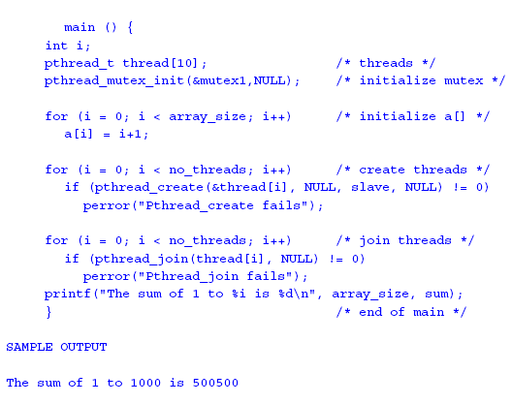

Slide 110
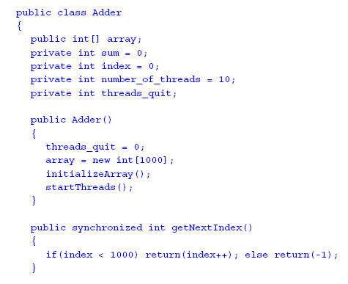
Java Example

Slide 111


Slide 112


