Slide 1
Chapter 9
Distributed Shared Memory

Slide 2
Distributed Shared Memory
Making the main memory of a cluster of computers look as though it is a single memory with a single address space.
Then can use shared memory programming techniques. (physically distributed)

Slide 3
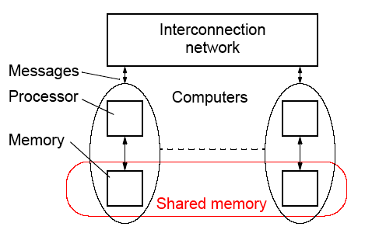
DSM System
Still need messages or mechanisms to get data to processor, but
these are hidden from the programmer:
Bus, switch (cluster)

Slide 4
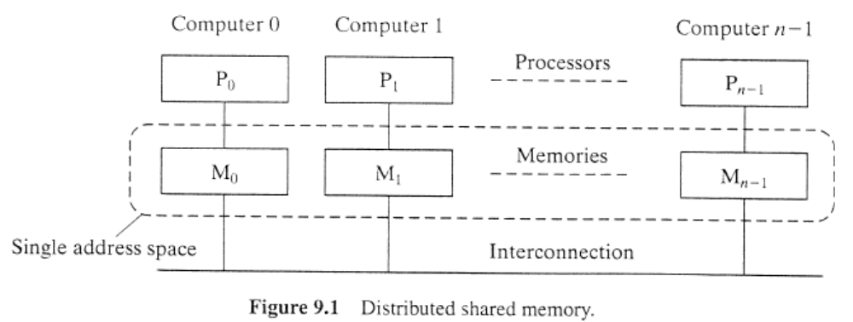

Slide 5
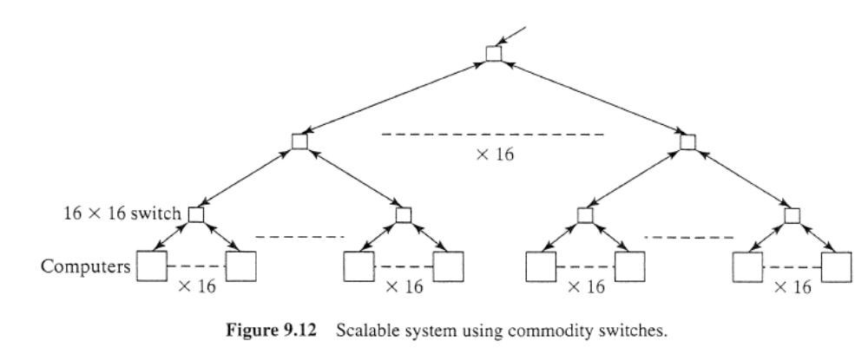

Slide 6
Advantages of DSM
• System scalable
• Hides the message passing - do not explicitly specific sending
messages between processes
• Can us simple extensions to sequential programming
• Can handle complex and large data bases without replication
or sending the data to processes

Slide 7
Disadvantages of DSM
• May incur a performance penalty
• Must provide for protection against simultaneous access to
shared data (locks, etc.)
• Little programmer control over actual messages being generated
• Performance of irregular problems in particular may be difficult

Slide 8
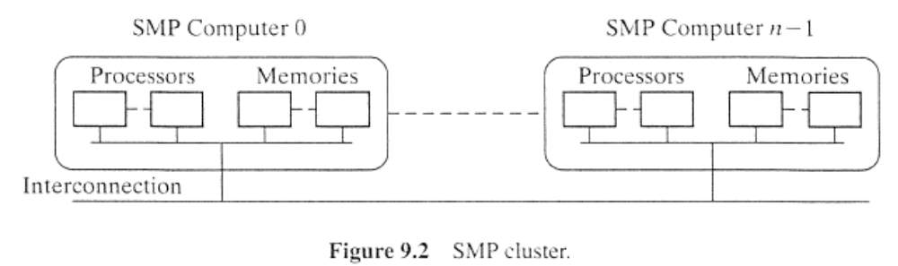
SMP cluster

Slide 9
Methods of Achieving DSM
• Hardware
Special network interfaces and cache coherence circuits
• Software
Modifying the OS kernel
Adding a software layer between the operating system and the application - most convenient way for teaching
purposes

Slide 10
Software DSM Implementation
• Page based - Using the system’s virtual memory
• Shared variable approach- Using routines to access
shared variables
• Object based- Shared data within collection of objects.
Access to shared data through object oriented discipline
(ideally)

Slide 11
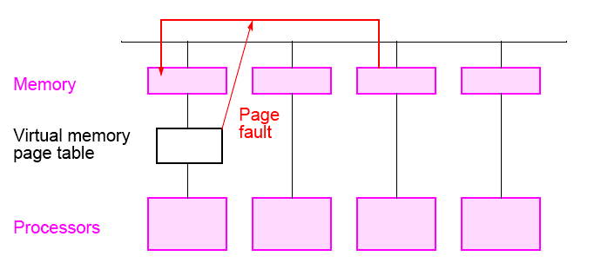
Software Page Based DSM Implementation
Virtual shared memory system
Disadvantage: complete page, false sharing effect and not portable

Slide 12
Shared-variable and
Object-based approach
Shared-variable approach
  Software routines
Object-based approach
  Similar to shared-variable

Slide 13
Some Software DSM Systems
• Treadmarks
Page based DSM system
Apparently not now available
• JIAJIA
C based
Obtained at UNC-Charlotte but required significant
modifications for our system (in message-passing calls)
• Adsmith object based
C++ library routines
We have this installed on our cluster - chosen for teaching

Slide 14
Hardware DSM Implementation
In the hardware approach, special network interfaces and cache coherence circuits are added to the system to make a memory reference to a remote memory location look like a reference to a local memory location.
The hardware approach should provide a higher level of performance than the software approach.
The purely software approach is more attractive than the hardware approach for teaching purposes.

Slide 15
Managing Shared Data
There are several ways that a processor could be given access to shared data.
  The simplest solution is to have a central server. (single reader/ single writer policy)
  multiple servers
  multiple copies of data (coherence policy, multiple reader/single writer policy)
There are two possibilities to handle this situation
  Update policy (broadcast)
  Invalidate policy
Multiple reader/multiple writer

Slide 16
Consistency Models
• Strict Consistency - Processors sees most recent update,
i.e. read returns the most recent wrote to location.
• Sequential Consistency - Result of any execution same as
an interleaving of individual programs.
• Relaxed Consistency- Delay making write visible to reduce
messages.
• Weak consistency - programmer must use synchronization
operations to enforce sequential consistency when
necessary.
• Release Consistency - programmer must use specific
synchronization operators, acquire and release.
• Lazy Release Consistency - update only done at time of
acquire.

Slide 17
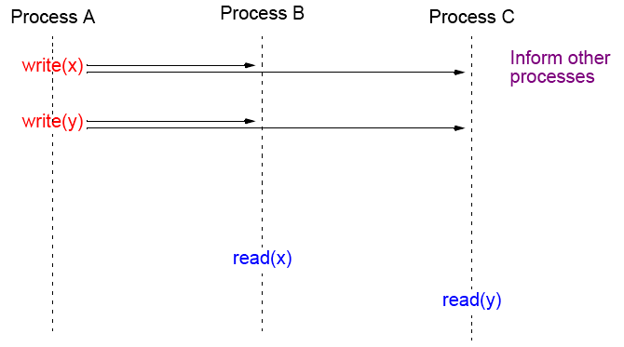
Strict Consistency
Every write immediately visible
Disadvantages: large number of messages, latency, maybe unnecessary.
Use invalidate policy

Slide 18
Consistency Models used on DSM Systems
Release Consistency
An extension of weak consistency in which the synchronization
operations have been specified:
• acquire operation - used before a shared variable or variables
are to be read. (as lock)
• release operation - used after the shared variable or variables
have been altered (written) and allows another process to
access to the variable(s) (as unlock)
Typically acquire is done with a lock operation and release by an
unlock operation (although not necessarily).

Slide 19
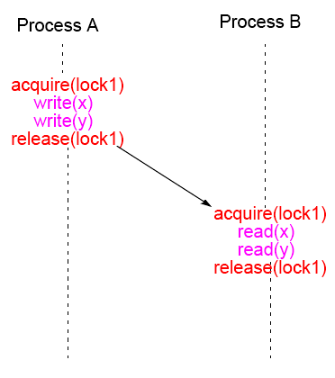
Release Consistency

Slide 20
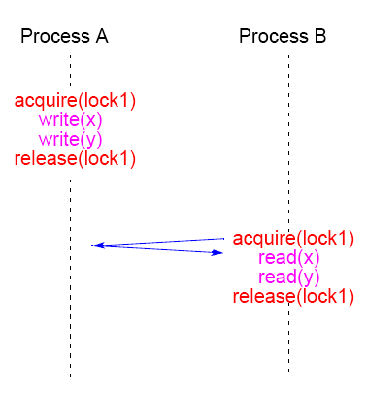
Lazy Release Consistency
Advantages: Fewer messages

Slide 21
Adsmith

Slide 22
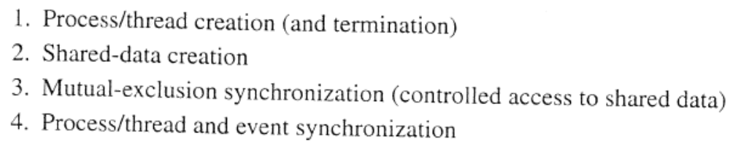
DISTRIBUTED SHARED MEMORY PROGRAMMING PRIMITIVES
As shared memory programming

Slide 23
Adsmith
• User-level libraries that create distributed shared memory system
on a cluster.
• Object based DSM - memory seen as a collection of objects that
can be shared among processes on different processors.
• Written in C++
• Built on top of pvm
• Freely available - installed on UNCC cluster
User writes application programs in C or C++ and calls Adsmith
routines for creation of shared data and control of its access.

Slide 24
Adsmith Routines
These notes are based upon material in Adsmith User Interface document.

Slide 25
Initialization/Termination
Explicit initialization/termination of Adsmith not necessary.

Slide 26
Process
To start a new process or processes:
adsm_spawn(filename, count)
Example
adsm_spawn(“prog1”,10);
starts 10 copies of prog1 (10 processes). Must use Adsmith routine to start a new process. Also version of adsm_spawn() with similar parameters to pvm_spawn().

Slide 27
Process “join”
adsmith_wait();
will cause the process to wait for all its child processes (processes it created) to terminate.
Versions available to wait for specific processes to terminate, using pvm tid to identify processes. Then would need to use the pvm form of adsmith() that returns the tids of child processes.

Slide 28
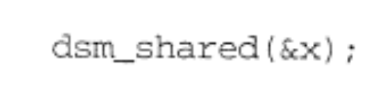
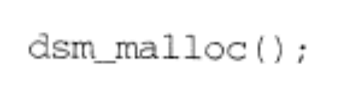
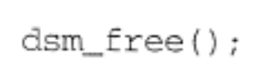
Shared Data Creation

Slide 29
Access to shared data (objects)
Adsmith uses “release consistency.” Programmer explicitly needs to control competing read/write access from different processes.
Three types of access in Adsmith, differentiated by the use of the
shared data:
• Ordinary Accesses - For regular assignment statements
accessing shared variables.
• Synchronization Accesses - Competing accesses used for
synchronization purposes.
• Non-Synchronization Accesses - Competing accesses, not
used for synchronization.

Slide 30
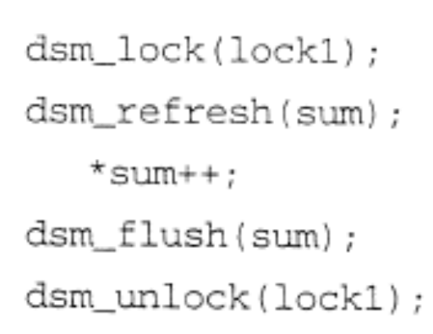

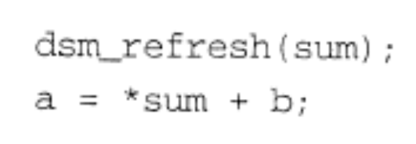
Shared Data Access

Slide 31
Ordinary Accesses - Basic read/write actions
Before read, do:
adsm_refresh()
to get most recent value - an “acquire/load.” After write, do:
adsm_flush()
to store result - “store”
Example
int *x; //shared variable
.
.
adsm_refresh(x);
a = *x + b;

Slide 32

Synchronization accesses
To control competing accesses:
• Semaphores
• Mutex’s (Mutual exclusion variables)
• Barriers.
available. All require an identifier to be specified as all three class instances are shared between processes.

Slide 33
Barrier Routines
One barrier routine
barrier()
class AdsmBarrier {
public:
AdsmBarrier( char *identifier );
void barrier( int count);
};

Slide 34
Example
AdsmBarrier barrier1(“sample”);
.
.
barrier1.barrier(procno);

Slide 35
Features to Improve Performance
Overlapping Computations with Communications
Routines that can be used to overlap messages or reduce number of messages:
• Prefetch
• Bulk Transfer
• Combined routines for critical sections

Slide 36
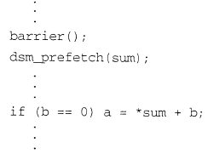
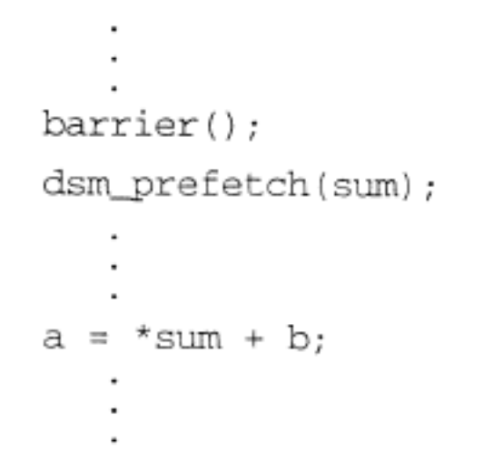
Prefetch
adsm_prefetch( void *ptr )
used before adsm_refresh() to get data as early as possible.
Non-blocking so that can continue with other work prior to issuing refresh.

Slide 37
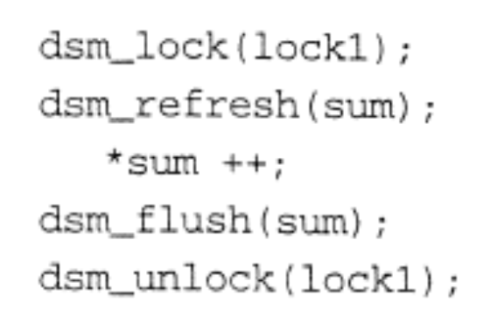

Reducing the Number of Messages

Slide 38
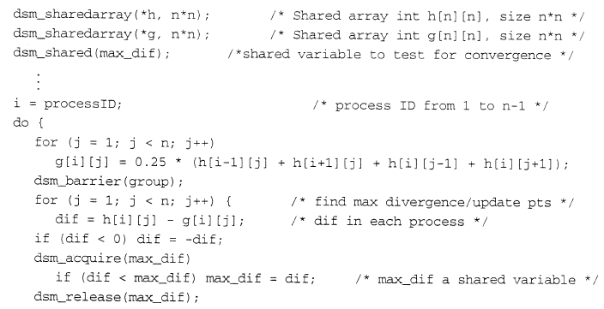

DISTRIBUTED SHARED MEMORY PROGRAMMING

