Slide 1
Parallel Computers
Chapter 1
1.<number>

Slide 2
In this chapter, we describe the demand for greater computational power from computers and the concept of using computers with multiple internal processors and multiple interconnected computers.
The prospects for increased speed of execution by using multiple computers or multiple processors and the limitations are discussed.
The various ways that such systems can be constructed are described, in particular by using multiple computers in a cluster, which has become a very cost-effective computer platform for high-performance computing.
1.<number>

Slide 3
Demand for Computational Speed
Continual demand for greater computational speed from a computer system than is currently possible
Areas requiring great computational speed include numerical modeling and simulation of scientific and engineering problems.
Computations must be completed within a “reasonable” time period.
  Second or minute in traditional area
  One day in the bioinformatics
1.<number>

Slide 4
Grand Challenge Problems
One that cannot be solved in a reasonable amount of time with today’s computers. Obviously, an execution time of 10 years is always unreasonable. (try to reduce the time)
Examples
Modeling large DNA structures
Global weather forecasting
Modeling motion of astronomical bodies.
Evolutionary tree construction.
Protein structure prediction and comparison.
1.<number>

Slide 5
Weather Forecasting
Atmosphere modeled by dividing it into 3-dimensional cells.
Complex mathematical equations are used to capture the various atmospheric effects. (multiplication or deletion)
Time series data
Calculations of each cell repeated many times to model passage of time.
1.<number>

Slide 6
Global Weather Forecasting Example
Suppose whole global atmosphere divided into cells of size 1 mile × 1 mile × 1 mile to a height of 10 miles (10 cells high) - about 5 × 10⁸ cells.
Suppose each calculation requires 200 floating point operations. In one time step, 10¹¹ floating point operations necessary.
To forecast the weather over 7 days using 1-minute intervals, a computer operating at 1Gflops (10⁹ floating point operations/s) takes 10⁶ seconds or over 10 days.
To perform calculation in 5 minutes requires computer operating at 3.4 Tflops (3.4 × 10¹² floating point operations/sec).
1.<number>

Slide 7
Modeling Motion of Astronomical Bodies
    Each body attracted to each other body by gravitational forces. Movement of each body predicted by calculating total force on each body.
    With N bodies, N - 1 forces to calculate for each body, or approx. N² calculations. (N log₂ N for an efficient approx. algorithm.)
    After determining new positions of bodies, calculations repeated.
1.<number>

Slide 8
A galaxy might have, say, 10¹¹ stars.
Even if each calculation done in 1 ms (extremely optimistic figure), it takes 10⁹ years for one iteration using N² algorithm and almost a year for one iteration using an efficient N log₂ N approximate algorithm.
1.<number>

Slide 9

Astrophysical N-body simulation by Scott Linssen
(undergraduate UNC-Charlotte student).
1.<number>

Slide 10
Global weather forecasting and simulation of a large number of bodies (astronomical or molecular) are traditional examples of applications.
  New applications can be found.
Parallel Computing
Using more than one computer (multi-computers), or a computer with more than one processor (multiprocessor), to solve a problem.
1.<number>

Slide 11
the overall problem is split into parts, each of which is performed by a separate processor in parallel. Writing programs for this form of computation is known as parallel programming.
The computing platform, a parallel computer, could be a specially designed computer system containing multiple processors or several computers interconnected in some way.
Motives
Usually faster computation - very simple idea - that n computers operating simultaneously can achieve the result n times faster - it will not be n times faster for various reasons. (ideal situation)
Other motives include: fault tolerance, larger amount of memory available, ...
1.<number>

Slide 12
the use of multiple computers/processors often allows a larger problem or a more precise solution of a problem to be solved in a reasonable amount of time.
A related factor is that multiple computers very often have more total main memory than a single computer.
A problem can be solved in a reasonable time, situations arise when the same problem has to be evaluated multiple times with different input values. This situation is especially applicable to parallel computers
1.<number>

Slide 13
the Internet and the World Wide Web has spawned a new area for parallel computers.
  multiple computers connected together as a "cluster," are used to service the requests.
1.<number>

Slide 14
Background
Parallel computers - computers with more than one processor - and their programming - parallel programming - has been around for more than 40 years.
1.<number>

Slide 15
Gill writes in 1958:
“... There is therefore nothing new in the idea of parallel programming, but its application to computers. The author cannot believe that there will be any insuperable difficulty in extending it to computers. It is not to be expected that the necessary programming techniques will be worked out overnight. Much experimenting remains to be done. After all, the techniques that are commonly used in programming today were only won at the cost of considerable toil several years ago. In fact the advent of parallel programming may do something to revive the pioneering spirit in programming which seems at the present to be degenerating into a rather dull and routine occupation ...”
Gill, S. (1958), “Parallel Programming,” The Computer Journal, vol. 1, April, pp. 2-10.
1.<number>

Slide 16
Holland wrote about a "computer capable of executing an arbitrary number of sub-programs simultaneously" in 1959 (Holland, 1959).
Conway described the design of a parallel computer and its programming in 1963 (Conway, 1963).
Flynn and Rudd (1996) write that "the continued drive for higher- and higher-performance systems ... leads us to one simple conclusion: the future is parallel:' We concur.
1.<number>

Slide 17
Speedup Factor
Execution time using one processor (best sequential algorithm)
t_{s}
S(p) =
t_{p}
Execution time using a multiprocessor with p processors
where t_{s} is execution time on a single processor and t_{p} is execution time on a multiprocessor (last processor).
S(p) gives increase in speed by using multiprocessor.
Use best sequential algorithm with single processor system. Underlying algorithm for parallel implementation might be (and is usually) different.
1.<number>

Slide 18
Speedup factor can also be cast in terms of computational steps:
Can also extend time complexity (for sequential computation) to parallel computations.
Computational steps alone may not be useful. (communication cost omit)
Number of computational steps using one processor
S(p) =
Number of parallel computational steps with p processors
1.<number>

Slide 19
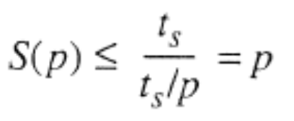
Maximum Speedup
Maximum speedup is usually p with p processors (linear speedup).
Possible to get superlinear speedup (greater than p) but usually a specific reason such as:
Suboptimal sequential algorithm (suggest to design optimal algorithm)
System architecture
Extra memory in multiprocessor system (disk)
Nondeterministic algorithm
1.<number>

Slide 20
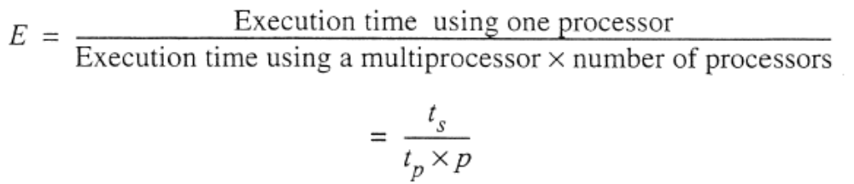
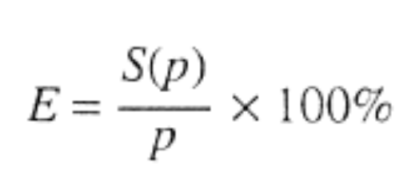
Efficiency
It is sometimes useful to know how long processors are being used on the computation, which can be found from the (system) efficiency.
1.<number>

Slide 21
Maximum Speedup
Several factors will appear as overhead in the parallel version and limit the speedup
  Periods when not all the processors can be performing useful work and are simply idle.
  Extra computations in the parallel version not appearing in the sequential version.
  Communication time between processes.
Some part of a computation must be performed sequentially.
1.<number>

Slide 22
Maximum Speedup
Amdahl’s law
t
s
ft
s
(1
-
f
)
t
s
Serial section
Parallelizable sections
(a) One processor
(b) Multiple
processors
p
processors
t
(1
-
f
)
t
s
/
p
p
1.<number>

Slide 23
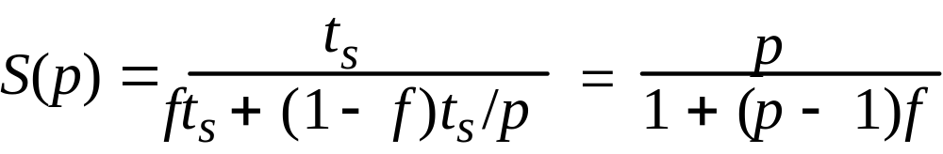
Speedup factor is given by:
This equation is known as Amdahl’s law
1.<number>

Slide 24

Speedup against number of processors
20
f
= 0%
16
12
f
= 5%
8
f
= 10%
4
f
= 20%
4
8
12
16
20
Number of processors
,
p
1.<number>

Slide 25
Even with infinite number of processors, maximum speedup limited to 1/f.
Example
With only 5% of computation being serial, maximum speedup is 20, irrespective of number of processors.
1.<number>

Slide 26
Superlinear Speedup example - Searching
(a) Searching each sub-space sequentially
Start
Time
t
s
t
s
/p
Sub-space
Δ
t
search
x
t
s
/p
Solution found
x
indeterminate
1.<number>

Slide 27
(b) Searching each sub-space in parallel
Δ
t
Solution found
1.<number>

Slide 28
Speed-up then given by
t
x
s
+
Δ
t

p
S(p)
=
Δ
t
1.<number>

Slide 29
Worst case for sequential search when solution found in last sub-space search. Then parallel version offers greatest benefit, i.e.
p
–
1
t
+
Δ
t

s
p
S(p)
=
→
∞
Δ
t
as
Δ
t tends to zero
1.<number>

Slide 30
Least advantage for parallel version when solution found in first sub-space search of the sequential search, i.e.
Actual speed-up depends upon which subspace holds solution but could be extremely large.
Δ
t
S(p) =
= 1
Δ
t
1.<number>

Slide 31
Scalability
The performance of a system will depend upon the size of the system, and generally the larger the system the better, but this comes with a cost. Scalability is a rather imprecise term.
Combined architecture/algorithmic scalability suggests that increased problem size can be accommodated with increased system size for a particular architecture and algorithm.
number of processors, p, n as the number of input data elements in a problem.
1.<number>

Slide 32

Usually, increasing the problem size improves the relative performance because more parallelism can be achieved.
Gustafson's law
For example, suppose we had a serial section of 5% and 20 processors; the speedup is 0.05 + 0.95(20) = 19.05 according to the formula instead of 10.26 according to Amdahl's law.
1.<number>

Slide 33

Gustafson quotes examples of speedup factors of 1021, 1020, and l016 that have been achieved in practice with a 1024 processor system on numerical and simulation problems.
Message-Passing Computations
1.<number>

Slide 34
Types of Parallel Computers
Two principal types:
Shared memory multiprocessor
Distributed memory multicomputer
Distributed Shared memory multiprocessor
1.<number>

Slide 35
Shared Memory Multiprocessor
1.<number>

Slide 36
Conventional Computer
Consists of a processor executing a program stored in a (main) memory:
Each main memory location located by its address. Addresses start at 0 and extend to 2^{b} - 1 when there are b bits (binary digits) in address.
Main memory
Instr
uctions (to processor)
Data (to or from processor)
Processor
1.<number>

Slide 37
Shared Memory Multiprocessor System
Natural way to extend single processor model - have multiple processors connected to multiple memory modules, such that each processor can access any memory module :
Memory module
One
address
space
Interconnection
network
Processors
1.<number>

Slide 38
Simplistic view of a small shared memory multiprocessor
Processors
Shared memory
Bus
Examples:
Dual Pentiums
Quad Pentiums
1.<number>

Slide 39
Quad Pentium Shared Memory Multiprocessor
Processor
Processor
Processor
Processor
L1 cache
L1 cache
L1 cache
L1 cache
L2 Cache
L2 Cache
L2 Cache
L2 Cache
Bus interface
Bus interface
Bus interface
Bus interface
Processor/
memory
b
us
I/O interf
ace
Memory controller
I/O b
us
Shared memory
Memory
1.<number>

Slide 40
Programming Shared Memory Multiprocessors
Threads - programmer decomposes program into individual parallel sequences, (threads), each being able to access variables declared outside threads.
Example Pthreads
Sequential programming language with preprocessor compiler directives to declare shared variables and specify parallelism.
Example OpenMP - industry standard - needs OpenMP compiler
1.<number>

Slide 41
Sequential programming language with added syntax to declare shared variables and specify parallelism.
Example UPC (Unified Parallel C) - needs a UPC compiler.
Parallel programming language with syntax to express parallelism - compiler creates executable code for each processor (not now common)
Sequential programming language and ask parallelizing compiler to convert it into parallel executable code. - also not now common
1.<number>

Slide 42
Small shared memory multiprocessor system can be complete graph.
Large system can be formed as hierarchical or distributed memory structure.
Cache
  make sure that copies of the same data in different caches are identical
1.<number>

Slide 43
Message-Passing Multicomputer
Complete computers connected through an interconnection network:
Interconnection
network
Messages
Processor
Local
memory
Computers
1.<number>

Slide 44
Programming a message-passing multicomputer still involves dividing the problem into parts that are intended to be executed simultaneously to solve the problem.
Message-passing library routines are inserted into a conventional sequential program for message passing.
The message-passing multicomputer will physically scale more easily than a shared memory multiprocessor.
1.<number>

Slide 45
Interconnection Networks
Limited and exhaustive interconnections
2- and 3-dimensional meshes
Hypercube (not now common)
Using Switches:
  Crossbar
  Trees
  Multistage interconnection networks
1.<number>

Slide 46
Key issues in network design are the bandwidth, latency, and cost.
  The bandwidth is the number of bits that can be transmitted in unit time, given as bits/sec.
  The network latency is the time to make a message transfer through the network. The communication latency is the total time to send the message, including the software overhead and interface delays. Message latency, or startup time, is the time to send a zero-length message. which is essentially the software and hardware overhead in sending a message.
1.<number>

Slide 47
The number of physical links in a path between two nodes is an important consideration because it will be a major factor in determining the delay for a message.
  The diameter is the minimum number of links between the two farthest nodes (computers) in the network.
  The bisection width of a network is the minimum number of links (or sometimes wires) that must be cut to divide the network into two equal parts.
  The bisection bandwidth is the collective bandwidth over these links, that is. the maximum number of bits that can be transmitted from one part of the divided network to the other part in unit time.
1.<number>

Slide 48
Mesh
A two-dimensional mesh can be created by having each node in a two-dimensional array connect to its four nearest neighbors.
  Diameter: P processors
  Torus
  The mesh and torus networks are popular because of their ease of layout and expandability.
  Meshes are particularly convenient for many scientific and engineering problems in which solution points are arranged in two-dimensional or three-dimensional arrays. (also can be three-dimensional mesh)
  Meshes can also be used in shared memory systems.
1.<number>

Slide 49
Two-dimensional array (mesh)
Computer/
Links
processor
Also three-dimensional - used in some large high performance systems.
1.<number>

Slide 50
Hypercube Network
In a d-dimensional (binary) hypercube network, each node connects to one node in each of the dimensions of the network.
Each node in a hypercube is assigned a d-bit binary address when there are d dimensions. Each bit is associated with one of the dimensions and can be a 0 or a 1.
The diameter of the network is given by log₂P for a p-node hypercube.
1.<number>

Slide 51
A d-dimensional hypercube actually consists of two d - 1 dimensional hypercubes with dth dimension links between them.
The bisection width is p/2 for a p-node hypercube.
In a practical system, the network must be laid out in two or possibly three dimensions.
As an alternative to direct links between individual computers, switches can be used in various configurations to route the messages between the computers.
1.<number>

Slide 52
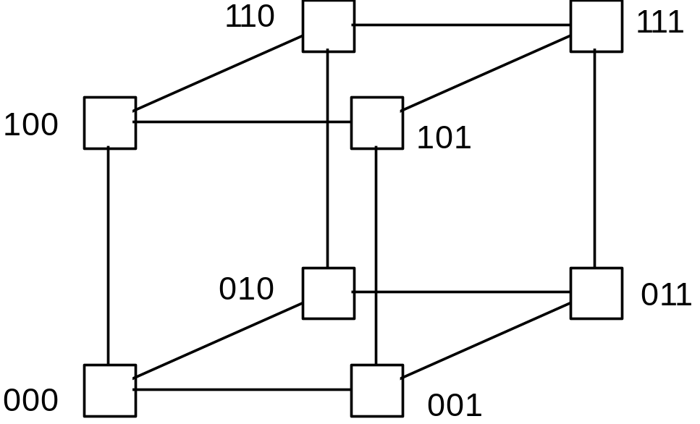
Three-dimensional hypercube
1.<number>

Slide 53
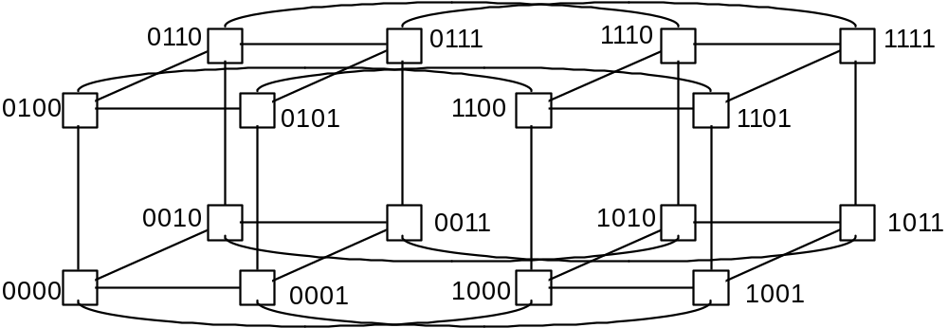
Four-dimensional hypercube
Hypercubes popular in 1980’s - not now
1.<number>

Slide 54
Crossbar switch
The crossbar switch provides exhaustive connections using one switch for each connection.
It is employed in shared memory systems.
Memor
ies
Processors
Switches
1.<number>

Slide 55
Tree Network
Another switch configuration is to use a binary tree.
Each switch in the tree has two links connecting to two switches below it as the network fans out from the root. This particular tree is a complete binary tree. In an m-ary tree, each node connects to m nodes beneath it.
The communication traffic in a tree interconnection network increases toward the root. which can be a bottleneck.
1.<number>

Slide 56
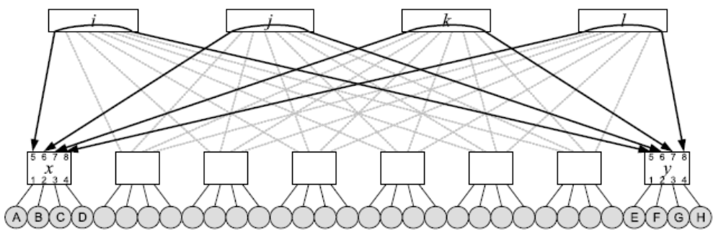
In a fat tree network (1985), the number of the links is progressively increased toward the root.
Jiazheng Zhou, Xuan-Yi Lin, and Yeh-Ching Chung, The Journal of Supercomputing, 2007
1.<number>

Slide 57
Tree
Root
Links
Switch
element
Processors
1.<number>

Slide 58
Multistage Interconnection Network
Example: Omega network
originally developed for telephone exchanges
2
´
2 switch elements
(straight-through or
crossover connections)
000
000
001
001
010
010
011
011
Inputs
Outputs
100
100
101
101
110
110
111
111
1.<number>

Slide 59
Communication Methods (1)
The ideal situation in passing a message from a source node to a destination node occurs when there is a direct link between the source node and the destination node.
There are two basic ways that messages can be transferred from a source to a destination: circuit switching and packet switching.
1.<number>

Slide 60
Communication Methods (2)
Circuit switching
  involves establishing the path and maintaining all the links in the path for the message to pass, uninterrupted, from the source to the destination.
  All the links are reserved for the transfer until the message transfer is complete.
  Ex. telephone system.
  Circuit switching has been used on some early multicomputers.
  None of the links can be used for other messages until the transfer is completed.
1.<number>

Slide 61
Communication Methods (3)
Packet switching
  the message is divided into '"packets" of information, each of which includes the source and destination addresses for routing the packet through the interconnection network, and the data.
  Ex. mail system.
  This form of packet switching is called store-and-forward packet switching.
  incurs a significant latency, since packets must first be stored in buffers within each node, whether or not an outgoing link is available.
1.<number>

Slide 62
Communication Methods (4)
cut-through
  This requirement (for store-and-forward packet switching) is eliminated in cut-through. if the outgoing link is available, the message is immediately passed forward without being stored in the nodal buffer
  (cut-through) however, that if the path is blocked. storage is needed for the complete message/packet being received.
1.<number>

Slide 63
Communication Methods (5)
wormhole routing
  an alternative to normal store-and-forward routing to reduce the size of the buffers and decrease the latency.
  the message is divided into smaller units called flits (one or two bytes)
  When the head flit moves forward. the next one can move forward, and so on.
Wormhole routing requires less storage at each node and produces a latency that is independent of the path length. (Circuit switching)
store-and-forward packet switching produces a latency that is approximately proportional to the length of the route.
1.<number>

Slide 64
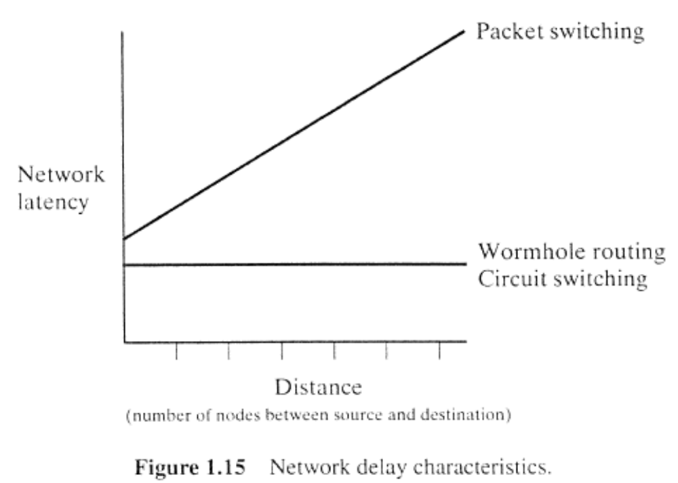
1.<number>

Slide 65
Communication Methods (6)
routing algorithms an be prone to livelock and deadlock.
  Livelock can occur particularly in adaptive routing algorithms and describes the situation in which a packet keeps going around the network without ever finding its destination.
  Deadlock occurs when packets cannot be forwarded to the next node because they are blocked by other packets waiting to be forwarded, and these packets are blocked.
Deadlock can occur in both store-and-forward and wormhole networks.
1.<number>

Slide 66
Distributed Shared Memory (1)
Message passing system
  It usually requires the programmers to use explicit message-passing calls in their code, which is very error prone and makes programs difficult to debug.
  Data cannot be shared; it must be copied. This may be problematic in applications that require multiple operations across large amounts of data.
  the message-passing paradigm has the advantage that special synchronization mechanisms are not necessary. (synchronization mechanisms can significantly increase the execution time)
1.<number>

Slide 67
Distributed Shared Memory (2)
Several researchers have pursued the concept of a distributed shared memory system.
  the memory is physically distributed with each processor, but each processor has access to the whole memory using a single memory address space.
  message passing occurs in some automated way.
  specially designed hardware or virtual memory management system (share virtual memory)
Interconnection
netw
or
k
Messages
Processor
Shared
memory
Computers
1.<number>

Slide 68
Flynn’s Classifications
Flynn (1966) created a classification for computers based upon instruction streams and data streams:
  Single instruction stream-single data stream (SISD) computer
Single processor computer - single stream of instructions generated from program. Instructions operate upon a single stream of data items.
1.<number>

Slide 69
Multiple Instruction Stream-Multiple Data Stream (MIMD) Computer
General-purpose multiprocessor system - each processor has a separate program and one instruction stream is generated from each program for each processor. Each instruction operates upon different data.
Both the shared memory and the message-passing multiprocessors so far described are in the MIMD classification.
1.<number>

Slide 70
Single Instruction Stream-Multiple Data Stream (SIMD) Computer
A specially designed computer - a single instruction stream from a single program, but multiple data streams exist. Instructions from program broadcast to more than one processor. Each processor executes same instruction in synchronism, but using different data.
Developed because a number of important applications that mostly operate upon arrays of data.
1.<number>

Slide 71
Multiple Program Multiple Data (MPMD) Structure
Within the MIMD classification, each processor will have its own program to execute:
Program
Program
Instructions
Instructions
Processor
Processor
Data
Data
1.<number>

Slide 72
Single Program Multiple Data (SPMD) Structure
Single source program written and each processor executes its personal copy of this program, although independently and not in synchronism.
Source program can be constructed so that parts of the program are executed by certain computers and not others depending upon the identity of the computer.
1.<number>

Slide 73
CLUSTER COMPUTING
-Interconnected Computers (1)
Supercomputing: fast, expensive.
cluster of workstations (COWs) or network of workstations (NOWs)
  Very high performance workstations and PCs are readily available at low cost.
  The latest processors can easily be incorporated into the system as they become available and the system can be expanded incrementally by adding additional com­puters, disks, and other resources.
  Existing application software can be used or modified.
Parallel programming software: PVM and MPI.
1.<number>

Slide 74
CLUSTER COMPUTING
-Interconnected Computers (2)
The concept of using multiple interconnected personal computers (PCs) as a parallel computing platform matured in the 1990s. (cluster computing)
Ethernet Connections
  The communication method for networked computers has commonly been an Ethernet type.
  The use of a single wire was regarded as a cost and layout advantage of the Ethernet design.
  The switch automatically routes the packets to their destinations and allows multiple simultaneous connections between separate pairs of computers.
1.<number>

Slide 75
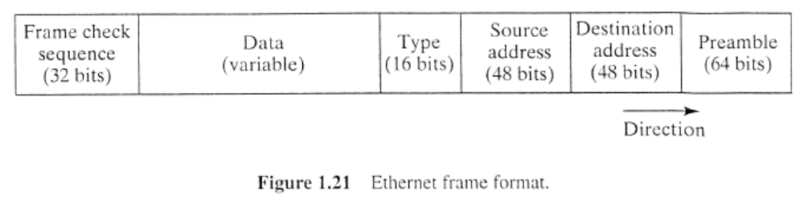
CLUSTER COMPUTING
-Interconnected Computers (3)
  The packet carries the source address, the destination address, and the data.
  The original speed for Ethernet was 10 Mbits/sec, which has been improved to 100 Mbits/sec and 1000 Mbits/sec (the latter called Gigabit Ethernet).
1.<number>

Slide 76
CLUSTER COMPUTING
-Interconnected Computers (4)
More Specialized/Higher Performance
Myrinet - 2.4 Gbits/sec - disadvantage: single vendor
cLan
SCI (Scalable Coherent Interface)
QNet
Infiniband - may be important as infininband interfaces may be integrated on next generation PCs. (>10Gbits/sec)
1.<number>

Slide 77
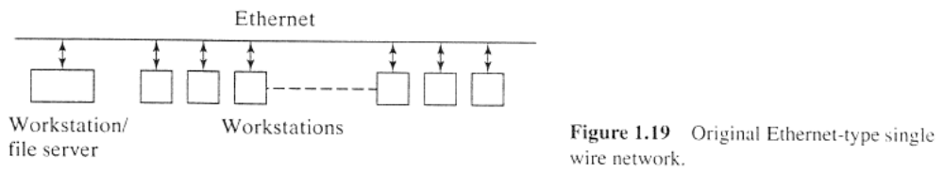
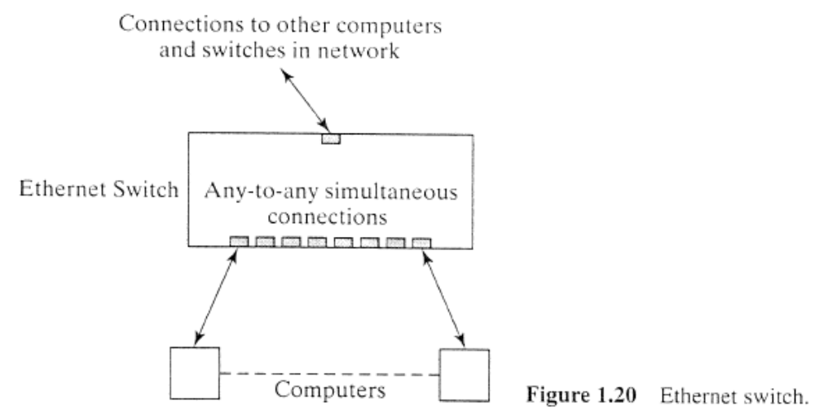
1.<number>

Slide 78

CLUSTER COMPUTING
-Interconnected Computers (5)
Network Addressing
  TCP/IP (Transmission Control Protocol/Internet Protocol) is a standard that establishes the rules for networked computers to communicate and pass data.
  TCP/IP defines the format of addresses as a 32-bit number divided into four 8-bit numbers (for IPv4).
  The address is divided into fields to select a network, a possible sub-network, and computer ("host") within the sub-network or network.
  IPv4 with its 32-bit addresses provides for about 4 billion hosts. (100,000,000 hosts by 2001)
1.<number>

Slide 79
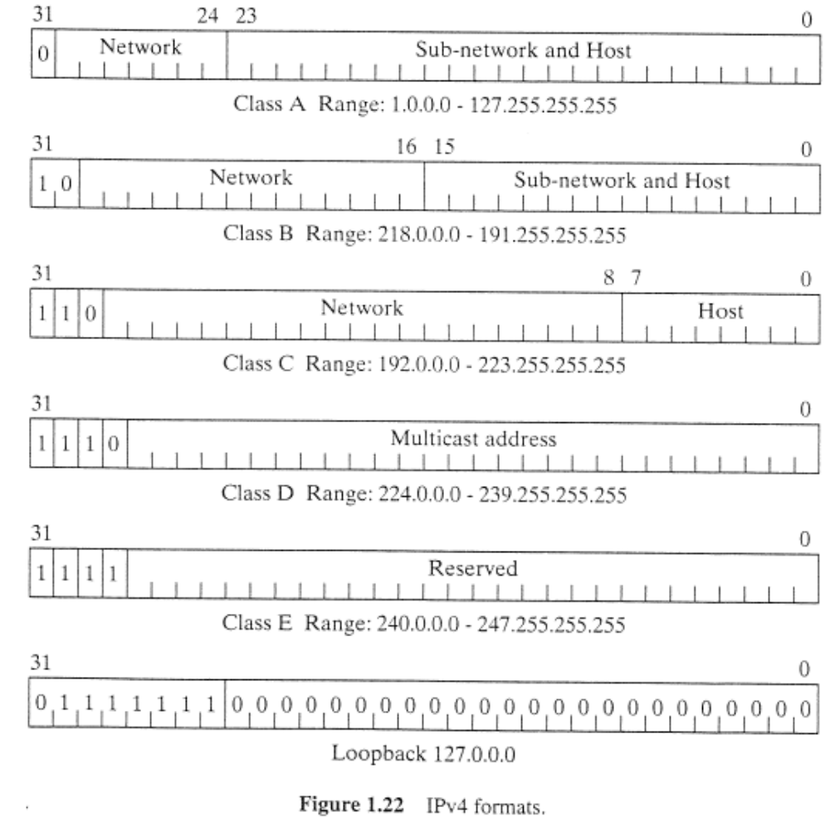
1.<number>

Slide 80
CLUSTER COMPUTING
-Interconnected Computers (6)
  IPv6 has been developed to extend the addressability of IPv4 by using 128 bits divided into eight 16-bit sections. This gives 2¹²⁸ possible hosts.
  The IP addressing information is important to setting up a cluster because IP addressing is usually used to communicate between computers within the cluster and between the cluster and users outside the cluster. (Internet Assigned Number Authority)
  Computers connect to an Ethernet cable via a Ethernet network interface card (NIC).
1.<number>

Slide 81
CLUSTER COMPUTING
-Cluster Configurations (1)
There are several ways a cluster can be formed.
Existing Networked Computers
  One of the first ways to form a cluster was to use existing networked workstations in a laboratory.
  Users at the computer can cause the computer to stop while the cluster computing work is in progress.
  security issues.
1.<number>

Slide 82
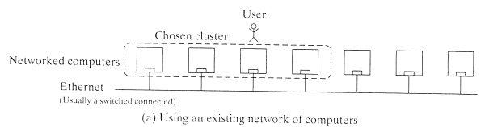
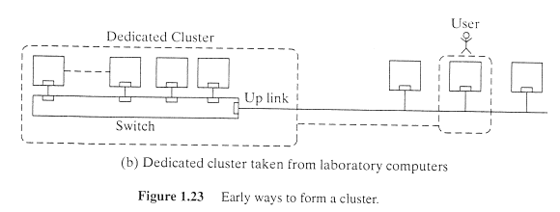
1.<number>

Slide 83
CLUSTER COMPUTING
-Cluster Configurations (2)
Moving to a Dedicated Computer Cluster
  It very cost-effective and less trouble simply to move computers from a laboratory into a dedicated cluster when the computers were upgraded in the laboratory.
Beowulf Clusters
  A small but very influential cluster-computing project was started at the NASA Goddard Space Flight Center in 1993.
  available low-cost components. (microprocessors, Linux, Ethernet)
  This name has stuck for describing any cluster of low-cost computers using commodity interconnects. (best cost/performance ratio)
1.<number>

Slide 84
CLUSTER COMPUTING
-Cluster Configurations (3)
Beyond Beowulf
  One would use higher-performance components if that made economic sense, and really high-performance clusters would use the highest-performance components available.
  Interconnects. Beowulf clusters commonly use fast Ethernet in low-cost clusters. (Gigabit Ethernet)
  Clusters with Multiple Interconnects. Multiple parallel interconnections to reduce the communication overhead.
  Symmetrical Multiprocessors (SMP) Cluster. Small shared memory multiprocessor systems based upon Pentium processors are very cost-effective, especially two-processor systems. (symmetrical multiprocessor)
1.<number>

Slide 85
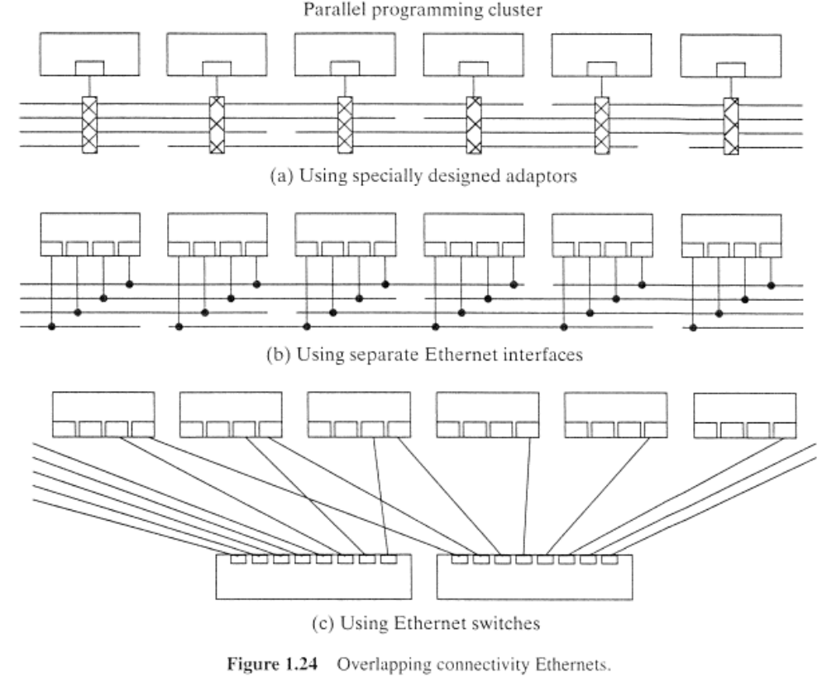
1.<number>

Slide 86
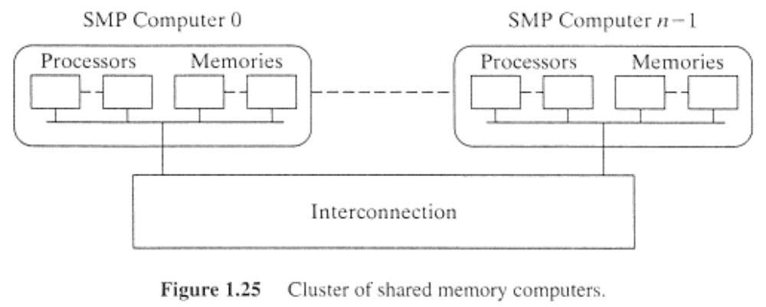
CLUSTER COMPUTING
-Cluster Configurations (4)
  Web Clusters. the "web" of computers to form a parallel computing platform. The idea was originally called Metacomputing and is now called grid computing.
1.<number>

Slide 87
Setting Up a Dedicated "Beowulf Style" Cluster (1)
Hardware Configuration.
  A common hardware configuration is to have one computer operating as a master node with the other computers in the cluster operating as compute nodes within a private network.
  Another computer acting as an administrative or management node can be added.
Software Configuration.
  Normally every computer in the cluster will have a copy of the operating system.
  The master node will normally also contain all the application files (as file server).
1.<number>

Slide 88
Setting Up a Dedicated "Beowulf Style" Cluster (2)
  The most commonly used network file system is NFS.
  message-passing software (MPI and PVM), cluster-management tools, parallel applications.
1.<number>

Slide 89
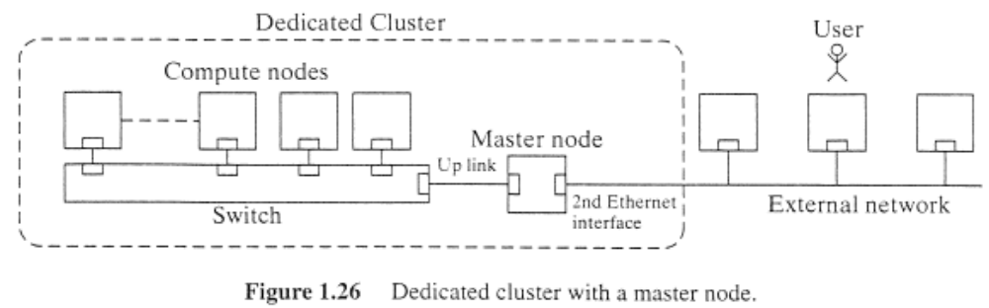
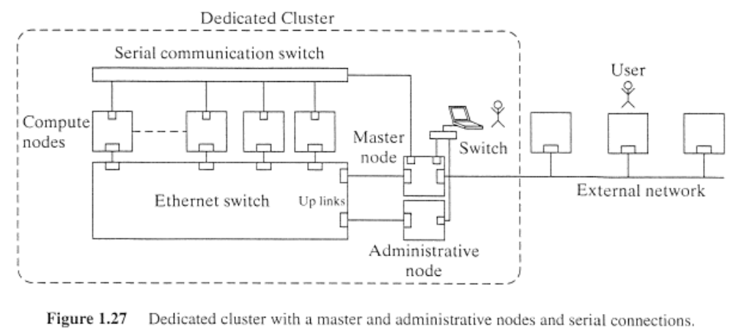
1.<number>

