Slide 1
Parallel Techniques
• Embarrassingly Parallel Computations (chapter 3)
• Partitioning and Divide-and-Conquer Strategies (chapter 4)
• Pipelined Computations (chapter 5)
• Synchronous Computations (chapter 6)
• Load Balancing and Termination Detection (chapter 7)
3.1

Slide 2
Chapter 3
Embarrassingly Parallel Computations
3.2

Slide 3
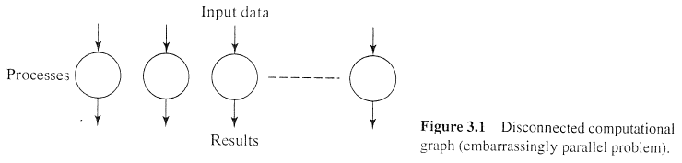
Embarrassingly Parallel Computations
A computation that can obviously be divided into a number of completely independent parts, each of which can be executed by a separate process(or). (embarrassingly parallel computation, naturally parallel)
Ideally, there would be no communication or very little communication between the separate processes; that is, a completely disconnected computational graph.

Slide 4
This situation will give the maximum possible speedup if all the available processors can be assigned processes for the total duration of the computation.
The key characteristic is that there is no interaction between the processes.
In a practical embarrassingly parallel computation, data has to be distributed to the processes and results collected and combined in some way. A common approach is the master-slave organization.

Slide 5
If dynamic process creation is used, first, a master process will be started that will spawn (start) identical slave processes.
the master-slave approach can be used with static process creation.
We will introduce load balancing in this chapter, but only for cases in which there is no interaction between slave processes. (chapter 7 for load balancing)

Slide 6
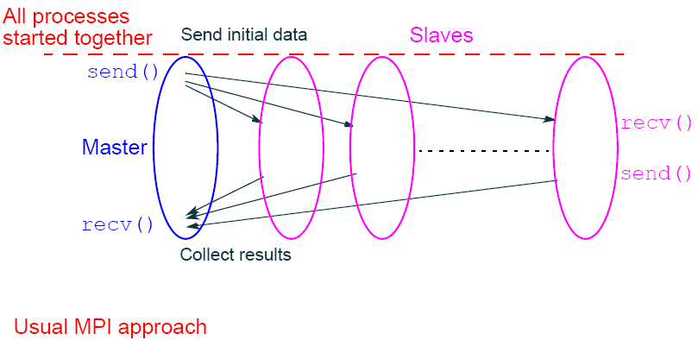
Practical embarrassingly parallel computation with static process creation and master-slave approach
3.4

Slide 7
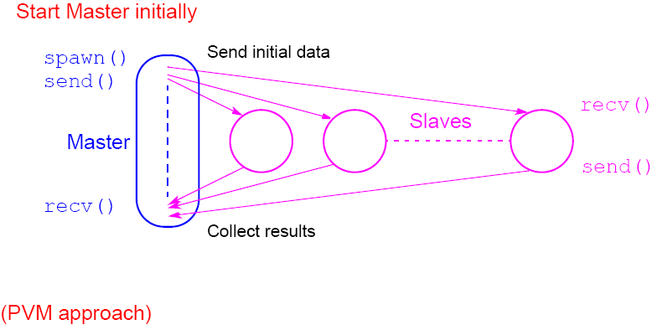
Practical embarrassingly parallel computation with dynamic process creation and master-slave approach
3.5

Slide 8
Embarrassingly Parallel Computation
Examples
• Geometrical Transformations of Images
• Mandelbrot set
• Monte Carlo Calculations
3.6

Slide 9
Geometrical Transformations of Images
computer graphics
  In any event, a number of graphical operations can be performed upon the stored image.
  Such graphical transformations must be done at high speed to be acceptable to the viewer. (chapter 11)
  The most basic way to store a two-dimensional image is a pixmap, in which each pixel (picture element) is stored as a binary number in a two-dimensional array. (bitmap)
    black-and-white images, a single binary bit is sufficient for each pixel, a 1 if the pixel is white and a 0 if the pixel is black.
    Grayscale images require more bits, typically using 8 bits to represent 256 different monochrome intensities.
    Color. Three bytes could be used for each pixel, one byte for red, one for green. and one for blue. (RGB)

Slide 10
  Geometrical transformations require mathematical operations to be performed on the coordinates of each pixel to move the position of the pixel without affecting its value.
  each pixel is independent. (truly embarrassingly parallel computation)

Slide 11
Some geometrical operations
Shifting
Object shifted by Dx in the x-dimension and Dy in the y-dimension:
x′ = x + Δx
y′ = y + Δy
where x and y are the original and x¢ and y¢ are the new coordinates.
Scaling
Object scaled by a factor S_{x} in x-direction and S_{y} in y-direction:
x′ = xS_{x}
y′ = yS_{y}
3.8

Slide 12
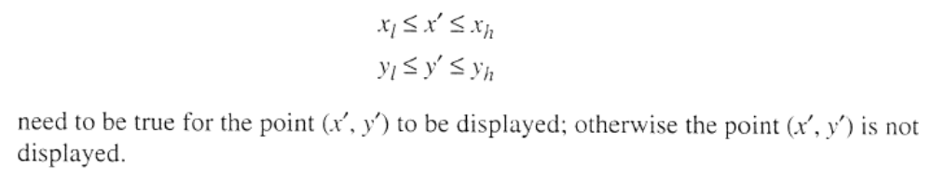
Rotation
Object rotated through an angle q about the origin of the coordinate system:
x′ = x cosθ + y sinθ
y′ = -x sinθ + y cosθ
Clipping
This transformation applies defined rectangular boundaries to a figure and deletes from the displayed picture those points outside the defined area:
3.8

Slide 13
  The input data is the bitmap that is typically held in a file and copied into an array.
  The main parallel programming concern is the division of the bitmap into groups of pixels for each processor because there are usually many more pixels than processes/processors.
  Suppose we use a master process and 48 slave processes and partition in groups of 10 rows. Each slave process processes one 640 x 10 area, returning the old coordinates and the new coordinates to the master for displaying. (The master then updates the bitmap)
  Wherever the new image does not appear in the display area, the bitmap is set to 0 (black).
  The results are returned one at a time rather than as one group, which would have reduced the message overhead time.

Slide 14
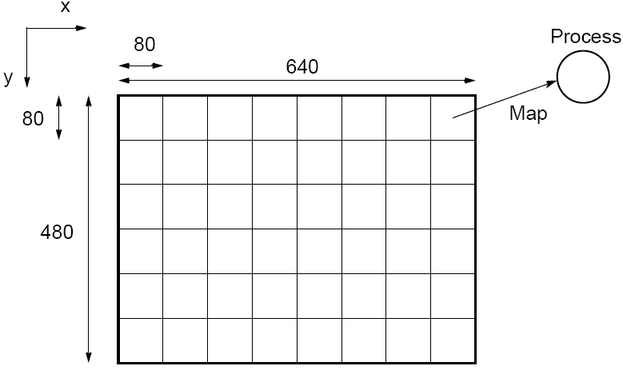
Partitioning into regions for individual processes
Square region for each process (can also use strips)
3.9

Slide 15
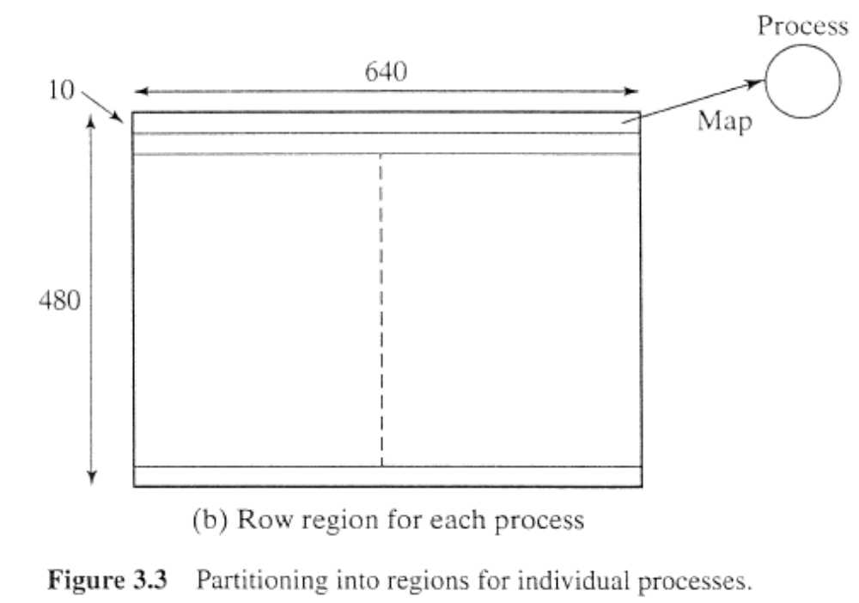

Slide 16
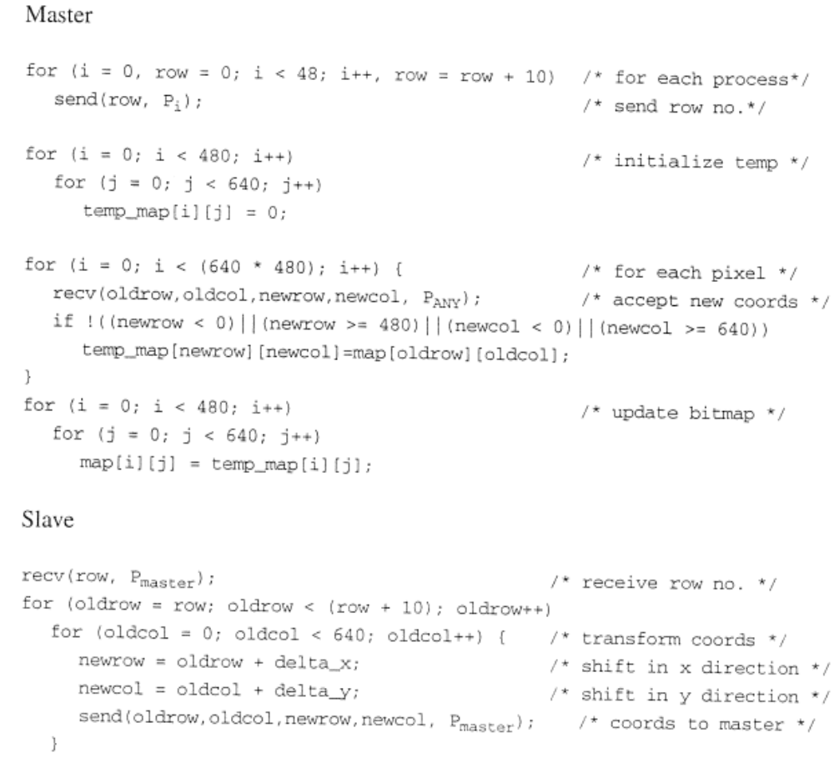

Slide 17
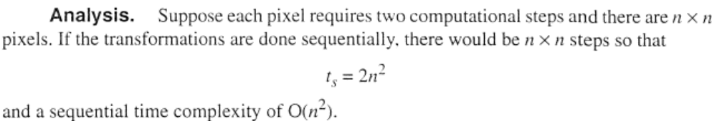
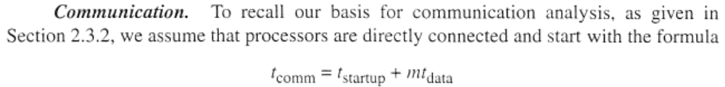
Analysis
The parallel time complexity is composed of two parts, communication and computation.

Slide 18
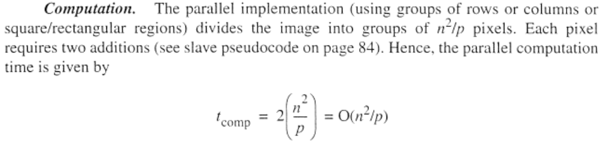
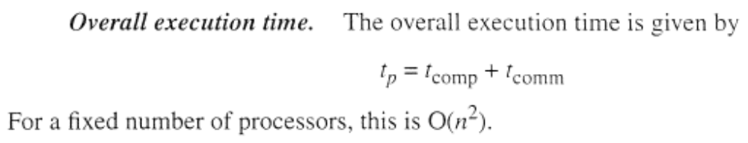

Slide 19
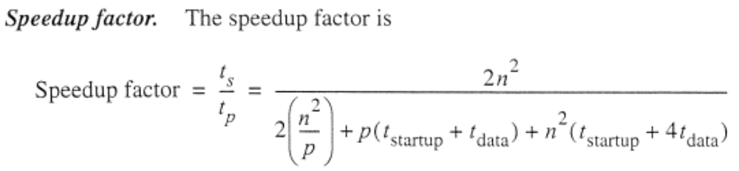
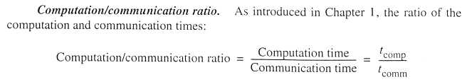
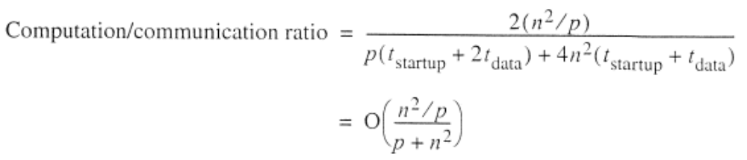
O(1) for fixed processors

Slide 20


Mandelbrot Set
Set of points in a complex plane that are quasi-stable (will increase and decrease, but not exceed some limit) when computed by iterating the function
where z_{k +1} is the (k + 1)th iteration of the complex number z = a + bi and c is a complex number giving position of point in the complex plane. The initial value for z is zero.
Iterations continued until magnitude of z is greater than 2 or number of iterations reaches arbitrary limit. Magnitude of z is the length of the vector given by
3.10

Slide 21
Sequential routine computing value of
one point returning number of iterations
structure complex {
float real;
float imag;
};
int cal_pixel(complex c)
{
int count, max;
complex z;
float temp, lengthsq;
max = 256;
z.real = 0; z.imag = 0;
count = 0; /* number of iterations */
do {
temp = z.real * z.real - z.imag * z.imag + c.real;
z.imag = 2 * z.real * z.imag + c.imag;
z.real = temp;
lengthsq = z.real * z.real + z.imag * z.imag;
count++;
} while ((lengthsq < 4.0) && (count < max));
return count;
}
3.11

Slide 22
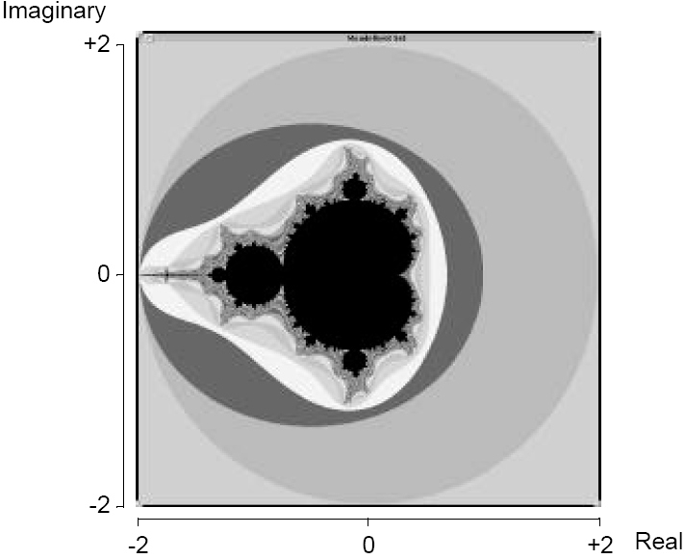
Mandelbrot set
3.12

Slide 23
Parallelizing Mandelbrot Set Computation
Static Task Assignment
Simply divide the region in to fixed number of parts, each computed by a separate processor.
Not very successful because different regions require different numbers of iterations and time.
Dynamic Task Assignment
Have processor request regions after computing previous regions
3.13

Slide 24
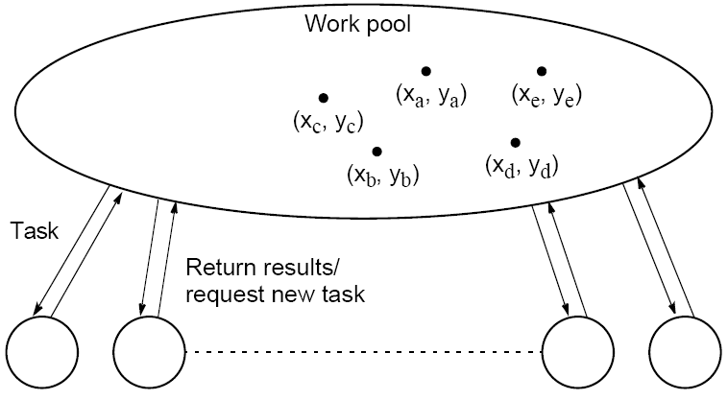
Dynamic Task Assignment
Work Pool/Processor Farms
3.14

Slide 25
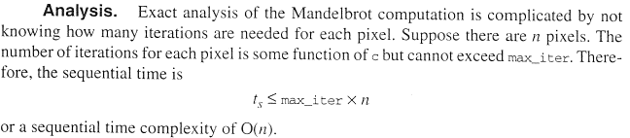
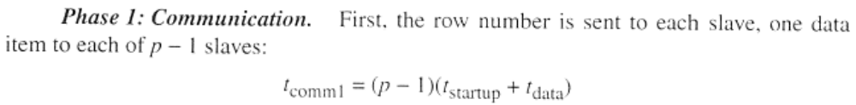
Analysis

Slide 26
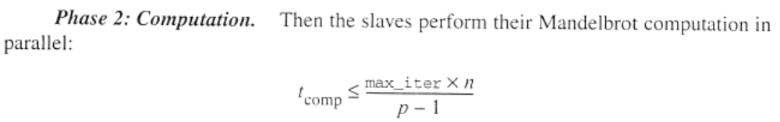
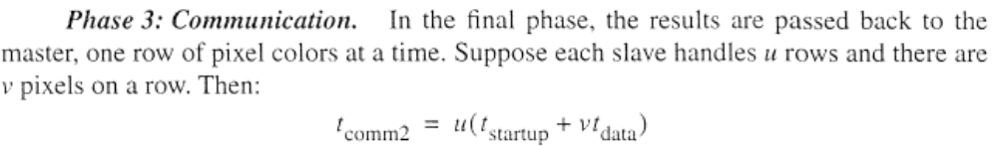


Slide 27
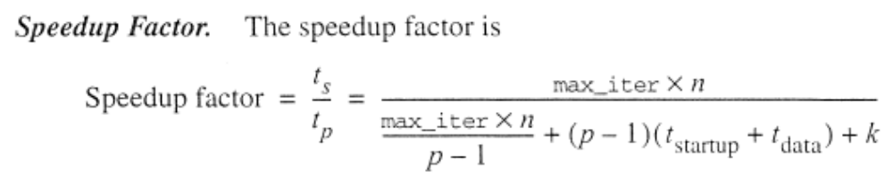
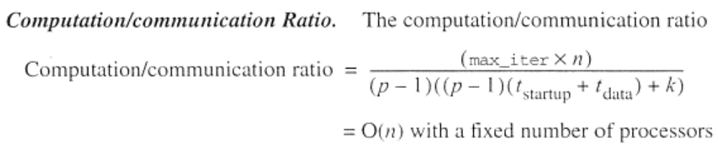


Slide 28
Monte Carlo Methods
Another embarrassingly parallel computation.
Monte Carlo methods use of random selections.
3.15

Slide 29



Circle formed within a 2 x 2 square. Ratio of area of circle to square given by:
Points within square chosen randomly. Score kept of how many points happen to lie within circle.
Fraction of points within the circle will be , given a sufficient number of randomly selected samples.
3.16

Slide 30
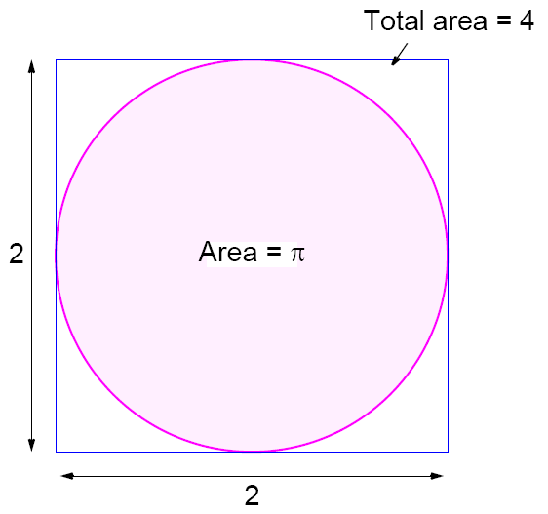
3.17

Slide 31

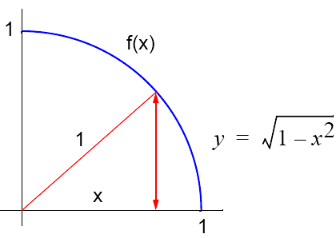

Computing an Integral
One quadrant can be described by integral
Random pairs of numbers, (xr,yr) generated, each between 0 and 1.
Counted as in circle if
3.18

Slide 32
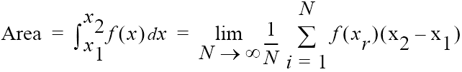
Alternative (better) Method
Use random values of x to compute f(x) and sum values of f(x):
where xr are randomly generated values of x between x₁ and x₂.
Monte Carlo method very useful if the function cannot be integrated numerically (maybe having a large number of variables)
3.19

Slide 33

Example
Computing the integral
Sequential Code
sum = 0;
for (i = 0; i < N; i++) { /* N random samples */
xr = rand_v(x1, x2); /* generate next random value */
sum = sum + xr * xr - 3 * xr; /* compute f(xr) */
}
area = (sum / N) * (x2 - x1);
Routine randv(x1, x2) returns a pseudorandom number between x1 and x2.
3.20

Slide 34
For parallelizing Monte Carlo code, must address best way to
generate random numbers in parallel - see textbook
3.21

